Slide 1
Transform Digital Connectivity Across Sub-saharan Africa
26 March 2025

Slide 2
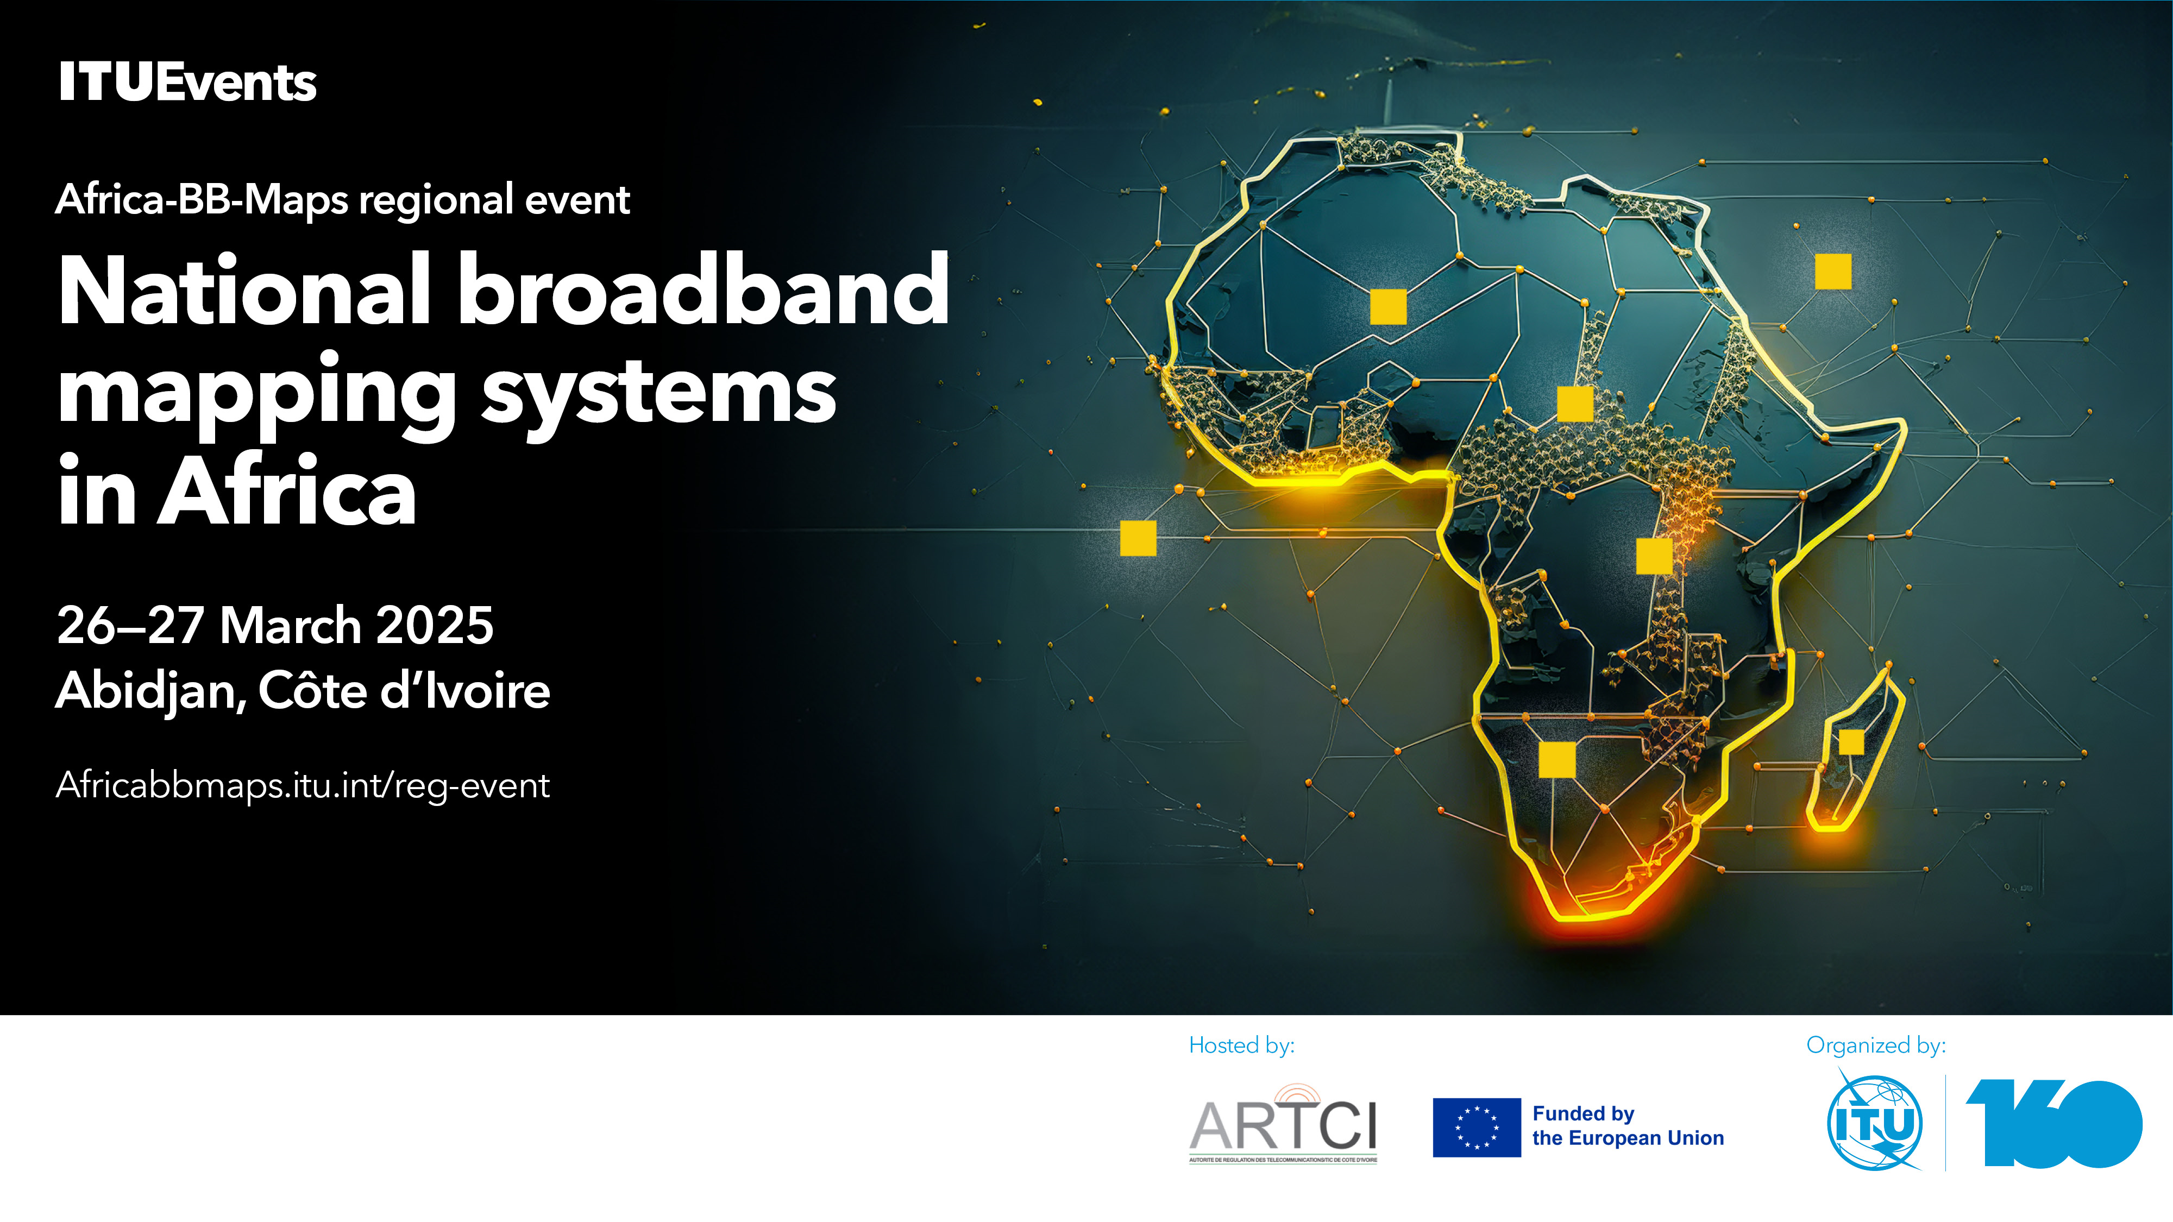
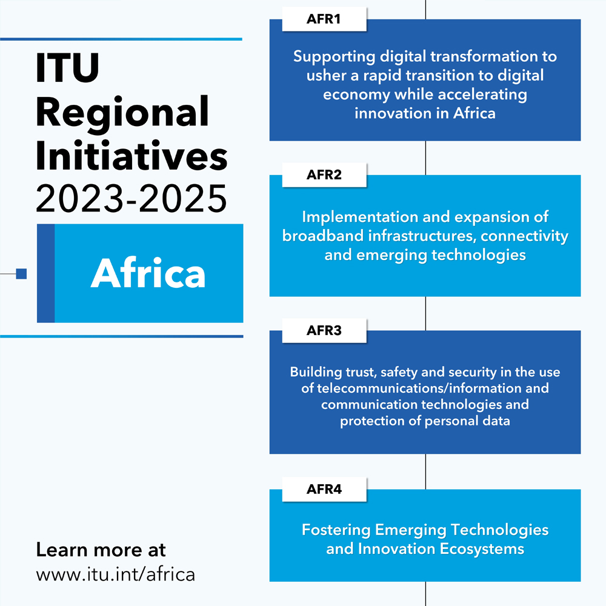
Africa BB Maps
The Africa’s National Broadband Mapping Systems (Africa-BB-Maps) project is dedicated to transforming digital connectivity across Sub-Saharan Africa (SSA)
Notes:
Regional Development Forum (RDF-AFR) ​ 7 April 2025​​, Na​irobi, Kenya
Regional Preparatory Meeting for the Africa region (RPM-AFR) 8 - 9 April 2024, Nairobi, Kenya ​​

Slide 3
Overall Objectives_______________________________________
Support the establishment of harmonized broadband mapping systems in eleven partner countries in the SSA region.
Proactive engagement & open communication for feedback
Knowledge Fair - mechanism for knowledge sharing & exchange on achievements and lessons learnt - a wider audience
Broadband mapping systems to produce critical data needed to identify gaps, support data-driven decision-making processes and drive strategic investments in broadband infrastructure across the region.

Slide 4
Africa’s connectivity gap: Can a map tell the story?
________________________________________
Why mapping Africa’s digital infrastructure
Maps tell compelling stories.
Vital step towards understanding the connectivity landscape.
To reach universal access it is critical to assess the specific connectivity gaps and monitor the progress of digital infrastructure on the continent.
Better Broadband mapping will lead to better planning and more efficient investment.
The data opens several interesting questions to be explored.
Some new investment tends to duplicate existing investment rather than to fill gaps.
Digital infrastructure maps →part of the public domain so that users and investors in other sectors of the economy can draw upon them.
Moving towards regionally-integrated digital infrastructure maps
Despite improvements, Sub-Saharan Africa has the widest coverage gaps worldwide
Notes:
The primary goal of AfricaBBMaps is to create comprehensive broadband mapping systems that produce readily available and validated data. This data will help identify gaps in internet connectivity, including issues related to coverage, quality, and affordability in the targeted countries. By addressing these gaps, the project aims to support data-driven decision-making for investments in digital infrastructure.
Through the development of accurate broadband maps, the project will enable policymakers, stakeholders, and investors to make informed decisions that can improve digital connectivity and infrastructure.
This, in turn, promises a brighter future for ICT development in the region, fostering economic growth and enhancing access to digital services for all.

