Slide 1
Mapping Connectivity
Experiences from the use of AGCOM’s Broadband Map
Aldo Milan - AGCOM

Slide 2


The official database of all Internet access networks available across the national territory
Broadband Map
It enables the analysis of broadband infrastructure deployment at address level and supports comparative assessments of technologies and connection speeds. This information can help identify the available Internet infrastructure at any location and assist public authorities in defining policies to bridge the digital divide

Slide 3

State of the connectivity
Detect the local availability of telephony and data services and identify the offered speeds for: Copper, Fiber and Wireless Technologies
Produce summary indicators at various territorial levels to identify areas ready for the transition to copper network alternatives
Support the development of regulation and identify potential remedies required to ensure a sustainable copper switch-off

Slide 4
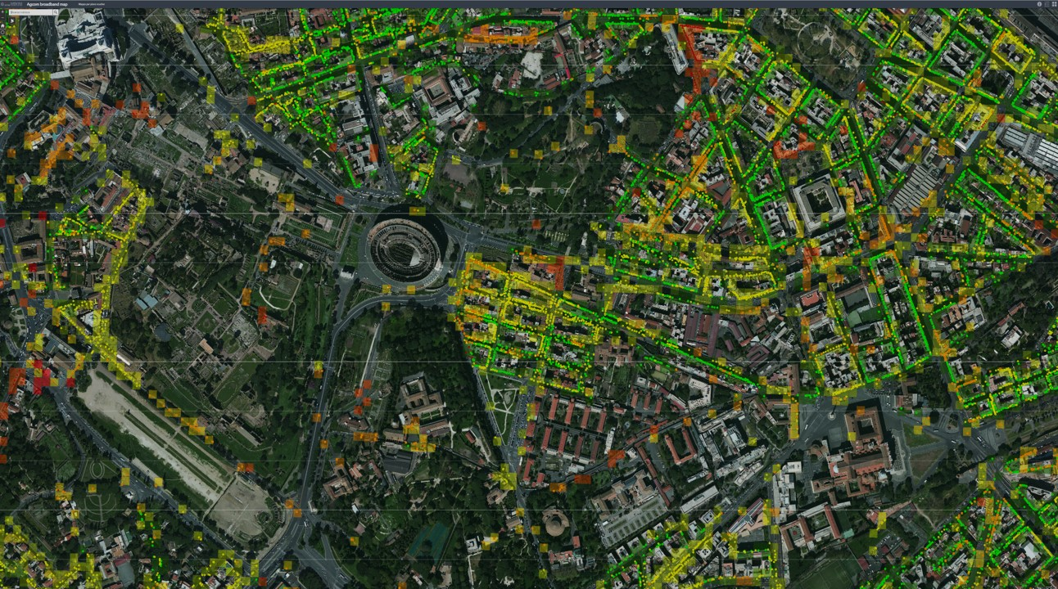


Key Requirements
Reliability – Data must be accurate and trustworthy
Resolution level – Mapping must be detailed and granular
Timely updates – Data should be continuously and regularly updated
Completeness – All network infrastructures must be included
Fexibility – BBmap can’t impose defininitions but it should adapt to local process

Slide 5
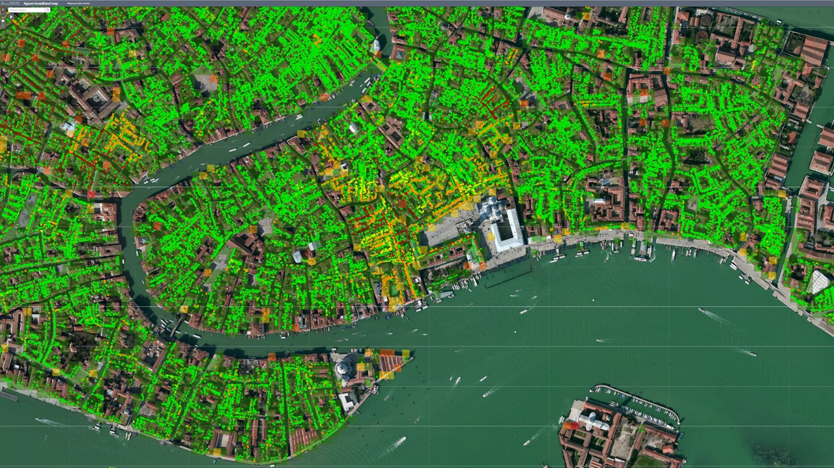


Metrics and Targets
Coverage is usually analyzed in terms of households covered
Depending on the accounting conventions applied, reported coverage may reach 100% or plateau just above 90%
For example, the European Commission’s Digital Decade targets aim for 100% coverage
However, detailed address-level checks may still reveal unserved households, even in areas classified as served — highlighting the challenge of reaching the last households
Population Dispersion Analysis (Italy)
According to national statistical data, about 93% of the population is concentrated in only 7% of the national territory
Extending wired coverage beyond this threshold is increasingly difficult and economically inefficient

Slide 6
Focus: BBmap components 1/2
ESRI
AGOL
arcgis.com
ESRI Enterprise
ESRI Desktop
AWS
AI
DB
Atoll Simulatore
Open source Desktop
Custom BBmap Apps
Custom
Android
App
Level
Application
Level
Platform
ESRI
AGOL
arcgis.com
ESRI Enterprise
Location
Tools
(Egon)
AWS
SNS Family Transfert Lambda
Open Source Postgres Postgis
Freeware
Open source
GIS Server
Google
Play
Level
Infrastructure
ESRI
AGOL
arcgis.com
ESR AOL arcgis.com
AWS
Storage Compute
Network
Security
Google

Slide 7
Focus: BBmap components 2/2
The system integrates both licensed components and open-source solutions
In recent years, development efforts have increasingly focused on open source, across all layers of the technology stack
The architecture is designed to be modular and adaptable, allowing for low-investment evolutions in response to changing needs
Particular attention is paid to maintenance and upgrade costs:
a sophisticated system with high update costs risks becoming unsustainable in the long term

Slide 8
Focus: managing geo positions 1/2
Key classes and relations
A - Unique
Grid-Code
Geo Coordinates
B - Unique
Address Code
Textual Description
(e.g. a postal address)
entry point
entry point
entry point
entry point
spacial based coding
toponymy based coding
1
p
1
0,m
0, 1
n
functional output
main output
secondary output

Slide 9
Focus: managing geo positions 2/2
A scalable path: from essential functions to advanced capabilities
Geo Coordinates
Textual Description
Common geocoding process
Math: F(«Textual Description») → R²
Geo Coordinates
Textual Description
B - Unique
Address Code
toponymy based coding
Introduced in 2015-2016 to support wholesale regulated market
(and reduce disputes)
Adopted with Incumbent’s commitments
A - Unique
Grid-Code
Geo Coordinates
B - Unique
Address Code
Textual Description
topographic based coding
toponymy based coding
Introduced in 2019-2020 to support general mapping (multiple infrastructure) and national vouchers
Math: P(a,b) – Best matching

Slide 10
Service vs Infrastructure Mapping
Infrastructure data is sensitive and must be handled with care.
It is essential to distinguish between service availability (what is offered to end users) and the underlying infrastructure (which may include commercially or nationally sensitive elements).
The mapping system must be both flexible and robust, capable of adapting to local requirements and regulatory constraints.
Different levels of data security and access control must be ensured.
Not all geographic databases can or should be exposed on the open web — data exposure must be selective and risk-aware.

Slide 11
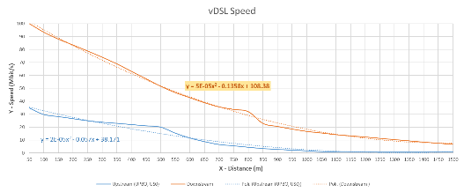
Focus: Estimate the speed – case FTTC

Slide 12
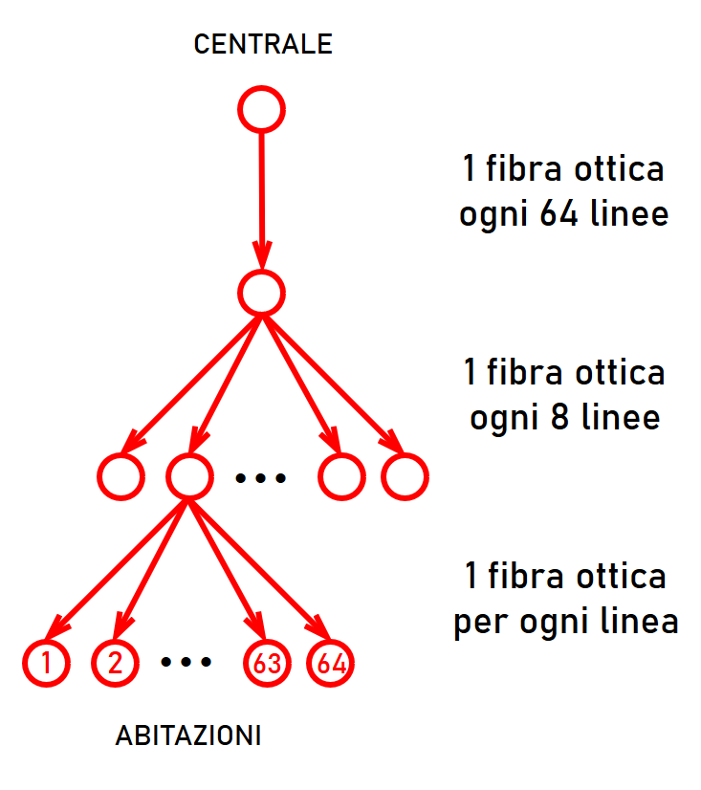
Focus: estimate the speed – Case FTTH
Gpon Splitting
2.5 Gbit/s shared by 64 users
Maximum load: 2.5/64= 39 Mbit/s (clearly not realistic)
With traffic model we get higher speeds

Slide 13

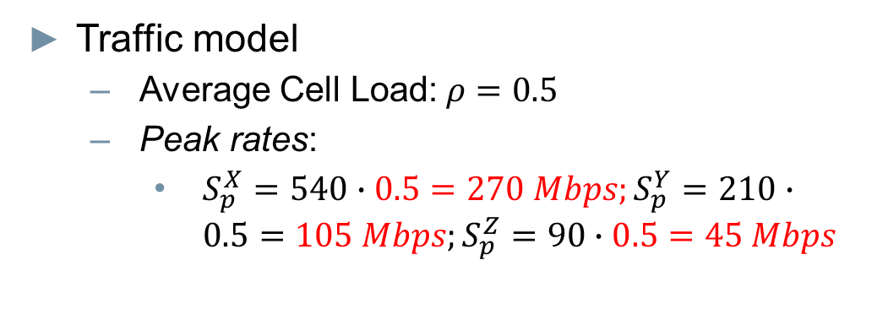


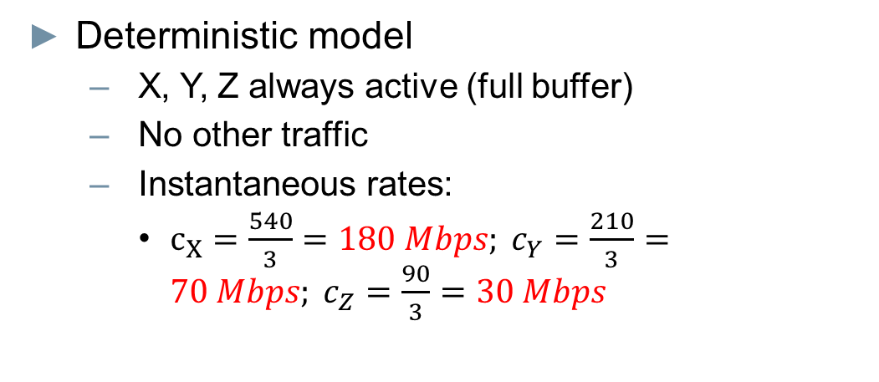

Focus: Estimate the speed – Case 5G
Deterministic model
  X, Y, Z always active (full buffer)
  No other traffic
  Instantaneous rates:
    $c_{X}=\frac{540}{3}=180 Mbps; c_{Y}=\frac{210}{3}=70 Mbps; c_{Z}=\frac{90}{3}=30 Mbps$
X
Z
Y
Traffic model
  Average Cell Load: $ρ=0.5$
  Peak rates:
    $S_{p}^{X}=540∙0.5=270 Mbps;S_{p}^{Y}=210∙0.5=105 Mbps;S_{p}^{Z}=90∙0.5=45 Mbps$
$C_{}=$ 540 Mbps
$C_{}=$ 210 Mbps
$C_{}=$ 90 Mbps

Slide 14
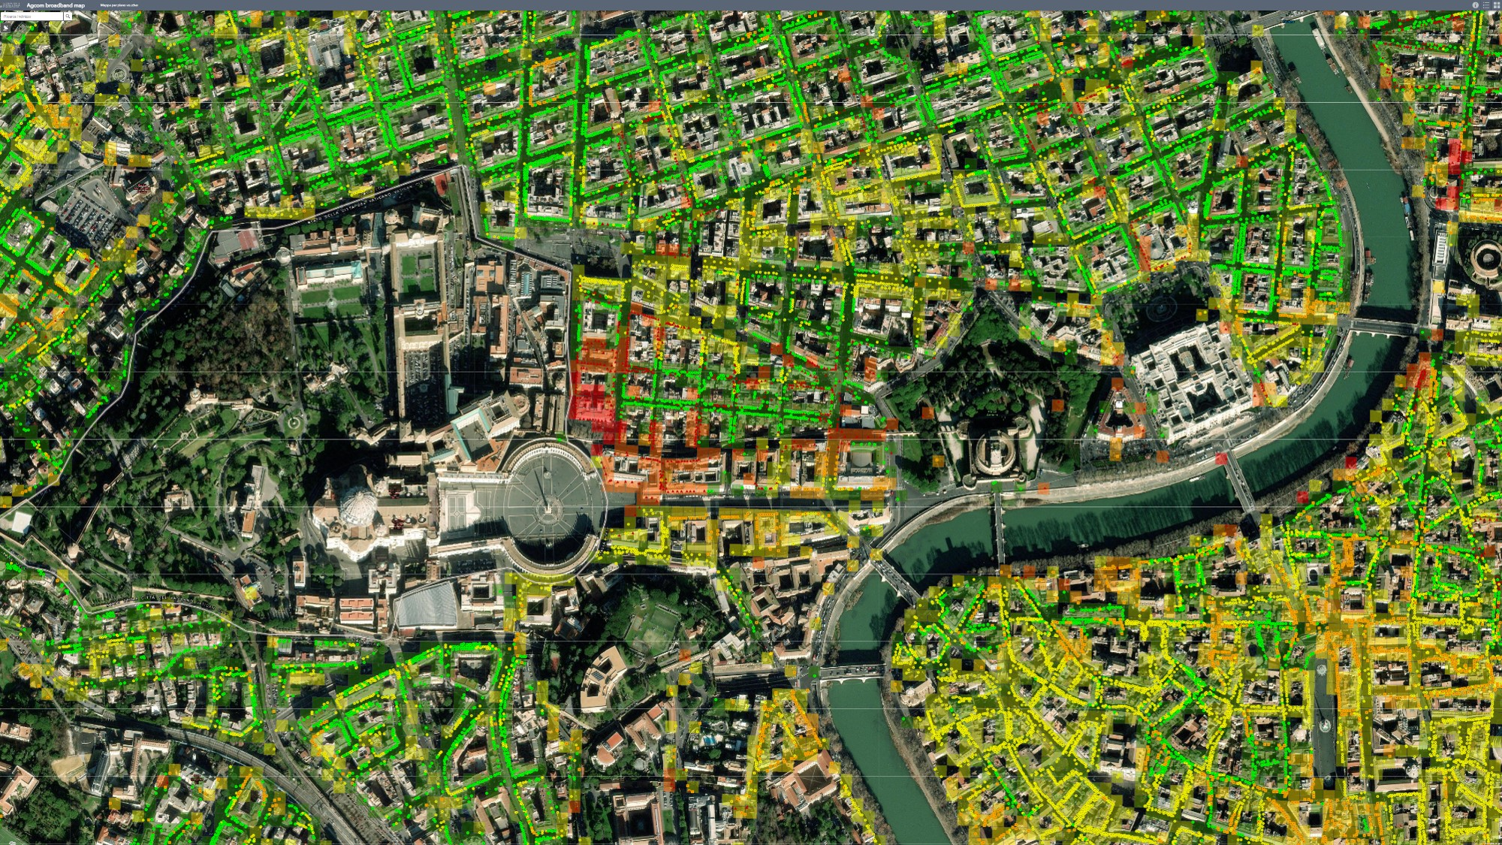
a.milan@agcom.it

