Slide 1
Africa-BB-Maps
Questionnaire Report / Template case study
26-27 March, Abidjan, Cote d'Ivoire

Slide 2
Africa-BB-Maps
Questionnaire Report

Slide 3
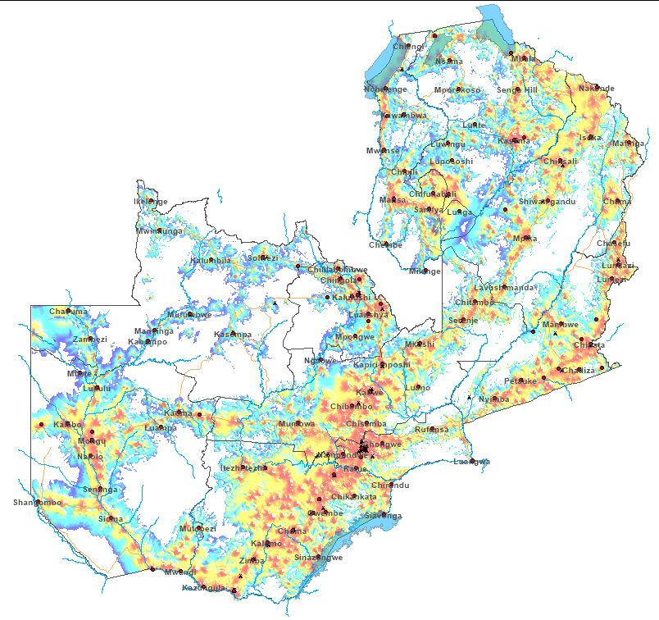
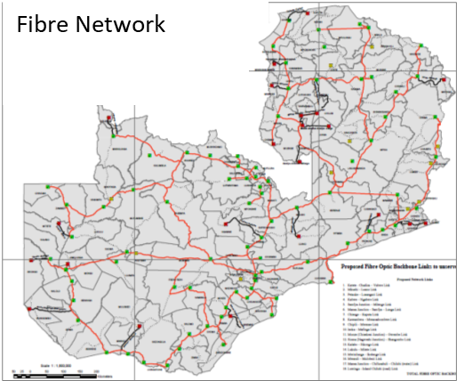
Introduction
Mobile broadband
About Zambia
Landlocked country in South-Central Africa
Land surface Area: 753,000km²
Population: ≈ 20m
Economic activities: Mining, Agriculture, Tourism
Broadband internet access:
Mobile broadband
Fibre networks
Fixed wireless
Mobile and fixed satellite
PICTURE
Satellite service

Slide 4
Policy frameworks
Acts of Parliament
ICT Act 15 – 2009
ECT Act 15 – 2009
Postal Act- 2009.
PICTURE
Regulations
The ICT (Universal Access) Regulations – 2012
The Radiocommunication – 2010
The Postal service (General) Regulations – 2016
Guidelines
QoS Guidelines - 2024
Licensing Guidelines - 2017
Installation Guidelines
Code of Conduct for ICT Service Providers - 2019
Consumer Protection Guidelines - April 2019

Slide 5
Broadband penetration and expansion
Broadband Penetration
Expansion strategy
Implementation of national 5G road map
Release of sub-1GHz spectrum
Implementation of Universal Access strategy
Attachment of special/ population coverage license conditions to prime sprectrum
80%
70%
10%
55.5%
14.5%
2022
2025
2030

Slide 6
Broadband coverage
Broadband data management
Collection: Submissions by Licensees
Mode: Templates designed in consultative process
Frequency of data collection and verified: Quarterly/ Annually
Broadband coverage and QoS data - ISPs
Mobile Broadband data: MNO submit technical data used by ZICTA to generate maps
QoS data: MNO submits/ ZICTA also undertakes independent measurements
Penalties: Applicable
Broadband coverage data publication
Statistics: Partially published on website. No independent party validation currently.
Maps: Not formally published. Process underway for online publication of mobile coverage maps
PICTURE

Slide 7
Q&As

