Slide 1
Africa-BB-Maps
Botswana case study
26-27 March, Abidjan, Cote d'Ivoire

Slide 2
Africa-BB-Maps
Questionnaire Report

Slide 3
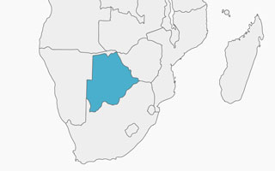
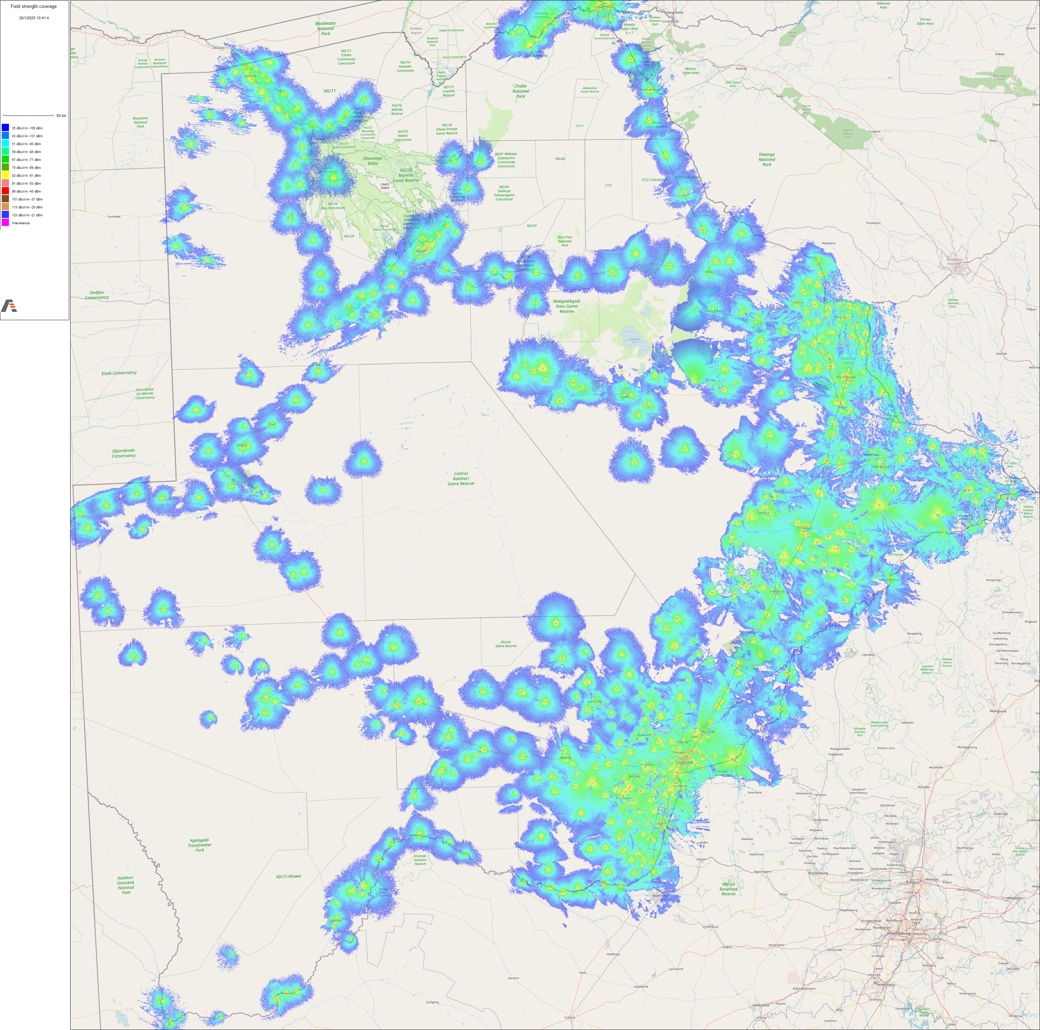
Introduction
The country has robust digitalization policies that drive broadband connectivity nationally . Broadband technologies found in Botswana are;
mobile,
fibre
wireless
satellite
collectively covering over
98% of the population.
PICTURE
Botswana is a landlocked country found in Southern Africa and covers about 581,730 ${km}^{2}$and a population of about 2.4million.
Mobile Broadband Coverage
Source: BOCRA

Slide 4
Policy frameworks
There are several broadband policy frameworks/ regulations available:
National Broadband Strategy (2018)
National ICT Policy
Communications Regulatory Act (2012)
Botswana Communications Regulatory Authority (BOCRA), aim to ensure universal access to affordable and quality communication services, particularly in underserved areas, through initiatives like the Universal Access and Services Fund (UASF). BOCRA also encourages their licensees to roll out broadband services.
Smart Botswana drives SmartBots initiatives that promotes roll out of broadband services in government facilities.
Currently Botswana does not have any specific policy provisions for broadband mapping.
PICTURE

Slide 5
Broadband penetration and expansion
Botswana’s current broadband penetrations stands at 129%.
There are efforts by government to extend broadband coverage and expansion in rural and undeserved through financial incentives offered to Mobile Network Operators through smart subsidies by the Universal Access and Service Fund (UASF) and other efforts like SmartBots initiatives.
Broadband Internet can be accessed for free in Government facilities like Clinics, schools and tribal administration offices
PICTURE

Slide 6
Broadband Mapping
There is no broadband mapping in Botswana beside coverage maps available on BOCRA’s Annual Reports available on their website.
PICTURE

Slide 7
Broadband Mapping Systems
There is no formal broadband mapping infrastructure systems available in Botswana.
BOCRA collects information from its licensees and develop mobile coverage maps for its internal use.
PICTURE

Slide 8
Broadband coverage
BOCRA collects broadband coverage data as when necessary/ available, not systematically. The data is self reported by the Internet Service Providers.
ISPs are required to submit broadband coverage and QoS data, but enforcement is not strict and there are no penalties.
There is no public access to broadband coverage data.
PICTURE

Slide 9
Q&As

