Slide 1
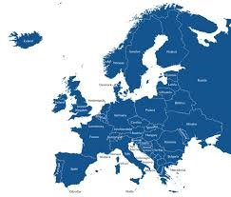
European experience on broadband mapping
Jaroslaw Ponder, Head of the ITU Office for Europe
26 March 2025, Cote d’Ivoire

Slide 2
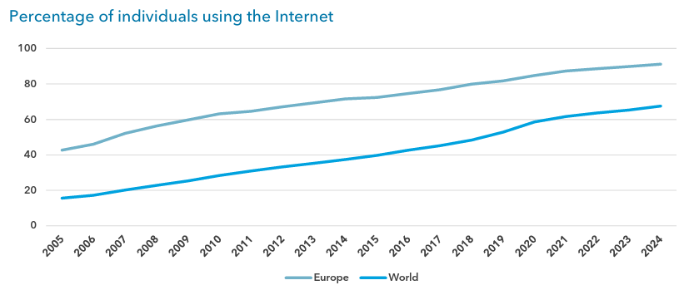
Percentage of individuals using the Internet
The percentage of individuals using the Internet stood at 91 per cent in 2024, approaching universal use. This puts Europe far ahead of the global average of 68 per cent.

Slide 3
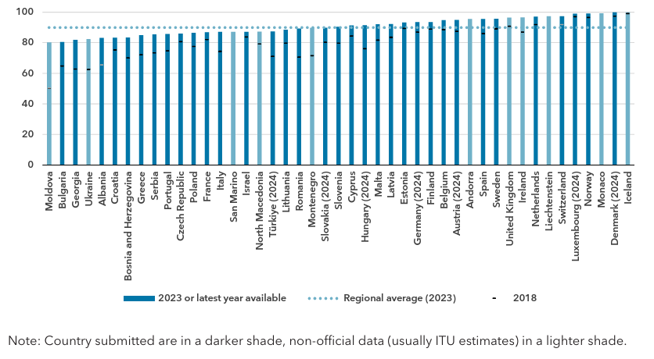
Percentage of individuals using the Internet in the Europe region, 2023 or latest year available

Slide 4
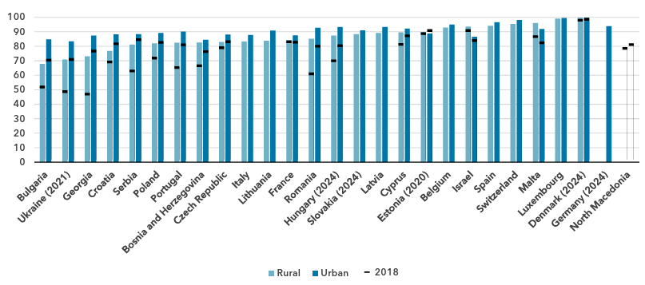
Percentage of individuals using the Internet by location, 2023 or latest year available
In urban areas in the Europe region, 93 per cent of the population was online, compared with 86 per cent in rural areas.
This gap is much smaller than it is globally, with 83 per cent online in urban areas, against only 48 per cent in rural areas.

Slide 5
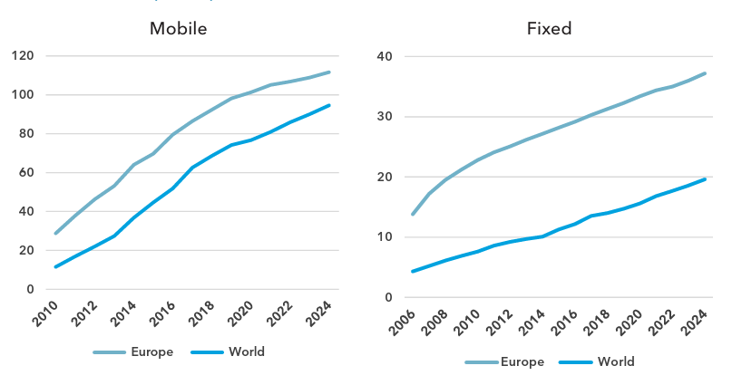
Broadband subscriptions per 100 inhabitants
The Europe region had 112 active mobile-broadband subscriptions per 100 inhabitants in 2024, above the global average of 95. The difference is considerably higher for fixed-broadband penetration: Europe boasted 37 subscriptions per 100 inhabitants, almost twice the global average of 20, and much higher than any other region.

Slide 6
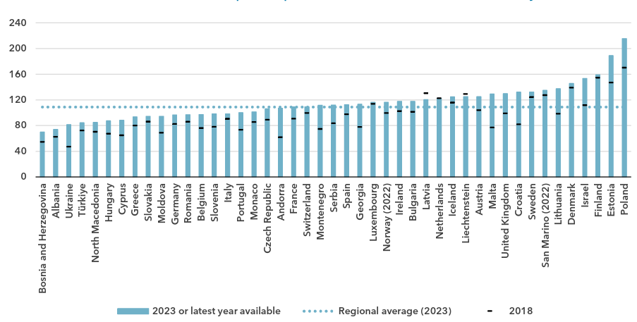
Active mobile-broadband subscriptions per 100 inhabitants, 2023 or latest year available

Slide 7
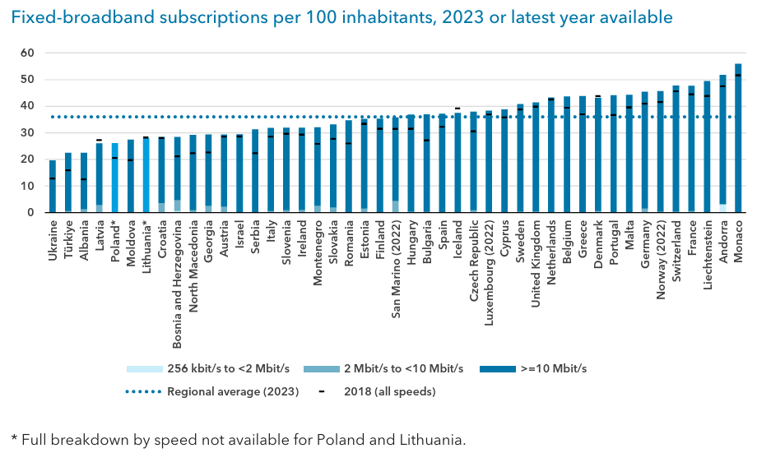
Fixed-broadband subscriptions per 100 inhabitants, 2023 or latest year available

Slide 8
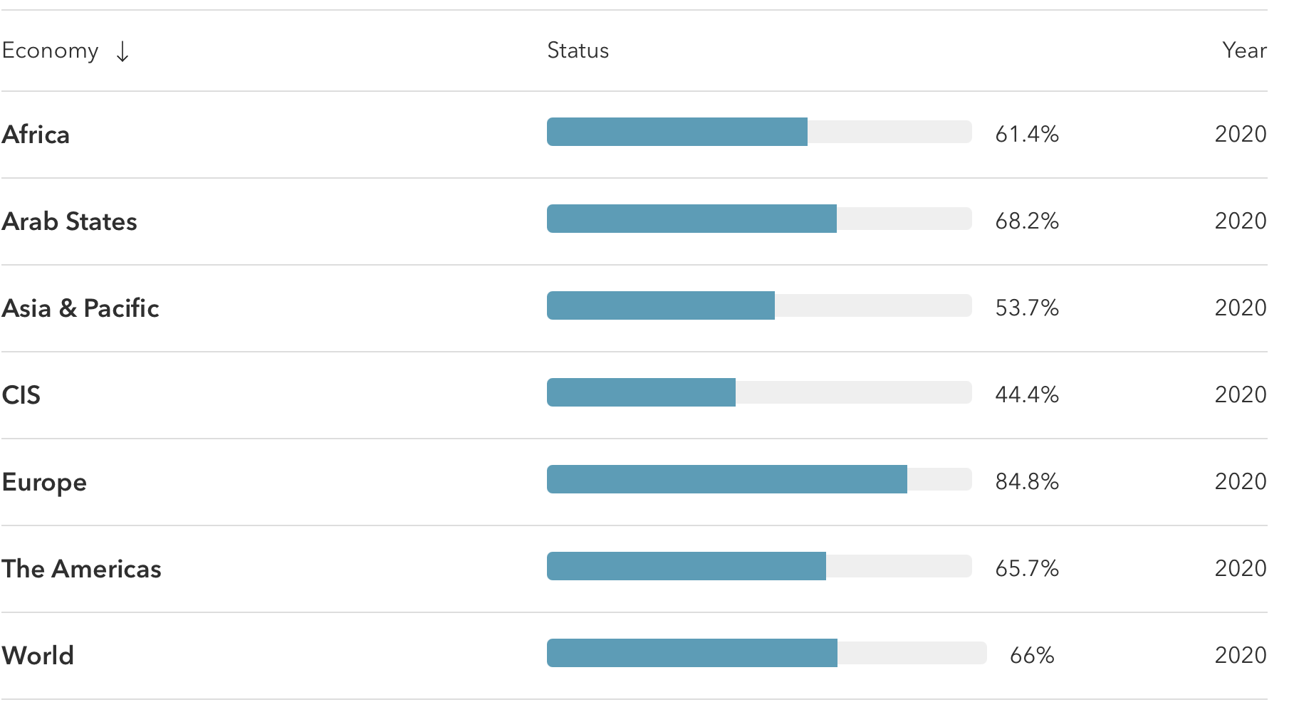
National broadband plans
As of October 2023, all EU member states were required to have national broadband plans or strategies in place to promote high-speed internet access and improve digital infrastructure.
This requirement was part of the European Union's Digital Agenda aimed at achieving widespread broadband coverage by 2025.

Slide 9
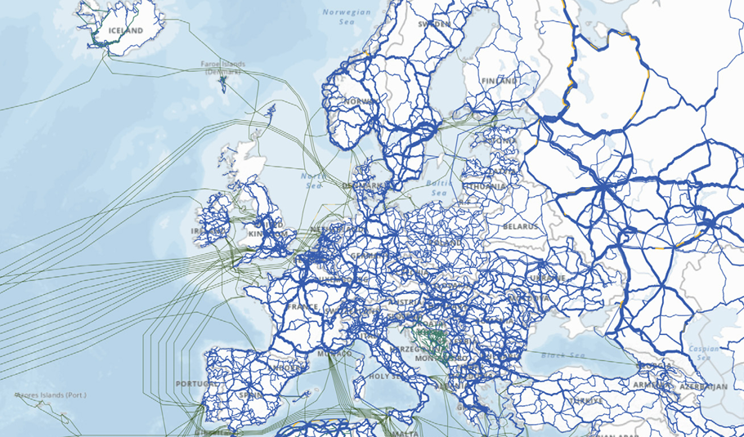
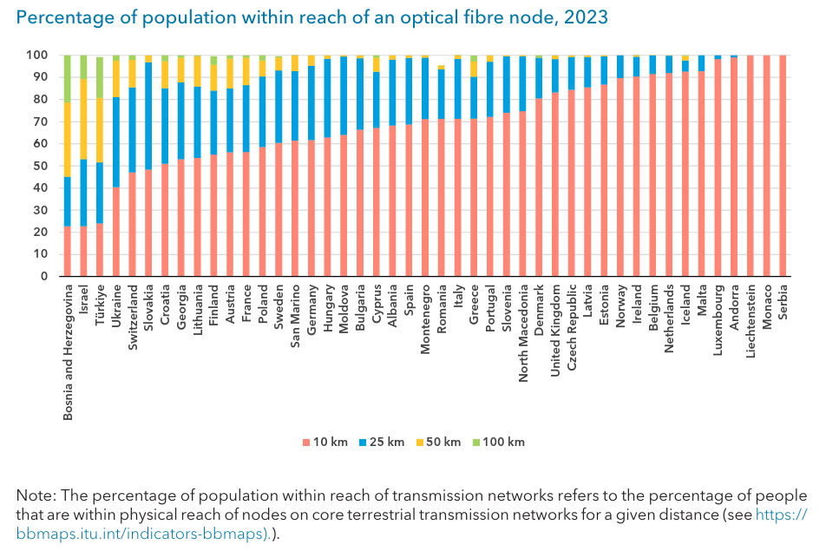
Mapping of the infrastructure
As of 2023, 61 per cent of the population of the Europe region lived within 10 km of an optical fibre node.
Almost 9 of every 10 people
(88 per cent) lived within 25 km, 97 per cent within 50 km and almost everyone within 100 km of a node.

Slide 10
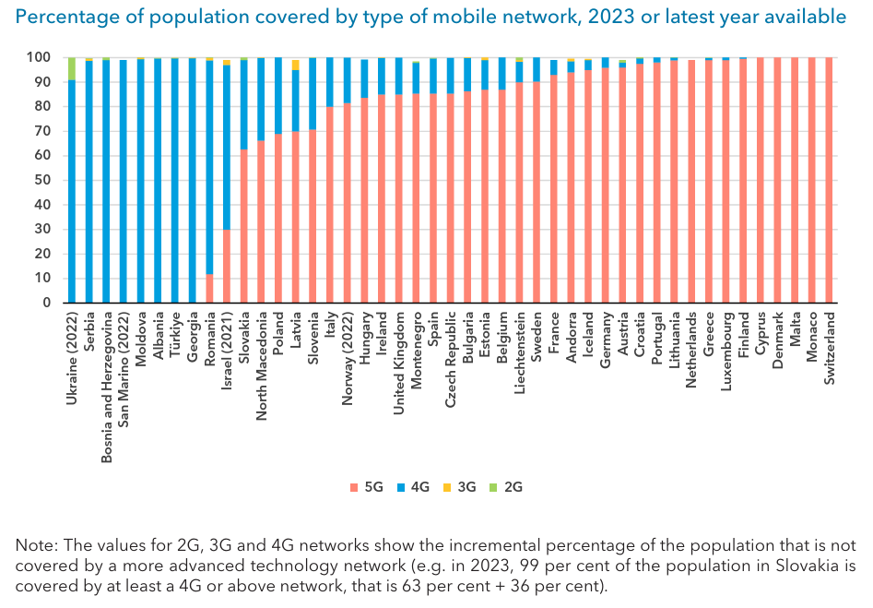
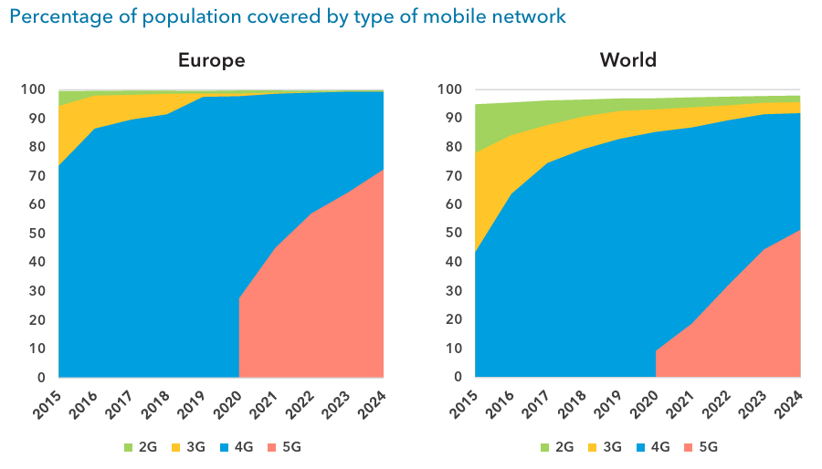
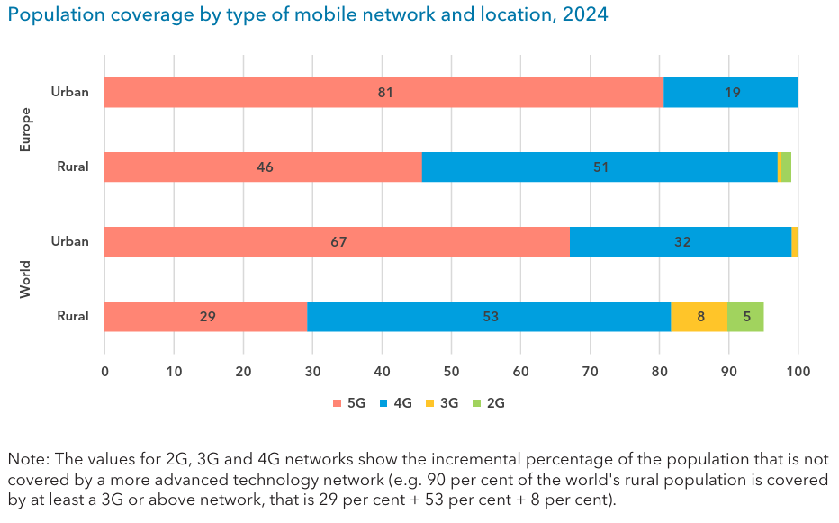
Mobile networks coverage
Between 2020 and 2024, 5G mobile network coverage in the region increased from 28 to 72 per cent of the population.
Globally, 5G coverage grew only from 9 to 51 per cent. Where 5G was not yet available, 4G mobile networks covered 99 per cent of the population in 2024, implying that almost everyone in the Europe region has access to a good quality mobile network.

Slide 11
European efforts towards a harmonized broadband mapping system
The European Union plays a key role in outlining the regulatory framework for broadband infrastructure and services.
The EU is supported by the Body of European Regulators for Electronic Communications (BEREC), which supports the consistent application of the EU regulatory framework and the functioning of the internal market of electronic communications.

Slide 12
European efforts toward a harmonized approach to broadban
2013 EU Guidelines on State Aid for Broadband
2014 Broadband Cost Reduction Directive (BCRD)
2018 European Electronic Communication Code (EECC)
2020 BEREC Guidelines on Geographical surveys of network deployments
2024 Gigabit Infrastructure Act (GIA)

Slide 13
EU Guidelines on State Aid for Broadband
The EU Guidelines on State Aid for Broadband provided specific indications on the application of the EU State Aid rules with regards to state aids in support of broadband deployment.
With regards to the involvement of the national regulatory authorities, countries were encourage to involve them in the different stages of design, implementation and monitoring of state aids.
Broadband Cost Reduction Directive (BCRD)
The directive aimed at facilitating the deployment of broadband networks by supporting the access to existing physical infrastructure by telecom operators and the coordination of civil works, by simplyfying permits procedures, and by ensuring that new and renovated buildings have physical infrastructures embedded.

Slide 14
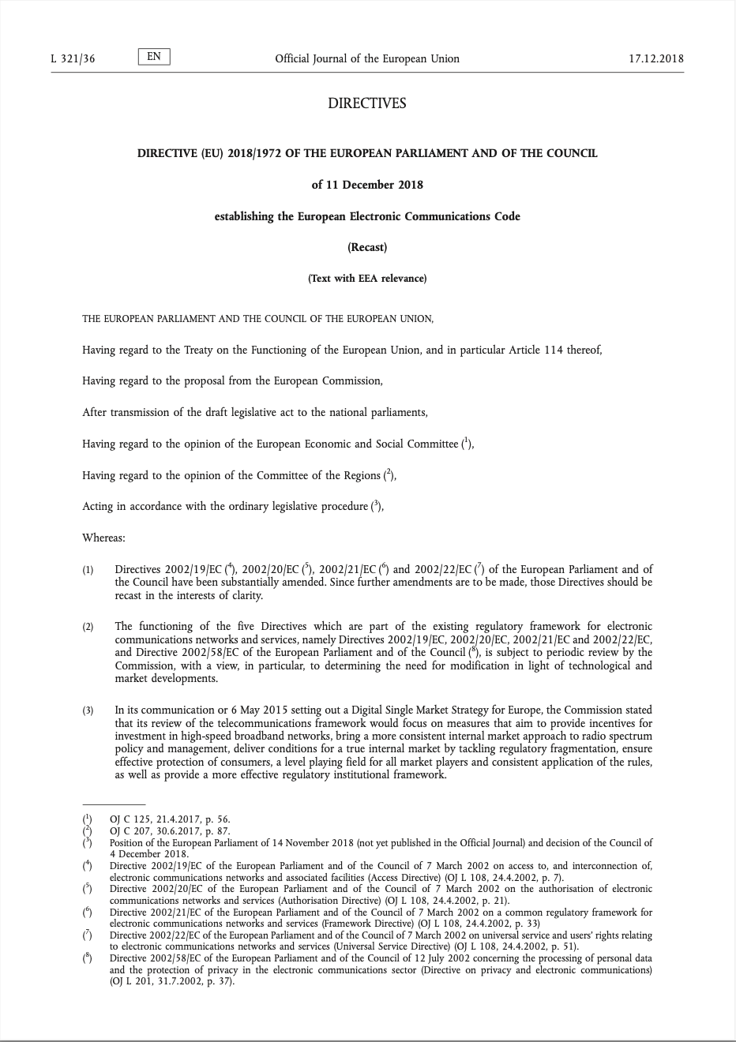
European Electronic Communications Code (EECC)
The European Electronic Communications Code was established by the EU Directive 2018/1972.
By establishing a set of rules that touches upon competition, consumer protection, network security, radio spectrum and innovation, among the many topics, the EECC plays a key role in supporting the harmonization of electronic communications sector in Europe.

Slide 15
EECC Art. 22
National regulatory and/or other competent authorities shall conduct a geographical survey of the reach of electronic communications networks capable of delivering broadband (‘broadband networks’) by 21 December 2023 and shall update it at least every three years thereafter.
The geographical survey shall include a survey of the current geographic reach of broadband networks within their territory, as required for the tasks of national regulatory and/or other competent authorities under this Directive and for the surveys required for the application of State aid rules.
The geographical survey may also include a forecast for a period determined by the relevant authority of the reach of broadband networks, including very high capacity networks, within their territory. […]

Slide 16
BEREC Guidelines to Assist NRAs on the Consistent Application of Geographical Surveys of Network Deployments
EECC Art.22.7: 7. […] BEREC shall, after consulting stakeholders and in close cooperation with the Commission and relevant national authorities, issue guidelines to assist national regulatory and/or other competent authorities on the consistent implementation of their obligations under this Article.
The guidelines were developed in 2020 to support the countries in implementing Article 22 of the European Electronic Communication Code with regard to geographical surveys.
The guidelines address data sources and frequency of data collection, geographical spatial resolution of data, elements of characterization of network connectivity or services, data and characterization of a gis system, forecast specificities, publication, confidentiality issues and aggregation of data to provide information to third users

Slide 17
Gigabit Infrastructure Act (GIA)
Applying from November 2025
GIA will apply to every Member State without the necessity for a transposition process, with the objective of facilitating deployment of very-high-capacity networks and providing for a more harmonized approach and impact.
GIA contains provisions related to existing physical infrastructure and coordination of civil works. For instance, it facilitates the availability of information on existing physical infrastructure and planned civil works through single information points.
GIA streamlines the procedures to obtain permits and rights of way.
GIA also provides for the role of BEREC as a key entity in providing the related guidelines (eg. coordination of civil works according (GIA Art. 5.6) and in its review and advisory functions.
Notes:
The measures adopted for the reductions of costs related to broadband roll-out following the Broadband Cost Reduction Directive (BCRD) varied across the different countries.

Slide 19
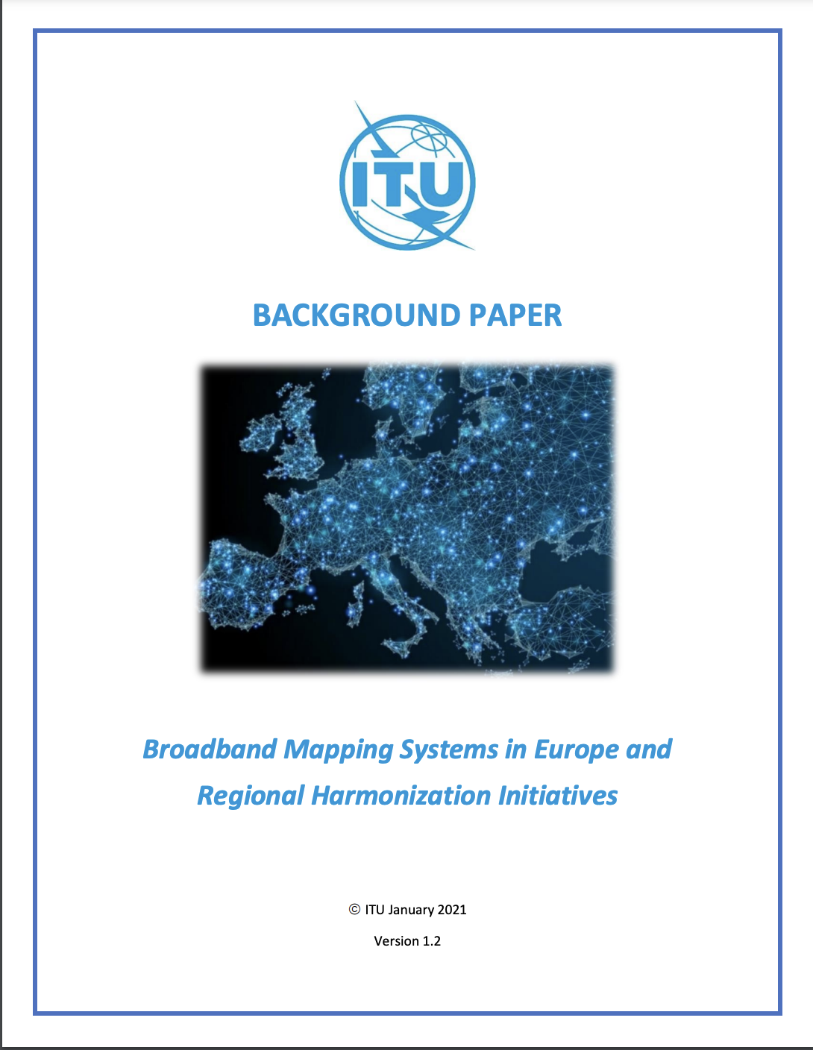
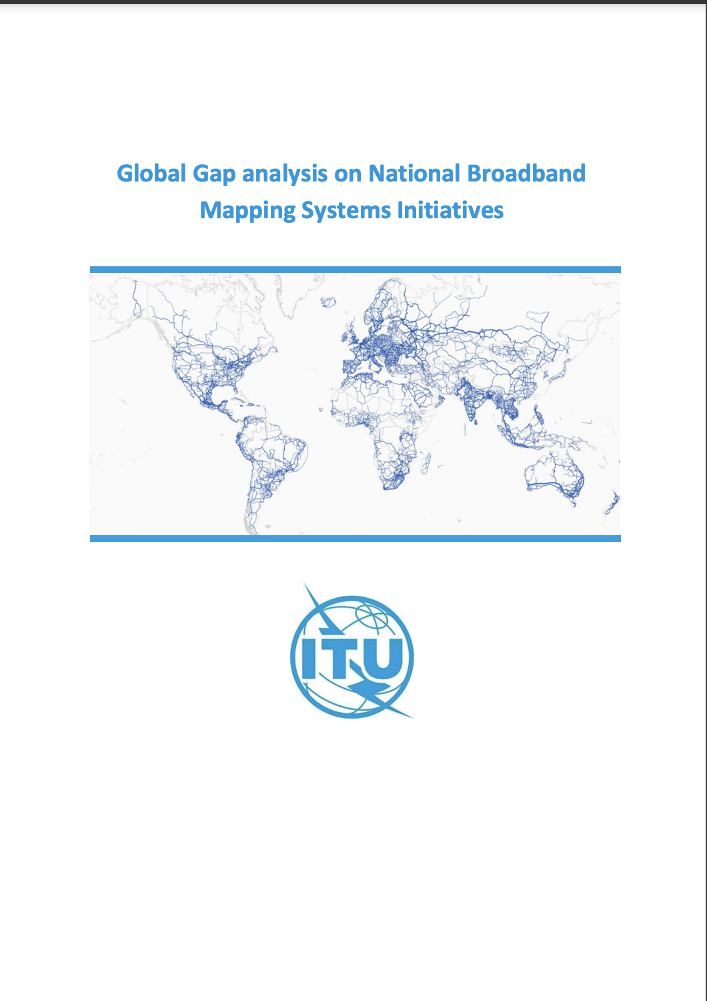
Gap analysis and guidelines
2021
2021
2022

Slide 20
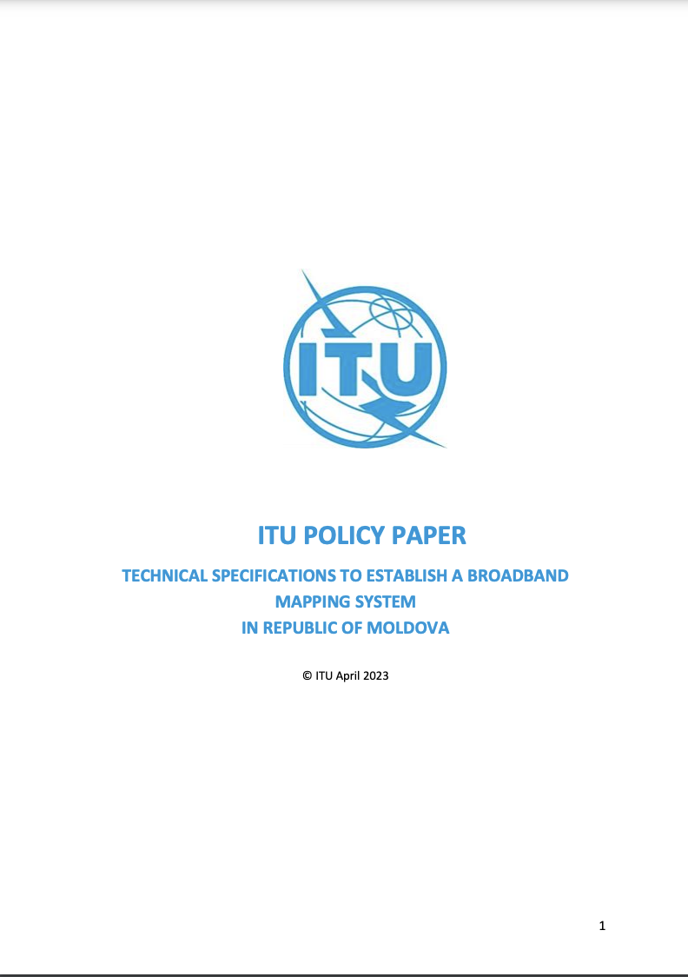
Technical assistance
Technical assistance in the field of broadband mapping systems
Technical specifications for the implementation of broadband mapping systems in Albania (2024)
Technical specifications to establish a broadband mapping system in the Republic of Moldova (2023)
Technical specifications for the implementation of broadband mapping systems in Bosnia and Herzegovina (2022)
Enabling environment for broadband mapping in Bosnia and Herzegovina (2021)

Slide 21
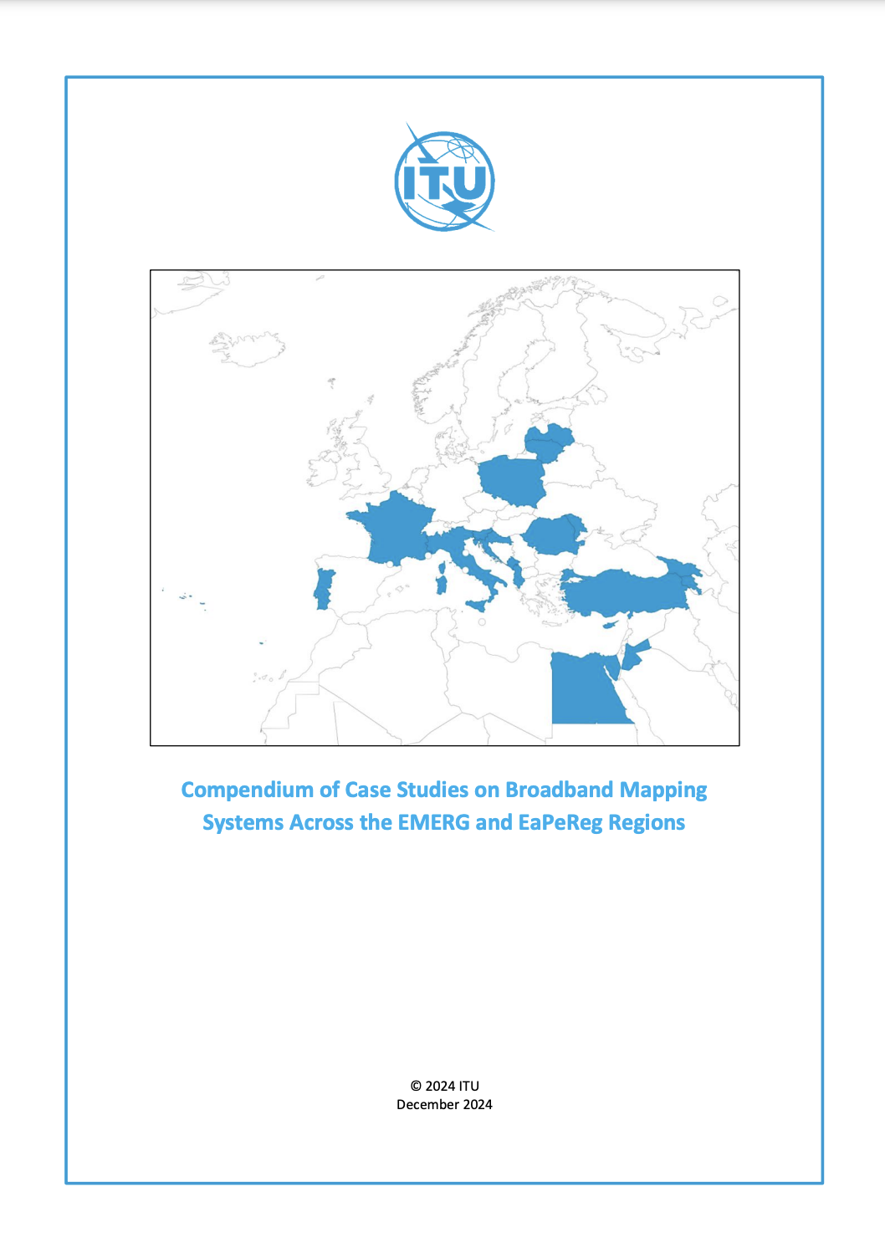
Compendium of case studies on broadband mapping systems in the EMERG and EaPeReg Regions
Joint Workshops held in physical and online formats
Compendium of 18 case studies on broadband mapping from countries from the EMERG and EaPeReg communities
2024

Slide 22
Thank you
More information:
www.itu.int/europe| EURregion@itu.int

