Slide 1
EU Support to Africa’s National Broadband Mapping Systems (Africa-BB-Maps)
26-27 March, Abidjan, Cote d'Ivoire

Slide 2
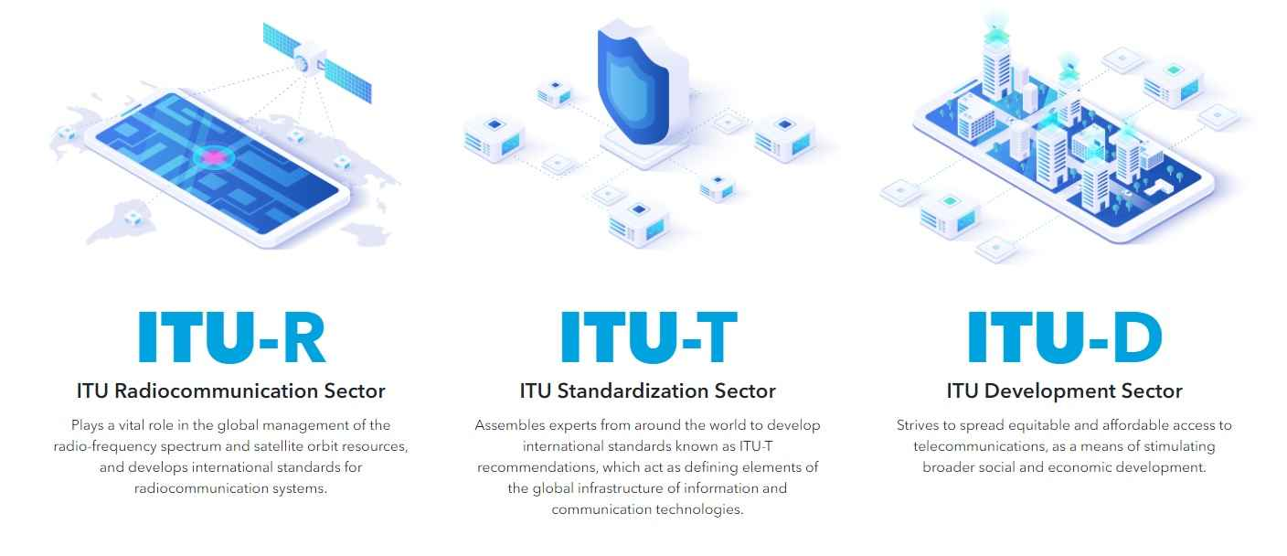
About
The International Telecommunication Union (ITU) is a specialized agency of the United Nations responsible for information and communication technologies.
Established in 1865 and is the oldest UN agency.
Structured around three sectors and the General Secretariat

Slide 3
Overall Objective:
Establish national broadband mapping systems in 11 beneficiary countries, capable of producing public available validated data.
Specific intervention:
1. Policy and regulatory support to create a conducive environment.
2. Promote open-source solutions and data practices.
3. Provide technical support for installation, use, and maintenance of systems.

Slide 4
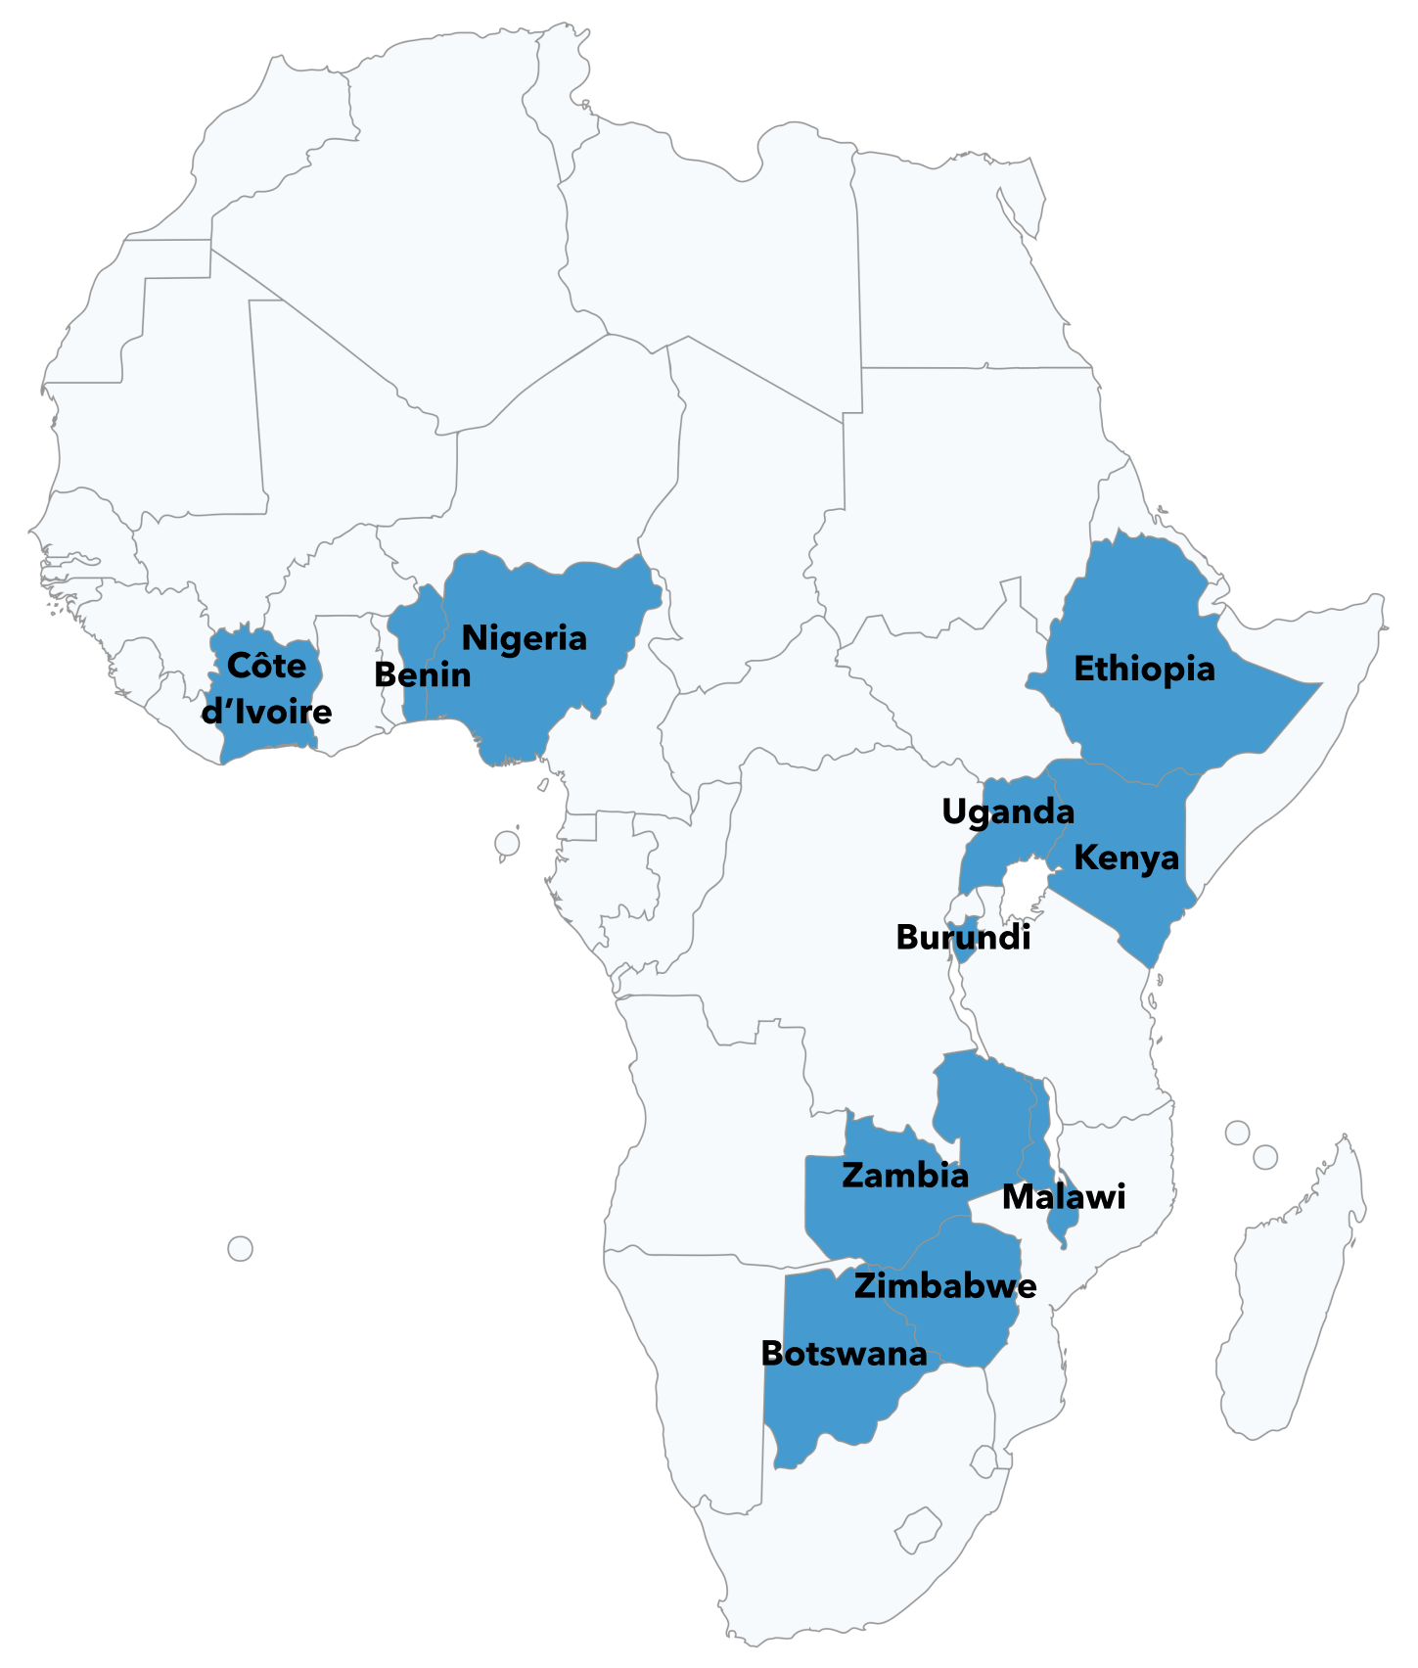
11 countries
€ 15 million
48 months

Slide 5
Countries in Focus
West Africa Region
Cote d'Ivoire
Nigeria
Benin
East Africa Region
Ethiopia
Kenya
Uganda
Southern Africa Region
Botswana
Malawi
Zambia
Zimbabwe
Central Africa Region
Burundi
Criteria
Expressed needs for support in broadband mapping.​
Level of maturity in implementing mapping systems. ​
Geographical and linguistic distribution across Sub-Saharan Africa.​
Alignment with Global Gateway connectivity investment priorities.​

Slide 6
Main Stakeholders
1. ITU
- Role: Implementing agency for the broadband mapping project.
- Responsibility: Provides technical expertise and oversees project implementation and coordination.
2. EC
- Role: Provides funding and strategic oversight for the projects.
- Responsibility: Ensures the projects align with broader regional development goals.
3. National Regulatory Authorities (NRAs)
- Role: Beneficiaries of the projects.
- Responsibility: Participate in capacity-building activities and implement regulatory changes.
4. EU Delegations:
Role: Participate in events, workshops, and communication efforts; consult with stakeholders and leverage DEL resources to support implementation.
Responsibilities: Facilitate the exchange of information to ensure projects complement ongoing initiatives in the country and share regular updates on activities at the country level.

Slide 7
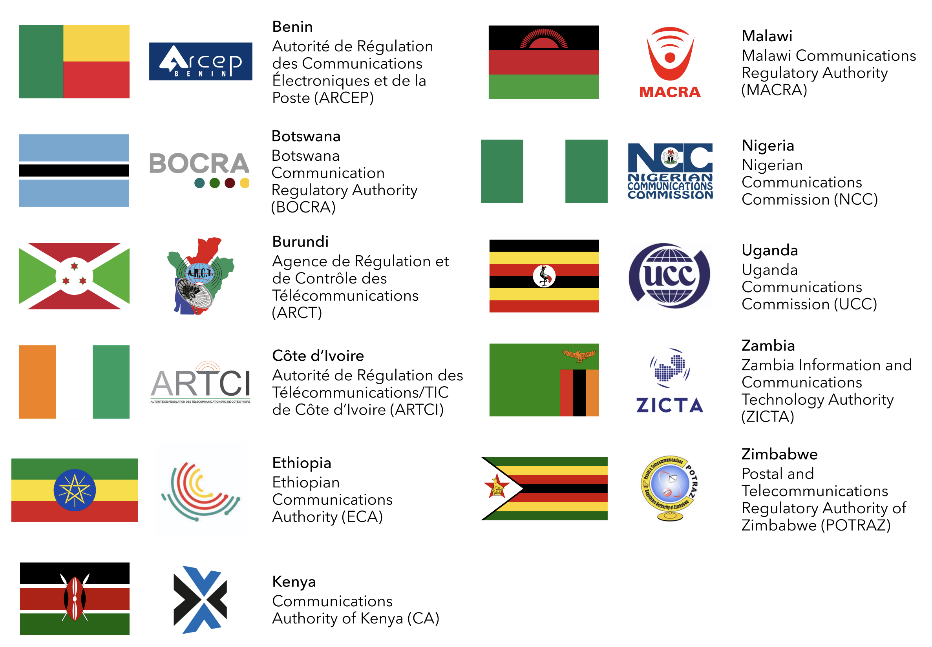
Governance
NRAs of Beneficiary Countries

Slide 8
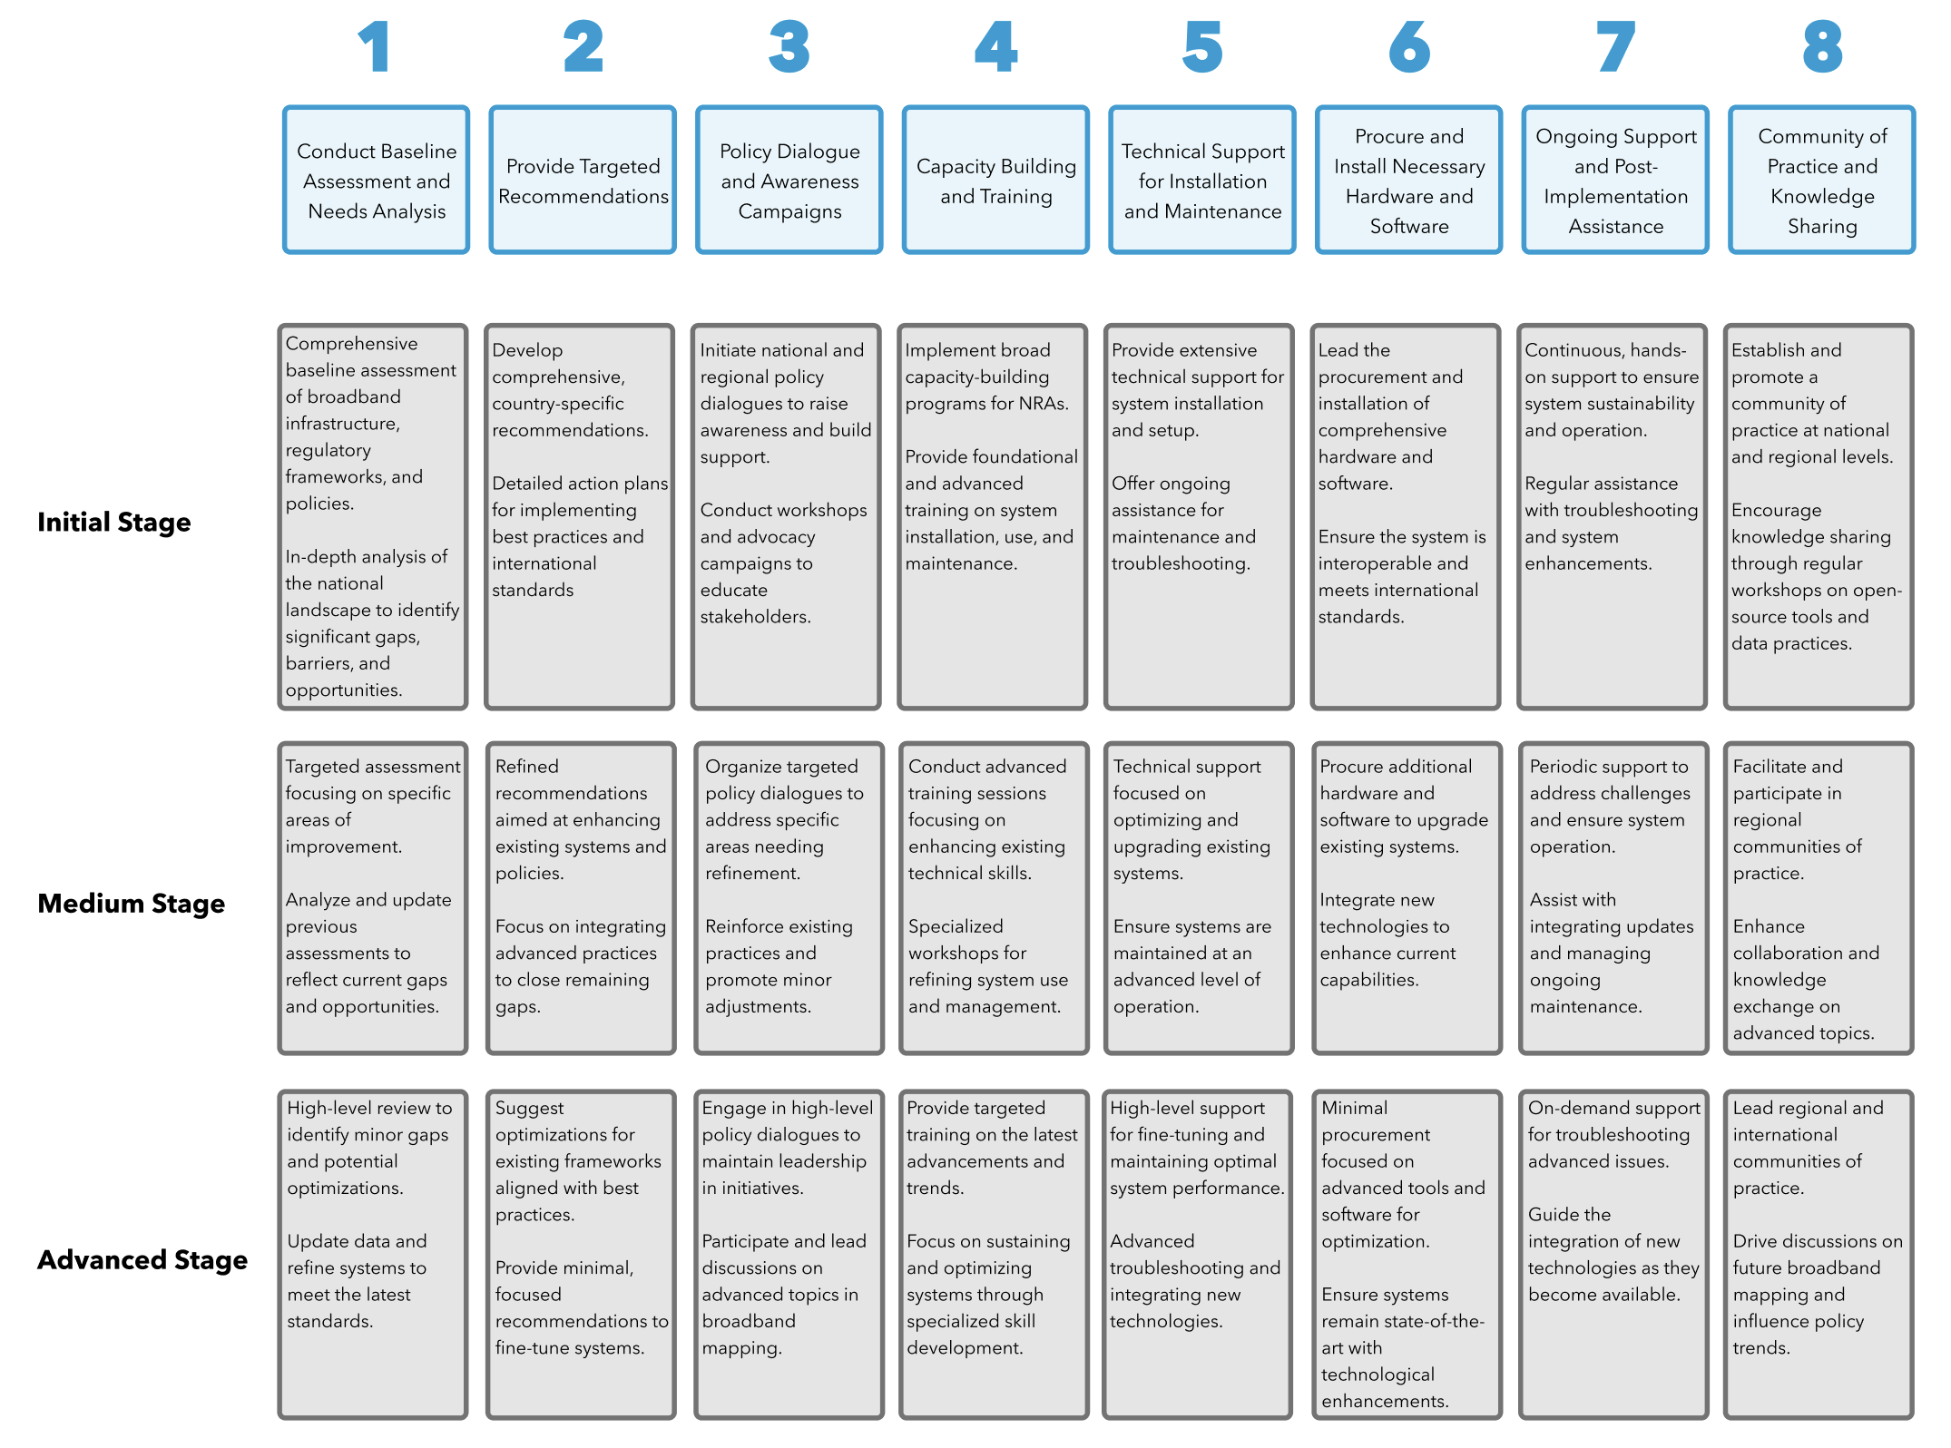
Our Approach

Slide 9
Expected outputs and activities
Output 1: Policy and Regulatory Support
Baseline Assessment and Maturity Matrix: Conduct baseline assessments and develop a maturity matrix to measure progress.
Policy Assessments and Recommendations: Perform needs analysis and provide policy recommendations for regulatory improvements.
Policy Dialogue and Advocacy: Organize national and regional workshops to promote policy harmonization and best practices.
Output 2: Open-Source Solutions and Data Practices
Promotion of Open-Source Solutions: Advocate for the adoption of open-source solutions at national and regional levels.
Common Data Standards: Identify and promote common data standards and practices for broadband mapping.
Development of Modular Software Tools: Create open-source software tools tailored to the unique challenges of low maturity countries.
Output 3: Technical Support
Technical Specifications and Procurement: Develop technical specifications for hardware and software procurement.
Training and Capacity Building: Conduct specialized training programs and workshops for technical staff.
Post-Implementation Support: Provide ongoing support to ensure the sustainability of broadband mapping systems.

Slide 10
Implementation arrangements
ITU Team | Beneficiary countries
ITU Team 1 | Cote d'Ivoire
ITU Team 2 | Nigeria
ITU Team 3 | Benin
ITU Team 4 | Ethiopia
ITU Team 5 | Kenya
ITU Team 6 | Uganda
ITU Team 7 | Botswana
ITU Team 8 | Malawi
ITU Team 9 | Zambia
ITU Team 10 | Zimbabwe
ITU Team 11 | Burundi
Project Management:
ITU as the implementing agency, managing overall project execution.
ITU Expert Teams:
Formation of 11 European expert teams and match making for each Sub-Saharan beneficiary country, composed telecommunications engineers and legal policy advisors.

Slide 11
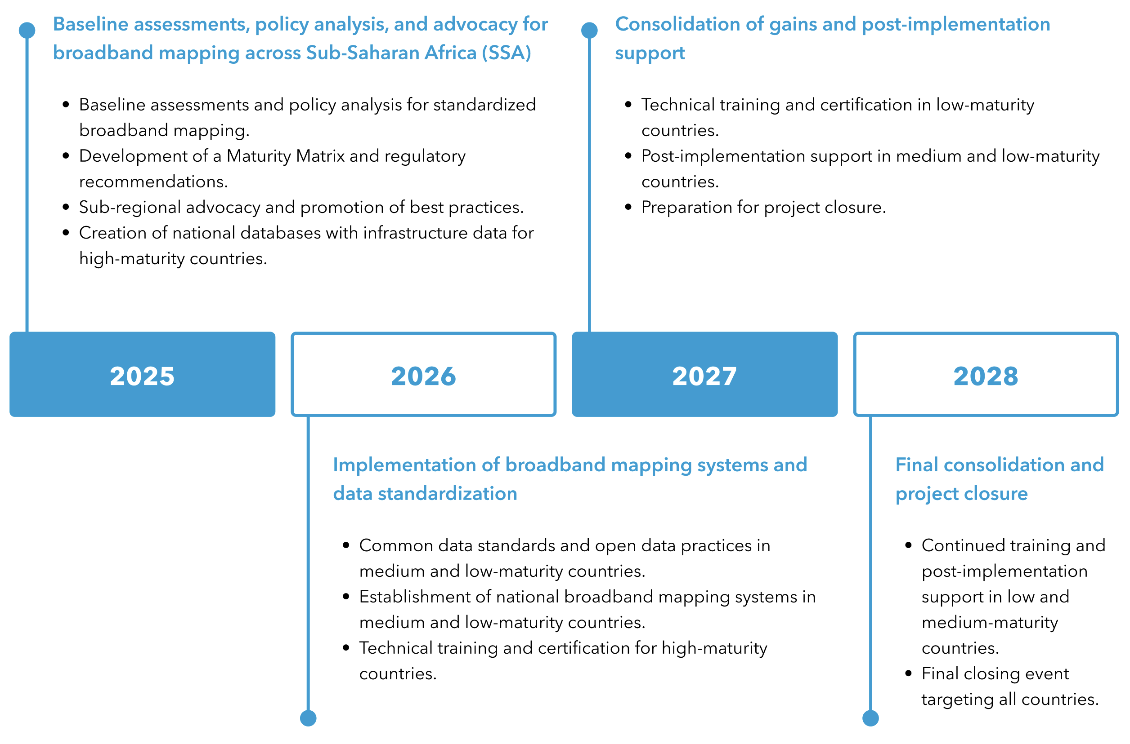
Project Timeline

Slide 12
EU Support to Africa’s National Broadband Mapping Systems (Africa-BB-Maps) Thank you, any question?

