Slide 1
Broadband infrastructure mapping in Poland
Marek Ostanek
Marcin Adamowicz
Strategy and Analyses Department

Slide 2
Case study: Poland
Regulatory institutions in Poland
Data collection system:
„SIDUSIS”
Ministry of Digital Affairs
Office of Electronic Communication
Data collection system
„PIT”
&
telecommunication registers
Broadband infrastructure mapping in Poland
There are two government institutions in Poland – Ministry of Digital Affairs and Office of Electronic Communication (NRA).
Both exist due to the same legal acts. The President of Office of Electronic Communication is an independent regulator, which is supervised by the Minister.
Źródło: UKE
Notes:
BROADBAND ACT:
In 2010 Polish Government accepted the Broadband Act, also known as Mega-Act, which supports the development of telecommunication services and networks. It is the key law act which started inventory of telecom infrastructure in Poland.
Article 29 of the Broadband Act Provides a legal basis of drawing up the inventory of existing telecommunications infrastructure and public telecommunications networks on the territory of Poland (in electronic form)
The SCOPE of the inventory includes:
Optical nodes;
Network routes;
Building to enable collocation; Technical channels; Planned and existing technical infrastructure; Road lane occupying fees;
STAKEHOLDERS – Obligated to forward the President of UKE of data on telecommunications infrastructure are:
telecommunications enterprises,
local government units,
State units;
The mentioned article precise frequency of collection of inventory data, which is being done twice a year. To the 31 March and 31 August all telecommunication companies, local government entities, and state units are obliged to send UKE reports in the framework of the Single Information Point.

Slide 3
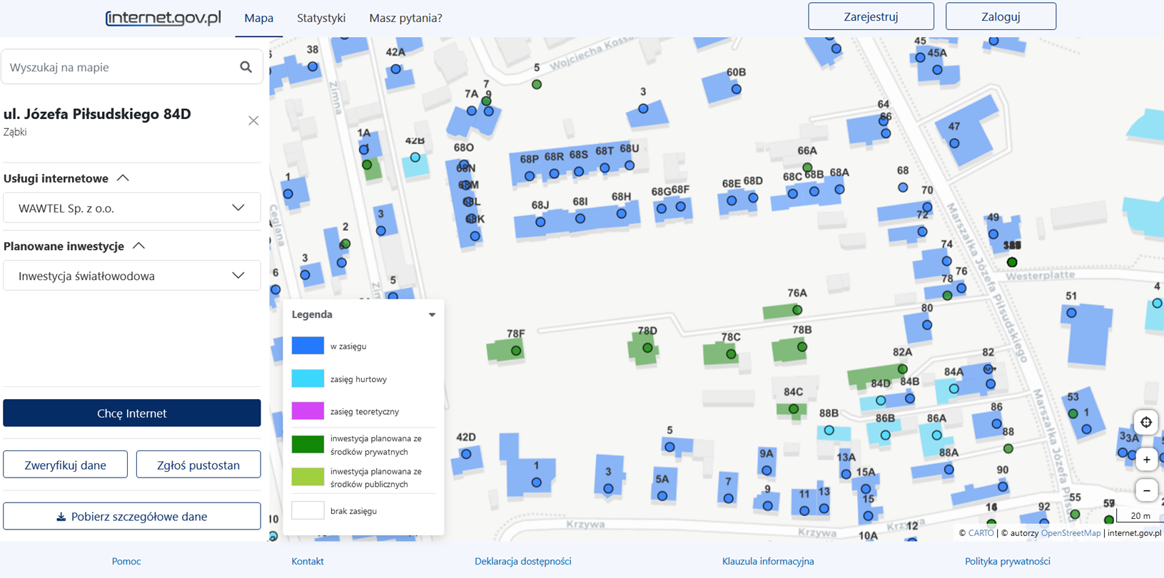
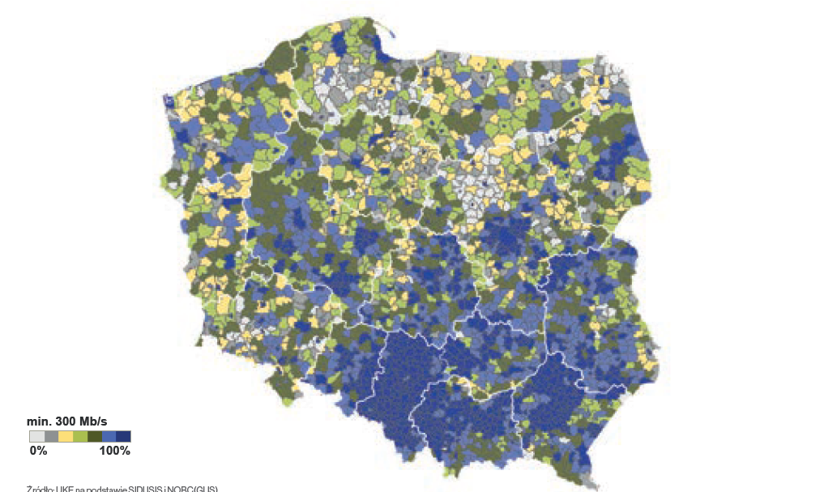
Data collection - Minister of Digital Affairs
Sidusis – the data presentation system of Ministry of Digital Affairs
Data transfer customer preferences
Location
Available operator
Media selection (fttx)
The range of fixed-line networks in Poland
CZĘSTOTLIWOŚĆ RAPORTOWANIA
Source: https://internet.gov.pl/map/?center=2349820.3607533704%3B6851791.294293443&zoom=20
Source: UKE upon data from https://internet.gov.pl/
In Sidusis (system maintained by the Ministry of Digital Affairs) information about the range of fixed-line networks is collected. Hence it is known how many households can use the Internet with specific parameters, i.e., in general, entrepreneurs provide information about what services they can provide in a specific place. Such information is published by the Ministry of Digital Affairs on the website internet.gov.pl
The maps shows the number of address points which are passed by the internet infrastructure of certain parameters, like 300 Mb/s.
Źródło: UKE
Notes:
BROADBAND ACT:
In 2010 Polish Government accepted the Broadband Act, also known as Mega-Act, which supports the development of telecommunication services and networks. It is the key law act which started inventory of telecom infrastructure in Poland.
Article 29 of the Broadband Act Provides a legal basis of drawing up the inventory of existing telecommunications infrastructure and public telecommunications networks on the territory of Poland (in electronic form)
The SCOPE of the inventory includes:
Optical nodes;
Network routes;
Building to enable collocation; Technical channels; Planned and existing technical infrastructure; Road lane occupying fees;
STAKEHOLDERS – Obligated to forward the President of UKE of data on telecommunications infrastructure are:
telecommunications enterprises,
local government units,
State units;
The mentioned article precise frequency of collection of inventory data, which is being done twice a year. To the 31 March and 31 August all telecommunication companies, local government entities, and state units are obliged to send UKE reports in the framework of the Single Information Point.

Slide 4
Departament Strategii i Analiz
Telecommunication register
Legal act „Prawo Komunikacji Elektronicznej” – the law of 12 July 2024, which describes:
the scope of the telecommunication register
the template of the registry application
The presentation of the telecommunication registered on the web page of UKE
The processing of application details (number of days for acceptance of application and issuance of the confirmation document
The same legal act gives the outline for cooperation with BEREC
Telecommunication register
Źródło: UKE
Notes:
There are some legal act descrivbing the activities of Polish NRA

Slide 5
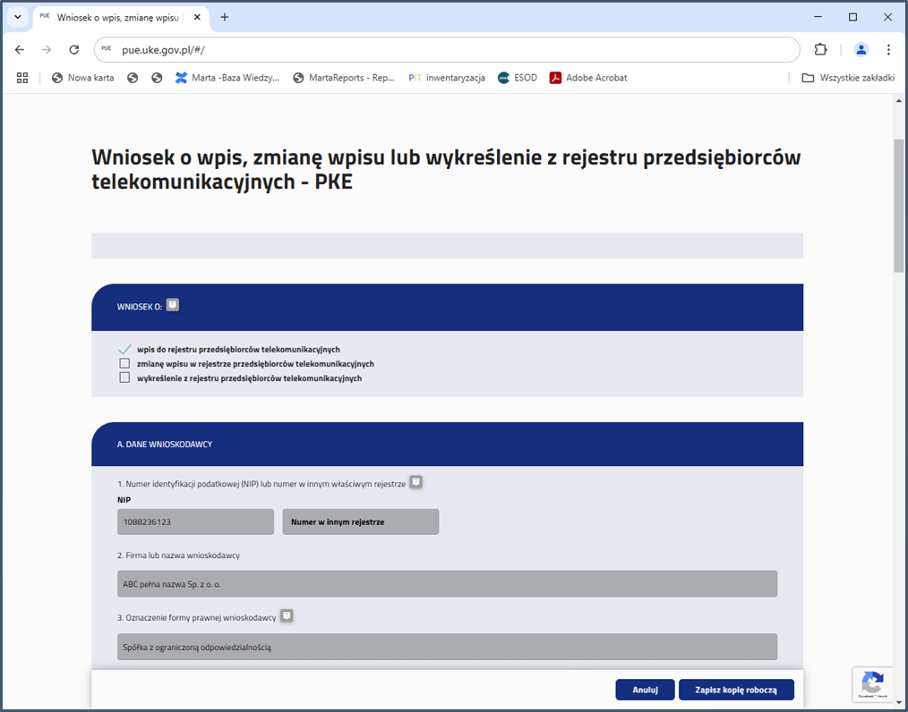
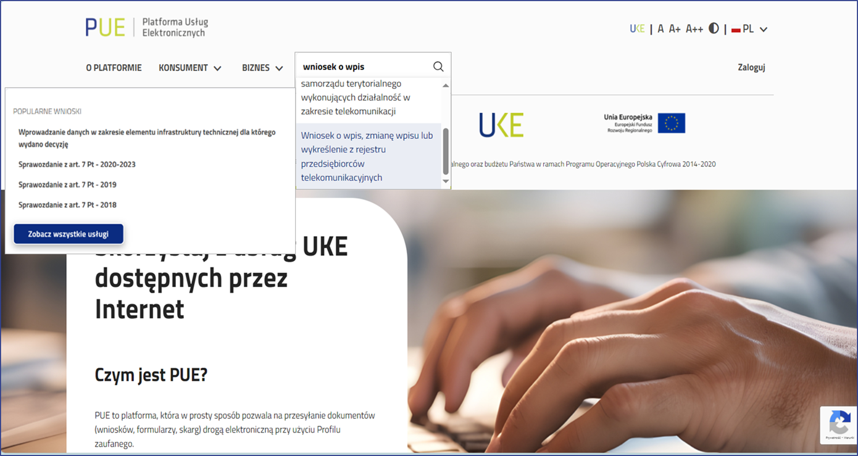
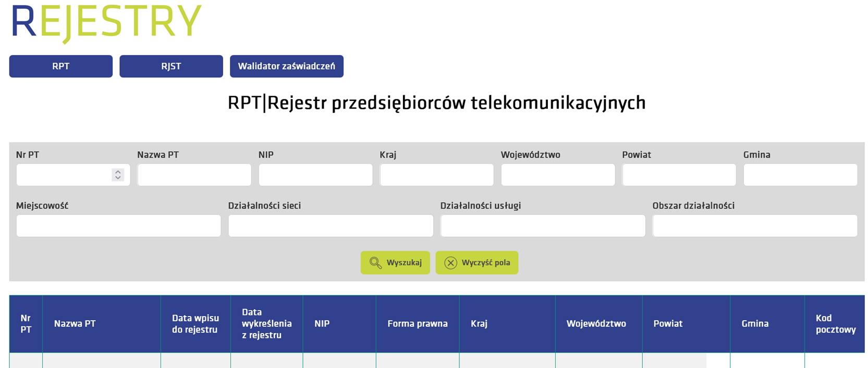
Departament Strategii i Analiz
Telecommunication register – application process
A communications platform enabling the exchange of data between the UK and telecommunications.
The platform enables registration, making changes to registers and obtaining electronic confirmation of entered data.
Application
3 working days formal processing by UKE
rejestry.uke.gov.pl
Telecommunication register
Telecommunication register
(data base)
pue.uke.gov.pl
7days
An application for maintaining and sharing information (every day) from the telecommunications registry
Confirmation from the register
Źródło: UKE

Slide 6
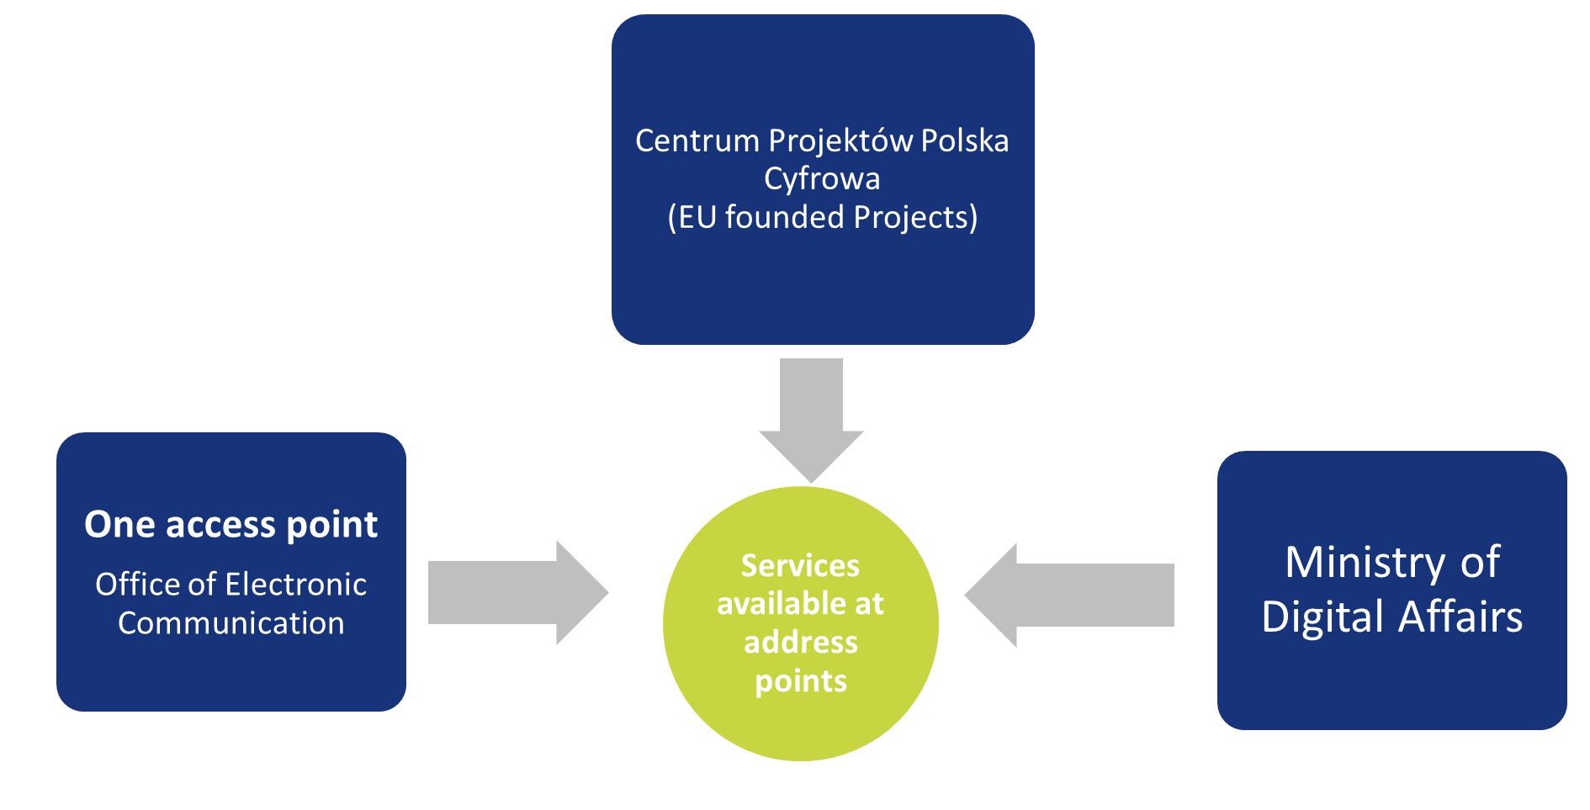
Big Picture
Data provided by all infrastructure operators (including commercial companies, local governmental bodies, municipal and other – jointly stakeholders).
UKE was collecting the data and mapped them since 2010.
Reporting defined by Polish law, entered live on January 1st 2022.
The reported data consists of all infrastructure elements: nodes, flexibility points (service access point), route of cable lines, optical lines, wireless lines, services at address points, buildings which enable colocation, planned and existing technical infrastructure, technical channels, road lane occupying fees
The mobile infrastructure is also reported.
Data collection: twice a year/ once a year
The communication with stakeholders is done through data transfer through single communication point (https://pit.uke.gov.pl/pl-pl/strona-glowna/).
Coordination of government institutions – better feedback for citizens and business users.
Government telecommunication reporting systems
Inventory of telecommunication infrastructure in Poland
CZĘSTOTLIWOŚĆ RAPORTOWANIA
UKE has been mapping data since 2010, ability to map and visualise data help in infrastructure evidencing and regulation.
Źródło: UKE
Notes:
BROADBAND ACT:
In 2010 Polish Government accepted the Broadband Act, also known as Mega-Act, which supports the development of telecommunication services and networks. It is the key law act which started inventory of telecom infrastructure in Poland.
Article 29 of the Broadband Act Provides a legal basis of drawing up the inventory of existing telecommunications infrastructure and public telecommunications networks on the territory of Poland (in electronic form)
The SCOPE of the inventory includes:
Optical nodes;
Network routes;
Building to enable collocation; Technical channels; Planned and existing technical infrastructure; Road lane occupying fees;
STAKEHOLDERS – Obligated to forward the President of UKE of data on telecommunications infrastructure are:
telecommunications enterprises,
local government units,
State units;
The mentioned article precise frequency of collection of inventory data, which is being done twice a year. To the 31 March and 31 August all telecommunication companies, local government entities, and state units are obliged to send UKE reports in the framework of the Single Information Point.

Slide 7
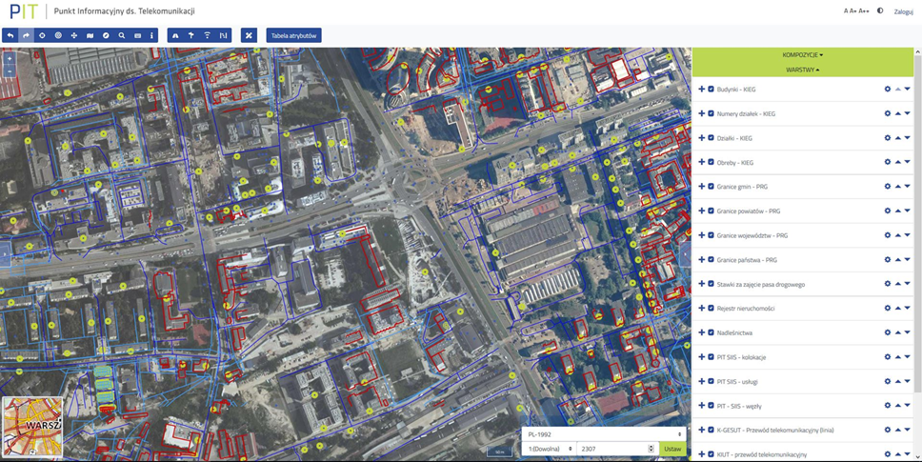
Case study: Poland
Data collection UKE (Office of Electronic Communication)
Inventory of telecommunication infrastructure in Poland
CZĘSTOTLIWOŚĆ RAPORTOWANIA
https://pitmap.uke.gov.pl/
The Information Point on Telecommunications (PIT) was created to provide telecommunications undertakings with access to information about:
Procedures (environment, location, right of way, construction law, code of administrative procedure) and formalities required before the start of construction works regarding technical and telecommunications infrastructure,
Existing and planned technical infrastructure,
Applicable rates for the right of way occupation.
Źródło: UKE
Notes:
BROADBAND ACT:
In 2010 Polish Government accepted the Broadband Act, also known as Mega-Act, which supports the development of telecommunication services and networks. It is the key law act which started inventory of telecom infrastructure in Poland.
Article 29 of the Broadband Act Provides a legal basis of drawing up the inventory of existing telecommunications infrastructure and public telecommunications networks on the territory of Poland (in electronic form)
The SCOPE of the inventory includes:
Optical nodes;
Network routes;
Building to enable collocation; Technical channels; Planned and existing technical infrastructure; Road lane occupying fees;
STAKEHOLDERS – Obligated to forward the President of UKE of data on telecommunications infrastructure are:
telecommunications enterprises,
local government units,
State units;
The mentioned article precise frequency of collection of inventory data, which is being done twice a year. To the 31 March and 31 August all telecommunication companies, local government entities, and state units are obliged to send UKE reports in the framework of the Single Information Point.

Slide 8
Data – information - knowledge
In 2010 Polish Government accepted the Broadband Act, also known as Mega-Act, which supports the development of telecommunication services and networks. It is the key law act which started inventory of telecom infrastructure in Poland.
Article 29 of the Broadband Act provides a legal basis of drawing up the inventory of existing telecommunications infrastructure and public telecommunications networks on the territory of Poland (in electronic form)
Data formats:
comma-separated values (about 95% of the data transferred);
Others (the remaining 5% of the data transferred), including:
Shapefile (SHP),
Keyhole Markup Language (KML),
GeoPackage (GPKG),
Geography Markup Language (GML),
GeoJSON
GeoTIFF (used only for reporting coverage of mobile signal)
Inventory of telecommunication infrastructure in Poland
7 data formats
Advanced search
Data analysis
Reports generation
Źródło: UKE
https://inteli.uke.gov.pl/
Notes:
BROADBAND ACT:
In 2010 Polish Government accepted the Broadband Act, also known as Mega-Act, which supports the development of telecommunication services and networks. It is the key law act which started inventory of telecom infrastructure in Poland.
Article 29 of the Broadband Act Provides a legal basis of drawing up the inventory of existing telecommunications infrastructure and public telecommunications networks on the territory of Poland (in electronic form)
The SCOPE of the inventory includes:
Optical nodes;
Network routes;
Building to enable collocation; Technical channels; Planned and existing technical infrastructure; Road lane occupying fees;
STAKEHOLDERS – Obligated to forward the President of UKE of data on telecommunications infrastructure are:
telecommunications enterprises,
local government units,
State units;
The mentioned article precise frequency of collection of inventory data, which is being done twice a year. To the 31 March and 31 August all telecommunication companies, local government entities, and state units are obliged to send UKE reports in the framework of the Single Information Point.

Slide 9
Regulatory Framework
Art. 29 of Mega Act defines:
Collected data
Telecommunication
infrastructure
Routes of cable lines
Service locations
Stakeholders
Telecommunication
companies
Municipal units
Local government units
Reporting frequency
twice a year
Inventory of telecommunication infrastructure in Poland
Źródło: UKE
Notes:
BROADBAND ACT:
In 2010 Polish Government accepted the Broadband Act, also known as Mega-Act, which supports the development of telecommunication services and networks. It is the key law act which started inventory of telecom infrastructure in Poland.
Article 29 of the Broadband Act Provides a legal basis of drawing up the inventory of existing telecommunications infrastructure and public telecommunications networks on the territory of Poland (in electronic form)
The SCOPE of the inventory includes:
Optical nodes;
Network routes;
Building to enable collocation; Technical channels; Planned and existing technical infrastructure; Road lane occupying fees;
STAKEHOLDERS – Obligated to forward the President of UKE of data on telecommunications infrastructure are:
telecommunications enterprises,
local government units,
State units;
The mentioned article precise frequency of collection of inventory data, which is being done twice a year. To the 31 March and 31 August all telecommunication companies, local government entities, and state units are obliged to send UKE reports in the framework of the Single Information Point.

Slide 10
Regulatory Framework
Art. 29c and 29d of Mega Act defines:
Collected data
Technological channels
Existing and planned
technical infrastructure
Road lane fees
Stakeholders
Telecommunication
companies
Municipal units
Local government units
Reporting frequency
up-to-date for technological channels and Road lane fees
once a year
for existing and planned
technical infrastructure
Inventory of telecommunication infrastructure in Poland
Źródło: UKE
Notes:
BROADBAND ACT:
In 2010 Polish Government accepted the Broadband Act, also known as Mega-Act, which supports the development of telecommunication services and networks. It is the key law act which started inventory of telecom infrastructure in Poland.
Article 29 of the Broadband Act Provides a legal basis of drawing up the inventory of existing telecommunications infrastructure and public telecommunications networks on the territory of Poland (in electronic form)
The SCOPE of the inventory includes:
Optical nodes;
Network routes;
Building to enable collocation; Technical channels; Planned and existing technical infrastructure; Road lane occupying fees;
STAKEHOLDERS – Obligated to forward the President of UKE of data on telecommunications infrastructure are:
telecommunications enterprises,
local government units,
State units;
The mentioned article precise frequency of collection of inventory data, which is being done twice a year. To the 31 March and 31 August all telecommunication companies, local government entities, and state units are obliged to send UKE reports in the framework of the Single Information Point.

Slide 11
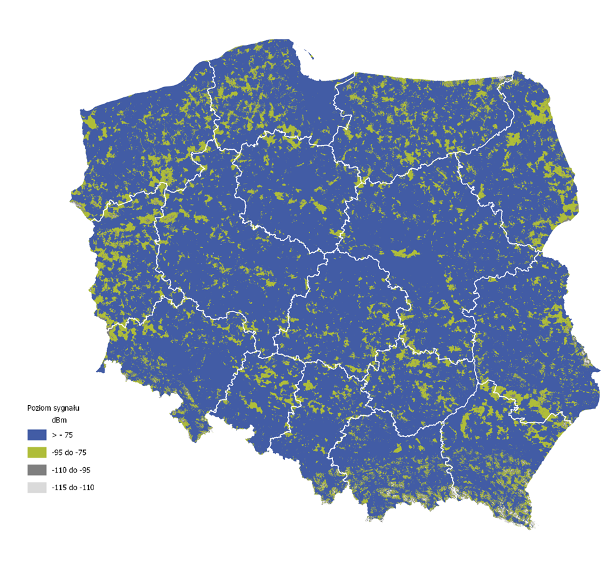
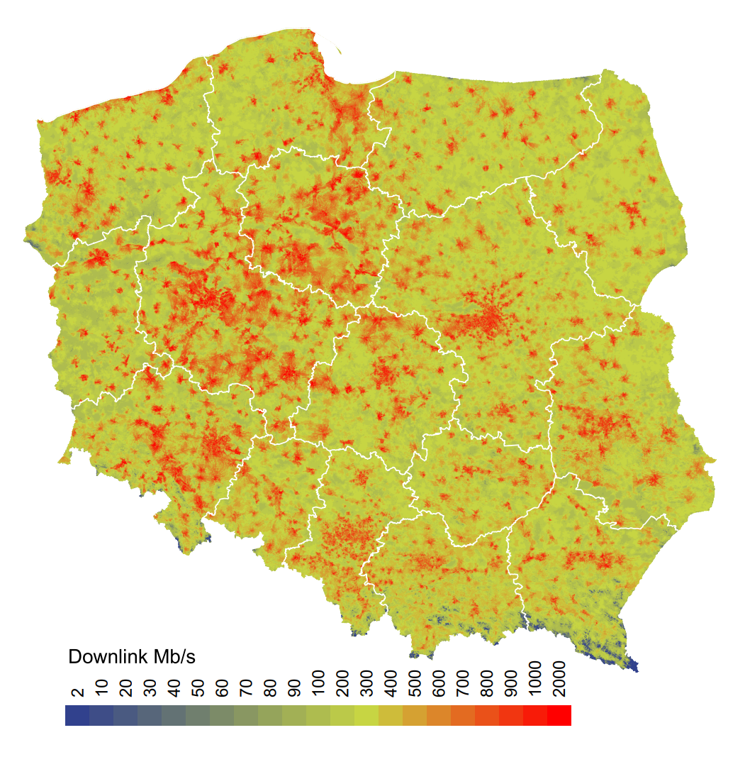
Regulatory institutions in Poland
UKE monitors and maps mobile infrastructure as well. We collect data about the basic station number and locations as well as the coverage of mobile networks in Poland.
There are 4 MNOs in Poland, which have the spectrum reservation and report the infrastructure to UKE as the regulator. There are also 135 MVNOs, which use the infrastructure of MNO.
Mobile infrastructure
Source: UKE
CZĘSTOTLIWOŚĆ RAPORTOWANIA
Source: UKE
The map shows coverage of Poland by the mobile signal. The whole country is covered by the signal sufficient for devices used by consumers.
The map shows the downlink speed in Poland.
Źródło: UKE
Notes:
BROADBAND ACT:
In 2010 Polish Government accepted the Broadband Act, also known as Mega-Act, which supports the development of telecommunication services and networks. It is the key law act which started inventory of telecom infrastructure in Poland.
Article 29 of the Broadband Act Provides a legal basis of drawing up the inventory of existing telecommunications infrastructure and public telecommunications networks on the territory of Poland (in electronic form)
The SCOPE of the inventory includes:
Optical nodes;
Network routes;
Building to enable collocation; Technical channels; Planned and existing technical infrastructure; Road lane occupying fees;
STAKEHOLDERS – Obligated to forward the President of UKE of data on telecommunications infrastructure are:
telecommunications enterprises,
local government units,
State units;
The mentioned article precise frequency of collection of inventory data, which is being done twice a year. To the 31 March and 31 August all telecommunication companies, local government entities, and state units are obliged to send UKE reports in the framework of the Single Information Point.

Slide 12
Added Value
Current infrastructure data from across the country
Improvement and optimization the process of planning, design and construction of public telecommunications networks. Planning and optimizing is a crucial issue. Overlapping cables, fibre optical lines, especially in rural area, may be avoided.
Better allocation of state aid for investors. Planning coverage in the white spots, which can be filled with infrastructure co-financed by state/EU.
Identification of areas, attractive for commercial fibre network operators, which invest without state aid.
Possibility to assess the areas, where SMP operator has a dominant position. The market fluctuates very quickly and the dominant position on local level (municipality) may changes due to new investments.
Supporting the wholesale operators model: one wholesaler-to-many retail operators.
Observing the division between the telecommunication infrastructure and services on nationwide and local level.
Interoperability on the government level
National security – information about the broadband network can be shared with the Defence Ministry
Value added for citizens: feedback about retail internet operators
Inventory of telecommunication infrastructure in Poland
CZĘSTOTLIWOŚĆ RAPORTOWANIA
Źródło: UKE
Notes:
BROADBAND ACT:
In 2010 Polish Government accepted the Broadband Act, also known as Mega-Act, which supports the development of telecommunication services and networks. It is the key law act which started inventory of telecom infrastructure in Poland.
Article 29 of the Broadband Act Provides a legal basis of drawing up the inventory of existing telecommunications infrastructure and public telecommunications networks on the territory of Poland (in electronic form)
The SCOPE of the inventory includes:
Optical nodes;
Network routes;
Building to enable collocation; Technical channels; Planned and existing technical infrastructure; Road lane occupying fees;
STAKEHOLDERS – Obligated to forward the President of UKE of data on telecommunications infrastructure are:
telecommunications enterprises,
local government units,
State units;
The mentioned article precise frequency of collection of inventory data, which is being done twice a year. To the 31 March and 31 August all telecommunication companies, local government entities, and state units are obliged to send UKE reports in the framework of the Single Information Point.

Slide 13
Benefits and challenges
Benefits: better regulation process
Data – information – knowledge, UKE makes „knowledge based” regulatory decisions
Possibility to support the infrastructure owners
Ability to read if Poland follows EU initiatives such as Gigabit Infrastructure Act
Identification overlapping infrastructure (f.e. copper and optical fibre), the copper infrastructure is going to be decommissioned.
Possibility to assess the market share of SMP operator at the local level (municipalities)
Supporting the wholesale broadband market (we observe division between infrastructure and services).
Challenges
Data quality, too many details, data validation problems
„holes in reporting” – missing or incorrect data
Information needed to plan decommissioning of copper network
Learning how to identify incorrect data
Cable routes – all bending points should be reported (in previous system the starting point - end point relationship was reported, therefore the cable routes were incomplete).
Vector graphics - the operators must learn how to use vector graphics, it has to be compatible with the State evidencing systems
Data formats – there are 7 data formats (mostly *.csv, geopack) – the Montenegro case shows that 7 data formats may work, in our case even 3
Inventory of telecommunication infrastructure in Poland
CZĘSTOTLIWOŚĆ RAPORTOWANIA
Źródło: UKE
Notes:
BROADBAND ACT:
In 2010 Polish Government accepted the Broadband Act, also known as Mega-Act, which supports the development of telecommunication services and networks. It is the key law act which started inventory of telecom infrastructure in Poland.
Article 29 of the Broadband Act Provides a legal basis of drawing up the inventory of existing telecommunications infrastructure and public telecommunications networks on the territory of Poland (in electronic form)
The SCOPE of the inventory includes:
Optical nodes;
Network routes;
Building to enable collocation; Technical channels; Planned and existing technical infrastructure; Road lane occupying fees;
STAKEHOLDERS – Obligated to forward the President of UKE of data on telecommunications infrastructure are:
telecommunications enterprises,
local government units,
State units;
The mentioned article precise frequency of collection of inventory data, which is being done twice a year. To the 31 March and 31 August all telecommunication companies, local government entities, and state units are obliged to send UKE reports in the framework of the Single Information Point.

Slide 14
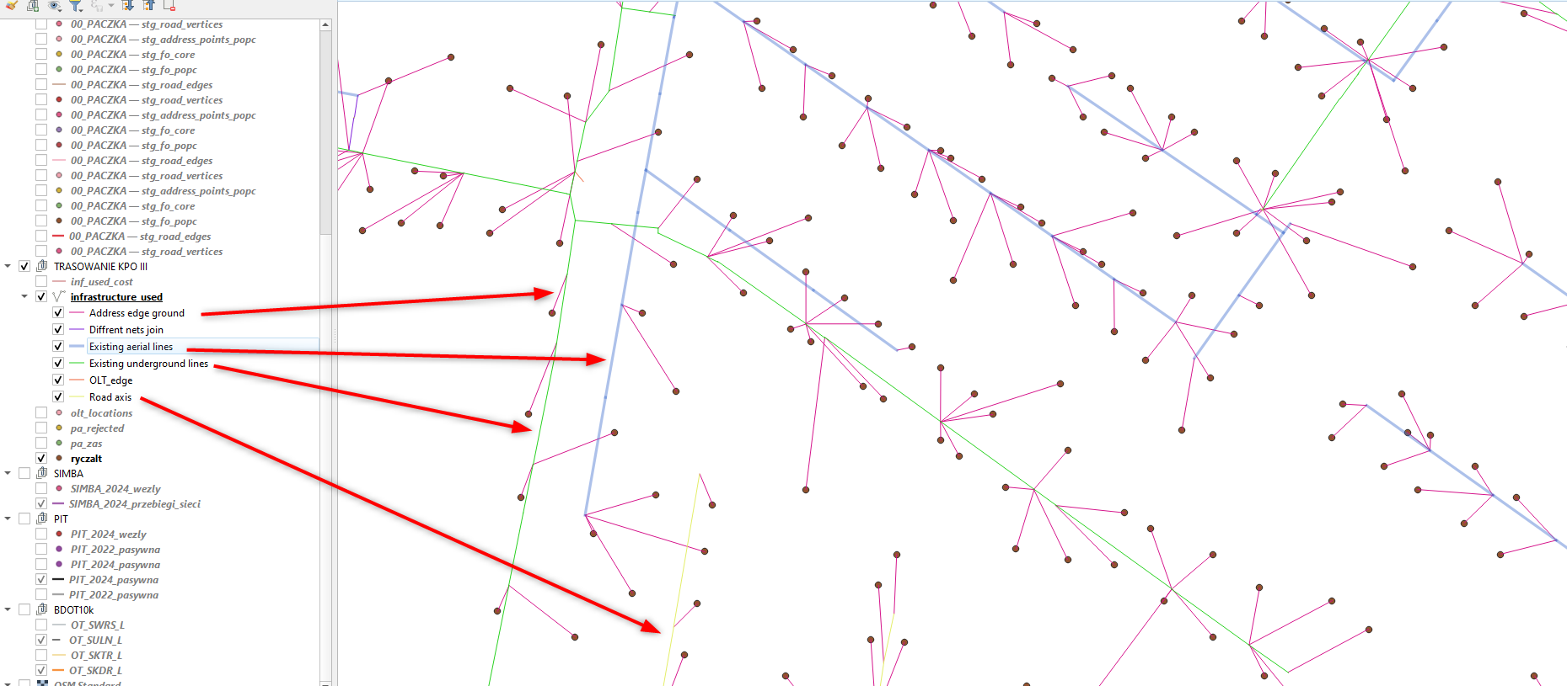
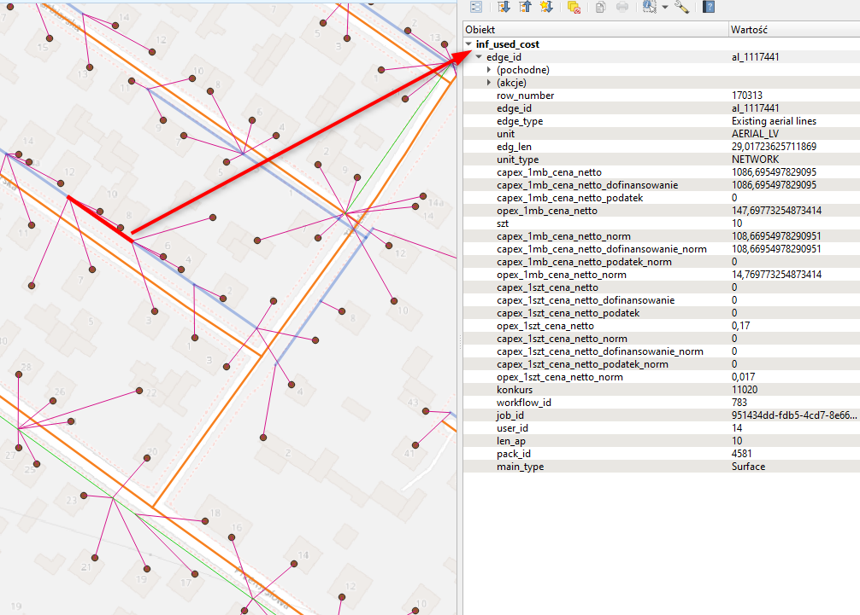
MKP – Network Planning and Cost Estimation Application
MKP – Network Planning and Cost Estimation Application
CZĘSTOTLIWOŚĆ RAPORTOWANIA
Źródło: UKE
Notes:
BROADBAND ACT:
In 2010 Polish Government accepted the Broadband Act, also known as Mega-Act, which supports the development of telecommunication services and networks. It is the key law act which started inventory of telecom infrastructure in Poland.
Article 29 of the Broadband Act Provides a legal basis of drawing up the inventory of existing telecommunications infrastructure and public telecommunications networks on the territory of Poland (in electronic form)
The SCOPE of the inventory includes:
Optical nodes;
Network routes;
Building to enable collocation; Technical channels; Planned and existing technical infrastructure; Road lane occupying fees;
STAKEHOLDERS – Obligated to forward the President of UKE of data on telecommunications infrastructure are:
telecommunications enterprises,
local government units,
State units;
The mentioned article precise frequency of collection of inventory data, which is being done twice a year. To the 31 March and 31 August all telecommunication companies, local government entities, and state units are obliged to send UKE reports in the framework of the Single Information Point.

