Slide 1
Broadband Mapping
in Slovenia
Marko Simončič, Head of Networks, Mapping and Investments Unit
Gregor Baliž, Telecommunictions specialst
March 2025
Notes:
•Type your notes

Slide 2
Agenda
Stakeholders involved
Open data policy
AKOS GIS
Legislation
Geoportal AKOS
Mobile version
Types of BB mapping
Notes:
•Type your notes
•1

Slide 3
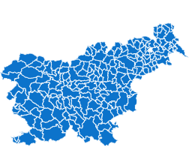
Stakeholders involved
Slovenian electronic communications' operators
Notes:
•Type your notes
•2

Slide 4
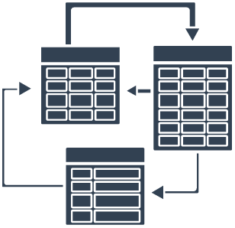
Open data policy
Data in AKOS mapping system
BASIC:
Consolidated cadastre of public infrastructure (PUBLIC)
Network termination points database (PUBLIC)
ADDITIONAL:
Register of spatial units (PUBLIC)
AJPES business register (PUBLIC)
The building cadastre (PUBLIC)
Central population register (NON-PUBLIC)
AKOS:
Retail mapping (prices, technologies, speed, services)
Wholesale mapping (prices, technologies, services)
Mobile coverage simulations by operator and technology
Field measures of mobile signal strength
Fixed coverage calculations by regions, municipalities, settlements
Decree on the provision and re-use of public information
Notes:
•Type your notes
•3

Slide 5
Legislation
Electronic communications act
Secondary legislation and other documents
The owner of the communications network is obliged to provide information on the types and location of networks directly to the authority responsible for land surveying.
All data are publicly available.
Any change should be reported to the authority within three months of such change.
The Agency oversees the implementation of the provisions (supervision).
The fine for the medium or large firm (in case they don‘t report data) is from 50.000 - 400.000 €
Rules on the management and content of data on communication networks and associated infrastructure, network termination points and other electronic communication networks.
An exchange format for providing data.
Technical support from authority.
1
2
Notes:
•Type your notes
•7

Slide 6
Geoportal AKOS
Published in May 2019
The main purpose of the Geoportal is to lower the costs of building very high capacity networks (VHCN) and to encourage shared use and joint construction.
Geoportal allows public access to AKOS data and also to the data that has not been accessible so far in a single portal. Main goals of providing these data to public are related to higher transparency of operation and proactive publication of spatial information.
Available also in English at: http://gis.akos-rs.si/
Notes:
•Type your notes
•8

Slide 7
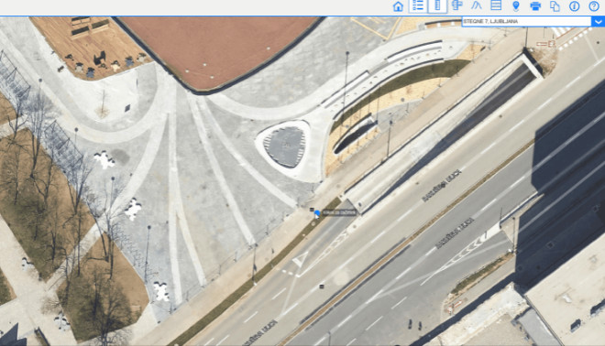
Geoportal AKOS- layers, tools
More than 110 layers in the fields of telecommunications, public infrastructure, postal services and railways
Additional tools and analyses (some on request of users) to ensure smooth usage
Simple and minimalistic design is created to ensure all users regardless of their GIS knowledge can browse and analyse the data and create maps
Most important data is updated daily (realtime, WFS)
Notes:
•Type your notes
•9

Slide 8
Mobile Geoportal AKOS
1/3 of Geoportal users access it through mobile device
Publication in the first half of 2023
Less tools and layers in a comparison with desktop version, but data is served from the same databases
Notes:
•Type your notes
•13

Slide 9
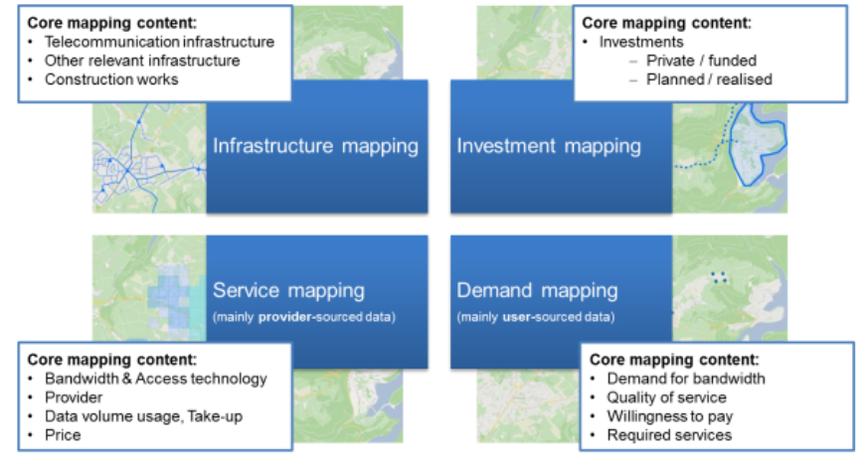
Four types of broadband mapping
Source: A study prepared for the European Commission DG Communications Networks, Content & Technology
Notes:
•Type your notes
•7

Slide 10
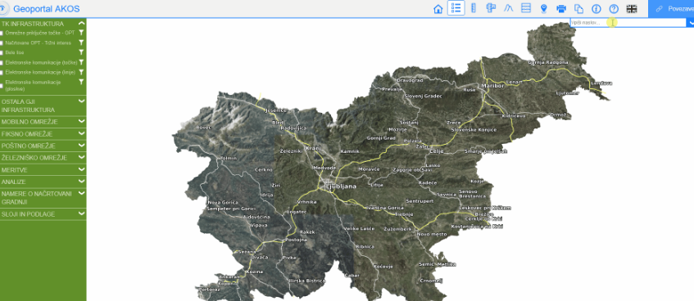
1. Infrastructure mapping:
Granularity of the data for fixed broadband map
Notes:
•Type your notes
•6

Slide 11
2. Service mapping
Retail services and products
Notes:
•Type your notes
•6

Slide 12
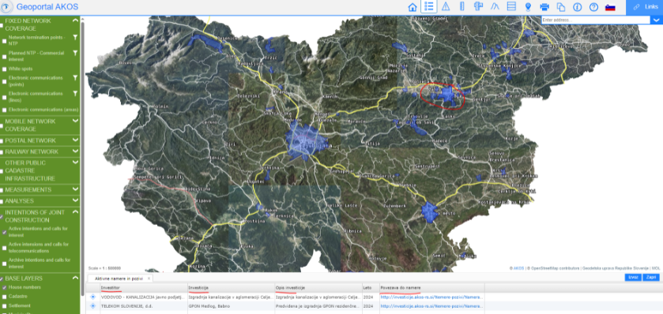
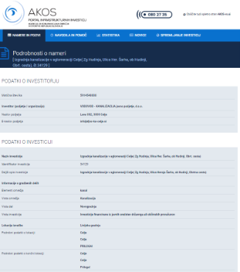
3. Investment mapping:
Intentions of joint construction
Notes:
•Type your notes
•6

Slide 13
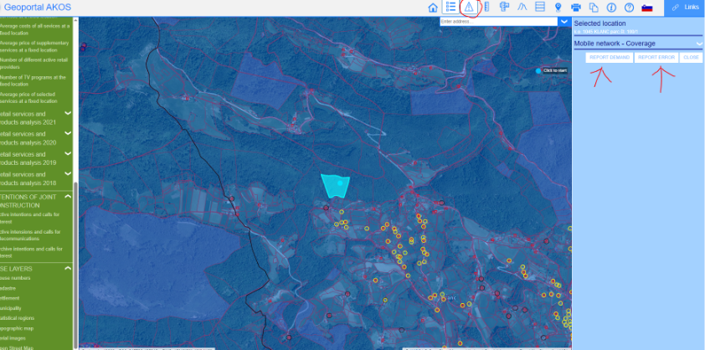
4. Demand mapping:
Report a demand or report an error
Notes:
•Type your notes
•6

Slide 14
THANK YOU
marko.simoncic@akos-rs.si
Notes:
•Type your notes
•14

