Slide 1
Africa-BB-Maps: Uganda Broadband Report
This report provides an overview of broadband development in Uganda. It covers policies, infrastructure, and mapping initiatives. Join us as we explore Uganda's digital landscape.

Slide 2
Questionnaire Report Overview
Focus
Objectives
Examine broadband penetration. Investigate expansion strategies.
Understand mapping systems. Identify policy frameworks.

Slide 3
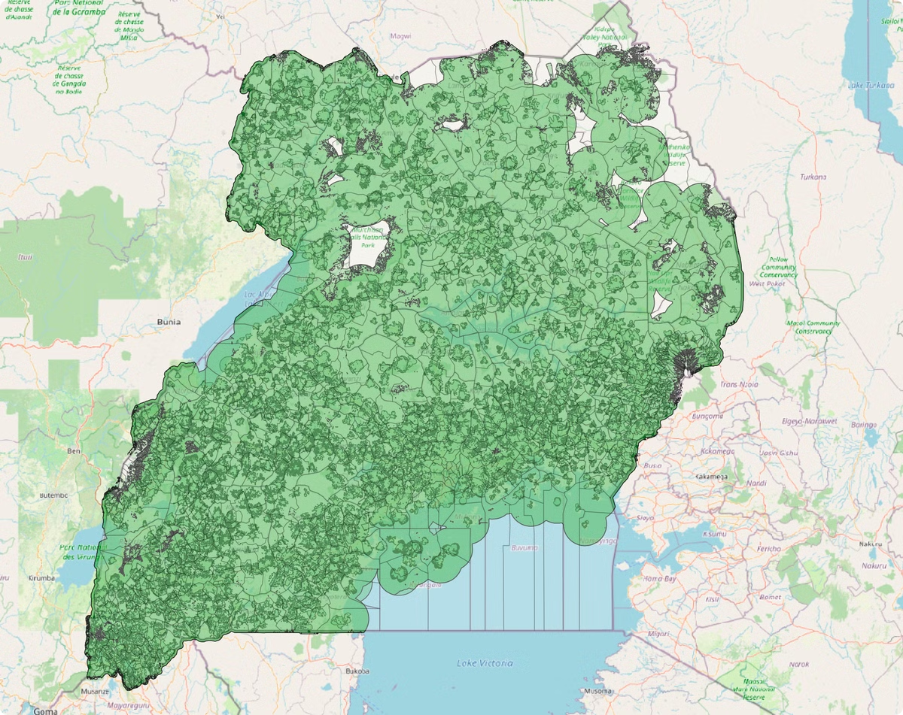
Introduction to Uganda
1
Country Profile
Landlocked East African nation
Capital is Kampala
Known for wildlife and the River Nile
Mainly rural, growing urbanization
Main economic activity- Agriculture
2
Population
Approximately 51.4 million (Census 2024)
Half the population <18yrs
Literacy rate of 54%
3
Broadband Technologies
Fiber
Mobile (3G, 4G, 5G)
FWA
Satellite

Slide 4
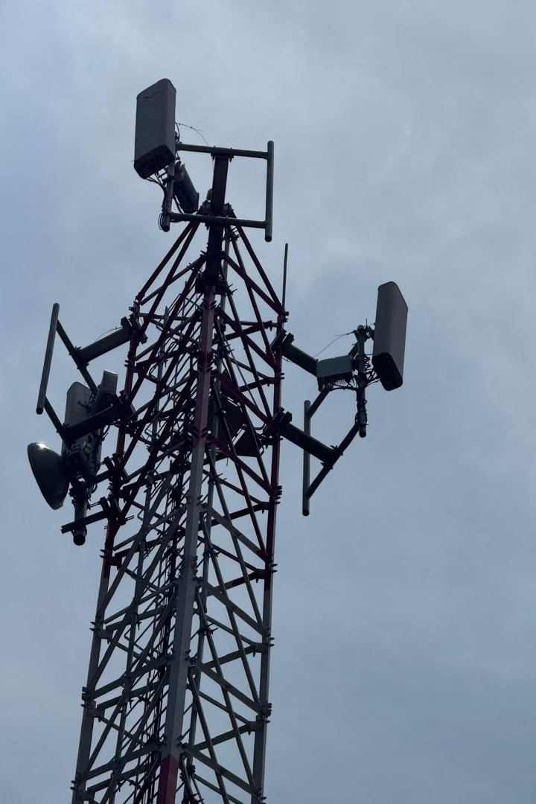
Policy Frameworks
National Broadband Policy (2018)
Enhance ICT penetration and affordability.
Uganda Communications Act (2013)
UCC regulates broadband deployment.
Digital Transformation Roadmap (2023/2024-2027/2028)
Guide the digital transformation efforts of Uganda, enabling it to capitalize on emerging technologies, enhance economic competitiveness, and improve the lives of our citizens. This aligns with Uganda's current National Development Plan.
Licensing Framework (2020)
Through this framework, infrastructure and service providers are licensed separately allowing the respective provider to focus on their niche.
Uganda Communications Commission Guidelines on Communications Infrastructure Deployment and Sharing.(2021)
These guidelines aim to reduce the high costs associated with constructing and maintaining communication infrastructure, which often contribute to elevated service prices for consumers.
UCUCSAF Strategy IV
Increased broadband access
QoS Framework (2007)
It includes parameters and benchmarks for evaluating the performance of mobile and data services
Framework for Monitoring Mobile Network Operator Service Coverage Obligations in Uganda (2024)
This stipulates the data collection, reporting and verification of implementation of coverage obligations of Mobile Network Operators and spectrum assignees.
UCC spectrum management guidelines
Support broadband adoptionby ensuring efficient allocation, licensing and utilisation of spectrum resources
Sector Cybersecurity Strategy (2022-2027)
Building confidence in the use of ICT

Slide 5
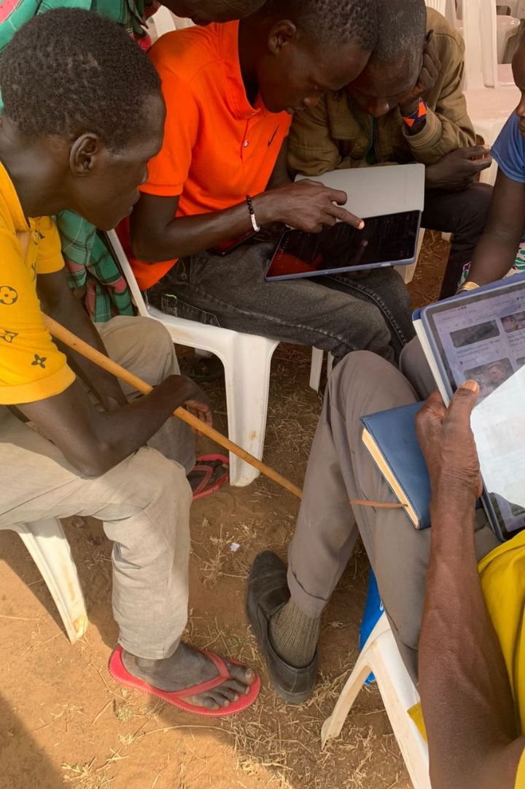
Broadband Penetration and Expansion
Internet Penetration is 64% (UCC annual communications sector report 2023).
Smart phone penetration stands at 33%. (UCC annual communications sector report 2023).
Usage of online government services stands at 2% (UBOS,2024 Census)
Over 5000 Towers constructed. (UCC annual communications sector report 2023).
Uganda aims for 90% broadband coverage by 2030. They also plan to increase household connectivity.
UCUSAF interventions;
Infrastructure subsidies for 86 sites.
Over 10,000 Household smart devices.
Digital Skilling for over 52,000 people.

Slide 6
Broadband Mapping Details
Fiber Networks
Mobile Coverage
30,000Km of fiber have been laid including the National Backbone Infrastructure(NBI). (UCC annual communications sector report 2023).
77% of the country covered by 3G and 31% by 4G. (UCC annual communications sector report 2023).

Slide 7
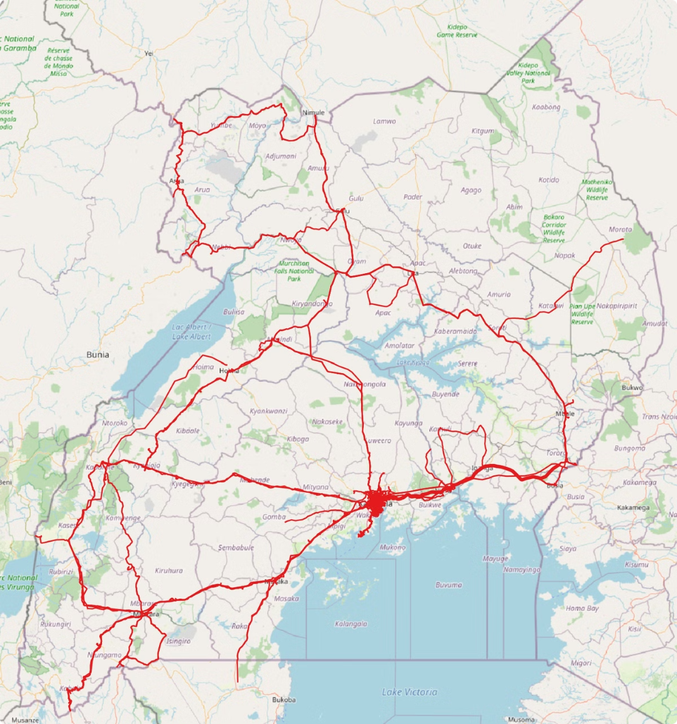
Broadband Mapping Systems - ArcGIS
1
Tools Used
Filemaker for operator data submission.
ArcGIS for operator data mapping.
Tems for monitoring QoS.
The tools are used by various departments.
2
Data Collected Includes
Fiber infrastructure, Mobile Coverage, Site and Cell information.
3
Accessibility
Not fully public, but reports are available.
Operator maps are publicly accessible on their websites.
4
Usage
Monitoring compliance of licensing coverage obligations.
Informs critical areas for UCUSAF interventions.

Slide 8
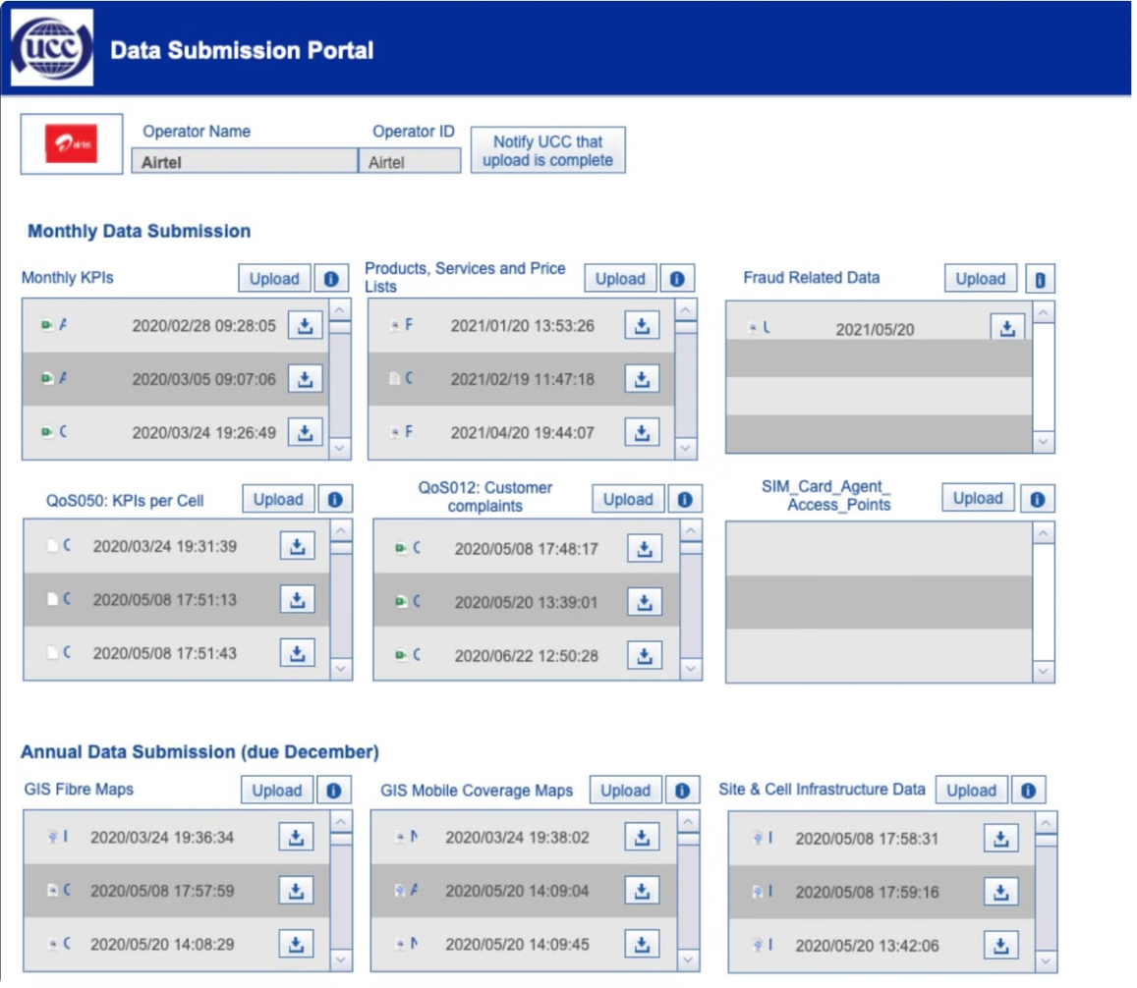
Broadband Coverage Data
Data Submission
All licensees are required to submit their network information.
Coverage and QoS on a quarterly basis.
There are penalties for non-compliance to data submission.
Currently no enforcement for non-compliance.
Publications
Coverage statistics published in market performance reports. (Not verified independently).
QoS performance monitored independently and published.

Slide 9
Challenges
Data is submitted in different unsupported formats.
Limited capacity to verify submitted data.
Capacity building needed in map analysis tools.
Limited access to administrative geospatial data.

Slide 10
Q&A
We hope this report has provided valuable insights into Uganda's broadband landscape. We are now happy to answer your questions.

