Slide 1
Africa-BB-Maps
Questionnaire Report / Template case study
26-27 March, Abidjan, Cote d'Ivoire

Slide 2
Africa-BB-Maps
Questionnaire Report

Slide 3
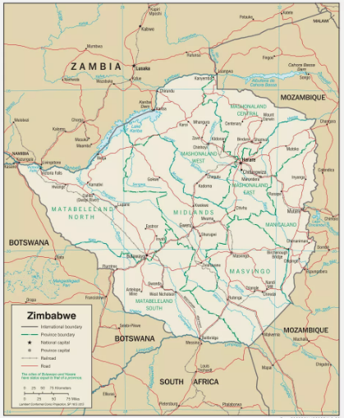
Introduction Zimbabwe
Member State: Zimbabwe (Member of AU, ATU,ITU, SADC, COMESA,… )
Population: 16.34 Million
Land Area: 390.757 square KMs, The country is landlocked
GDP Per Capita: USD2156.03 [2023]
Mobile Penetration: 98.6%
Internet User Penetration: 83.52%
PICTURE

Slide 4
Introduction
The following technologies are being used to deliver broadband services to consumers
3G
4G
5G
Fiber
Satellite
Zimbabwe has National Broadband Plan which is a is a blueprint for inclusive ICT development and adoption in Zimbabwe. The Plan seeks to enhance universal access to and adoption of Broadband services across the nation. The plan defines Broadband as Internet speed of at least 1 Mbps in line with the SADC definition. The plan identifies five broad goals and a set of objectives for realizing the Broadband dream
PICTURE

Slide 5
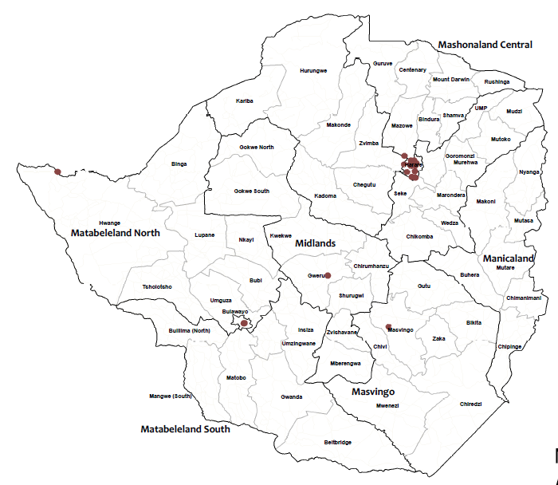
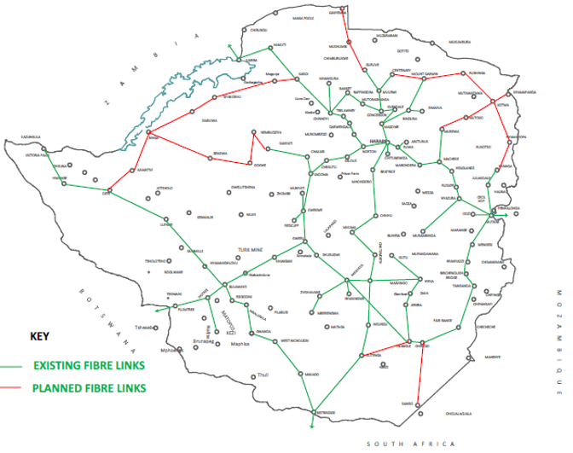
Fiber Backbone and 5G Coverage
PICTURE

Slide 6
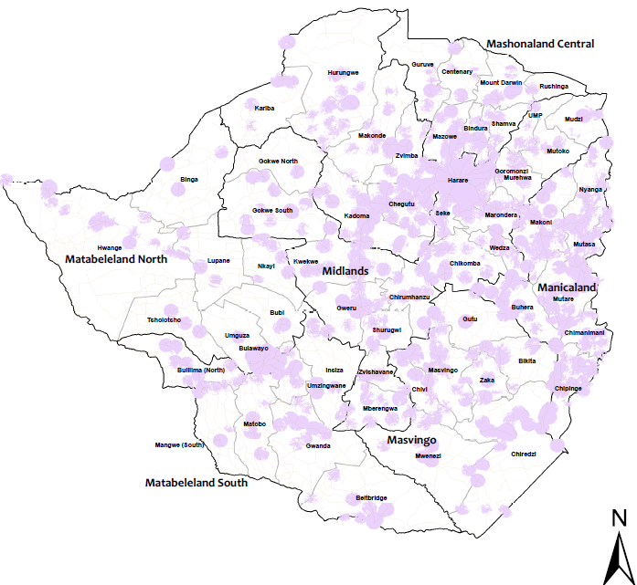
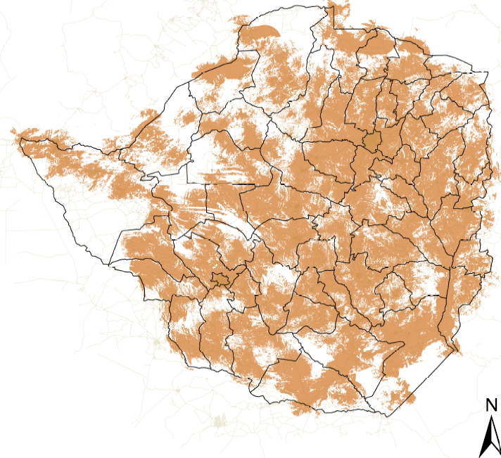
UMTS and LTE Coverage Maps
PICTURE

Slide 7
Policy frameworks
The main Act, Postal and Telecommunications Act [Chapter 12:05] provides for regulation of ICT services in Zimbabwe.
Statutory Instrument 12 of 2021 provides Converged Licensing Framework which introduced technology neutral licenses and allows POTRAZ to have oversight on national broadband roll out and implementation
The National Broadband Plan augments the National ICT Policy, which is periodically reviewed. As a living document, the National Broadband Plan of necessity should be subjected to continual review and updates to keep pace with technological developments and evolving consumer needs and choices
National Development Strategy (NDS 1) comes in with required monitoring and evaluation of the Broadband
PICTURE

Slide 8
GIGA Initiative
The GIGA Project is collaboration between ITU and Zimbabwe Government. In summary the GIGA project seeks to provide the cheapest available means to connect schools to Internet. This is done using Data on available infrastructure. Data was supplied on
Coverage maps 2G/3G/4G but the project only considered 4G
Fiber map
Schools’ location data
School Internet connectivity Data
Cost and technical analysis was done by the ITU Team.
For schools beyond a threshold distance from existing infrastructure, satellite option was put as the viable option.
PICTURE

Slide 9
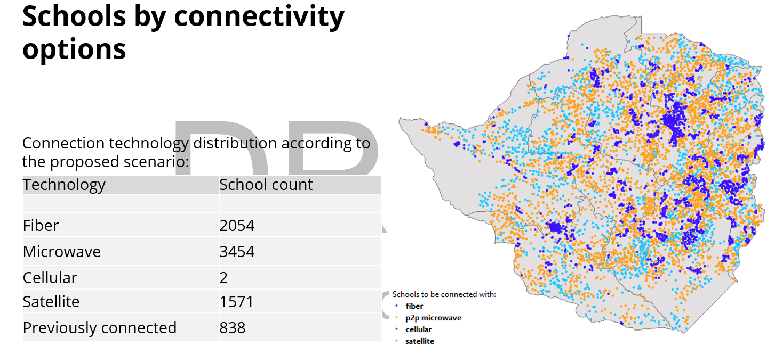
GIGA – Sample Maps/Statistics
PICTURE

Slide 10
GIGA – Sample Maps/Statistics
PICTURE

Slide 11
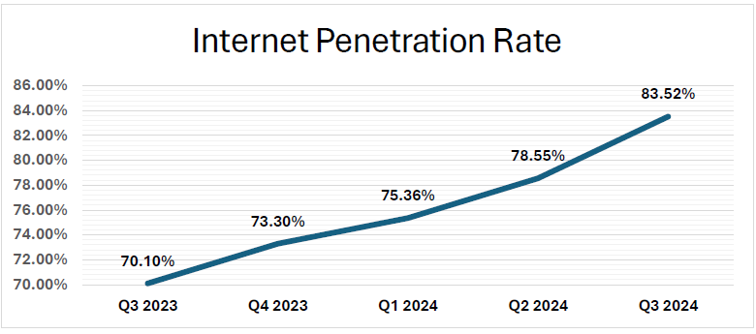
Broadband/Internet penetration and expansion
POSTAL & TELECOMMUNICATIONS SECTOR ABRIDGED PERFORMANCE REPORT THIRD QUARTER 2024
PICTURE

Slide 12
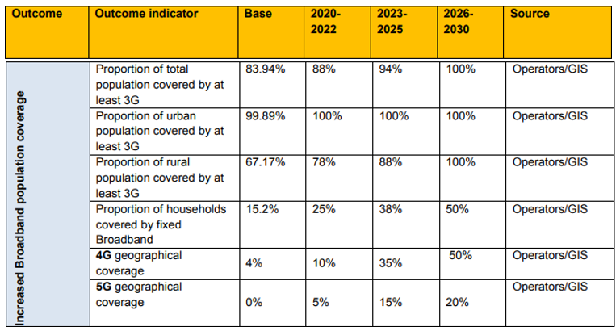
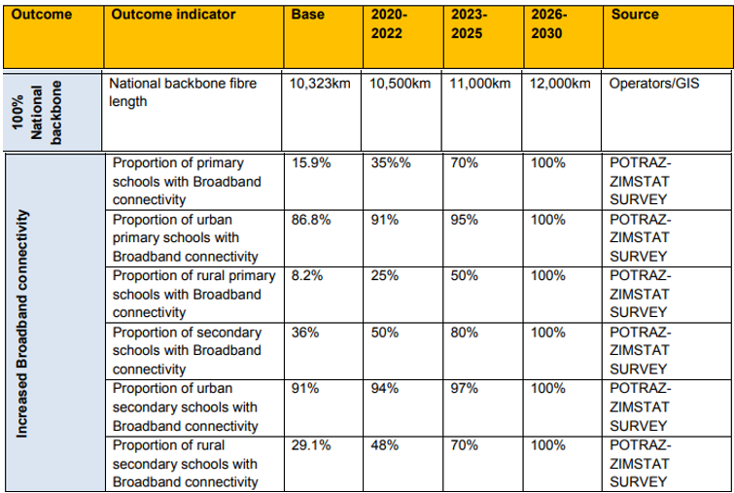
Broadband/Internet penetration and expansion/Targets
PICTURE
Targets According to Zimbabwe National Broadband Plan

Slide 13
Broadband Mapping
POTRAZ collects infrastructure information on Fiber and wireless technologies using templates. Using Quarterly reports other relevant information is collected such as number of customers connected, growth, consumer statistics etc. Some consumer statistics are done through surveys as required. Quality of Service information is collected by an Automated QoS Monitoring System
Potraz Send out a template with requirements for operators to fill in and return on or before set deadline. The example below is from the LTE network Infrastructure information template
Currently other sectors are not involved in the broadband mapping process
PICTURE

Slide 14
Broadband Mapping Systems
Broadband mapping systems are not currently available to the public. We however expect the GIGA project output to go public once ongoing discussions are concluded between ITU and POTRAZ
Internal broadband Maps are produced form data collected and used for:
Evaluation of network roll out targets set in the operator’s license
Provide network coverage statistics on government request
Provide parent Ministry with extend of coverage per technology
Internal use to assess efficient utilization of spectrum and other resources
USF projects to facilitate rural coverage and location of connectivity points
As a measure to agree with operators on expanse of their network
Assist in determining technology to provide broadband to need areas
The technical service department manages the mapping portfolio and following challenges arise:
Quality of information received from operators despite orientation
Expertise to effectively analyze collected information for national economic benefit
Absence of peer review mechanism
Inadequate tools and expertise to produce high quality work
Inadequate collaboration with all stakeholders
Absence of legislation allowing public access to the mapping output for national benefit
PICTURE

Slide 15
Broadband coverage
Operators are required to submit biannual Regulatory Reports as well as any other data that may be requested by the Regulator from time to time.
Operators are also required to comply with Quality of Service Regulations (Statutory Instrument 42 of 2016 and Statutory instrument 154 of 2024). The Regulations provide for penalization of Operators that fail to meet set KPI thresholds.
Coverage data is currently not being published for public consultation, however, the Authority is in the final stages of the deployment of a Mobile Application that will provide consumers with information on network coverage data as well as Quality of Service delivered in various districts and provinces of the country
PICTURE

Slide 16
Q&As

