Slide 1




Africa-BB-Maps
Questionnaire Report-BURUNDI
26-27 March, Abidjan, Cote d'Ivoire
Dr Samuel MUHIZI, Director General of ARCT

Slide 2
Introduction
2
Burundi (pronounced: the Republic of Burundi) is a landlocked African country with a large shoreline on Lake Tanganyika, located in the EAST AFRICA region.
With 27,834 km², It is bordered to the west by the Democratic Republic of Congo, to the north by Rwanda, and to the east and south by Tanzania.
Since February 4, 2019, its political capital has been Gitega. Bujumbura, the economic capital is the most populous city in the country.
Independence: 1-7-1962
Population: Around 13.000.000 (INSBU Projection 2025)
PICTURE

Slide 3
INSTITUTIONAL FRAMEWORK:
ICT Ministry -SETIC –ARCT- FSU
1
2
3
4
5
Digital
Financial Services
Digital infrastructures Network
Digital Skills
Digital
Solutions
Entrepreneurship
ITN ( Institut de Technologie Numérique);
Télécentre Communautaire
(Digital Community Lab)
Hubs
(BujaHub, KitHubs …)
e-Health ;
e-Immigration;
e-Teledeclaration
e-Register
e-Minister
Etc,
B-Switch;
eBanking;
eMobile Money
Etc …
PAEEJ;
BIJE;
BIDF
Etc …
Last Mile;
National Backbone
Rural Connectivity;
Mini National Data
Center ;
Etc.

Slide 4
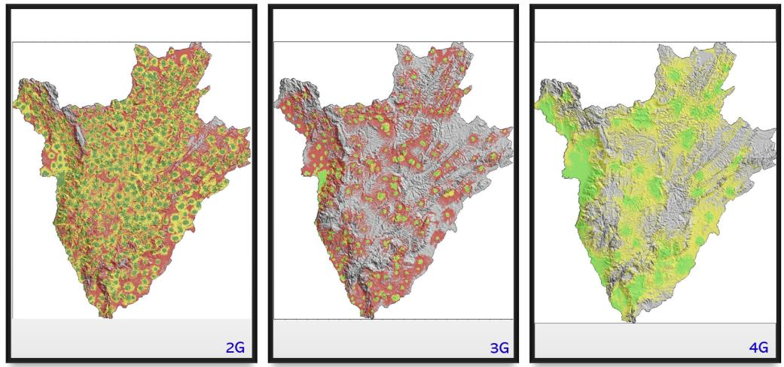
Broadband technologies: Mobile networks
Opérateur | 2G | 3G | 4G | 5G
Onatel | 37.5% | 20% | 3.6% | 0
Econet-Leo | 77% (380 sites) | 11% (110 sites) | 3.5% (51 sites) | 0
Viettel | 95% (586 sites) | 48% (357 sites) | 27% (279 sites) | 10 sites
4
Lumitel mobile network coverage (2025)
Notes:
Mobile Networks: Operators like Viettel (Lumitel) and Econet-Leo provided 4G in urban areas and 3G elsewhere, but rural coverage was patchy.
Lumitel with a 5m DTM

Slide 5
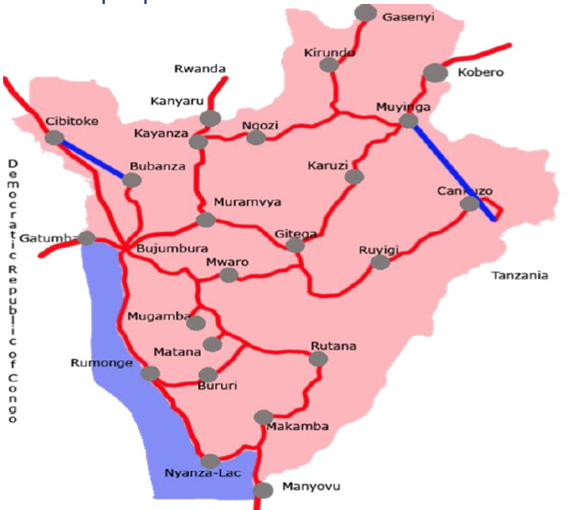
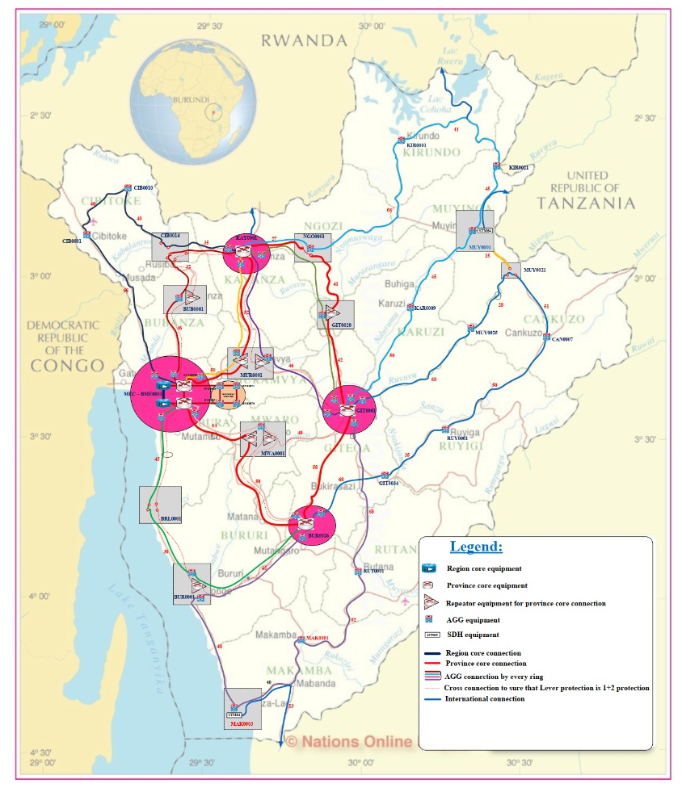
Broadband technologies: National Fiber Optic Networks
5
Operator | Network Length | Coverage
BBS | 1,750 km | 18/18 provinces
Viettel | 3,400 km | 18/18 provinces
MAN Onatel | 350 km | Bujumbura Municipality
Characteristics of National Fiber Optic Networks
BBS fiber optic network (2024) with 380 subscribers
BBS fiber optic network (2024) with 163 subscribers
Notes:
The Burundi Backbone System (BBS) and Viettel’s networks cover all 18 provinces with 1,750 km and 3,400 km of fiber, respectively, but last-mile connectivity is limited outside cities like Bujumbura and Gitega.
Currently, all 18 provinces of Burundi are covered by fiber optic networks. Three main networks have been deployed:
BBS National Network
Viettel National Network
Onatel Metropolitan Network (MAN)

Slide 6
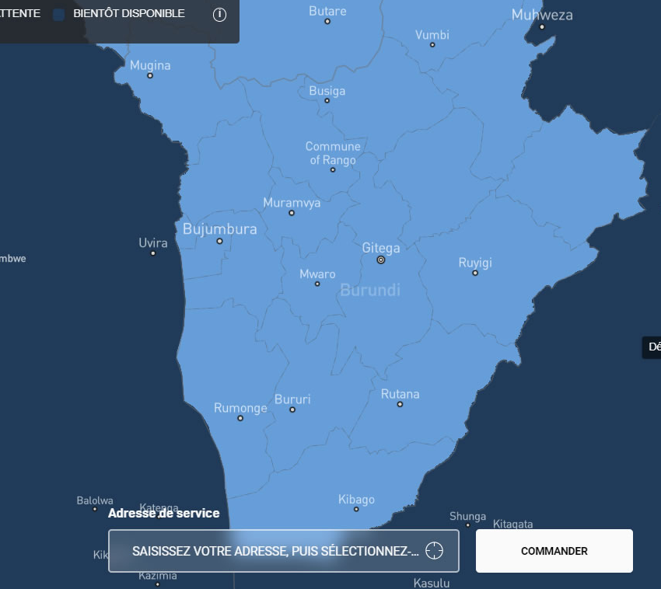
Broadband technologies: Satellite (Starlink)
Starlink’s satellite internet service became operational in Burundi on September 24, 2024, following regulatory approval ARCT in May 2024.
This means that, unlike mobile or fiber networks, Starlink’s availability map for Burundi effectively encompasses all 18 provinces, including urban centers like Bujumbura and Gitega, as well as remote rural areas.
Starlink already counts more than 1204 subscribers as of march 2025 highlighting the rapid adoption of the technology.
Its long-term viability depends on cost reductions and local partnerships to integrate it into the national broadband strategy.
By 2026, it could capture a significant share of rural and institutional users, reshaping Burundi’s connectivity landscape alongside fiber and mobile networks.
6
Burundi Starlink availability map
Notes:
As a satellite-based broadband technology, Starlink provides coverage across the entire country, regardless of terrestrial infrastructure limitations, as long as users have a clear view of the sky

Slide 7
Broadband technologies: ADSL, WiMAX
7
Chaîne de valeur de l’accès à Internet haut débit
Notes:
Les FAI déploient des réseaux d’accès hertziens : WiMax, Wifi et VSAT et utilisent la FO de BBS au cas par cas.

Slide 8






Strategies, infrastructure development, legal framework : ways
Strategy
Partnerships and Collaboration
Digital Government
Vision Burundi emerging Country in 2040 and developed country in 2060;
National ICT’s policy 2010-2025;
e-Commerce National Strategy
Etc..
We Collaborate with national regional and international organizations to leverage best practices, funding opportunities, and knowledge sharing..
Master plan for digitalization of publics services 2023-2033,
Internet access equity;
Digital sovereignty;
Cybersecurity and Data privacy ;
Etc..
Innovation Week;
Code week;
Girls in Tech
Etc…
ICT legal framework harmonization
Infrastructure Development
Talent Development
Policy and Regulation

Slide 9
The Regulatory Framework: Telecoms Services
9
The telecommunications and postal sector is a dynamic sector of production, sales, and distribution of services.
Without being exhaustive, here are some regulatory texts to ensure the management and control of activities in this sector (telecoms services):
Law No. 1/22 of August 22, 2024; Governing Electronic and Postal Communications in Burundi;
Decree № 100/97 of 2/10/2023 of 18 April 2014, establishing the operating conditions for the electronic communications sector in Burundi.
Decree №100/054 of 29 March 2024 amending Decree №100/186 of 16 October 2017 establishing the Universal ICT Service Fund.
No specific mapping systems in place
PICTURE

Slide 10



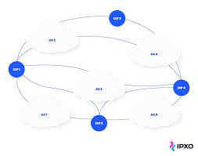

Broadband penetration and expansion
3 Telecoms operators 8,33 M Mobiles subscribers
11 ISP operators
3,28 M Internet Subscribers
(year 2024)
Internet and Mobile penetration rate (%)
+12M Habitants
64 % young
54% Women
01
10 ISPs
21%
Nationals Backbones optical fiber (BBS): 1750 Km
MAN : ONATEL: 350km
VIETTEL Fiber optic : 3400km
BERNET (14)
1 IXP
BDIXP
06
COMGOV (100)

Slide 11
Broadband penetration and expansion
11
Objectives for the Next 5 Years
Implementation of 3G,4G and 5G network: The PAFEN project, led by SETIC, and (funded by the World Bank) aim to enhance broadband access nationwide. These efforts indirectly support 5G by improving underlying infrastructure like towers and power supply. Following spectrum release, testing and infrastructure upgrade have been done by LUMITEL.
Direct private investments in 2025.
Rural connectivity: This program led by the Ministry of ICT through various project aims to deploy broadband connectivity across the entire country, including along major road axes, which span approximately of national roads.
Optimization, and redeployment of Unified Communication Infrastructure: COMGOV, BERNET,SCHOOL CONNECTIVITY, etc.
Public Wi-Fi Deployment in Burundi: Communities and Rural Centres by FSU.
PICTURE
Notes:
The government of Burundi, through the Ministry of ICT, ARCT, and the Universal Service Fund, plans several actions for the development of broadband, including:

Slide 12
Broadband penetration and expansion
12
Objectives for the Next 5 Years(2/2)
Extension of ONATEL's MAN Network In the different cities,
Last Mile Broadband Connectivity
Development of a Green Infrastructure Policy and Regulatory Guidelines: Establishing a regulatory framework for infrastructure sharing by the ARCT as part of the PAFEN project.
Development of a New Political and Broadband Strategy: For the broadband market and universal access, defining a reverse auction model to extend network coverage in underserved rural areas.
PICTURE

Slide 13
Broadband Mapping
13
Infrastructure and Coverage Data Included
Types of Data:
Fiber Optic Networks: Location and extent of existing fiber optic networks.
Telecommunication Towers: Locations of mobile antennas and their capacity.
Coverage Areas: Maps showing areas with broadband access (urban and rural).
Internet Connection Speed: through Drive Tests, network monitoring and evaluation.
Data Collection
Data Sources:
Telecommunication Operators: Collaboration with service providers to obtain data on existing infrastructure.
Field Surveys: Assessments conducted by teams on the ground to collect information on coverage and service quality (a study was conducted under PAFEN).
Online monitoring and control platforms within ARCT.
Integration with Other Sectors
Intersectoral Collaboration:
Collaborate with stakeholders: INSBU, other Ministries, operators and other ixisting initiaves
PICTURE

Slide 14
Broadband Mapping Systems
14
No specific broadband mapping systems; however, progress has been made with the establishment of a quality of services monitoring platforms.
The Annuaire Statistique du Burundi published by the Institut National de la Statistique du Burundi (INSBU) offers a detailed lens on the ICT sector.
Regular market benchmarks
Collaborations with Regional and International partners in harmonization of legal broadband framework and related data collection.
PICTURE
Notes:
The ARCT has recently launched a mobile and web platform to check in real-time the coverage and performance of mobile networks nationwide. This innovation will help us make informed decisions to improve network connectivity throughout the country!
This platform complements other tools aimed at monitoring the quality of service(2G, 3G, 4G) provided by telecom operators to their customers. :
Android App DQoSARCT: Available on the Play Store
Web: https://bi.dqos.cloud

Slide 15
Broadband coverage
15
Data Collection Responsibilities:
The collection of broadband coverage data is primarily carried out by the Communication Regulatory Authority (ARCT) in collaboration with Internet Service Providers (ISPs).
Methods of Data Collection
Public Surveys and Driver Test: Teams conduct field assessments and measurements to gather accurate information on coverage and service quality.
Technological Platforms: Real-Time Performance Monitoring system exist together with web based platform DQoS used to collect real-time data on network performance.
Operator Data: ISPs provide data on their infrastructure and coverage through regular reports.
Frequency of Data Collection and Updates: Data is collected quarterly based on reports from ISPs and results from field surveys. A Platform have been implemented for monthly data collection and evaluation .
Regular Data verification is performed by the ARCT to ensure accuracy and reliability.
PICTURE

Slide 16
Broadband coverage
16
Obligations of Operators and ISPs
Data Submission: ISPs are required to submit data on broadband coverage and Quality of Service (QoS) to the ARCT.
Penalties for Non-Compliance: strict penalties and sanctions exist for non-compliance such as fines and restrictions on licensing.
Data Validation by Independent Parties: Collected data are validated by stakeholders under ARCT’s coordination.
Data Publication: Broadband coverage data are published for public consultation, allowing citizens and stakeholders to access information on broadband availability.
PICTURE

Slide 17
17
Thank you !

