Slide 1
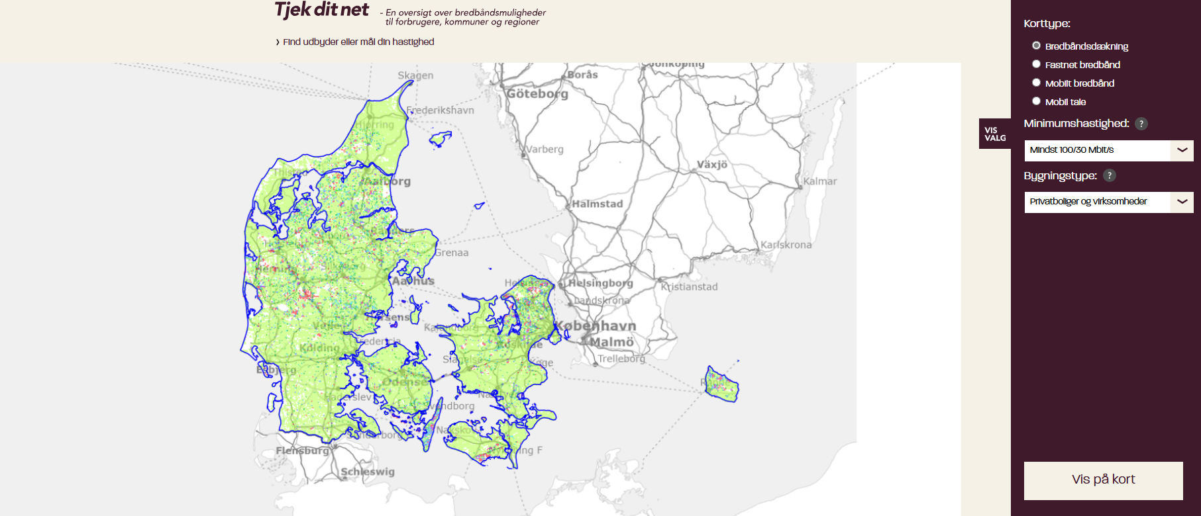
Broadband Mapping in Denmark
Notes:
##-AccessibilityAssistant: Skip layout check-##

Slide 2


Broadband mapping?
Where
What
Who
Notes:
Where:
Address-specific mapping for precise infrastructure assessment.
What:
Available technologies, including supported speeds and bit rates.
Connection Services (not physical infrastructure)
Who:
Classification of addresses by type (residential, commercial, vacation homes).
Homes Connected: Addresses with an active broadband connection.
Homes Passed: Addresses where network cables are in place but require final connection to the building within standard cost limits.
No distinction is made between connected and passed homes in reporting.

Slide 3


Broadband mapping in Denmark
Fixed Broadband
  Four primary technologies
Mobile Broadband
  Four operators operating across three networks
3
21. marts 2025
Digitaliseringsstyrelsen
Notes:
##-AccessibilityAssistant: Skip layout check-##

Slide 4
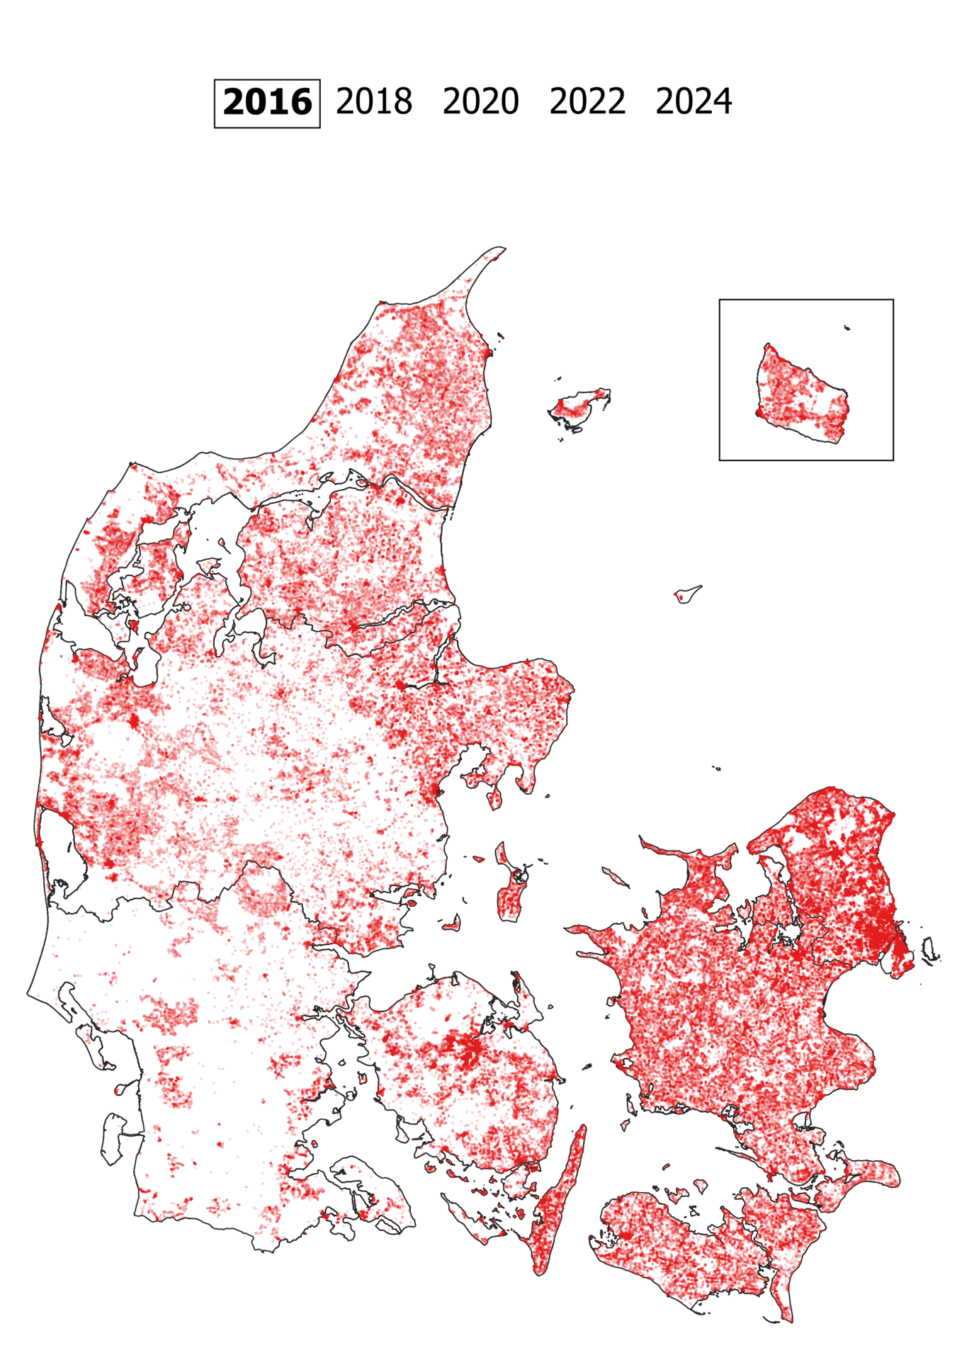
How is Broadband mapping used?
National connectivity goals systematically monitored
  Identification of coverage gaps.
  Political initiatives targeting areas with limited coverage
    Danish state aid program
  Consumer tool/website: Tjekditnet.dk
Notes:
##-AccessibilityAssistant: Skip layout check-##

Slide 5
The Danish broadband mapping
Forside | Tjekditnet
Notes:
##-AccessibilityAssistant: Skip layout check-##

Slide 6
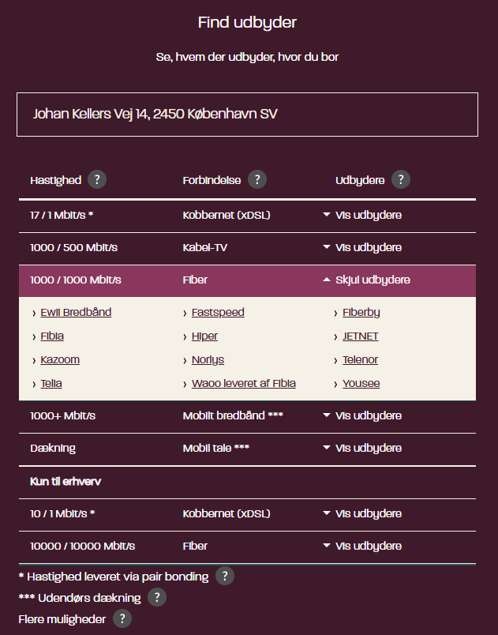
Presentation of broadband mapping results
Provider lookup
Notes:
##-AccessibilityAssistant: Skip layout check-##

Slide 7
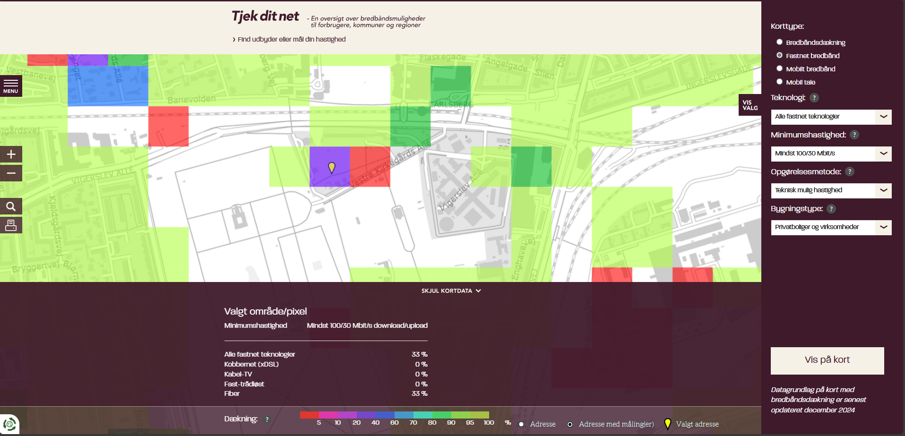
Presentation of broadband mapping results
Map function
  Fixed boardband
Notes:
##-AccessibilityAssistant: Skip layout check-##

Slide 8
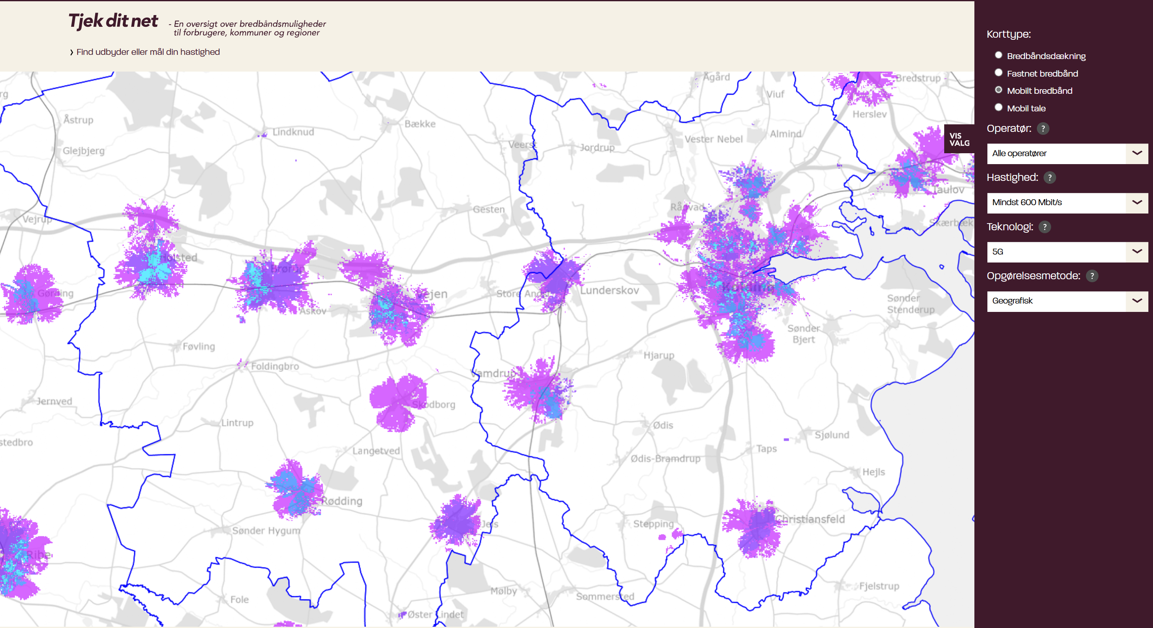
Presentation of broadband mapping results
Map function
  Mobile broadband (geographic coverage)
Notes:
##-AccessibilityAssistant: Skip layout check-##

Slide 9
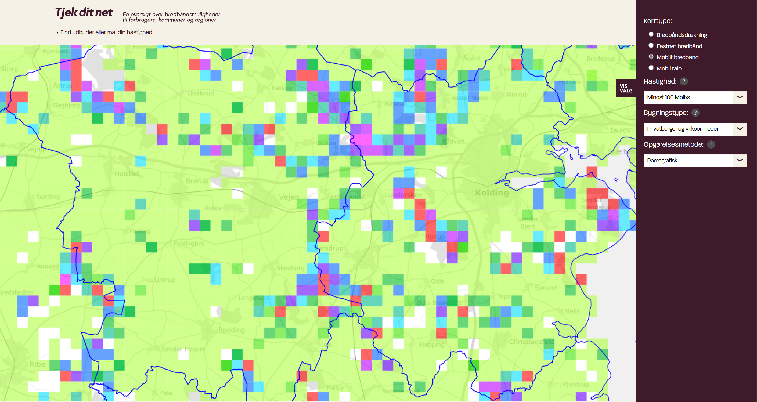
Presentation of broadband mapping results
Map function
  Mobile broadband (demographic coverage)
Notes:
##-AccessibilityAssistant: Skip layout check-##

Slide 10
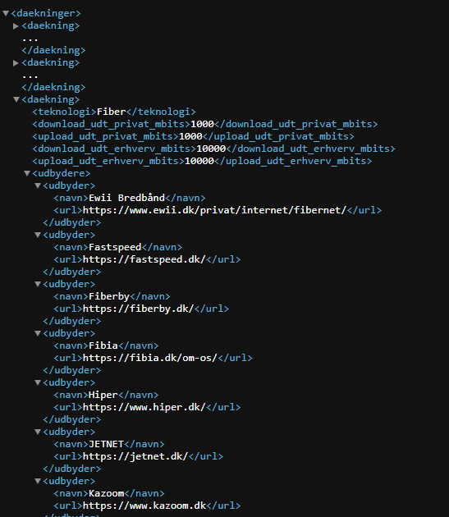
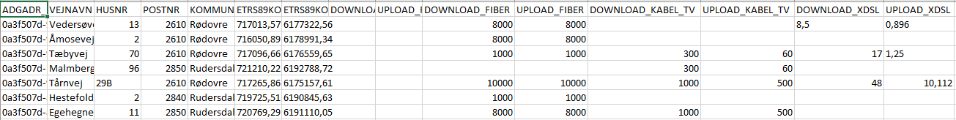
Presentation of broadband mapping results
Data download
  API
  Free and open coverage data as csv
Notes:
##-AccessibilityAssistant: Skip layout check-##

Slide 11
Data Acquisition
  National telecommunication legislation
  Commercially important
    Data is publicly available
    Data is used by operators to plan commercial rollout
  Win/Win situation
Notes:
##-AccessibilityAssistant: Skip layout check-##

Slide 12

Fixed broadband
Easily measurable
Physical transmission cables
Foundational Data Architecture – how to
Comprehensive data infrastructure framework
Danish implementation model:
  Authoritative centralized repository of:
    geocoded address identifiers
    buildings and residential/commercial units
Alternative data acquisition strategies:
  OpenStreetMap
  Electrical metering
Notes:
##-AccessibilityAssistant: Skip layout check-##

Slide 13

Mobile broadband
Main goal: comparable and accurate model
Developed by the operator
  No state-supervision
On-site measurement input
Danish implementation model:
  Authoritative centralized repository of:
    Surface model
    Terrain model
Alternative data acquisition strategies:
  OpenStreetMap
  Copernicus or Shuttle Radar Topography Mission
  Electrical metering
Notes:
##-AccessibilityAssistant: Skip layout check-##

Slide 14

Closing thoughts
Legislative frameworks
Establish incentives for operators to prioritize data delivery.
Common (data)framework
The key to success is achieved through active collaboration and dialog with the operators.
Notes:
##-AccessibilityAssistant: Skip layout check-##

Slide 15
Closing thoughts
Questions?
Notes:
##-AccessibilityAssistant: Skip layout check-##

