Slide 1
Africa-BB-Maps
Questionnaire Report / Template case study
26-27 March, Abidjan, Cote d'Ivoire

Slide 2
Africa-BB-Maps
Questionnaire Report

Slide 3
Introduction
There are two telecommunications operators with a unified license and one licensed Internet Service Provider (ISP).
Ethio Telecom : The incumbent operator has operated as a monopoly for over 130 years
in the telecommunications market.
Safaricom Ethiopia: A new entrant which has been operating in the country's telecommunications market for the past four years.
WebSprix: A newly licensed ISP previously operating as a Virtual ISP (VISP) using Ethio Telecom's network (This is the first of others to be licensed soon)

Slide 4
Introduction
As of the beginning of 2025
Mobile Subscribers for Ethio telecom 75.5 million, Safaricom 10 Million, Total 85.5 million
Mobile Broadband for Ethio telecom 43 million and Safaricom 6 million Mobile Internet users,
Total 49 million
Fixed Broadband subscribers < 1 million, Low penetration, the service is restricted mainly in urban areas
Fixed line subscribers (Voice service) 821,700
Fiber optic cable more than 45,000 km
Cell Tower: 13,000 mobile towers
Regulatory Landscape: Market liberalization and new licensing efforts. Incumbent Privatization not yet happened.
International Gateway Capacity:
Ethio Telecom: >1Tbps
Safaricom Ethiopia: 120 Gbps

Slide 5
Policy frameworks(I)
There is a National ICT Policy and a Broadband strategy, which are currently being revised and updated, as they are slightly outdated.
The Universal Access and Service regulatory Framework, includes a Universal Access and Service Framework (Policy)
The Universal Access Fund Regulation
A Universal Access Fund Five Years Strategic Plan
Universal Access and Service Fund Operating Manual

Slide 6
Policy frameworks(II)
Currently, there is an absence of a comprehensive broadband mapping strategy or policy,
No government initiatives are in place to address broadband mapping.
There are no collaborative partnerships engaged in this endeavor.
There is no integration of broadband mapping within national infrastructure
projects
Ethiopia is working to tackle broadband-related challenges through the Universal Access Fund.
The challenge is that the fund has not yet been implemented because operators have been given a three-year grace period at the commencement of liberalization with second operator entry, before they start to pay the levy

Slide 7
Some of the objectives of the Universal Access fund
Extend broadband infrastructure and services to rural and remote areas of the country that are currently lacking access.
Improve urban and rural connectivity by developing and enhancing the national fiber backbone to close the digital divide.
Encourage the use of ICT in sectors like health and education.
Promote digital inclusion and literacy.
Promote and support special projects, like community networks, that are in line with the goals of the Universal Access Fund.
Promote content development in local languages and innovation in ICT.
Empower women, elderly, and disadvantaged citizens to utilize ICT.

Slide 8
Broadband penetration and expansion
Ethiopia's telecommunications sector is evolving rapidly, especially after the
liberalization of the sector in 2019.
This has led to enhancing connectivity and service quality for citizens through new providers since 2021 and expanded mobile access.
Ethio telecom and Safaricom Ethiopia are providing 2G, 3G, 4G, and 5G services.
The goal for the next five years is to expand on the current 93% broadband coverage in 3G with a focus on expanding 4G coverage.
This expansion will target underserved areas, such as rural and remote areas.
Investment from the Universal Access Fund will prioritize these areas based on their viability in the telecommunications market.

Slide 9
Broadband penetration and expansion
Ethio telecom
The ET’s population and geographic coverage of 2G and 3G networks are almost similar, with 93% and 67% respectively.
The 4G population coverage is 35%
Ethio Telecom launched the 5G mobile network first as a pilot in Addis Ababa. Within a year, it was commercialized and is currently operating in more than 14 regional capital cities and other big cities.
Safaricom Ethiopia
The population coverage for 2G, 3G, and 4G will be almost 42% by early 2025 as all technologies operate on the same cell towers.
Its coverage is expanding according to the roll-out strategy accepted as its license commitment from commercial launch
Safaricom Ethiopia is in the process of launching 5G in Addis Ababa.

Slide 10
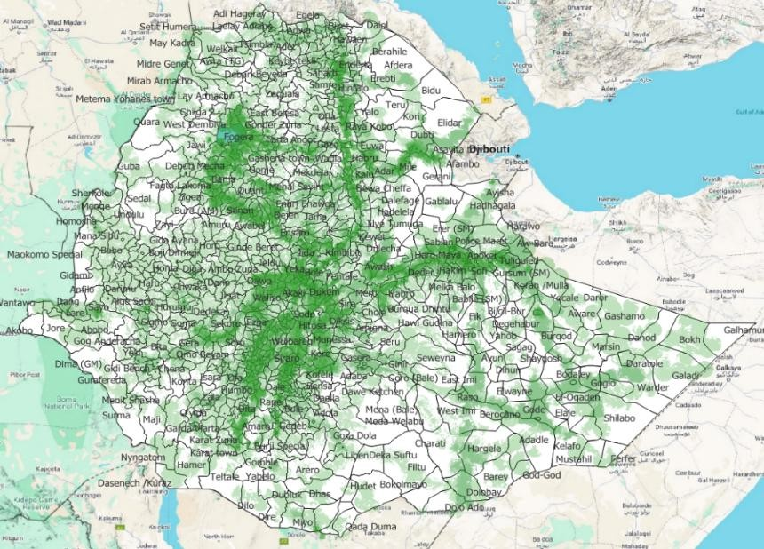
Broadband penetration and expansion
2G Geographic Coverage - 93% population coverage in mid 2024
The light green and bold green areas represent the 2G geographic coverage of Ethio telecom and Safaricom Ethiopia (including commitments to mid 2025), respectively.
The white areas show coverage gaps

Slide 11
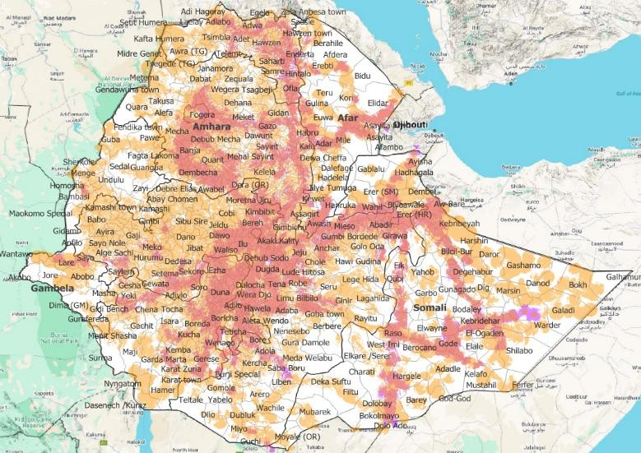
Broadband penetration and expansion
3G Geographic Coverage – 93% population coverage at mid 2024
The yellow and brown areas represent the 3G geographic coverage of Ethio Telecom and Safaricom Ethiopia (including commitments to mid 2025), respectively.
The white areas show coverage gaps

Slide 12
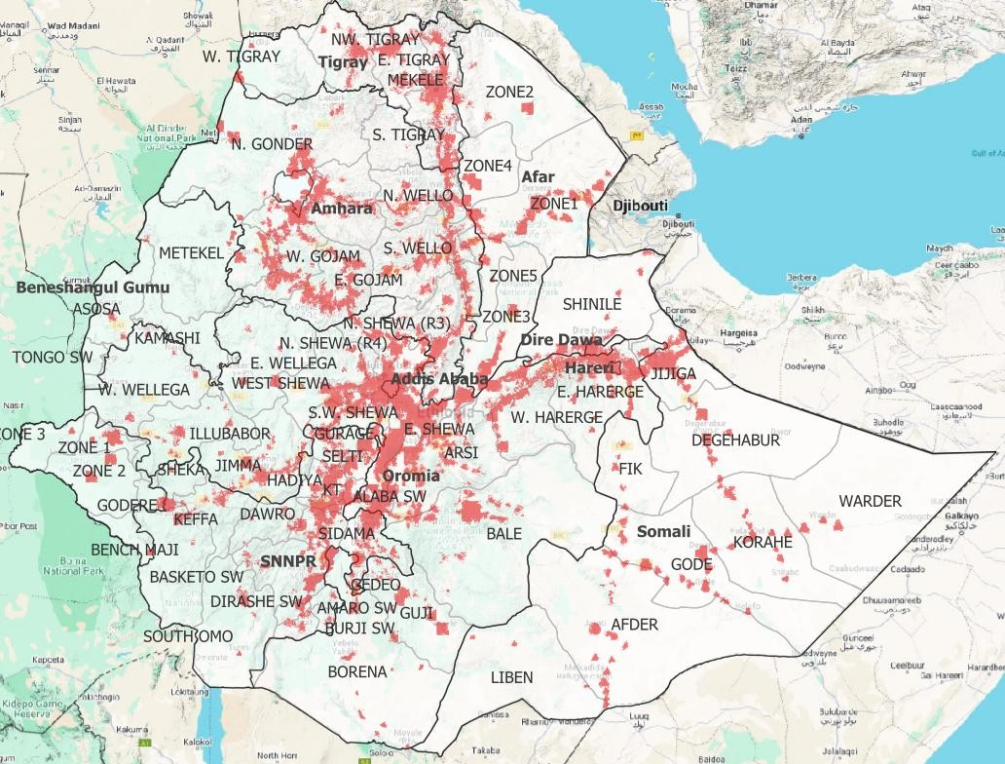
Broadband penetration and expansion
4G Geographic Coverage - 35% population coverage at mid 2024
The brown areas represent the 4G geographic coverage of Ethio Telecom and Safaricom Ethiopia.
Both operators have almost similar levels of geographic coverage,
covering around 35% in mid 2024, expanding as shown to 42% in early 2025 due to Safaricom commitments
The white areas indicate coverage gaps.

Slide 13
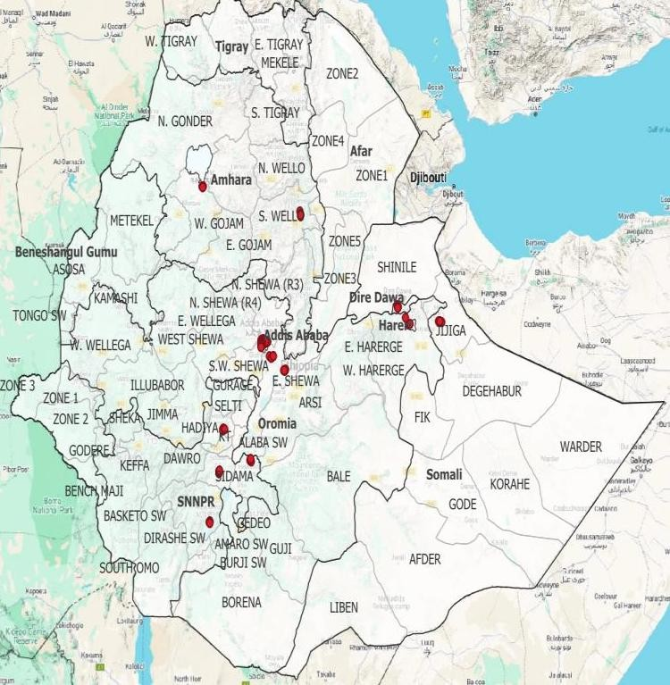
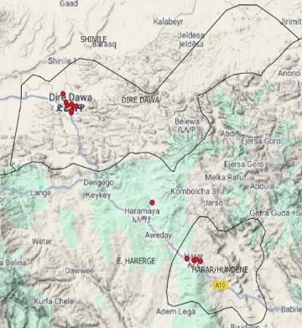
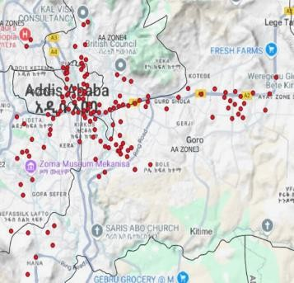
Ethiopia Telecom's 5G mobile network cell sites geographical locations

Slide 14
Broadband penetration and expansion
ET 5G Cell Towers Geographic location
The brown areas represent the geographical locations of Ethio Telecom's 5G cell towers.
There is no coverage map for 5G due to the limited number of sites deployed and their fragmented distribution throughout the country.

Slide 15
Broadband Mapping
The ECA is a newly established office that was founded just five years ago with the goal of regulating the communications sector, focusing on telecommunications and postal services.
Currently, ECA has not conducted any ICT infrastructure mapping activities solely
for internal use.
Under our universal access program, we receive the broadband data from operators. We completed the first gap assessment in 2021 and the second assessment is currently in progress, with an expected completion date of June 2025.

Slide 16
Broadband Mapping Systems(I)
Currently, we do not possess a Broadband Mapping System. However, we collect data from operators to create internal broadband maps. These maps are intended solely for internal use and occasionally serve as references for other responsible personnel.
The maps can be tailored to specific underserved areas or provide comprehensive coverage of the entire country.
They are managed by the Regulator (ECA).

Slide 17
Broadband Mapping Systems(II)
Opportunity:
The Ethiopian Communications Authority sees the African-Broadband Map initiatives as a great opportunity to start developing the Broadband map system in an organized and structured manner to manage the broadband maps and solve the current Broadband Map management problem.
This will also help solve connectivity gaps in the country, enhance investment, and bring economic opportunities.

Slide 18
Broadband Mapping Systems(III)
Challenges
At present, there is no system in place to store the data collected from operators.
Whenever updated network data is required, we must communicate with or request information from the operators directly.
Data collection demands considerable time and effort; however, if a system could be established that allows for automatic integration with operators’ systems to continuously update their data when available, it would significantly enhance efficiency.
Additionally, a lack of skilled manpower remains a challenge in this endeavor.
Finance is another challenge for the development of such a system.

Slide 19
Broadband coverage(I)
The ECA collects broadband data from operators in digital format.
The ECA has collected broadband data twice so far - first during the gap assessment in 2021 and again in October 2024 during the second gap assessment, which is currently being finalized.
As we did not have an Internet Service Provider (ISP) before, we have not yet started gathering data from them.
However, we have recently granted an ISP license, as the first of many to come, and will begin collecting broadband data and monitoring quality of service (QoS) in the future, or create a system for obtaining broadband data from them.

Slide 20
Broadband coverage(II)
Reports on QoS are submitted by each operator every quarter, and a specific coverage target report is provided by the new entrant each year.
Broadband data is currently not available for public access or consultation, but it can be used for various purposes as a reference upon request from different entities.
The data collected has not been verified by a third party yet.

Slide 21
To make the project successful, important issues are:
Create ownership and responsibility
Promote cooperation and integration among beneficiary countries
Mobilize the necessary resources for the project
Develop the skills and capacity of the project beneficiary countries.

Slide 22
Q&As

