Slide 1
Future Networks and Spectrum Management
Sebastien Peytrignet, Project Officer
Notes:
Introduce yourself

Slide 3
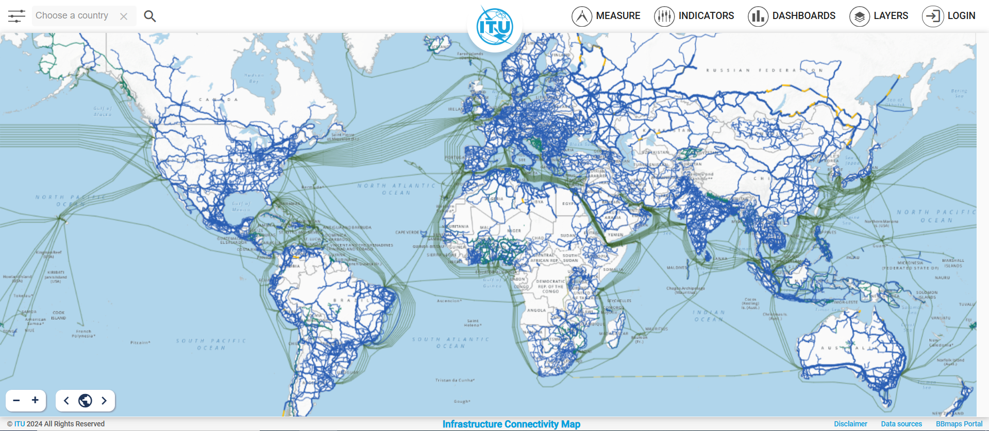
ITU Broadband Maps
Infrastructure Mapping
https://bbmaps.itu.int/bbmaps/

Slide 4
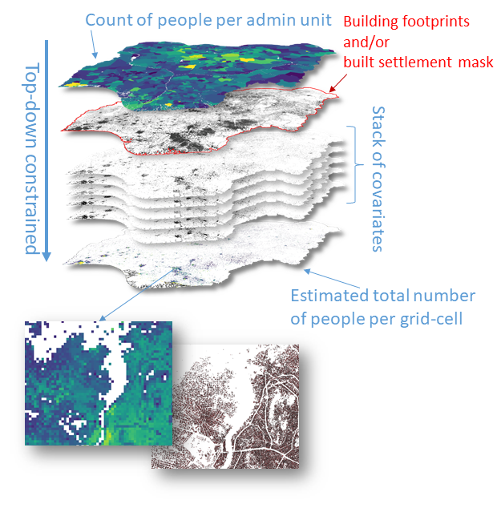
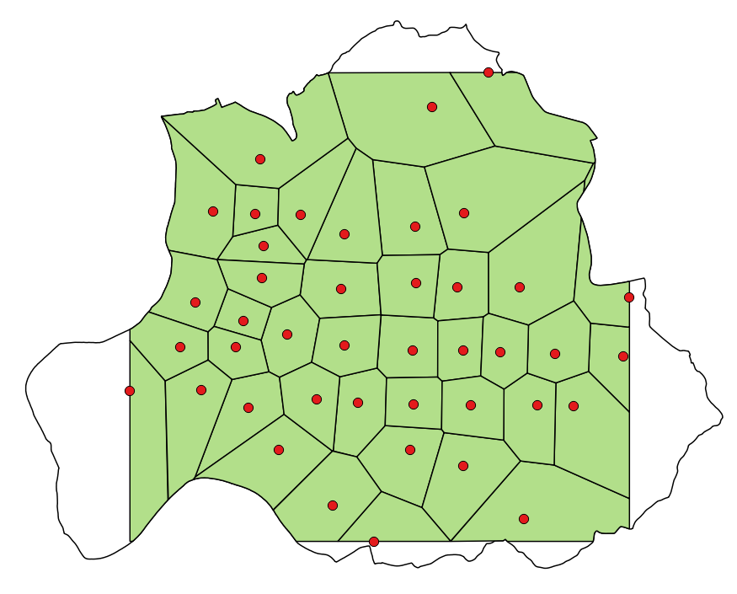
Connectivity demand estimation
Infrastructure Analysis
We estimate the throughput demand in Mbps associated with specific locations (e.g. a school or residential building).
First, we draw a circle around each location – which roughly represents the catchment area for this school.
Then, we estimate how many people live in this catchment area using highly granular population data.
Once we know the number of potential users, we estimate the total throughput.
Source: WorldPop

Slide 5
Infrastructure Analysis
Technologies
Fiber
Cellular
Point-to-point microwave
Satellite
Wired
Wireless

Slide 6
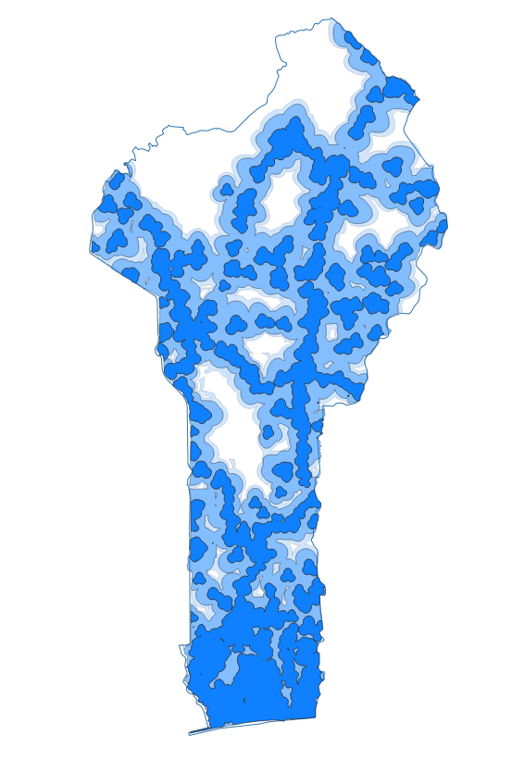
Cellular: mobile coverage analysis
Infrastructure Analysis
Either the existing coverage areas or the modelled coverage areas are used to assess the feasibility of different types of cellular connectivity available at the schools. This approach clarifies which options are the most practical and accessible within each school’s vicinity.
4G coverage area strength, dBm
Strong
Average
Weak
Notes:
GITHUB

Slide 7
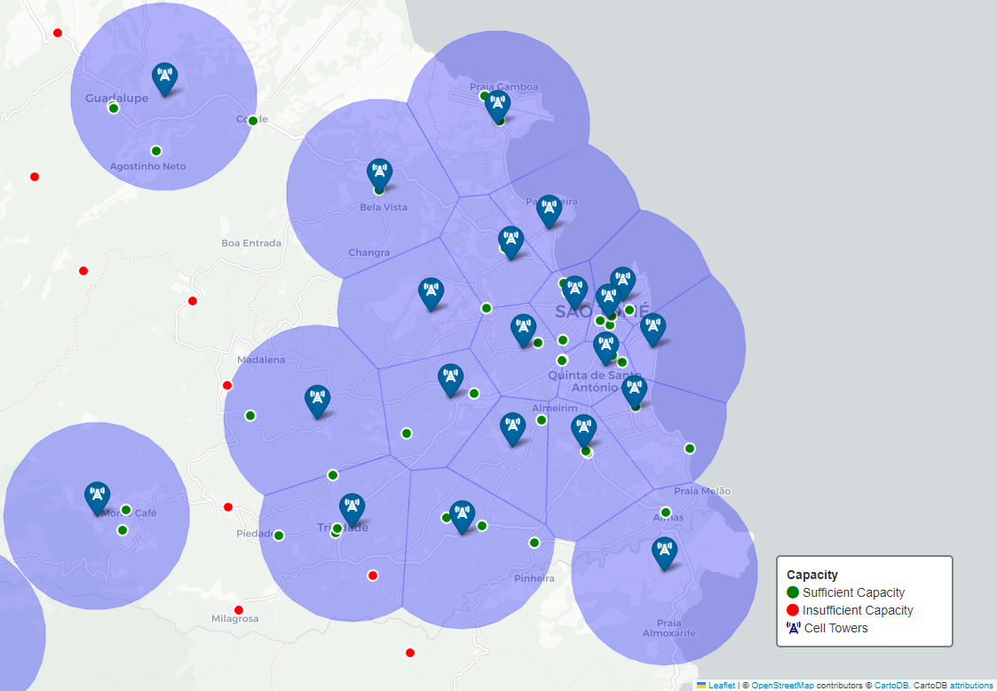
Cellular: mobile capacity analysis
Infrastructure Analysis
We estimate the available capacity in a cellular service area
And assess its adequacy for connecting a point of interest to the internet.
This is achieved by comparing the available capacity against the specific internet requirements of the location
Notes:
https://github.com/FNS-Division/mobile-network-capacity-checker

Slide 8
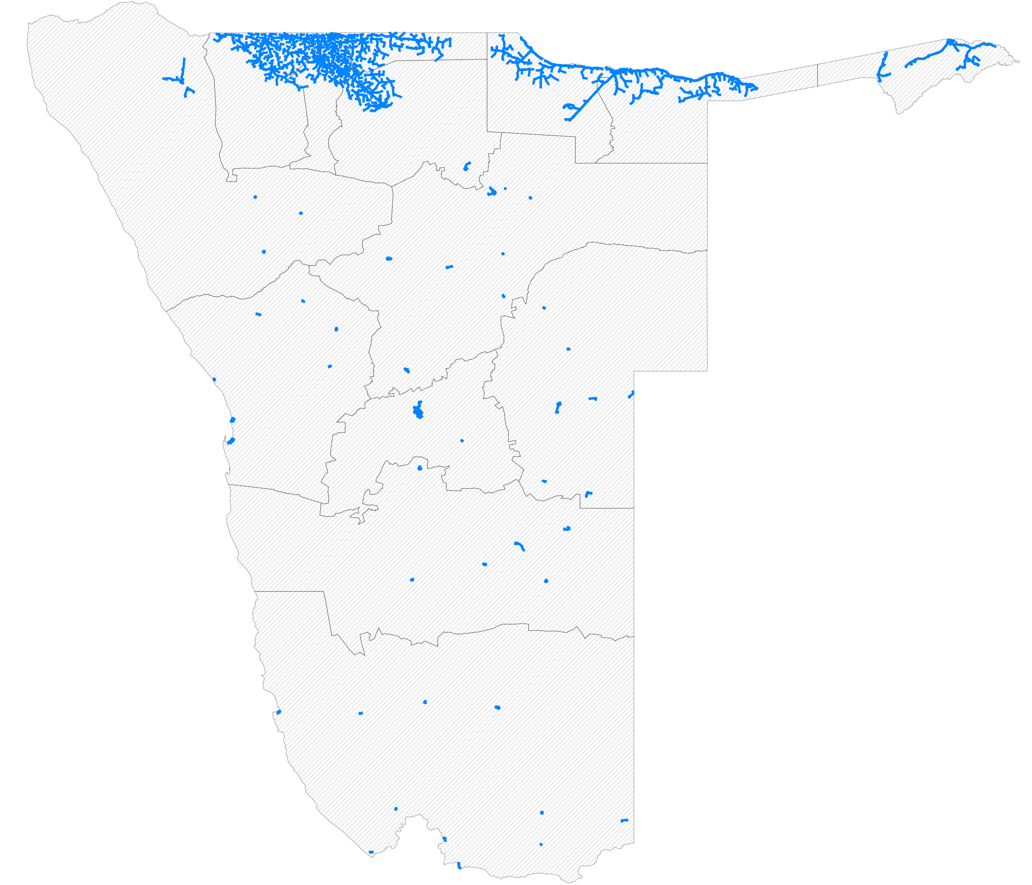
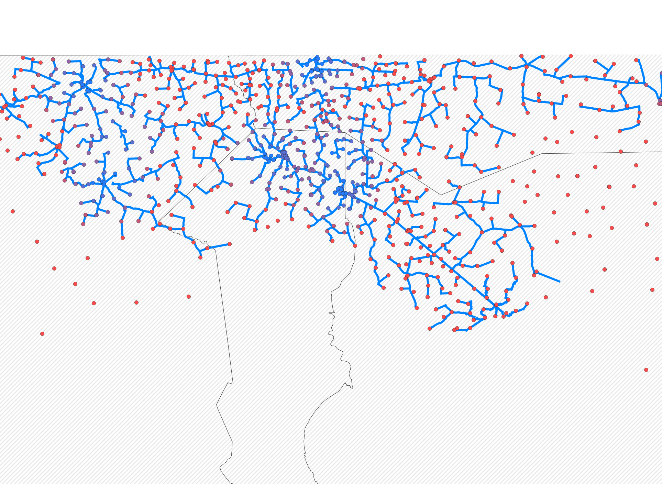
Fiber: fiber path analysis
Infrastructure Analysis
Our second tool predicts the optimal fiber path, to connect points of interest to the fiber network.
This tool finds a fiber path that connects all points of interest with the shortest fiber path possible – thus minimizing costs.
The fiber lines are laid along the existing road network.
Once a point of interest is connected, it can extend the fiber path to other places.
Schematic fiber lines
Notes:
GITHUB

Slide 9
Point-to-point microwave: visibility analysis
Infrastructure Analysis
One option for connecting locations to the internet is through point-to-point radio links.
However, establishing these links may be unfeasible when obstacles obstruct the radio wave propagation path or when signal attenuation occurs due to power loss over distance.
To determine the feasibility of establishing a link, visibility analysis must be conducted.
Notes:
GITHUB

Slide 10
Cost calculations
Financial Planning
For each school
1. Assess feasibility of technologies
2. Select the best technology
3. Report deployment cost
Based on costs or other criteria related to quality or regulations
Notes:
Among feasible options, we select a technology based on internal criteria – usually the lowest cost option.
We then report the cost of deploying that technology
"Our next tool – which we call the cost model - assesses the best connectivity options for each point of interest."
"How does it work?"
"For every point of interest we want to connecs, this tool evaluates the feasibility of various technologies. Let’s go through the options."
Fiber: "If the location is close enough to an existing fiber node, fiber becomes a candidate. It typically provides reliable, high-speed connectivity, but only if it's within reach."
Cellular: "We check if there’s 4G or 5G coverage in the area. If so, cellular becomes a feasible option, for places already within range of the mobile network."
Point-to-Point Microwave: "Here, line-of-sight is crucial. We assess whether the location is visible from a cell tower, because microwave links require a clear path to work effectively."
Satellite: "Finally, satellite remains an option – typically, for remote or hard-to-reach areas."
"So, how do we choose?"
"Among the feasible options, our tool applies internal criteria to select the most suitable technology—this is typically the lowest-cost option. But there might be other criteria apart from cost, related to regulations, and our tool takes this into account. This allows us to deploy connectivity solutions that are both practical and cost-effective."
"The final step?"
"We calculate and report the deployment cost for the selected technology, giving a clear picture of how much money would be needed to connect each location."
"In short…"
"This tool helps us make data-driven decisions about which technology to deploy for each site."

Slide 11
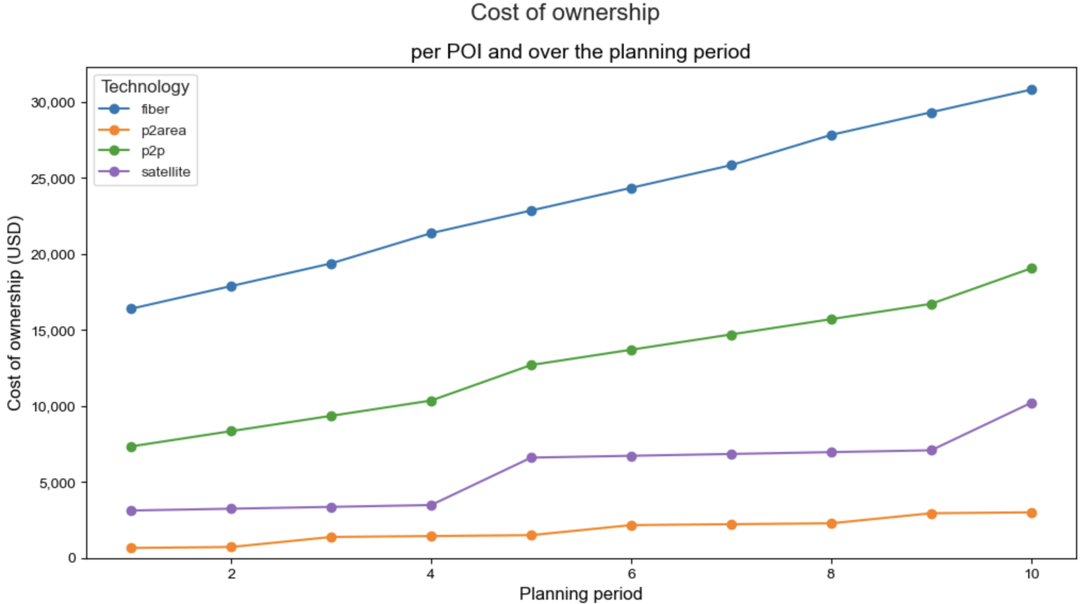
Cost calculations
Financial Planning
Capital Expenditure (CAPEX)
On-premises hardware setup costs (materials, labor)
Fiber optical cable line
Operational Expenditure (OPEX)
Annual hardware maintenance and replacement costs
Annual license costs
Access links, backhaul links and retransmission towers
Notes:
"I can dive a bit deeper into our cost model."
"The total cost of connecting a location, such as a school, can be broken down into two main categories: Capital Expenditure (CAPEX) and Operational Expenditure (OPEX)."
"First, let's talk about CAPEX."
"Capital Expenditure covers all one-time, up-front costs. These are the initial investments we make. For example, it includes the cost of installing a receiver, laying the fiber line, or purchasing any specialized equipment. In the case of point-to-point microwave links, we may even need to build retransmission towers to ensure the signal reaches its destination."
"These CAPEX costs are typically one-off, but we also need to account for potential equipment replacement every few years, for example every 3 to 4 years."
"Next, we have OPEX."
"Operational Expenditure includes the ongoing costs to keep the connection running year after year. These costs kick in after the first year and cover things like hardware maintenance, service fees, and even annual licensing fees for bandwidth. The OPEX ensures that the connection remains operational over time."
"So, to calculate the total cost for the planning period, we add up both CAPEX and OPEX."
"In the chart to the right, you can see an example of total costs for different technologies over time for a single point of interest. On the Y-axis, we have the total cost in US dollars, and on the X-axis, the planning period in years. You’ll notice that some technologies are cheaper than others in this particular country. Here, for instance, fiber is the most expensive option. And you can see that costs accumulate over time, which is especially visible for high OPEX technologies."

Slide 12
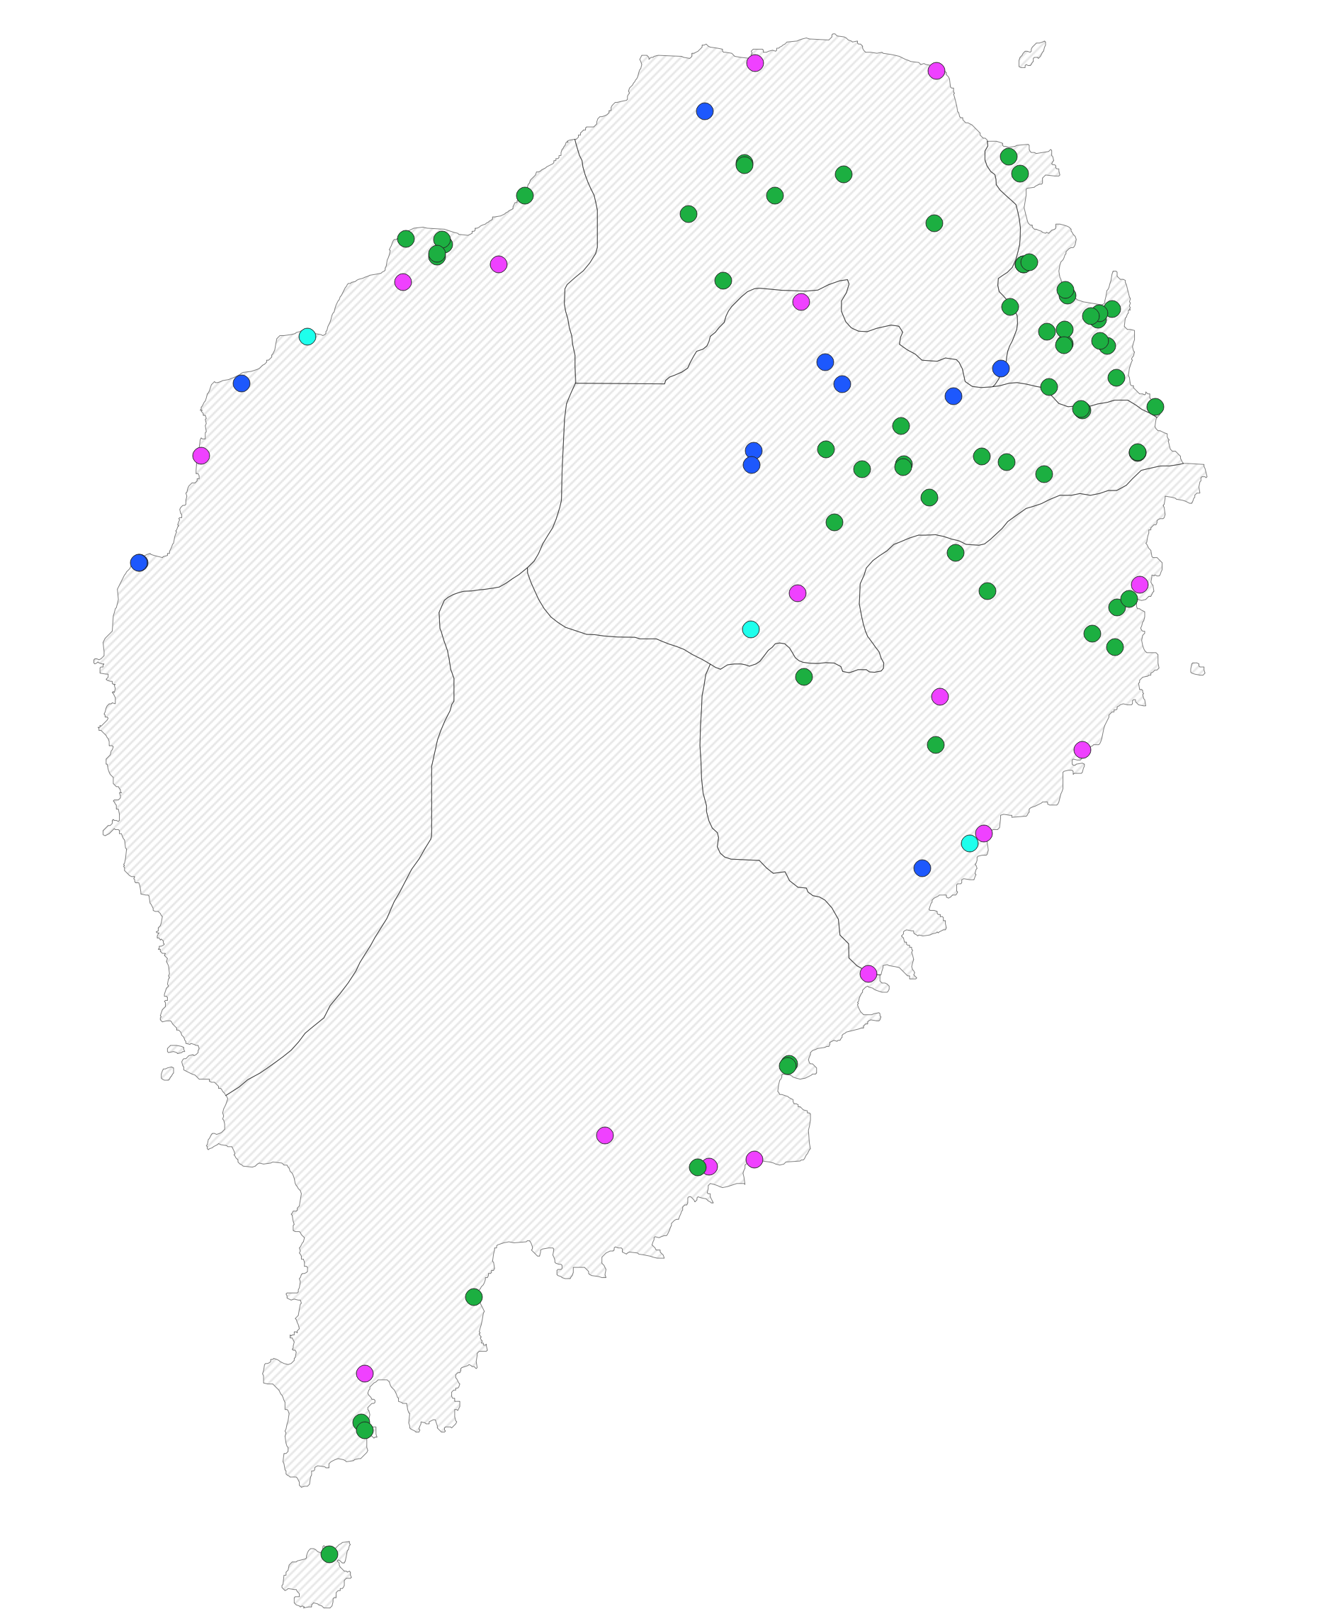
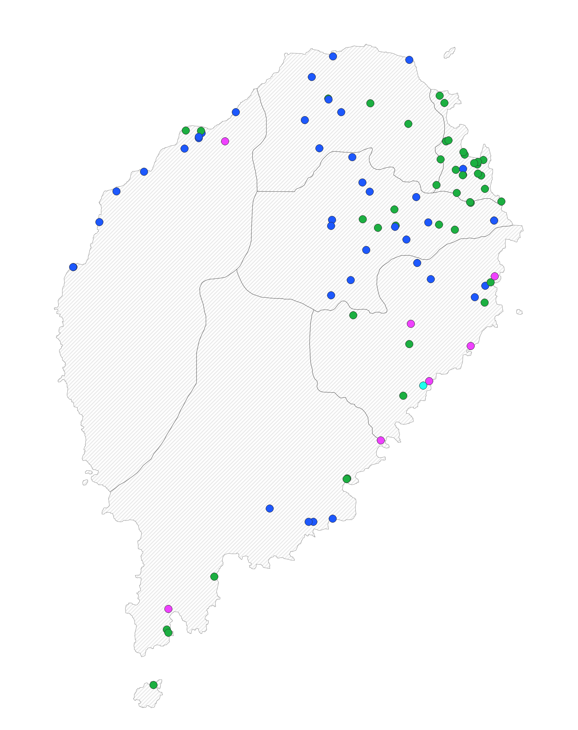
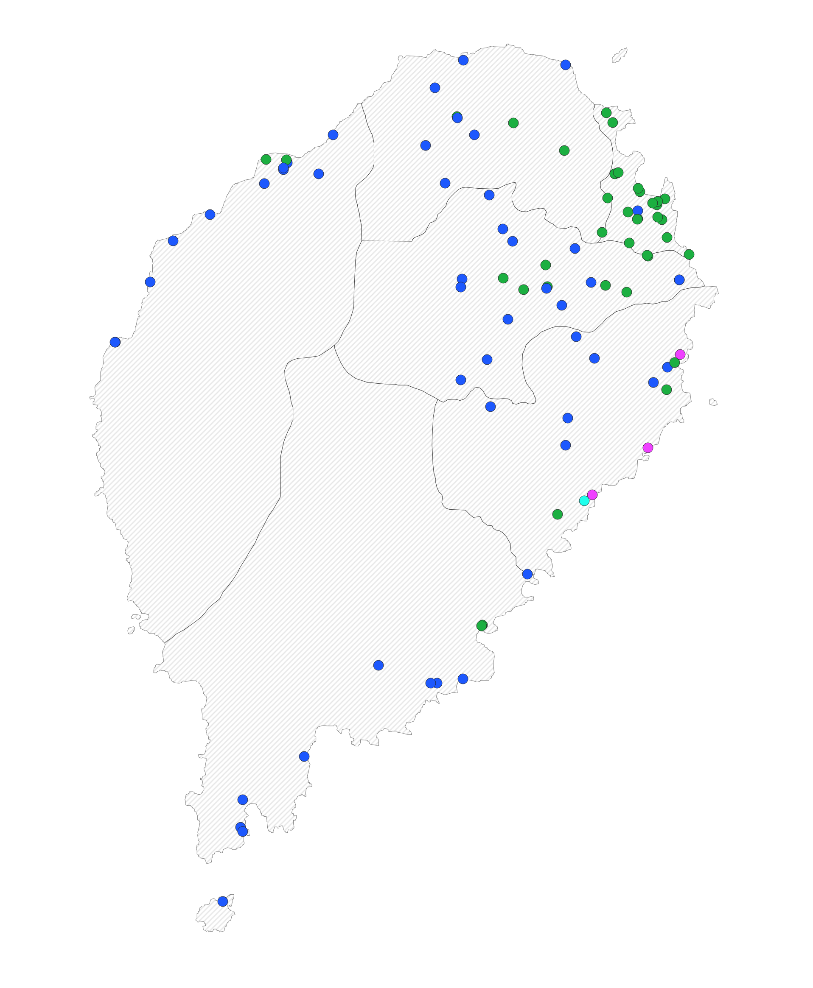
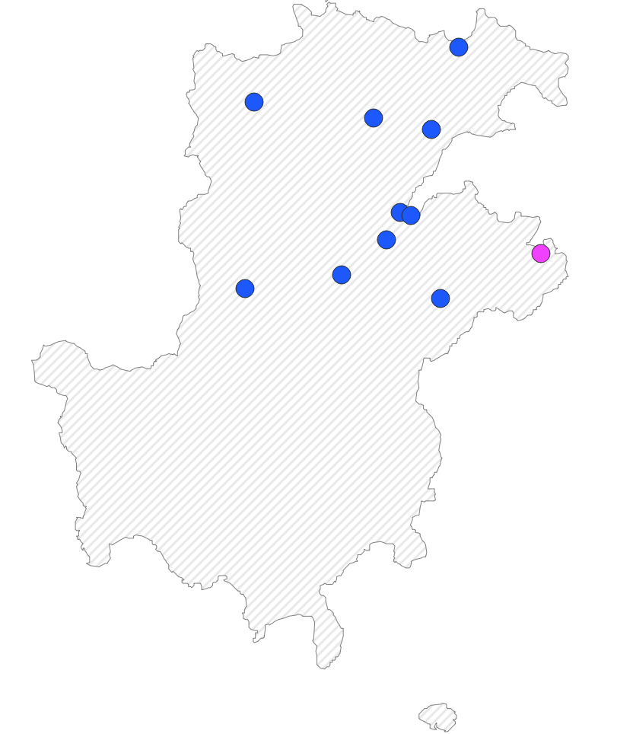
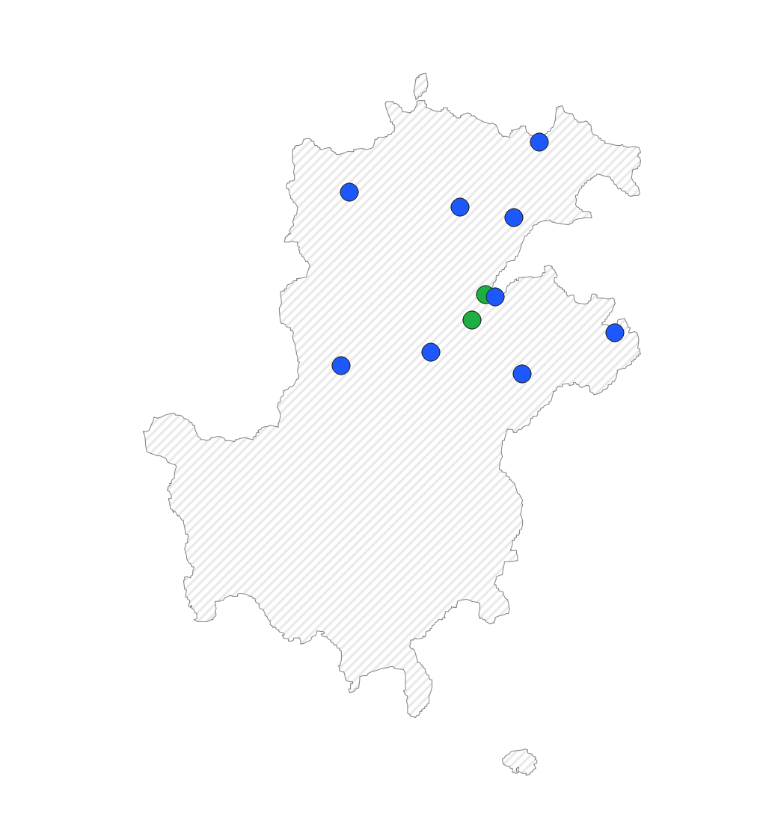
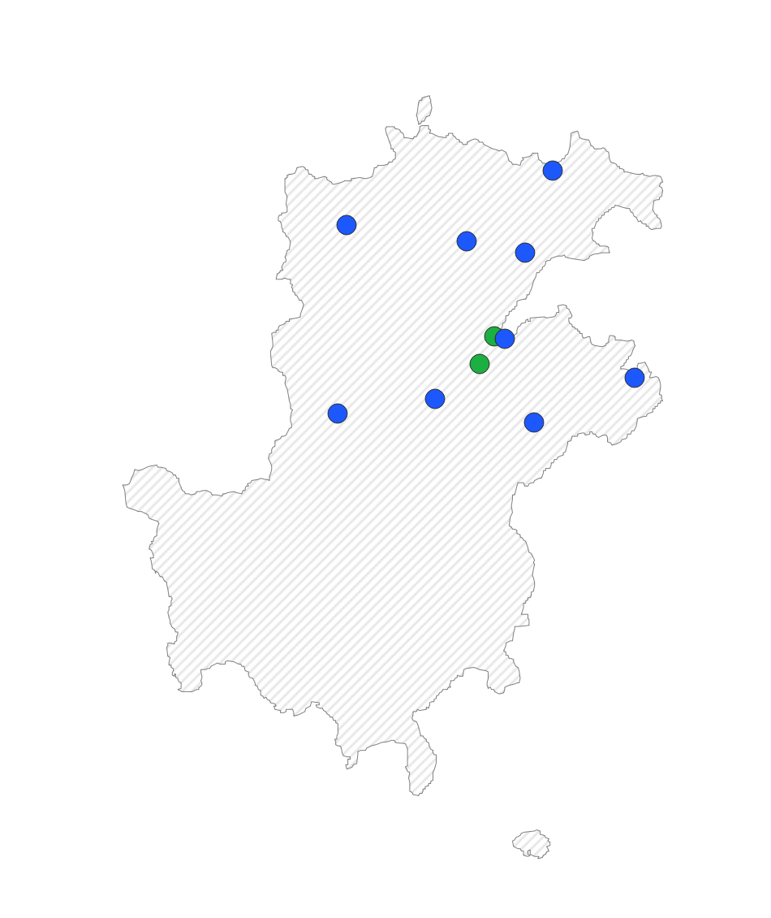
Connectivity scenarios
Financial Planning
Technologies
Fiber
Cellular
P2P
Satellite
Maximum length of fiber allowed
3 km
5 km
10 km
Notes:
Finally, all the tools in this toolkit allow us to run various connectivity scenarios.
A scenario refers to a specific combination of settings and parameters that we choose across different modules, such as fiber path modeling and cost analysis.
For example, in the case of this country, we were asked to demonstrate how the technology assignment would change when we adjusted the maximum fiber length allowed per point of interest.
If a fiber line can only be 1 km long, then only sites that are very close to a fiber node can be connected. However, if we are allowed to extend the fiber line to 10 km, we'll see a much larger number of sites connected with fiber.
In this particular case, the analysis shows that by allowing longer fiber lines, we can connect more points of interest to the network. As you can see, when the maximum distance parameter increases from 3 to 5 to 10 km, the number and proportion of blue dots, representing points of interest connected with fiber, increases accordingly.
So, running connectivity scenarios is like doing sensitivity analysis, which is valuable for the end user because it enables them to test assumptions and evaluate the robustness of the results.

