Slide 1
The ITU Academy
Training to develop the capacity of ICT policy-makers and professionals across the globe

Slide 2
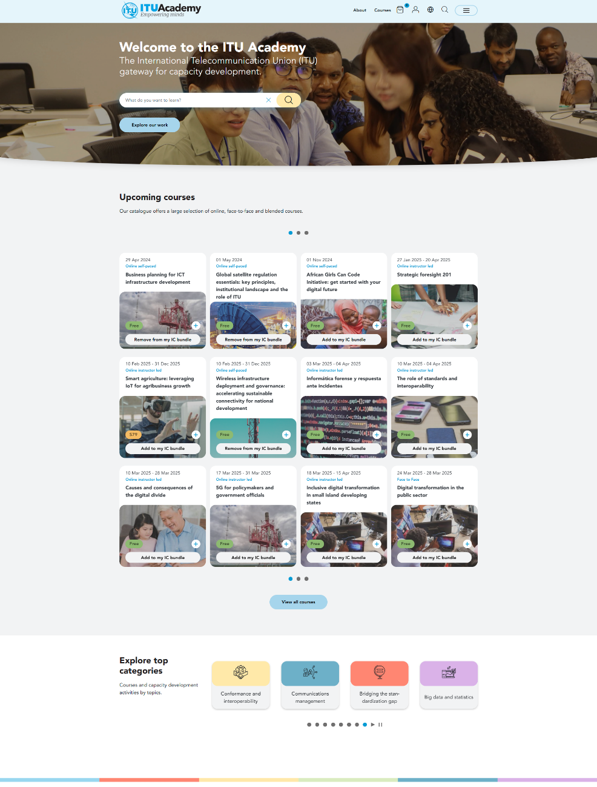
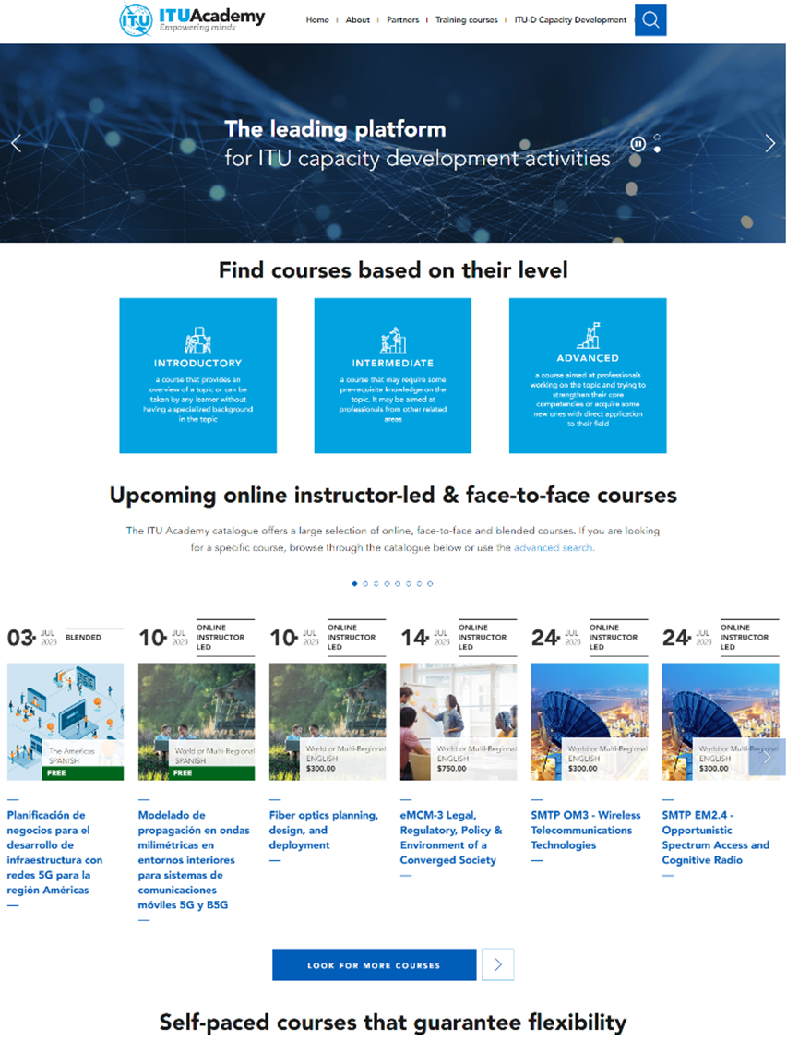
The ITU Academy is the main online gateway to the capacity development activities of the ITU, the United Nations agency for digital technologies. It brings together under one umbrella a wide range of training activities and knowledge resources in the field of information and communication technologies (ICTs) and digital development.

Slide 3
Comprehensive learning experience
Accessible anytime, anywhere
Career-oriented
Affordable
ITU-certified courses tailored to equip users with in-demand skills for today’s fast-evolving digital world.
Our courses are mostly free or competitively priced, without compromising on quality.
Users can learn at their own pace from any device connected to the Internet.
academy.itu.int

Slide 4
Top-quality learning
Premium content
Multi-language
Collaborative learning environment
Learning materials developed by industry experts to ensure users receive a quality educational experience.
Selected learning content available in several of the UN official languages.
Users can connect and network with industry professionals through group projects and community forums.
academy.itu.int
Notes:
Expert courses

Slide 5
A growing community
65’000+ users from the entire digital sector:
Policymakers, regulators, government officials
ICT professionals
Professionals from academia and civil society
+70% of participants are from developing countries
academy.itu.int

Slide 6
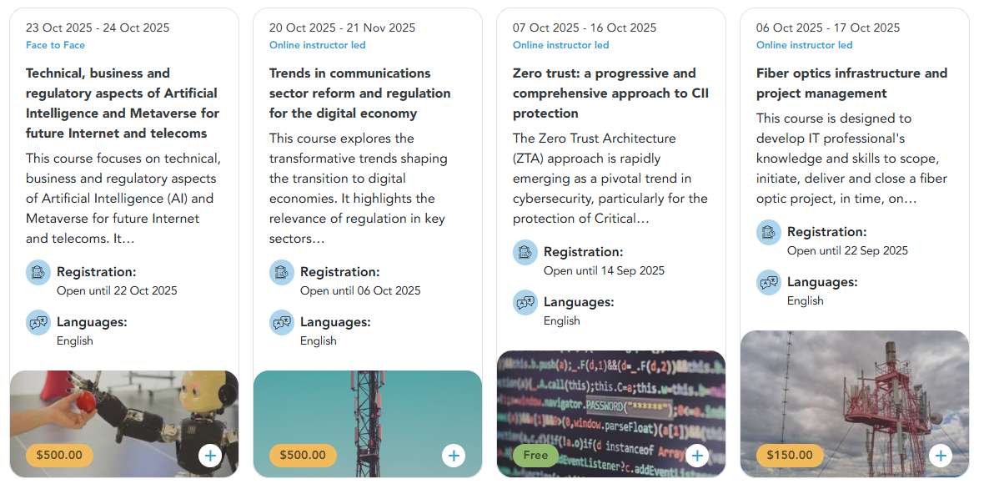
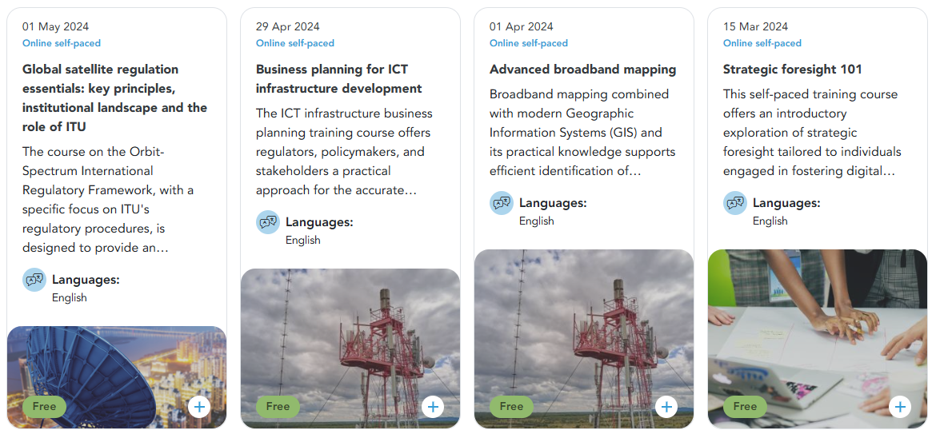
Upcoming online instructor-led & face-to-face courses
Multiple learning modality to fit all needs
Self-paced courses that guarantee flexibility
Intermediate and advanced training courses with global experts
Introductory training courses on foundational and emerging topics in the ICT field
academy.itu.int

Slide 7
Our partners
and more…
academy.itu.int

Slide 8
ITU Academy Training Centres
Worldwide network of internationally-recognized institutions offering high-quality training to ICT professionals across the globe, with a focus on the needs of developing countries
14 centres worldwide
6 priority areas
Policy and regulation
Network infrastructure
Spectrum management
Cybersecurity
Digital inclusion
Digital services
academy.itu.int

Slide 9
Our training catalogue

Slide 10
Wide-ranging training catalogue
Over 130 courses delivered annually by ITU and its partners on various topics, including:
academy.itu.int

Slide 11
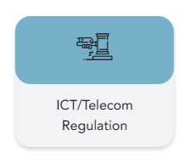
Policy & regulation training content
Online self-paced courses:
Introduction to spectrum management
Introduction to quality of service
Introduction to digital regulation
Introduction to universal service financing
Introduction to broadband mapping
Global satellite regulation essentials: key principles, institutional landscape and the role of ITU
Selected examples

Slide 12
Policy & regulation training content
Instructor-led courses, delivered by ITU:
Digital transformation regulation
Business planning for ICT infrastructure development
Instructor-led courses, delivered by ITU Academy Training Centres:
Disruptive technologies and governance in the digital era
e-Governance legal framework
ICT policy planning for good governance
Trends in communications sector reform and regulation for the digital economy
Governance of artificial intelligence
Public Policy Analysis for Digital Transformation
Economics of innovation applied to the digital sector
Selected examples

Slide 13
Our quality standards

Slide 14
Our tried and tested standardized process to ensure training quality
2
4
6
Pre-training assessment
Course evaluation
Post-training impact evaluation
Before the course
During the course
After the course
1
3
5
Quality check of content by ITU expert and of instructional design by ITU Academy team
Formative and summative assessments
Certification
academy.itu.int

