Slide 1
Africa-BB-Maps
Questionnaire Report / Kenya case study
26-27 March, Abidjan, Cote d'Ivoire

Slide 2
Introduction
Kenya Broadband Infrastructure Overview
Kenya, located in East Africa, spans approximately 580,367 square kilometers and is home to around 54 million people. Nairobi serves as its capital and economic center, while Mombasa is the primary port city. The nation boasts diverse landscapes, including the Great Rift Valley, savannahs, and coastal areas. This presentation provides an overview of Kenya’s broadband infrastructure, covering technologies, policies, mapping initiatives, and future expansion strategies.
PICTURE

Slide 3
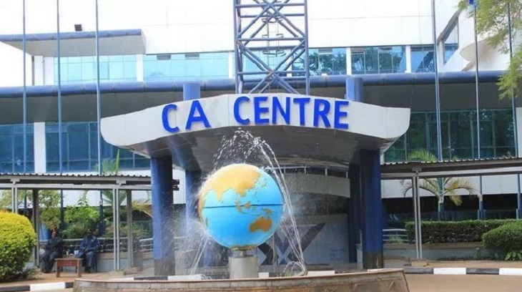
Policy Frameworks
Kenya's broadband development is guided by the National Broadband Strategy (NBS), with the Communications Authority of Kenya (CA) regulating the telecommunications sector. Policies prioritize affordable internet access, digital inclusion, and effective spectrum management.
National Broadband Strategy
2018-2023
Communications Authority of Kenya
Guides broadband development.
Regulates the telecommunications sector.
Digital Inclusion
Focus on affordable internet access.
The government offers incentives, including tax reliefs and funding support, to encourage broadband expansion in underserved regions.

Slide 4
Broadband Penetration and Expansion
Kenya aims to increase broadband penetration from approximately 44% to 80% by 2030. Expansion strategies focus on enhancing connectivity in rural and underserved areas.
97%
Current Penetration
Approximate broadband penetration rate.
100%
Target by 2030
Aims to increase penetration rate.
Government initiatives like the Universal Service Fund (USF) and public-private partnerships (PPP) are crucial for achieving national broadband goals.

Slide 5
Broadband Penetration and Expansion Cont….
Kenya is actively investing in broadband infrastructure to enhance digital connectivity. Submarine cable projects improve international connectivity, while tax incentives and funding programs encourage broadband expansion in underserved areas. Collaboration between the government, private sector, and development partners is key to advancing broadband access.
Submarine Cables namely:
TEAMS, Essy, Z Africa, PEACE,DARE,LIONZ & SEACOM
Enhance international connectivity.
Tax Incentives
Encourage expansion in underserved areas.
Collaboration
Government, private sector, and development partners.

Slide 6
Broadband Mapping Systems Cont…
Kenya employs comprehensive broadband mapping initiatives to track infrastructure and coverage, using data from various sources. This data is integrated with with existing population data, road infrastructure as well as schools and hospitals
Maps are used to determine future projects aimed at reaching the unserved and underserved communities
Data Collection
Data Integration
Regulatory Reporting from ISPs.
Infrastructure and coverage data.
Field Surveys by government agencies.
Locations of key infrastructure.
Geospatial Technologies for mapping.
Classification of underserved areas.
These efforts are aided by partnerships with global organizations such as the World Bank, ITU, and Smart Africa Alliance.

Slide 7
Broadband Mapping Systems Cont…
CA manages a Geoportal system together with a GIS system which is used to map and determine broadband coverage among other ICT infrastructure including Broadcasting and Postal Data.
Some of the Challenges include:
1)Capacity_ Few GIS experts in the Authority
2) System Access_ The system has few licenses which limit access to more staff
3) Lack of a dedicated GIS department to map and manage data
PICTURE

Slide 8
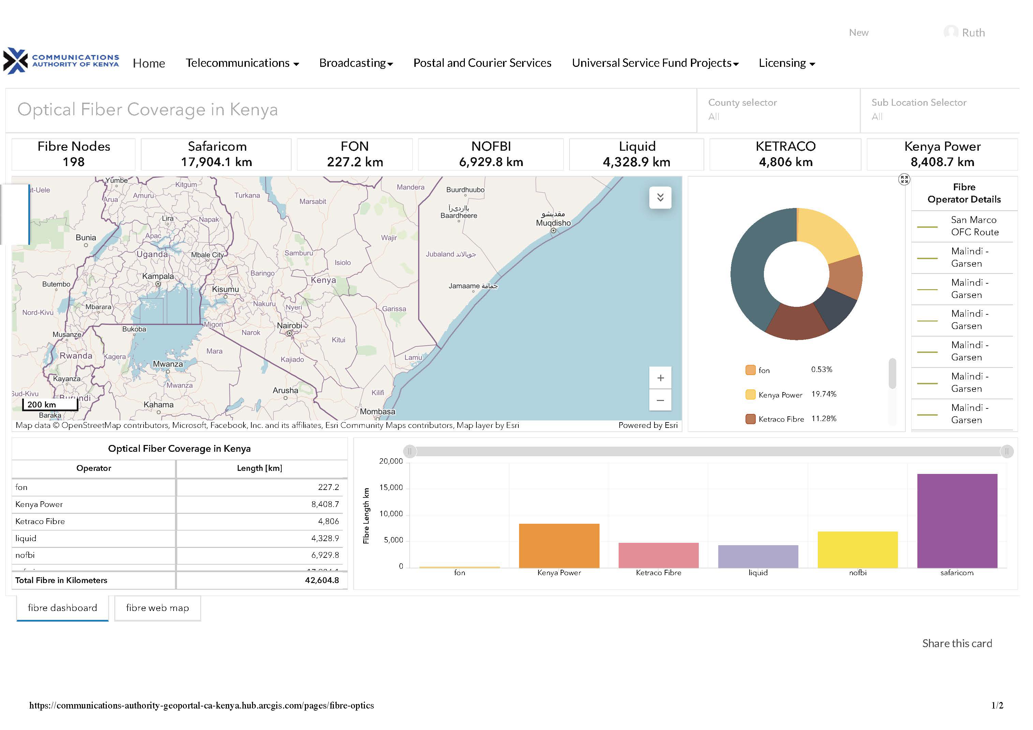
Broadband Mapping Systems Cont…

Slide 9
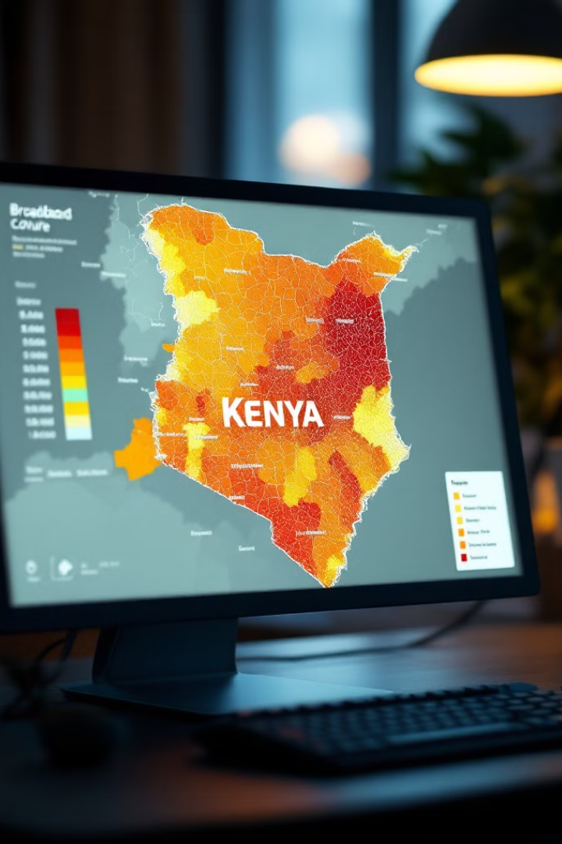
Broadband Mapping Systems cont…
Kenya’s broadband mapping data is partially accessible to the public, with detailed infrastructure maps available to government agencies, ISPs, and research institutions. The Communications Authority of Kenya (CA) manages the system, using collected data to create internal maps highlighting coverage gaps.
Accessibility
Internal Maps
Partially accessible to the public via reports and government portals.
Highlights coverage gaps and underserved areas.
Management
Managed by the Communications Authority of Kenya (CA).
Challenges include data accuracy concerns and limited resources for updates.

Slide 10
Broadband Coverage Data Collection
The Communications Authority of Kenya (CA) collects broadband coverage data quarterly from ISPs and mobile network operators. Field surveys and geospatial analysis validate this data, which is updated annually to ensure accuracy.
Data Collection
Collected by the Communications Authority of Kenya (CA) on a Quarterly basis.
Reporting
All licensees submit quarterly reports.
Validation
Field surveys and geospatial analysis.
ISPs are legally required to submit data, with non-compliance leading to penalties. Some data is published for public consultation.

Slide 11
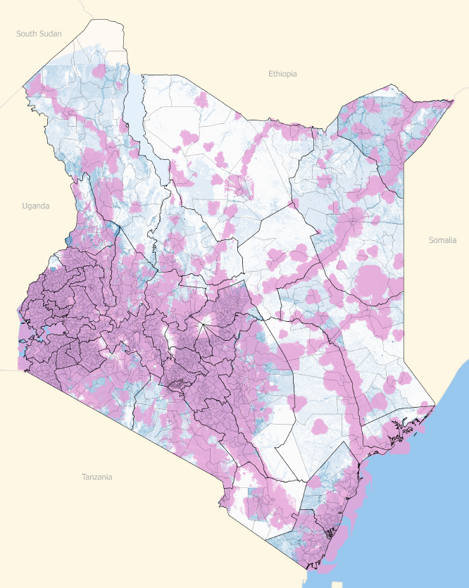
Broadband Infrastructure and Coverage cont…
Universal Access Baseline - 2016 (Mobile Network 2G, 3G)
94.4% of population covered by 2G
5.6% Pop (2.66 Million) with no coverage
78% population covered by 3G
Only 17% of the land area covered
5,657 out of 7,149 sub-locations fully covered
418 sub-locations with less than 50% population coverage
164 Sub-Locations no (0%) coverage
Sub-location population 2G coverage
Coverage | 100% | >90% | 50% - 90% | < 50% | 0%
Sub-locations | 5,657 | 485 | 425 | 418 | 164

Slide 12
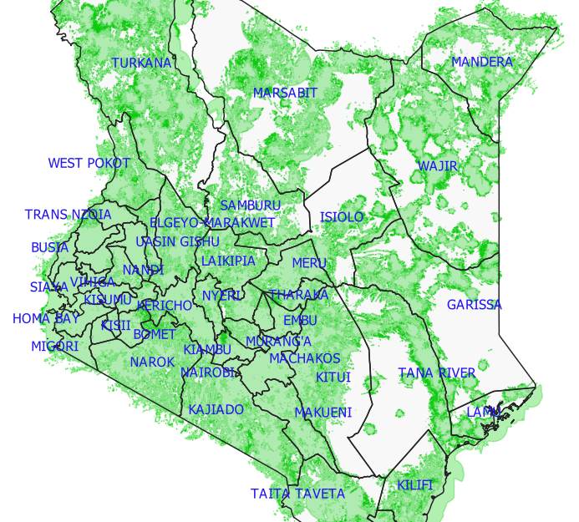
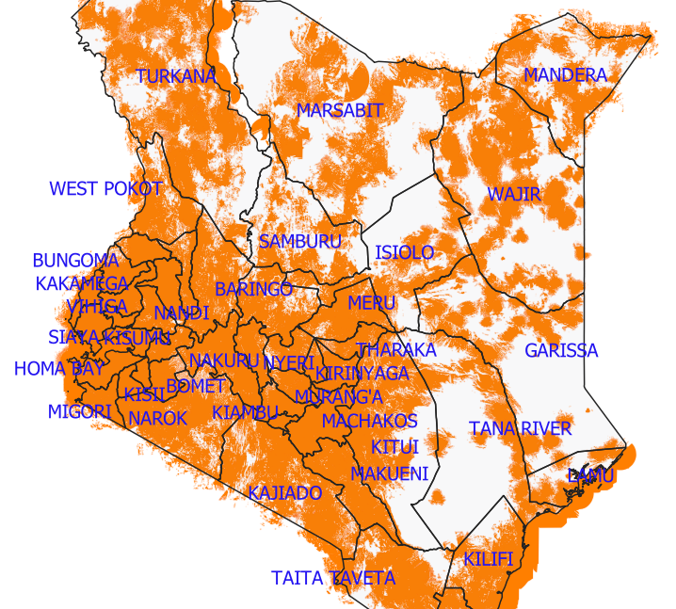
Broadband Infrastructure and Coverage
Voice (2G) Coverage (96.6% of pop. & 56.5% of Geo-Area
Broadband (3G/4G) Coverage (96.3% of pop. & 56.3% of Geo-Area)

Slide 13
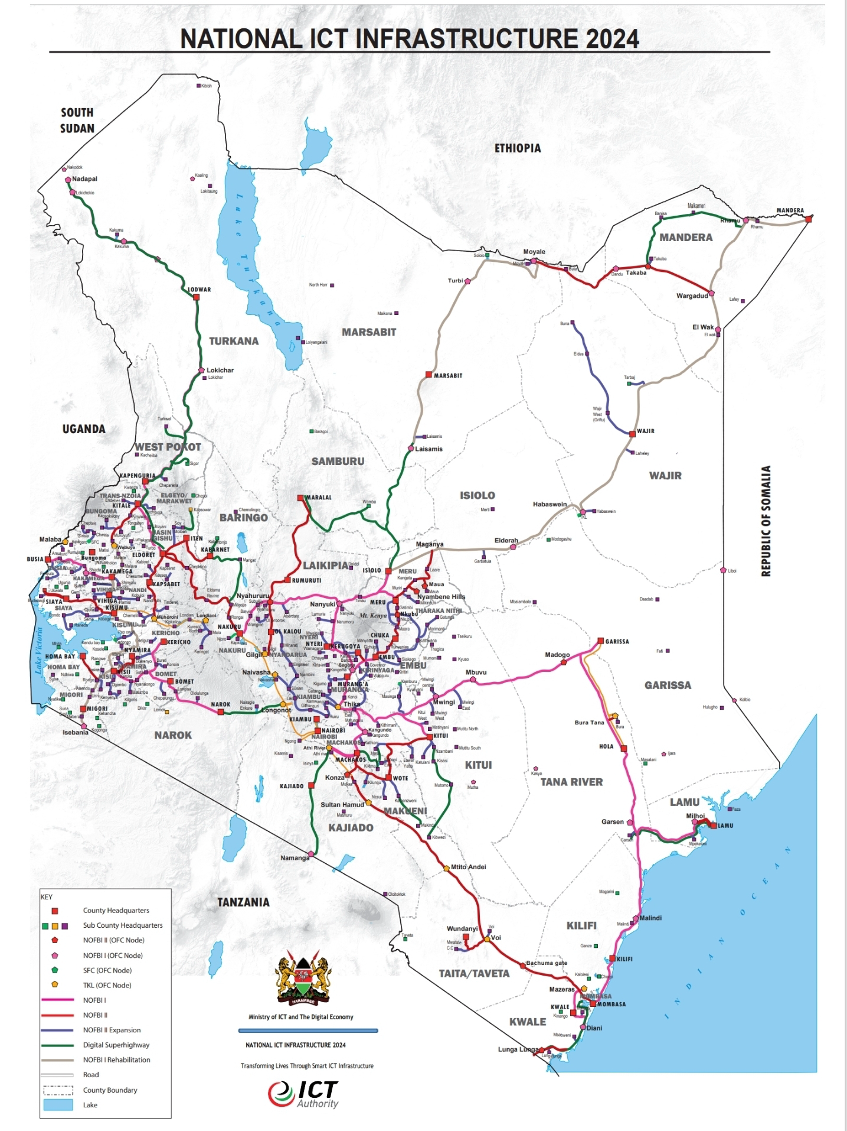
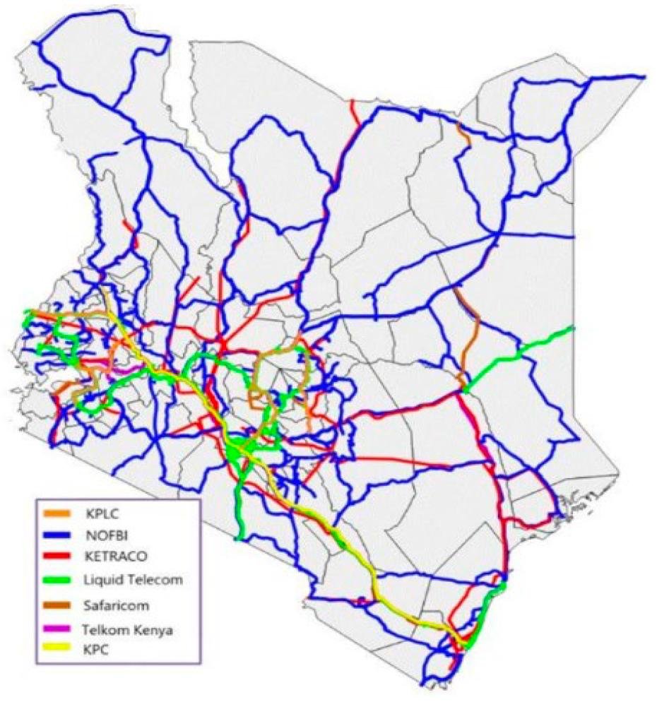
Broadband Infrastructure and Coverage cont….
Broadband coverage maps illustrate fiber optic, 4G/5G, and satellite reach across Kenya. A population distribution map highlights broadband accessibility, while visuals demonstrate broadband penetration progress and future expansion targets.
-Coverage map depicting broadband infrastructure distribution in
private and public sector.
- These visuals offer insights into the current state and future goals of broadband
expansion in Kenya.

Slide 14
Q&As

