Slide 1
Broadband Mapping Results
in Lithuania
Vaidotas RADZEVIČIUS
Regional Event on National Broadband Mapping Systems in Africa 26–27 March 2025 in Abidjan, Côte d’Ivoire

Slide 2
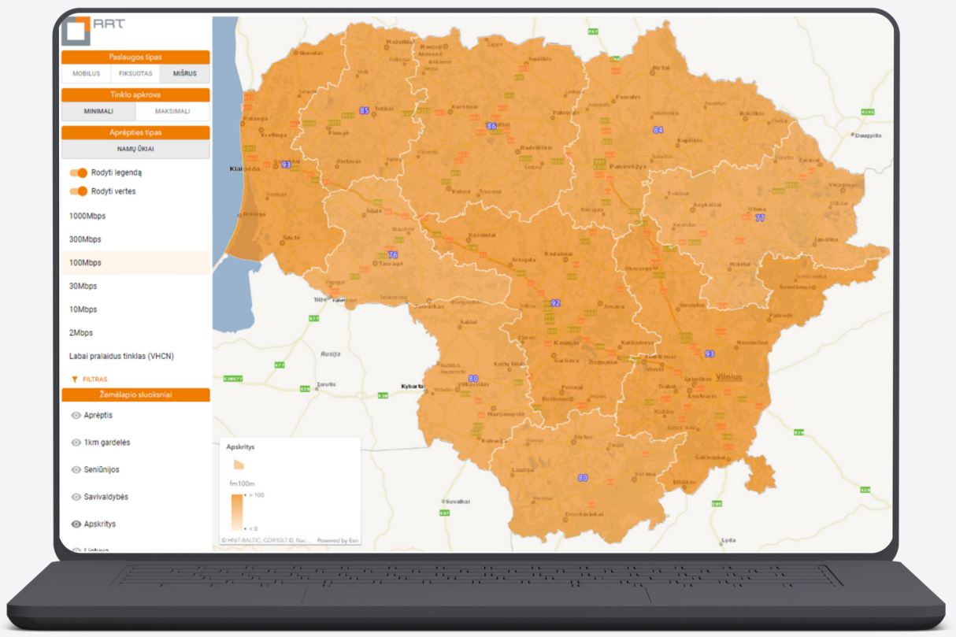
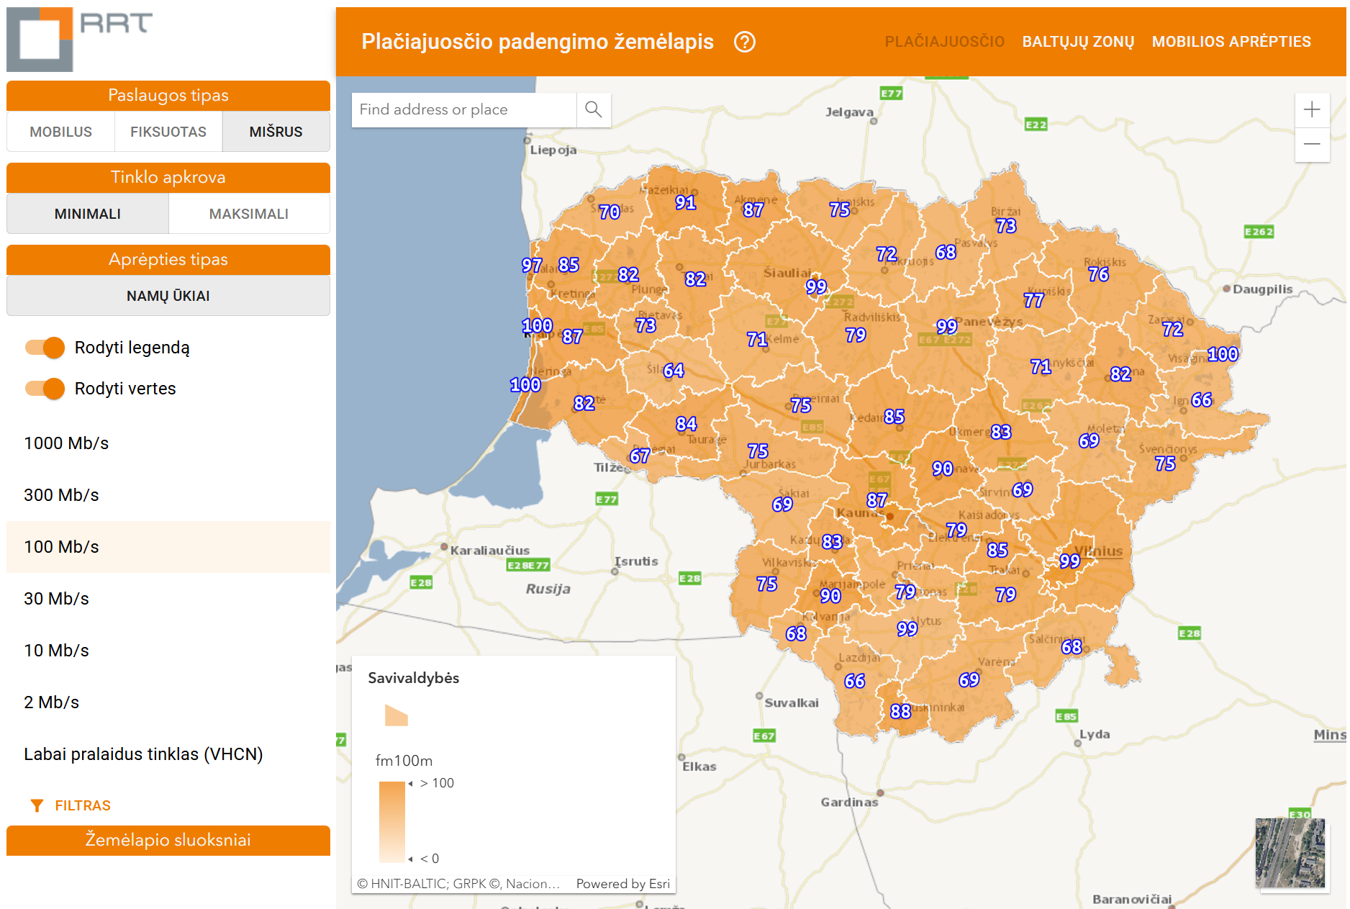
GEOGRAPHICAL BROADBAND SURVEY
GEOGRAPHICAL BROADBAND SURVEY
Available online
placiajuostis.rrt.lt

Slide 3
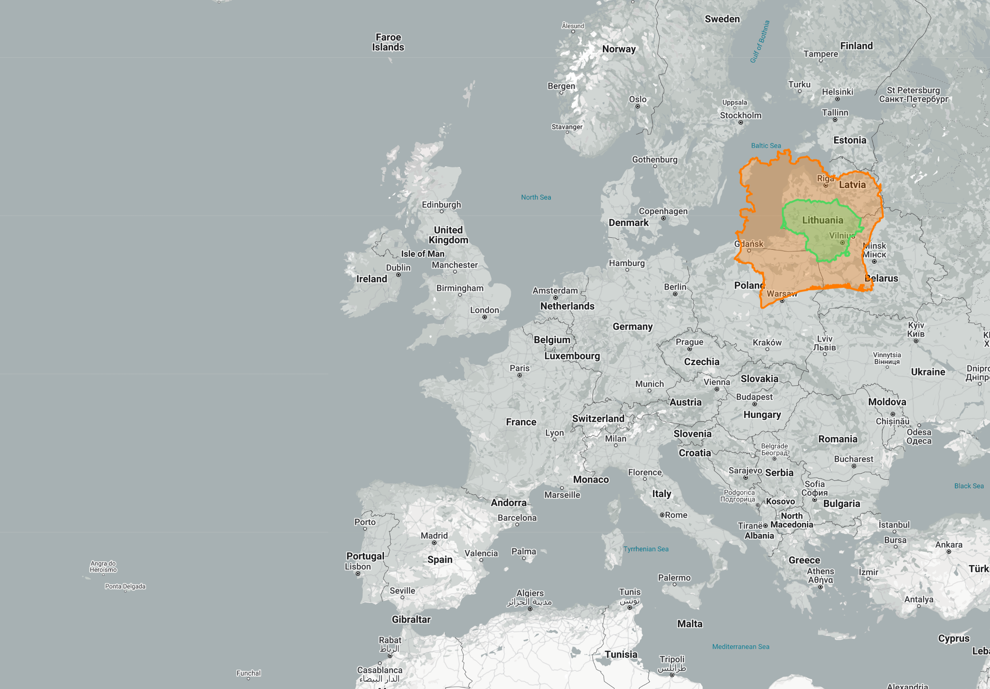
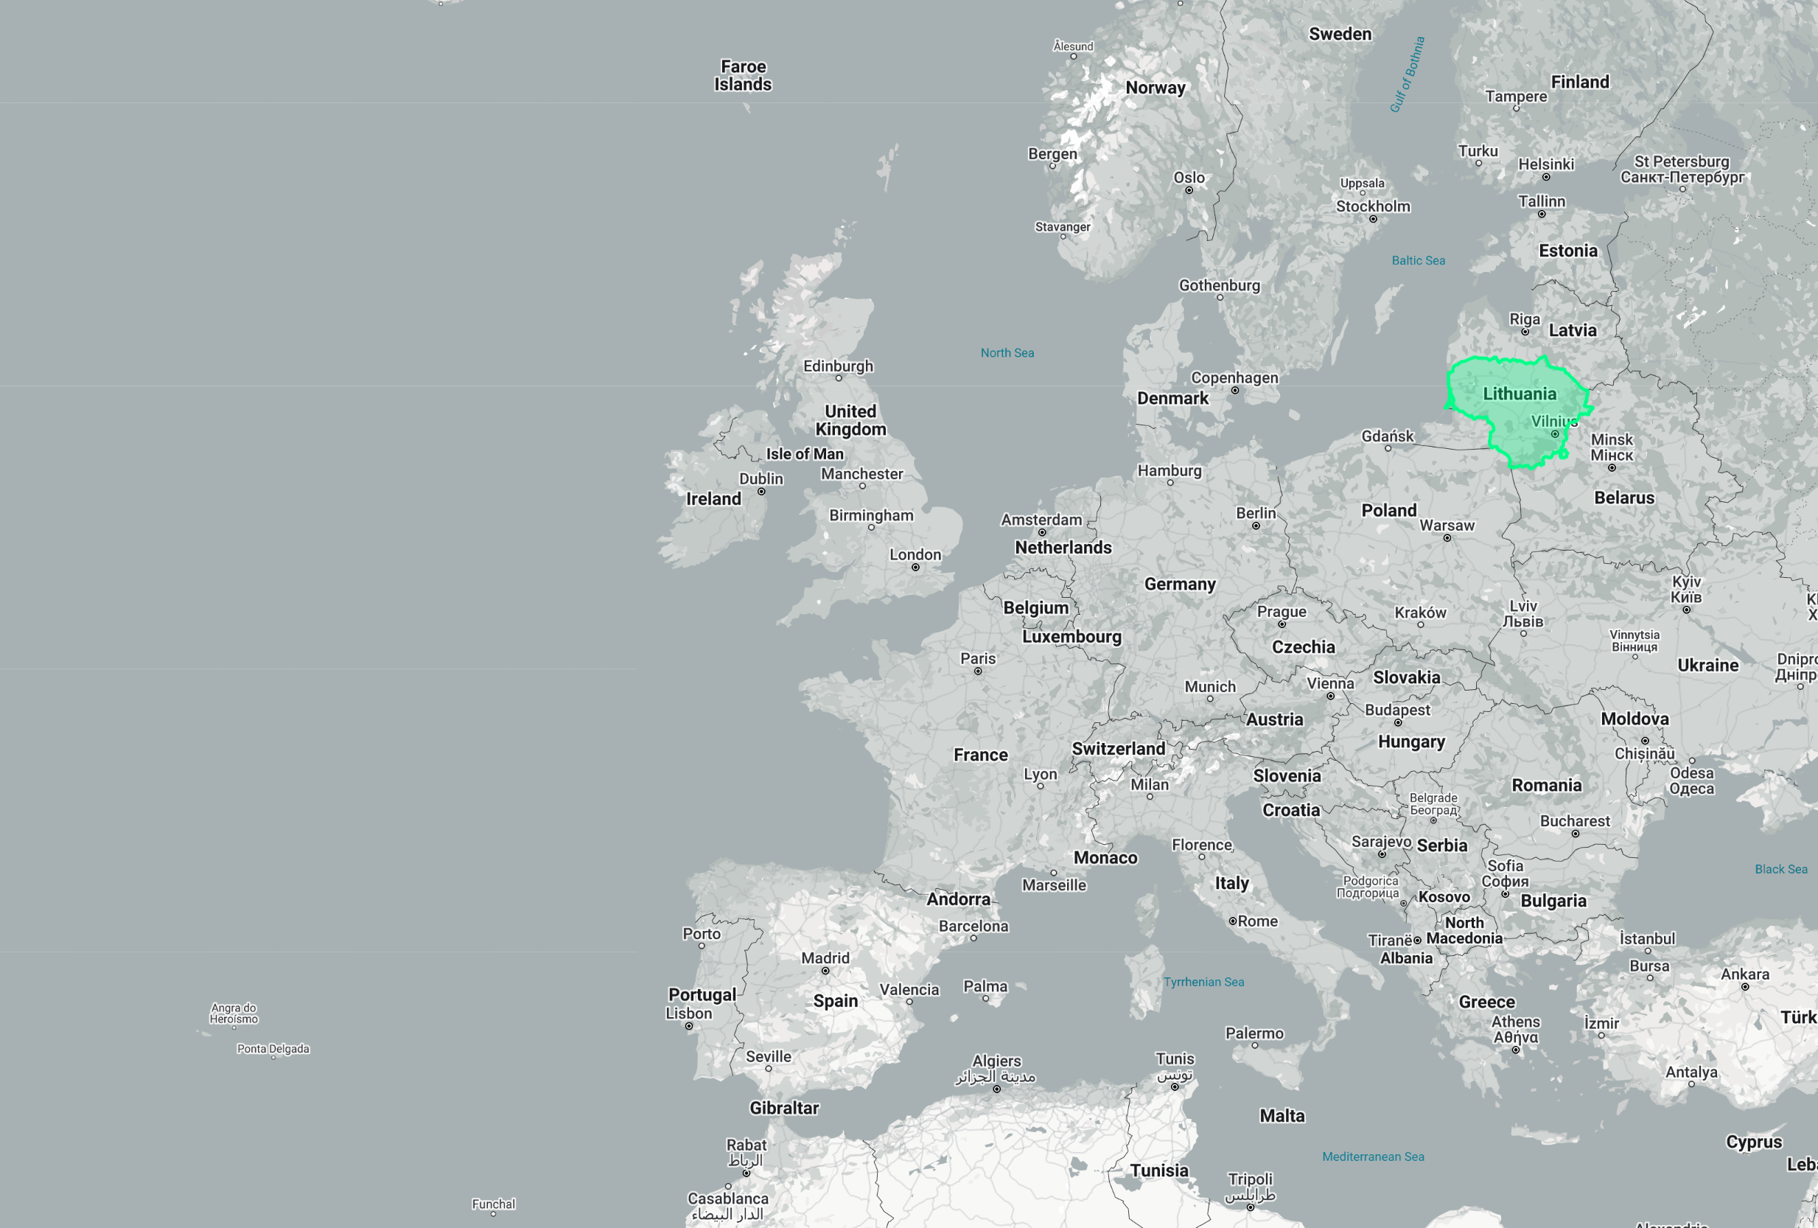
WHY BROADBAND MAPPING WAS CONDUCTED?
Article 22 of European Electronic Communications Code states:
National regulatory and/or other competent authorities shall conduct a geographical survey of the reach of electronic communications networks capable of delivering broadband (‘broadband networks’) by 21 December 2023 and shall update it at least every three years thereafter.

Slide 4
GOAL OF BROADBAND MAPPING
FINISH:
January 18th, 2024
Determine the coverage of existing electronic communications networks capable of providing broadband services, including the Very High Capacity Networks (VHCN)
5. PUBLICATION OF RESULTS
4. PUBLIC CONSULTATION ON RESULTS
3. EVALUATION OF NETWORK COVERAGE
2. DATA COLLECTION & VERIFICATION
START:
May 18th, 2023
1. METHODOLOGY

Slide 5
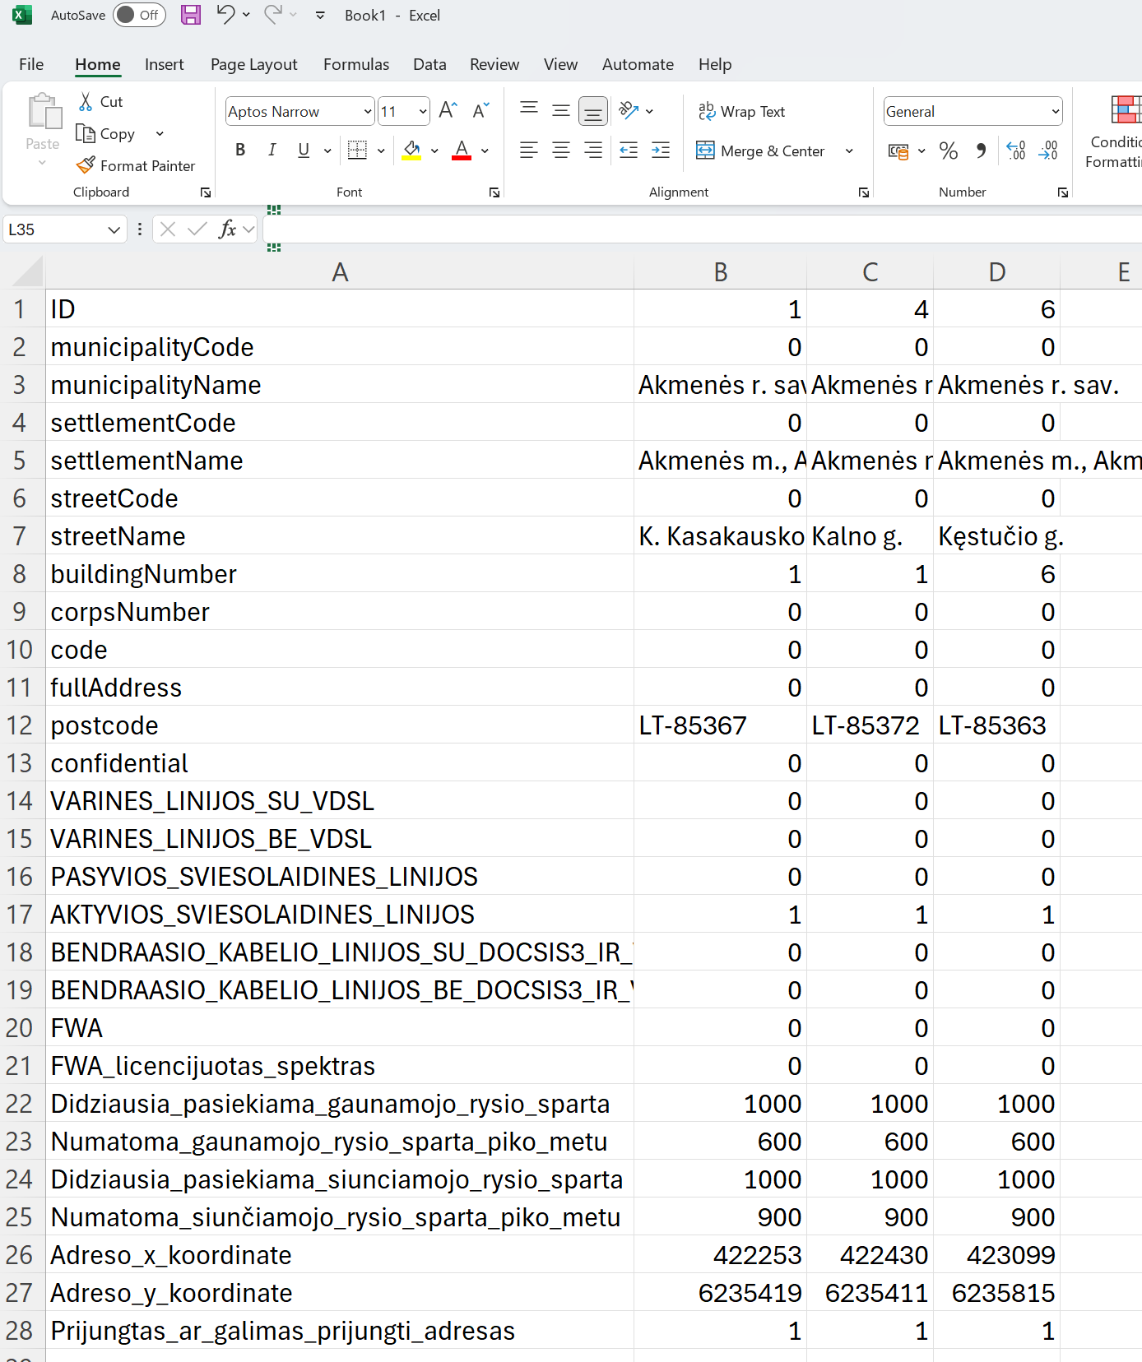
BROADBAND﻿ MAPPING METHODOLOGY
Data collection:
Current situation & forecast;
Data collection resolution:
60 x 60 meters grid for mobile network;
Address level for fixed network.
Required information:
Cells‘ load of mobile network (average, peak hours);
Download and upload speed of the fixed network (maximum, peak hours).
Principles of data transmission speed calculation of mobile network (propagation modelling, outdoors, 1,5 m from ground, min. signal level -115 dBm, etc.).
Multiple resolution of publishing aggregated results: from 60 x 60 meters to counties (NUTS3).

Slide 6
BROADBAND﻿ MAPPING
DATA COLLECTION & COVERAGE EVALUATION
Coverage of fixed communication networks
data collected from public electronic communication service providers,
data already available to RRT, obtained during other studies or calculations on the development of fixed communication networks.
Coverage of mobile communication networks
calculations performed by RRT using HTZ Communications software, according to the technical information provided by the operators about the base stations they manage.
https://atdi.com/products-and-solutions/htz-communications/

Slide 7
BROADBAND﻿ MAPPING
DATA COLLECTION & COVERAGE EVALUATION (2)
Data collected from 65 operators of fixed networks and from 3 operators of mobile networks.
Household numbers, locations and distribution gathered from national real estate register.
Mapping with ESRI ArgGIS Pro software
https://www.esri.com/en-us/arcgis/products/arcgis-pro/overview

Slide 8
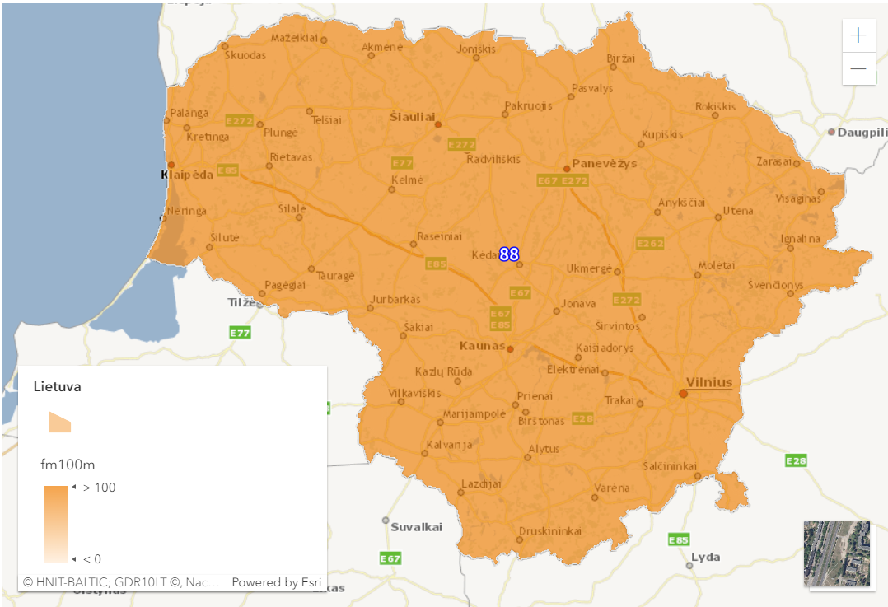
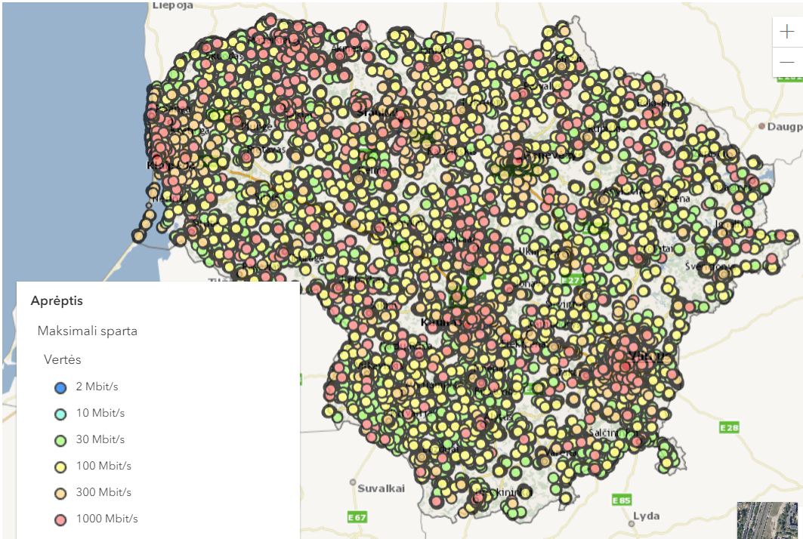
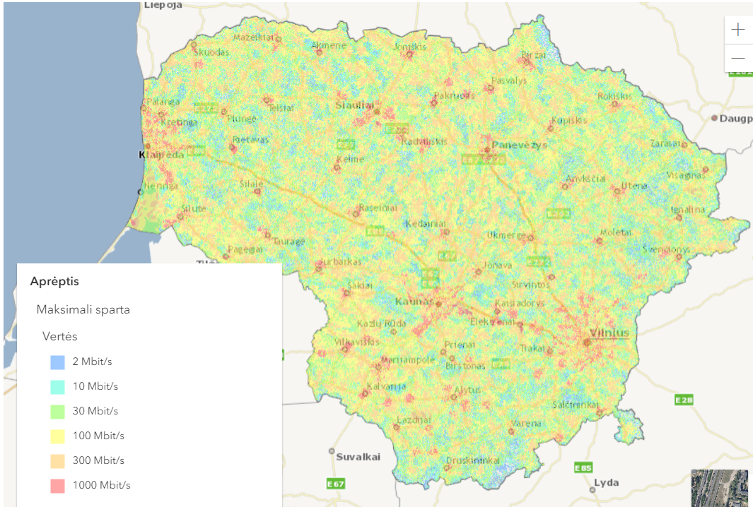
ONLINE APP OF BROADBAND SURVEY
Exact locations of fixed connections
Expected download speed in mobile networks
Overall percentage of covered households

Slide 9
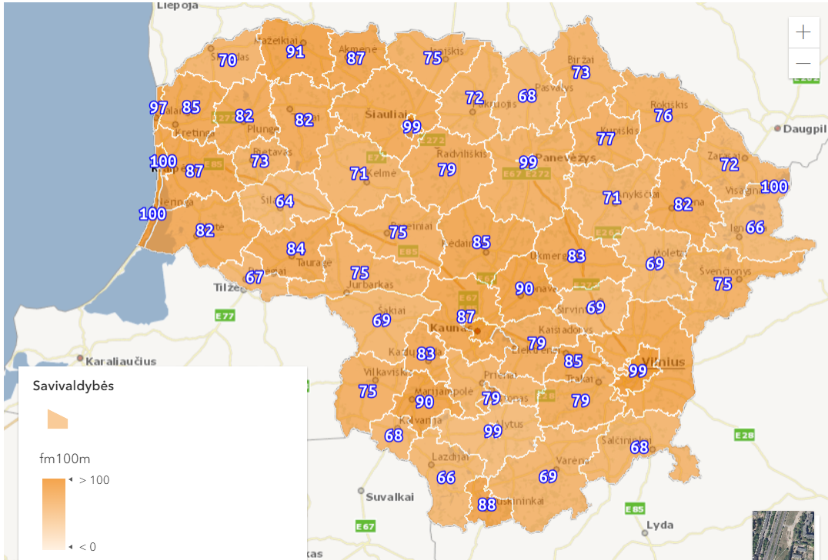
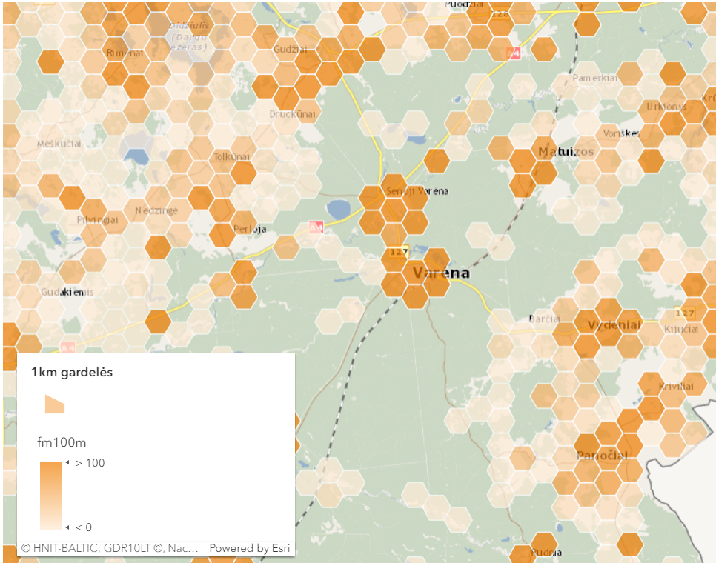
ONLINE APP OF BROADBAND SURVEY
Multiple options to analyze the results

Slide 10
RESULTS OF BROADBAND SURVEY
KEY TAKEAWAYS
National level
Overall coverage of networks capable of providing low data rates (2, 10, 30 Mb/s) and VHCN is very good: 97% of households are covered with speeds up to 30 Mb/s.
100 Mb/s download speeds are available to 88% of households.
County level
Overall coverage is very good, covering with speeds up to 30 Mb/s at least 9/10 households in each county.
Municipality level
Overall coverage is good for data transfer speeds up to 10 Mb/s and VHCN, it is available to at least 9/10 households in each municipality.
Networks capable of providing at least 30 Mb/s data transfer speed cover at least 3/4 of the households and 100 Mb/s data speed cover at least 1/2 of the households in each municipality

Slide 11
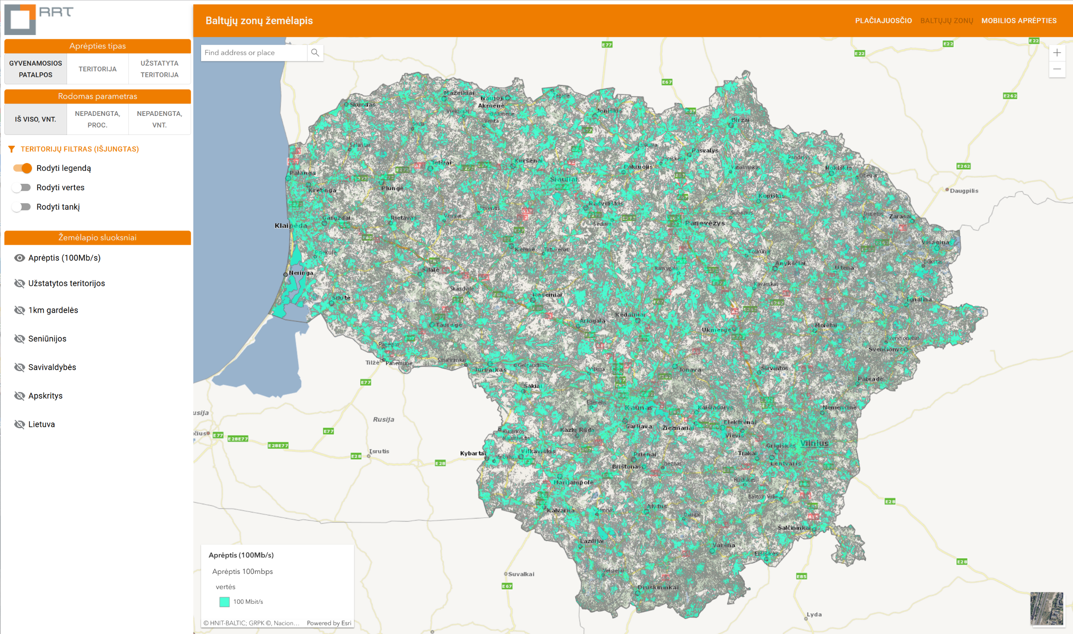
NEXT STEP: MAPPING WHITE SPACES
GOAL OF MAPPING WHITE SPACES
Determine households and territories where 100 Mb/s data transfer speeds are not available with current infrastructure of electronic communications networks (or won’t be available within next 3 years)
RESULTS in 2024:
59,3% of territory of Lithuania is within the White Spaces
17,2% of living quarters (residential buildings) are within White Spaces

Slide 12
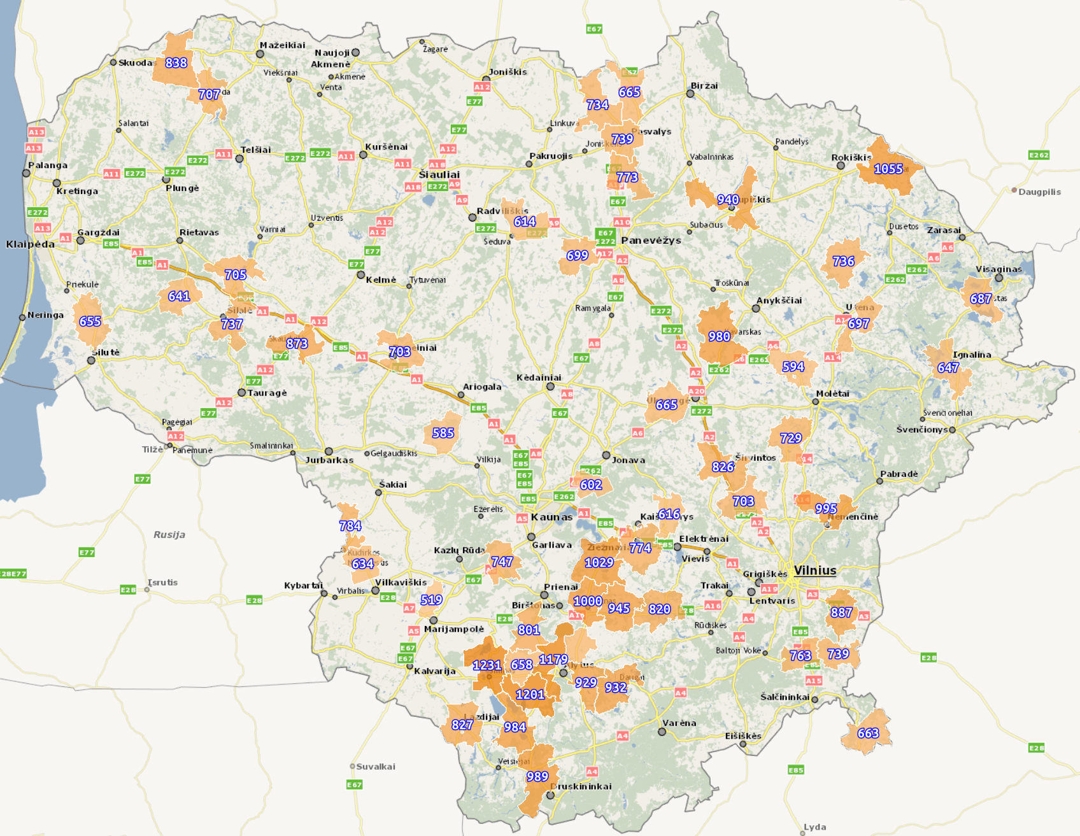
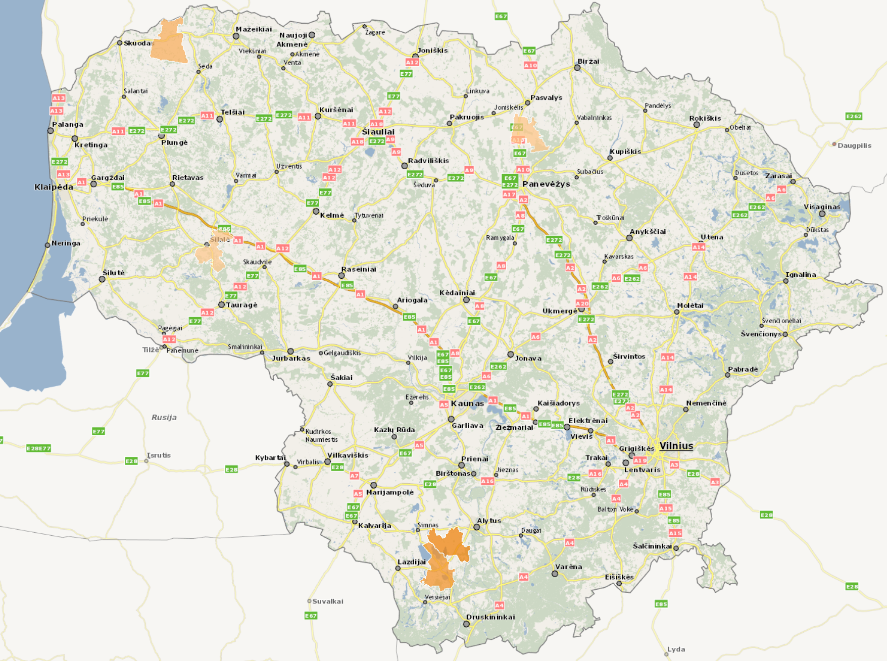
ANALYZING WHITE SPACES
Filtering by: coverage type, number of objects, administrative borders, absolute values, percentages, density of households, etc.
2
3
1
4
Finding areas that need improvement most.
5

Slide 13
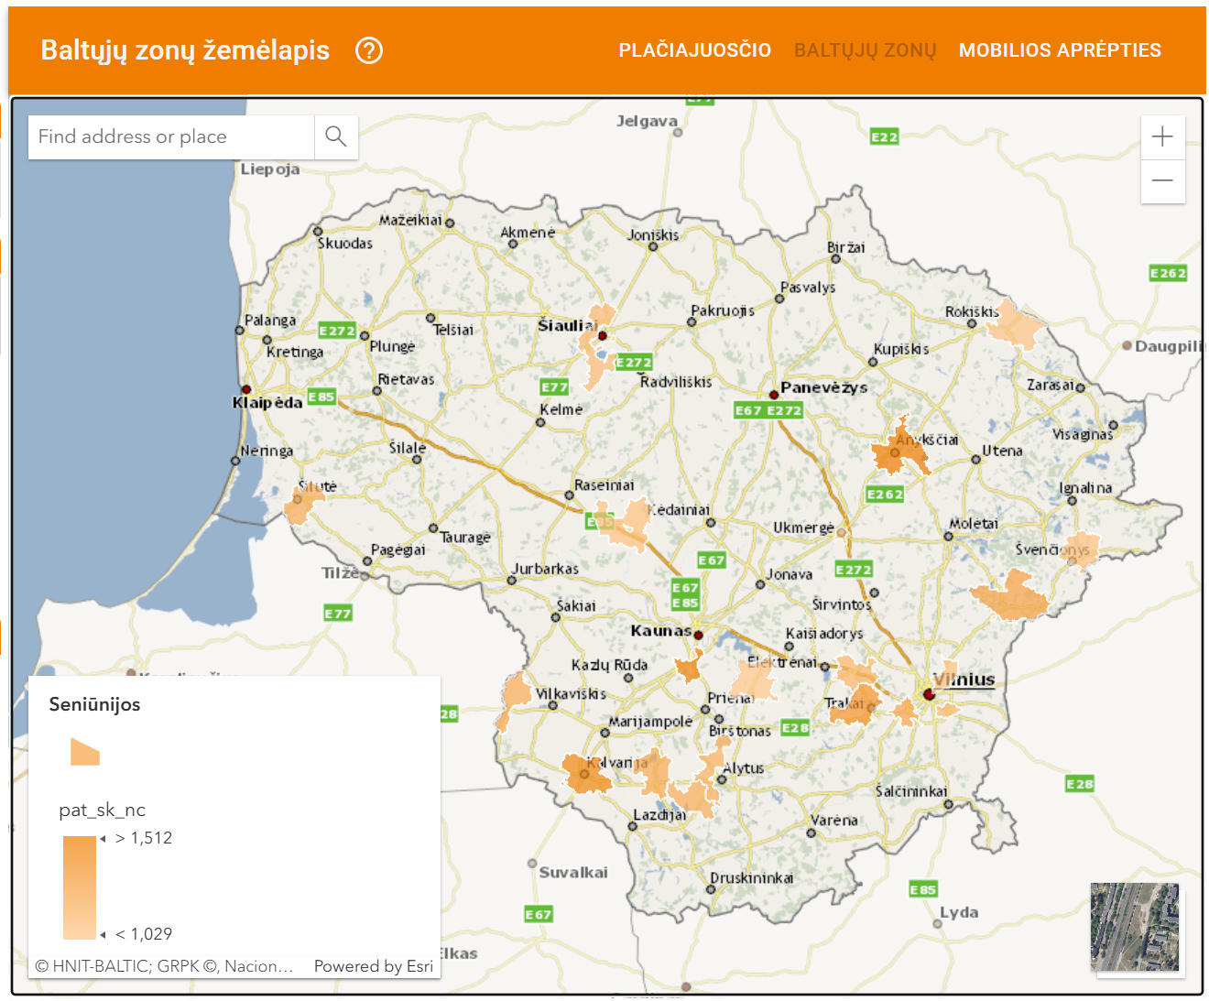
SUGGESTIONS FOR FUTURE DEVELOPMENT POLICIES
22 municipalities that have 1000 or more residential buildings within White Spaces were identified as needing priority measures
Additional 74 municipalities with building density 10-50/km² were assigned to mobile operators proportionally to improve coverage
Public funding measures for operators and end-users were suggested for municipalities with lowest density of residential buildings

Slide 14
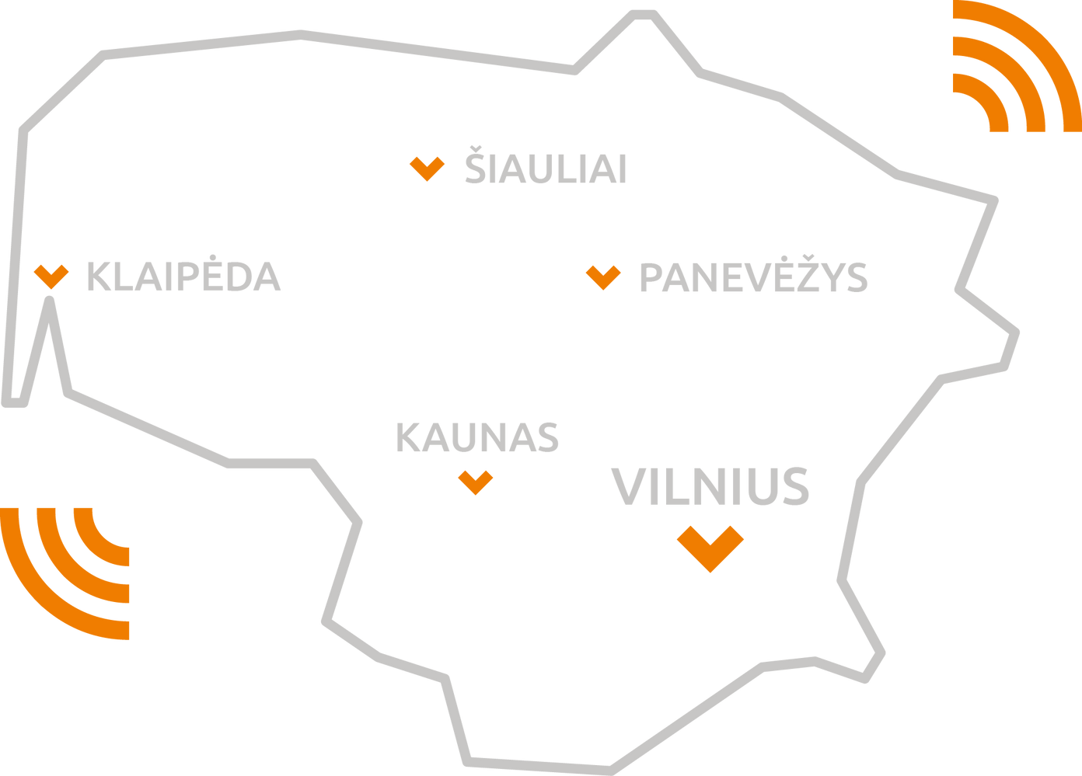
THANK YOU!
ANY QUESTIONS?
Presented by
Vaidotas RADZEVIČIUS

