Slide 1

Africa-BB-Maps
Questionnaire Report / Template case study
26-27 March, Abidjan, Cote d'Ivoire

Slide 2

Africa-BB-Maps
Questionnaire Report - Malawi

Slide 3




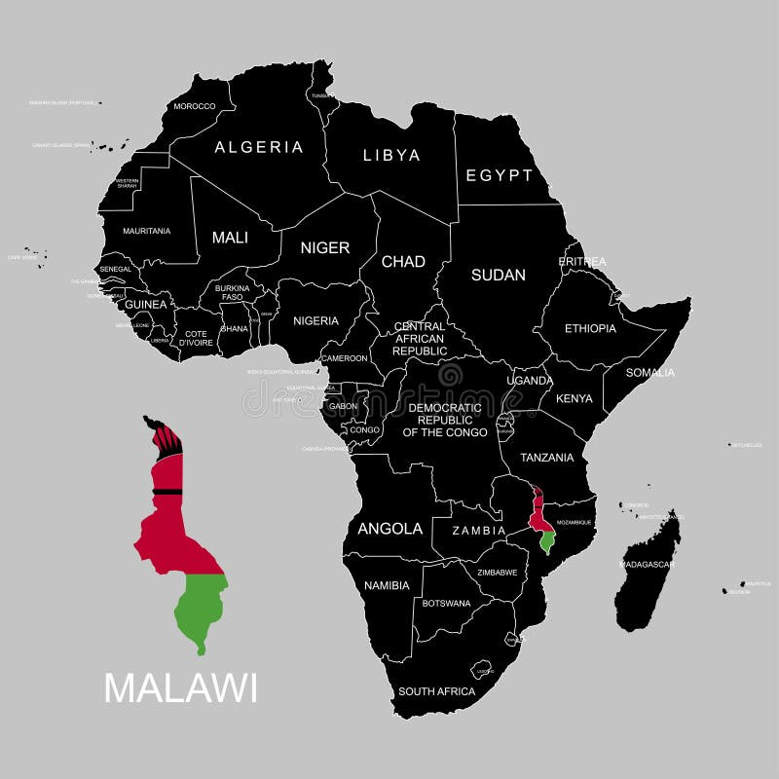
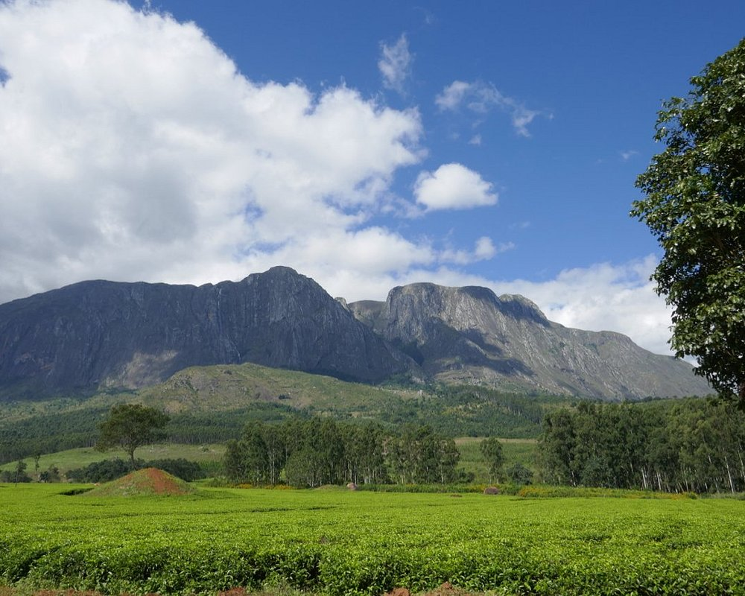

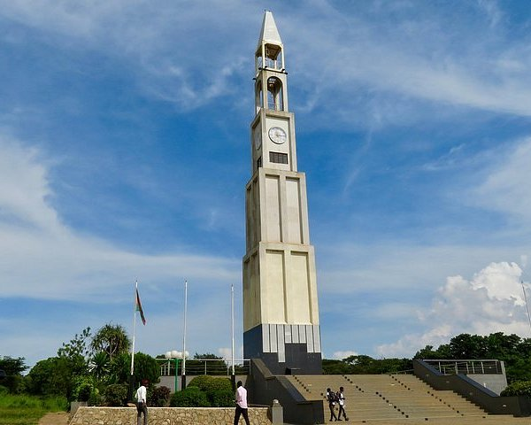
Introduction
MALAWI
Malawi gained independence on 6th July 1964 and was previously known as Nyasaland
Capital: Lilongwe
Major languages: English and Chichewa (both official)
Major religions: Christianity (80%) and Islam (20%)
Currency: Malawi kwacha (MWK)
Media: Radio is the medium of choice. A state TV station opened in 1999
Area: 118,480 km² (46,000 miles²) (half the size of the UK)
Climate: Sub tropical: rainy season, December to May; dry season, May to December
Lake: 585 km long by 80 km wide (364 miles long by 50 miles wide)
Population: 20.9 million (2023 World Bank), growing at 3% per year
PICTURE
Malawi was named one of the top 10 countries to visit in the world in 2014 by Lonely Planet’s Best in Travel 2014.
Lake Malawi National Park, Majete Wildlife Reserve, Zomba Plateau, Liwonde National Park, Likoma Island, Nyika National Park, Thyolo Tea Estates, Nkhotakota Wildlife Reserve, Mount Mulanje

Slide 4
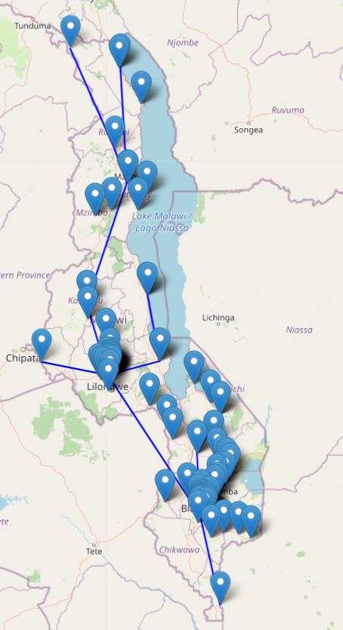
Introduction
Broadband technologies widely used in Malawi
Fixed Broadband Network
- ESCOM Fiber
- Open Connect Limited
- Simbanet
Mobile Network (3G/4G/5G)
- Airtel Malawi Plc., TNM Plc., Access Communications
Wireless Broadband Services
- Converged Technology Networks, MTL, Inq. Digital, Globe, etc
Satellite
- Starlink
PICTURE

Slide 5

Policy frameworks
Policies and regulations on broadband
The Communications Acts, 2016
National Broadband Strategy (2019–2023)
National Digitalisation Policy 2023
Malawi Digital Economy Strategy 2024
Malawi 2063
Government initiatives on broadband
National Fiber Backbone Project
Yathu Yathu Data
Last Mile Rural Connectivity Project
PICTURE

Slide 6
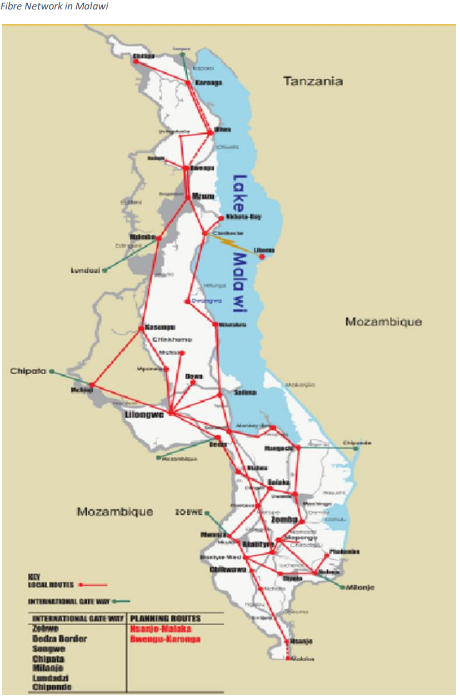
Broadband penetration and expansion
Current Broadband Penetration levels
Mobile Broadband Penetration 47%
Fiber coverage 5,585.14km
Targets for the next 5 years and expansion strategy
The Malawi Digital Economy Strategy (2024-2029)
Aims to increase network access to 80% of the population by 2027
Yathu Yathu Data
Provide broadband services, targeting rural and hard-to-reach areas across Malawi.
PICTURE

Slide 7
Broadband Mapping
Types of Broadband Infrastructure
Fiber Networks – Metropolitan, National backbone and cross boarder uplinks
Mobile broadband towers (3G, 4G, 5G)
Satellite – VSAT and Starlink
Broadband data collection
Data provided by ISPs and Telecom operators
Field surveys conducted by the government
Crowdsourced user data (complaints)
Integration to other systems
Some level of integration exists, but it is not fully structured
Ministry of Information
National Planning
PICTURE
Notes:
Malawi's broadband infrastructure consists of:
1. Fiber Optic Networks
National Backbone Network:
Cross-Border Connectivity:
2. Mobile Broadband
4G LTE: Major operators Airtel Malawi, TNM.
3G and 2G: Widely used in rural areas.
5G (Planned): Early-stage deployments.
3. Fixed Wireless Broadband
WiMAX & LTE Fixed Wireless: Used by ISPs to provide last-mile broadband
Microwave Radio Links: Used for backhaul.
4. Satellite Internet
VSAT
Starlink: Emerging options for rural broadband connectivity.
4. Public and Community Broadband Initiatives
Telecenters and Public Wi-Fi – Government and NGOs support public internet access points in schools, hospitals, and markets.
Private Sector Wi-Fi Hotspots: Available in cafes, hotels, and business areas.

Slide 8
Broadband Mapping Systems
Currently Malawi does not have broadband mapping system.
Broadband data is collected, and the data is used to develop internal broadband maps that are used to driver initiatives towards developing the underserved communities.
Digital Malawi Acceleration Project (DMAP)
Community Broadband Operators
Free Public Wi-Fi Initiative
Notes:
The Telecoms develop coverage maps for their use. TNM and Airtel are the major Telecom companies

Slide 9
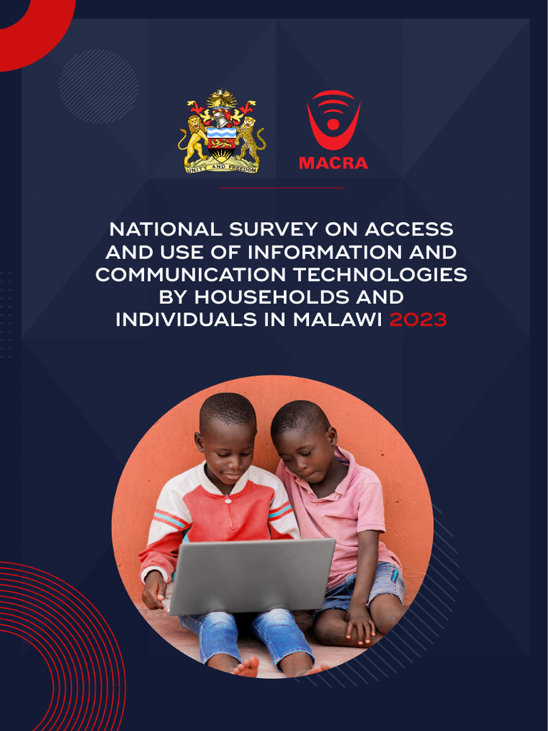
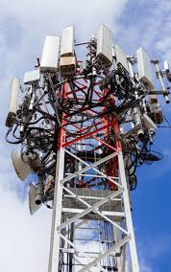

Broadband coverage
Who Collects Broadband Data Coverage:
Malawi Communications Regulatory Authority
License obligations - Quarterly
National ICT Surveys – Periodic e.g. 3-4 years
Infrastructure audit (latest – 2024)
Broadband Gap Studies – Last one was in 2020
Verification – Consultations with Telcos, data integration, Field assessments (Drive Tests)
ISP Obligations:
Required to submit broadband coverage and QoS data
Penalties are not fixed in license, but the Regulator has the mandate to penalize ISPs for non-compliance whenever data is requested
PICTURE

Slide 10
Q&As

