Slide 1
Africa-BB-Maps
Questionnaire Report / Template case study
Nigeria
26-27 March, Abidjan, Cote d'Ivoire

Slide 2
Africa-BB-Maps
Questionnaire Report

Slide 3
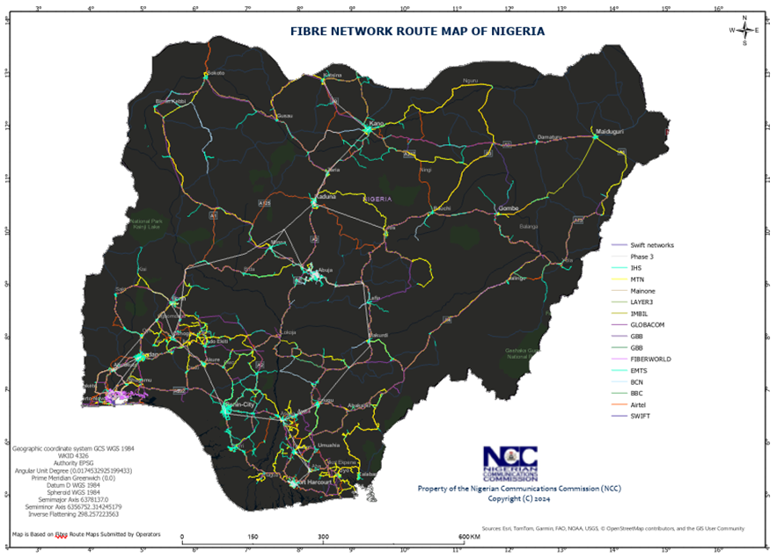
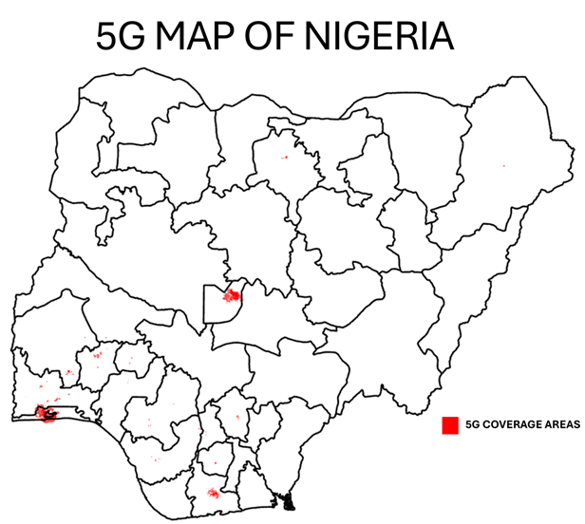
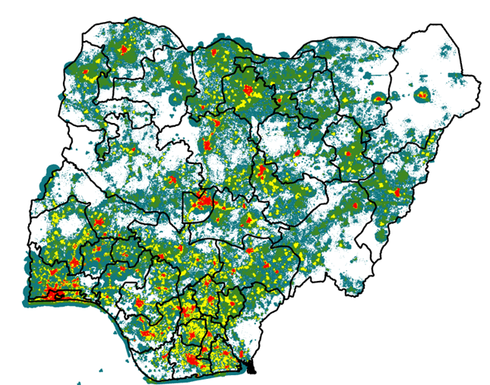
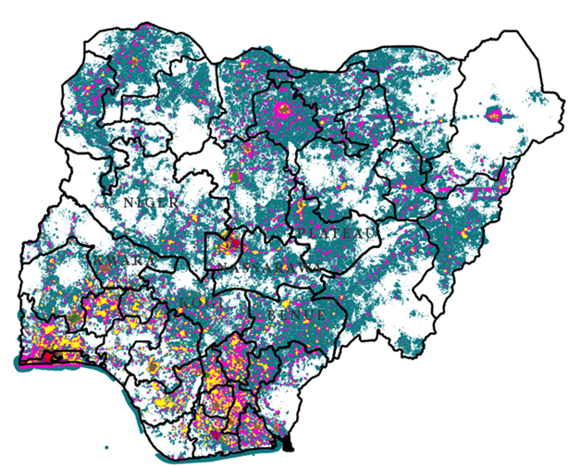
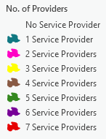
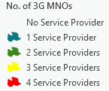
Introduction ¹
FIBRE NETWORK MAP OF NIGERIA
Nigeria, with over 200 million people, has experienced rapid telecom growth, driven by the Nigerian National Broadband Plan (NNBP) 2020-2025.
Mobile Broadband (3G/4G/5G) – Dominates with over 58.37% market share (98.76M subscribers).
Mobile broadband coverage grew from 34% to 84.31% in five years.
Fixed Broadband (Fiber & Wireless) – Expanding with increased infrastructure investments.
Fibre network reach increased from 40,000 km to 98,000 km in last 5 years.
Broadband penetration increased from 32% to 45.6% in last 6 years.
PICTURE
3G MAP OF NIGERIA
4G MAP OF NIGERIA
13.28%
89.42%
84.31%

Slide 4
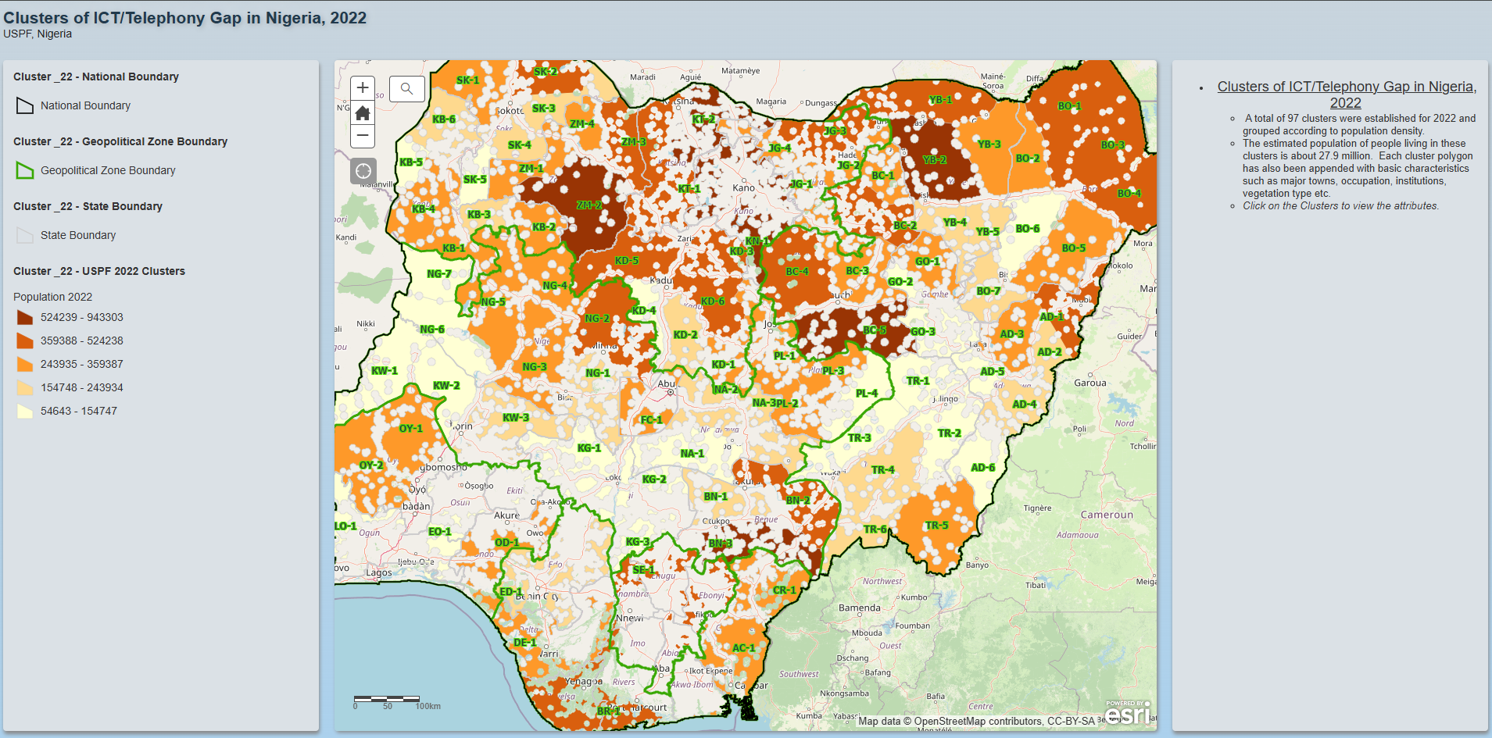
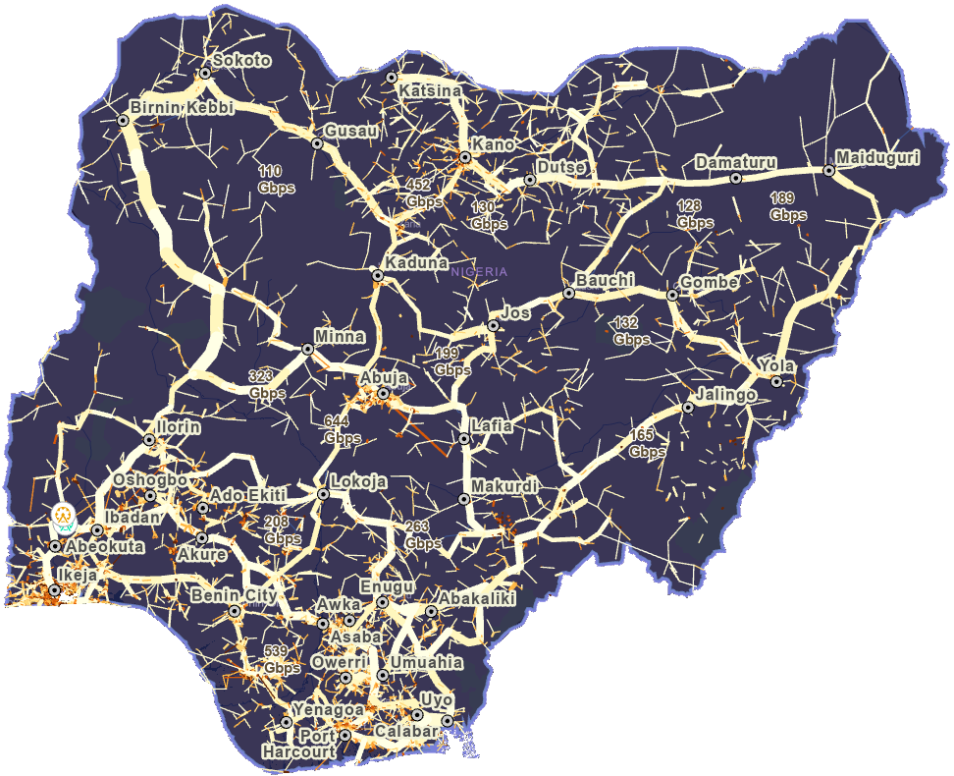
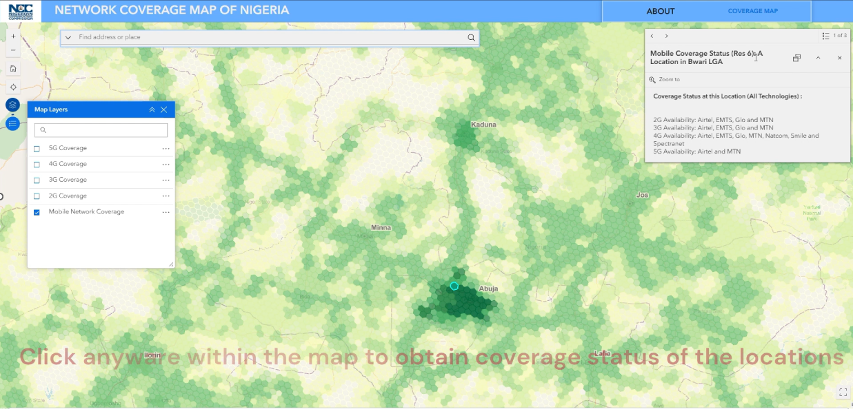
Introduction ²
CLUSTER OF COVERAGE GAP MAP OF NIGERIA
The Universal Service Provision Fund (USPF) works to expand telecom services by identifying and tracking underserved and unserved areas in Nigeria through cluster access gap maps. This helps monitor progress in reducing coverage gaps.
Furthermore, the Nigerian Communications Commission (NCC) supports connectivity with a 13Tbps Fixed Services (Microwave Links) map, providing broadband backhaul in challenging terrains where fibre deployment is limited.
Leveraging these resources, interactive coverage maps have been developed, allowing users to check network availability across Nigeria.
PICTURE
MICROWAVE FREQUENCY LINKS
INTERACTIVE COVERAGE MAP
MICROWAVE FREQUENCY LINKS MAP

Slide 5
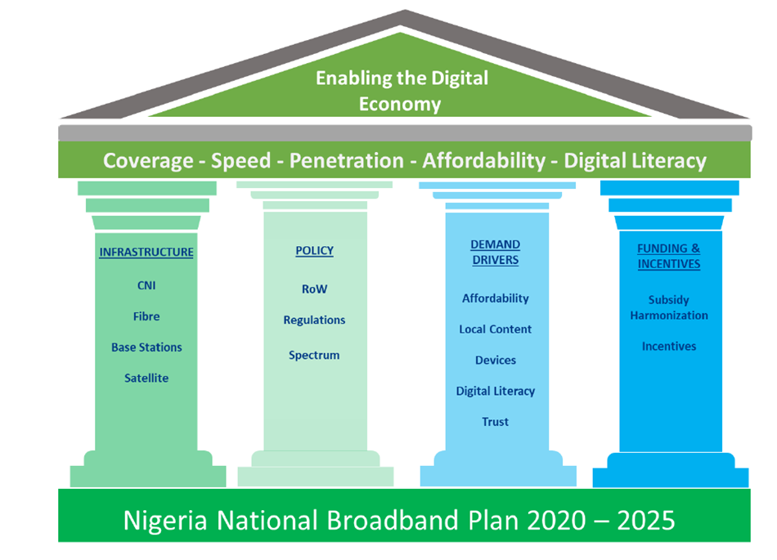
Policy Frameworks
National Broadband Plan (NBP) 2020–2025: Key policy driving broadband expansion; targets 70% penetration by 2025.
Nigerian Digital Economy Policy and Strategy (NDEPS) 2020-2030: Aims to position Nigeria as a leading global digital economy, focusing on broadband expansion, digital literacy, service infrastructure, cybersecurity, and local content development.
Regulatory Framework: NCC regulates licensing, spectrum assignments, and QoS standards under the Nigerian Communications Act (2003)
Other Instruments: 5G Policy (2021), Open Access Model for fibre deployment, and other initiatives supporting broadband growth.
Broadband Mapping: Not yet integrated into national infrastructure projects, but discussions with the energy regulator are ongoing to ensure alignment.
PICTURE

Slide 6
Broadband Penetration and Expansion
Nigeria’s Broadband penetration currently stands at about 45.6% projected to exceed 80% in the next 5 years, covering many rural and underserved communities.
Key Initiatives by NCC and the FMCI&DE
Spectrum Rollout Monitoring: Ensuring compliance with broadband deployment obligations.
Commercial Satellite Communication Guidelines: Driving broadband deployment in unserved and underserved areas.
USPF Targeted Interventions:
Connectivity programmes: subsidized, PPP-driven telecom infrastructure projects, implemented and operated by service providers to support access initiatives in unserved and underserved communities.
Access programmes: Grant-funded projects that drive ICT adoption in unserved and underserved communities by providing end-user devices alongside telecom infrastructure.
National Broadband Alliance for Nigeria: Multi-stakeholder initiative led by the Ministry to accelerate broadband adoption, bridge the digital divide, and ensure inclusive, affordable connectivity.
Project BRIDGE: Deploying 90,000km of fibre to expand high-speed internet access.
Project 774: Extending broadband infrastructure to all 774 LGAs for nationwide connectivity.
Right of Way (RoW) Reforms – Reducing costs and bureaucratic barriers to facilitate faster fibre deployment.

Slide 7
Broadband Mapping ¹
Fixed Telecom Networks – Fibre route maps
Core Components
Current Scope
Microwave Frequency Links – Nationwide backhaul capacity
🚫 No other sectors are currently integrated
Base Station Infrastructure – Tower and site locations
Mobile Network Coverage – 3G, 4G, and 5G availability
Ongoing discussions with the Federal Ministry of Works for an MoU to protect telecom infrastructure (optic fibre) during and after construction
Data Collection & Management
Future
Integration
📌 Sources:
Industry reports,
regulatory submissions,
and field assessments
Crowdsourced data
May involve GIS overlaps for better coordination and infrastructure planning

Slide 8
Broadband Mapping ²
S/N | Data Type | Method of Data Collection
1 | Fibre Network Data | Quarterly submission by Network Operators/ Service Providers
2 | Microwave Frequency Links and Base Station data | Half-yearly submission by Network Operators
3 | Mobile Coverage Data | Quarterly submission of Coverage Prediction data by Mobile Network Operators
4 | Coverage and QoE Performance Data (speed, latency etc.) | Crowdsourced data. (Ongoing initiative)

Slide 9
Broadband Mapping Systems
Data Collection
Management & Responsibilities
Infrastructure & Coverage Data: Collected from operators for broadband map development.
Cluster Gap Mapping (USPF): Identifies unserved & underserved areas for targeted interventions.
Spectrum Administration Dept: Develops & manages Mobile Coverage Maps.
Technical Standards & Network Integrity Dept: Oversees Fibre Network Mapping.
USPF: Maintains and updates Coverage Cluster Gap Maps
Future Integration
Current Usage
Breaking Data Silos – A collaborative system is needed to enhance coordination and efficiency.
Broadband mapping data is currently used internally but plans are underway to publicly share broadband coverage data
Infrastructure Protection – Ongoing MoU discussions with the Federal Ministry of Works to safeguard optic fibre during and after construction, leveraging GIS overlaps for better planning.

Slide 10
Broadband Coverage
01.
02.
03.
04.
Who Collects Broadband Coverage Data?
Data Collection, Updates & Verification
Compliance & Penalties
Data Availability & Public Access
The Broadband Implementation Steering Committee (BISC) oversees the monitoring of the NNBP and coordinates data collection.
The Nigerian Communications Commission (NCC) collects broadband data from licensees as well as through drive tests.
Licensees are mandated to submit broadband coverage and Quality of Service (QoS) data.
Data is validated using drive tests and other field verification methodologies.
NCC is working on acquiring an independent crowdsourcing platform for enhanced validation and real-time performance insights.
Non-compliance with data submission requirements attracts penalties, as stipulated in Sections 64 and 65 of the NCA 2003.
Broadband data is being collected internally but is not yet publicly published.
External entities may request access, subject to approval.
Plans are underway to enhance public consultation and transparency in broadband coverage reporting.

Slide 11
Q&As

