Slide 1
Four Brands, One Common Purpose:
Better Connectivity for All

Slide 2


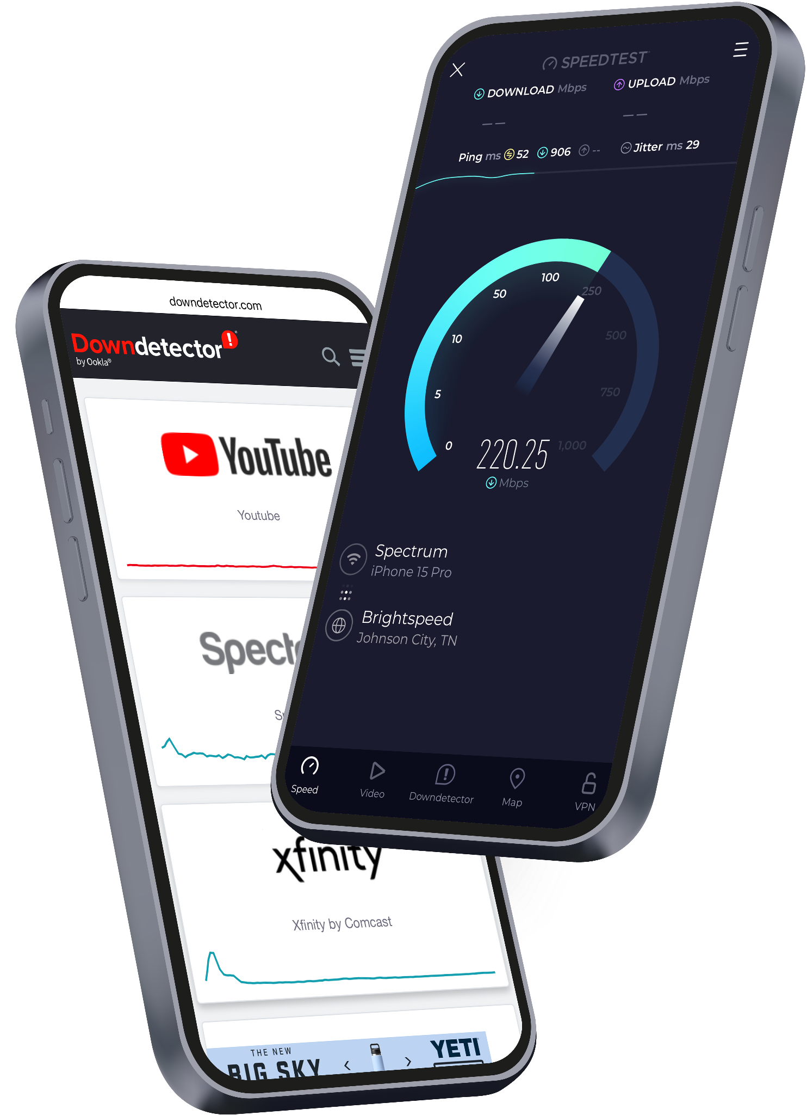













Billions of daily crowdsourced network performance samples
Tens of Millions of data points on NPS, subscriber ratings, and consumer sentiment
Millions of miles of controlled drive and walk network surveys
150M+
25M+
600M+
11M+
unique users
mo. problem reports
app installs
daily tests
21K+
50+
55B+
15K+
services monitored
countries
tests to date
global test servers
Defining the Future of Connectivity
The Global Media’s Trusted Source
Ookla data is used by governments, regulators, standards bodies, NGOs, academic institutions, trade groups, and analysts to solve the biggest connectivity challenges
articles published annually referencing Ookla brands
unique monthly impressions on publications citing Ookla data
share of voice for Ookla and Speedtest combined in network intelligence
140K+
Global Reach and Impact
70B+
90%
of the Fortune 500 trust Ekahau networking insights
56.3%
1,500+
Enterprise clients for Ookla in over 150 countries

Slide 3



Data Sources
Current Solutions
Speedtest Intelligence®
Aggregated and analyzed data based on ACTIVE “GO” Speedtests allowing you to visualize and easily understand the full landscape of network experience in your markets. Filter and compare performance by Provider Per Location, Historical periods, Device or chipset, Product manufacturer, Mobile and Fixed technology.
QoS
Active “GO” Speedtests
Cell Analytics™
Using billions of coverage scans, discover and prioritize areas for expansion and network optimization, get intelligence about wireless service quality, performance, RF conditions, data usage, user density, cell site locations, and much more — surfaced in one easy-to-navigate platform, viewed both outdoors and inside buildings, including 3D views.
Coverage
Coverage Scans
3
rd
Party
Consumer QoE™
Detailed metrics for multiple services, including web browsing, streaming video, gaming, and video conferencing. Based on foreground tests through the SDK.
QoE
Foreground Testing

Slide 4


















Sample of International Regulatory Clients
Canada
United Kingdom
Indonesia
Philippines
Malaysia
Nigeria
Jordan
Morocco
Ecuador
Saudi Arabia
Mexico
Egypt
Brazil
Colombia
UAE
Singapore
United States, Federal & State Governments

Slide 5
Quotes from yesterday’s Africa-BB-Maps Event
“Evidence-based policy and regulation”
“Ambient Population”
“Measured Progress”
“If you can’t map it, you can’t manage it”

Slide 6
Defining Areas of Need
1. Determining where people live, work and travel
2. Measuring Existing Connectivity with Crowdsource Data
3. Generating Additional Data

Slide 7
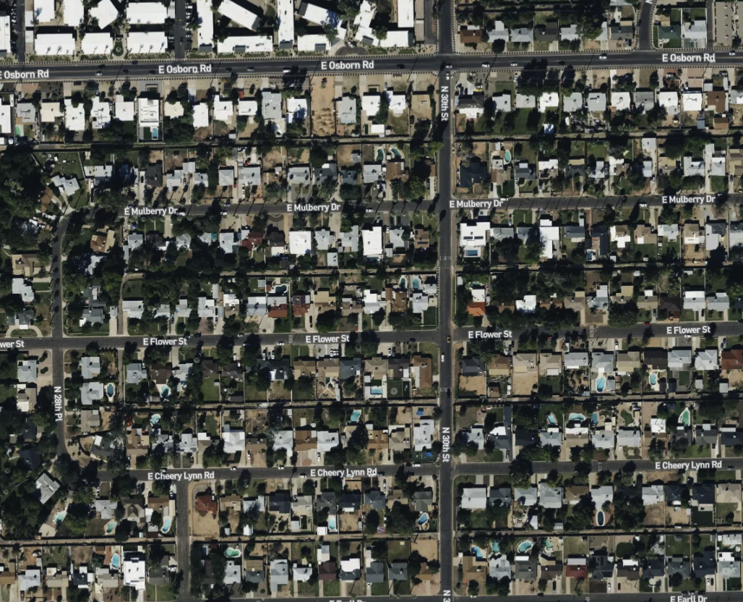

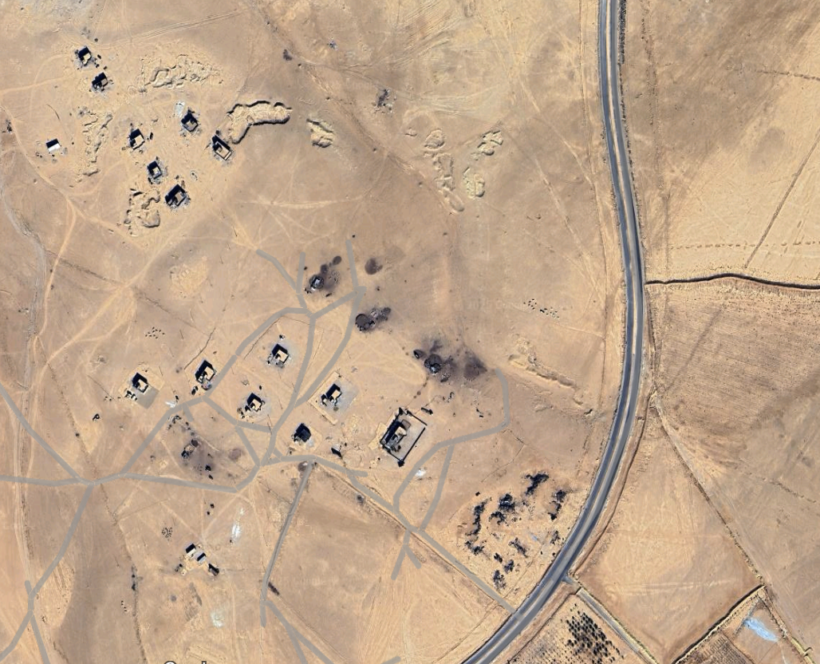
Prioritizing Investment: Where Do People Live?
High Density
Medium Density
Low Density
Most of these areas already have coverage today – but indoor service can vary.
Although mostly covered, these areas may not have the latest generation of services.
Low density means poor ROI. Subsidy is often required to justify investment.

Slide 8
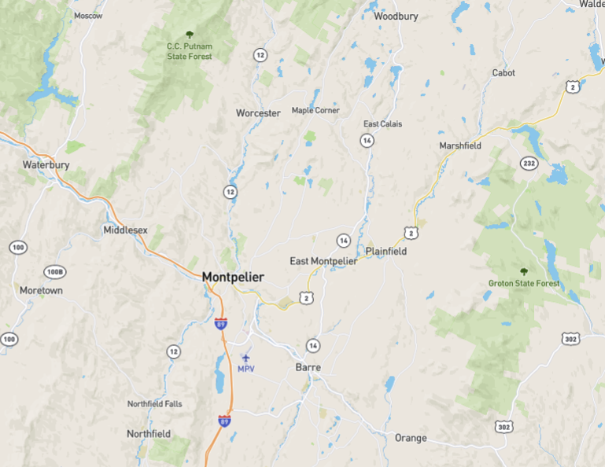
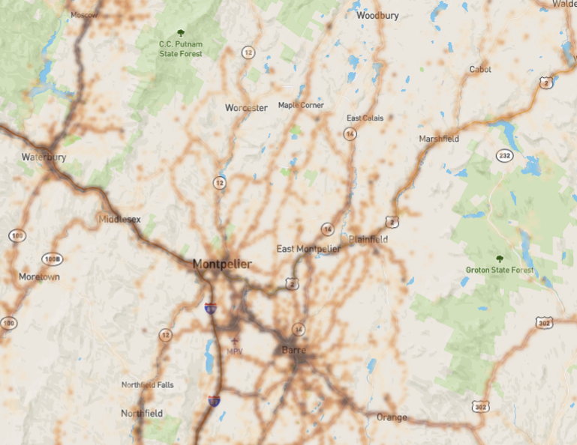
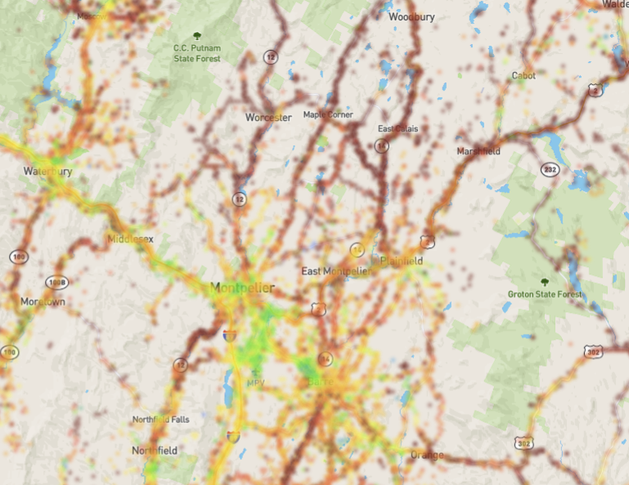
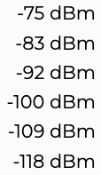
Prioritizing Investment: Where Do People Travel?
Crowsourced Data provides the first step to understanding areas of human activity and network availability
Important travel routes commonly extend through unpopulated areas
Roads with low traffic counts cannot justify private infrastructure investment
Lack of coverage on roadways is a Public Safety concern
High speed connectivity drives Economic Development
User Density
Signal Strength
High
Med.
Where only a few devices are reporting, crowdsourced data may need to be supplemented
Low
0
Images shown from Ookla’s Cell Analytics portal

Slide 9
Defining Areas of Need
1. Determining where people live, work and travel
2. Measuring Existing Connectivity with Crowdsource Data
3. Generating Additional Data

Slide 10
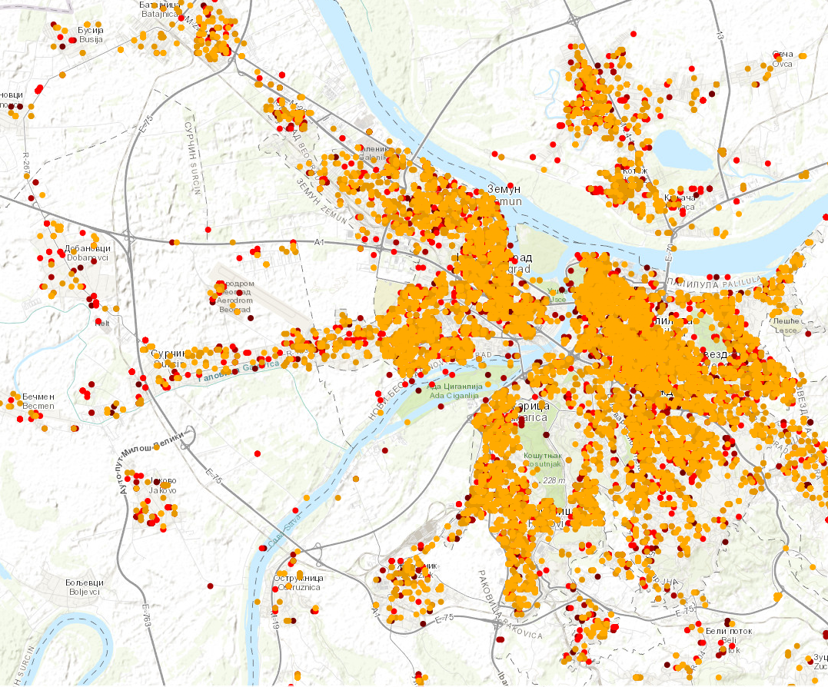
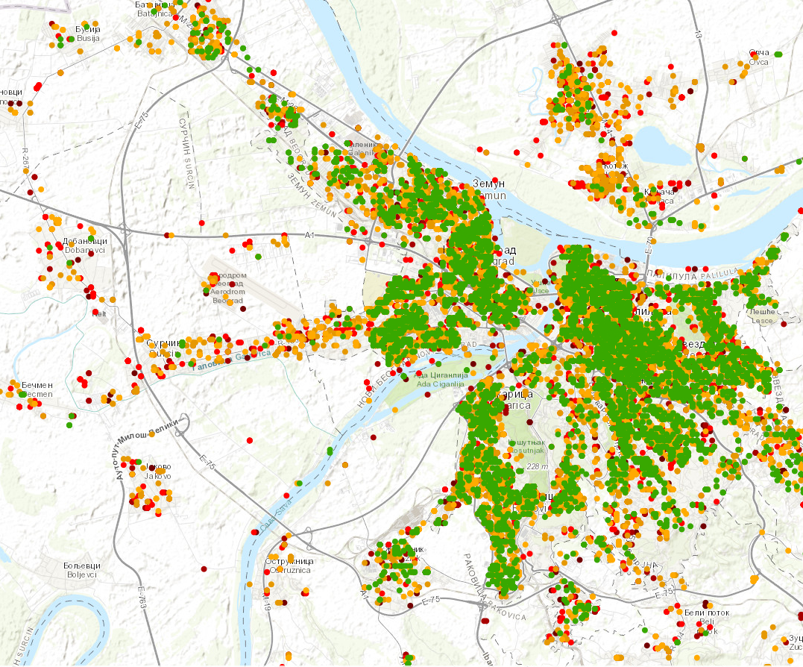
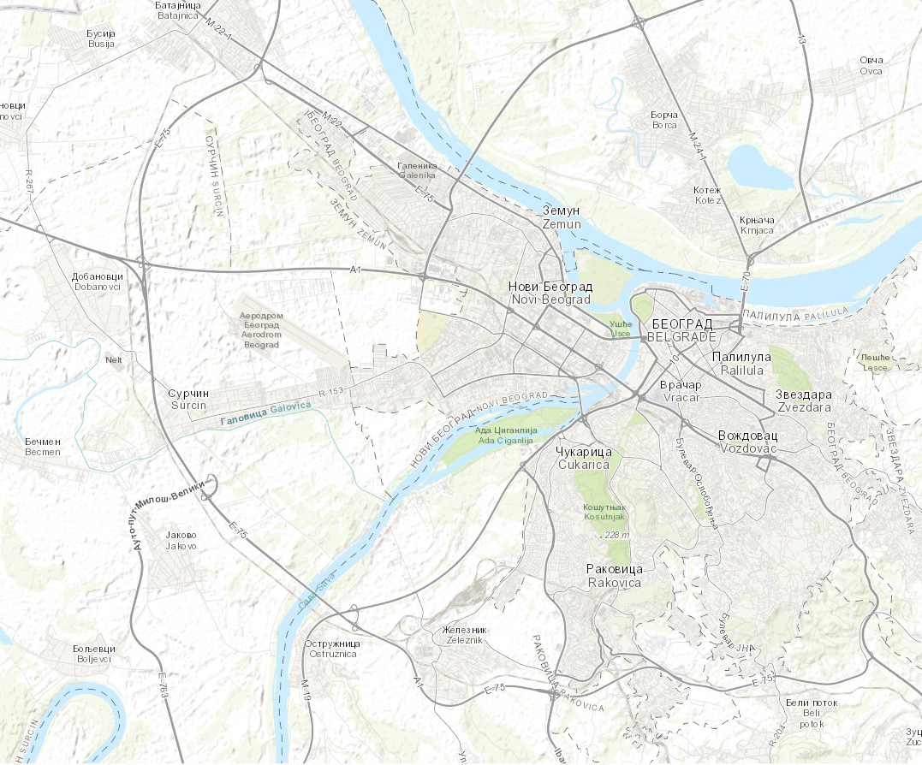
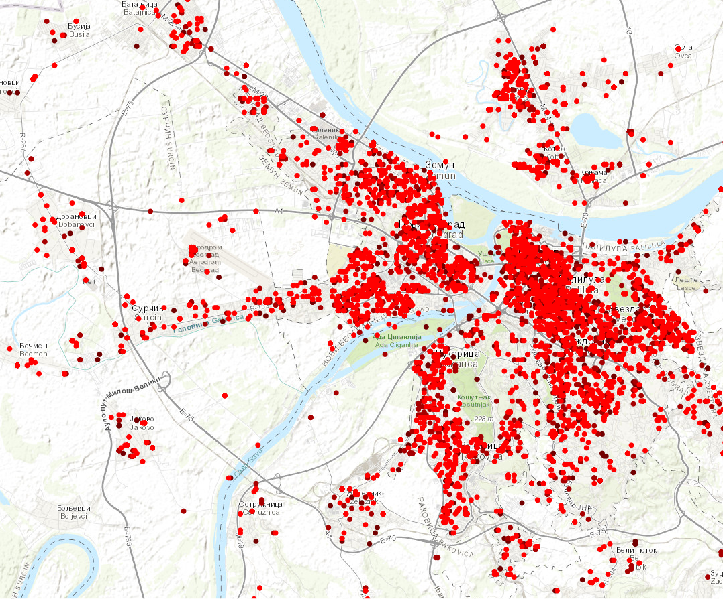
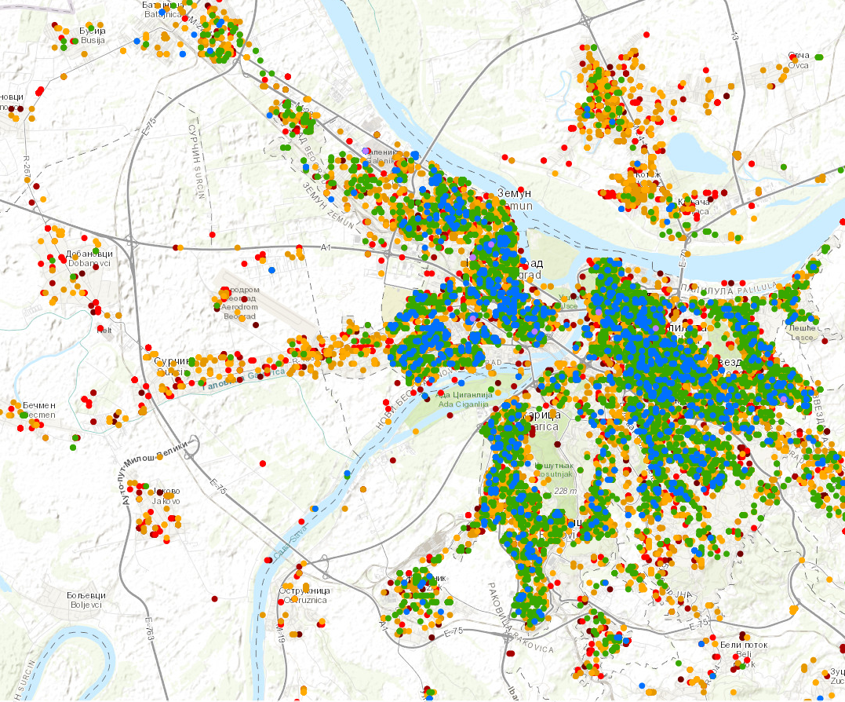
What level of service
is available?
Bežanijska
Borča
Belgrade, Serbia
Fixed operators tested via native mobile and desktop applications
Filtered for records with GPS-provided longitude and latitude
Layering with the fastest tests on top provides evidence for where broadband speeds are being met and where they are not
Areas with significant evidence of being underserved can be targeted for investment
Belgrade
Dobanovci
Rokovika
Less than 25 Mbps
Ostružnica
Speedtest® Measurements
25 - 100 Mbps
100 - 300 Mbps
Beli Potok
300+ Mbps

Slide 11
Standardizing geography for service area size
Broadband infrastructure deployment decisions are generally based on anticipated Return on Investment (ROI) which is calculated on cost per location
Traditional boundaries such as postal codes, census areas and political or administrative zones vary greatly in size
Data analysis on large and inconsistently populated areas makes comparisons difficult
By evaluating smaller, consistent geographies, you can better understand network availability and more precisely target investment
Tests meet minimum standards?
Eligible for
funding?
Does the existing network meet minimum performance levels?
Yes
No
No
Yes

Slide 12
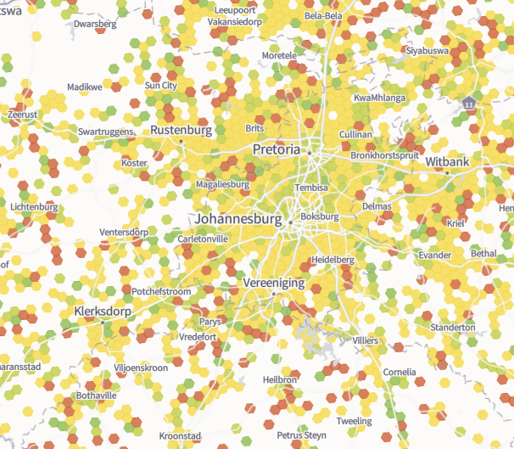
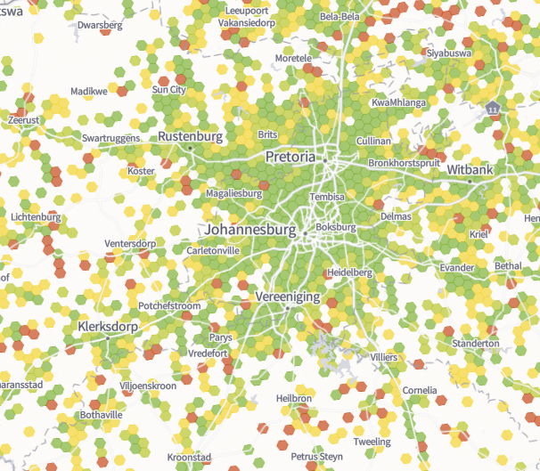
Johannesburg, South Africa
Median Speeds vs. Best Speeds (Mobile)
All Mobile Networks
Median Mobile Download Speeds
Best Mobile Download Speeds (Top 10% of tests)
> 100 Mbps
> 100 Mbps
25 - 100 Mbps
25 - 100 Mbps
10 - 25 Mbps
10 - 25 Mbps
< 10 Mbps
< 10 Mbps
Previous 12 months as of 31 March 2025
Previous 12 months as of 31 March 2025
Note: On the mobile networks, both MEDIAN and BEST speeds show similar increases broadly across the networks.

Slide 13
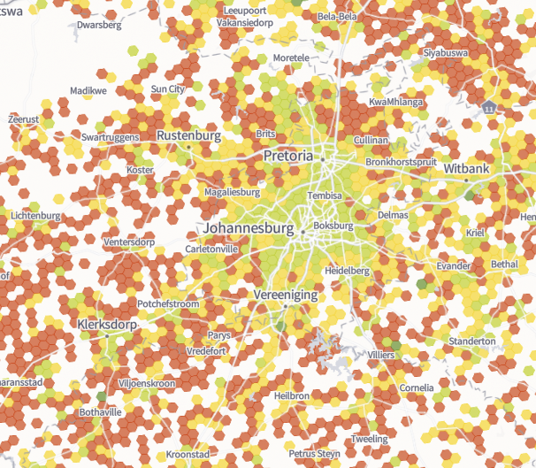
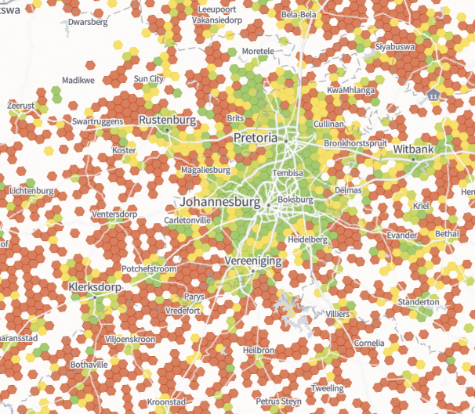
Johannesburg, South Africa
Median Speeds vs. Best Speeds (Fixed)
All Fixed Networks
Median Fixed Download Speeds
Best Fixed Download Speeds (Top 10% of tests)
> 100 Mbps
> 100 Mbps
25 - 100 Mbps
25 - 100 Mbps
10 - 25 Mbps
10 - 25 Mbps
< 10 Mbps
< 10 Mbps
BEST speeds represent the top 10% of results for fastest throughput.
Previous 12 months as of 31 March 2025
Previous 12 months as of 31 March 2025
Note: On the fixed networks, there is only marginally better BEST speeds vs. MEDIAN speeds

Slide 14
Defining Areas of Need
1. Determining where people live, work and travel
2. Measuring Existing Connectivity with Crowdsource Data
3. Generating Additional Data

Slide 15
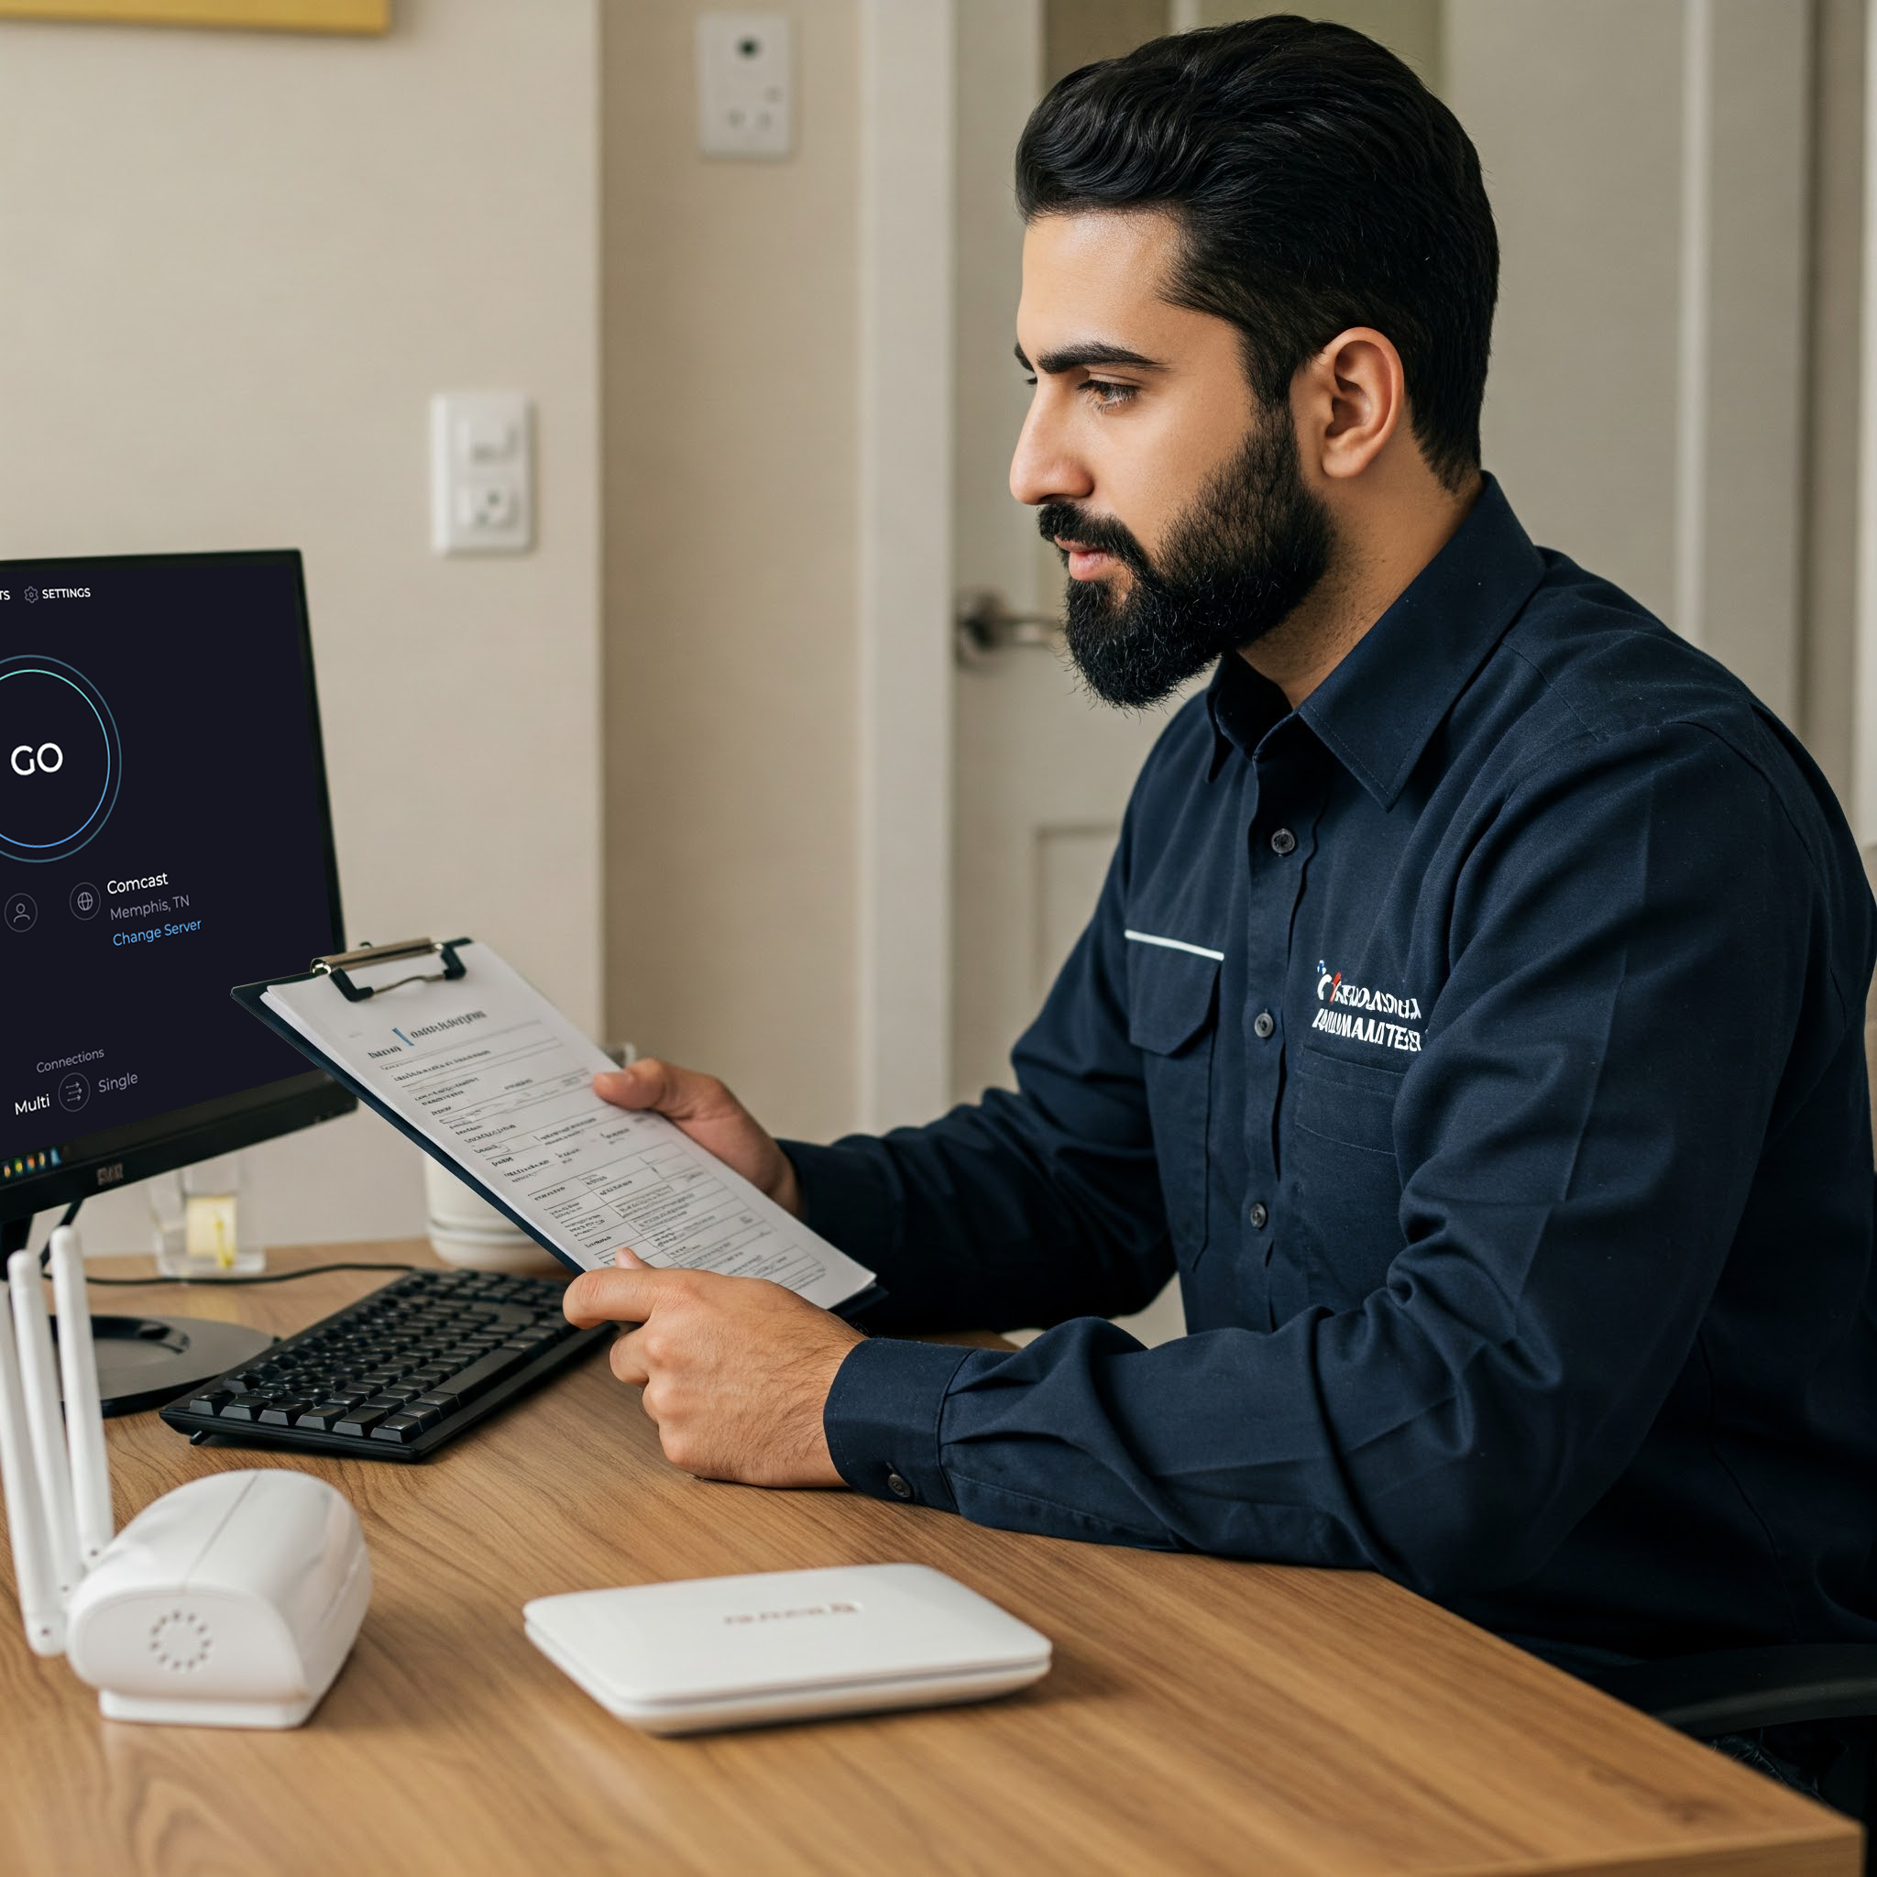











Increasing test counts and network data collection
Workshops
Partner with regulators, ISPs, operators, universities to show how ST data can help improve connectivity. Provide consumer-facing guides/content promoting why, how, and when to test.
Installer testing requirements
Require installers to conduct a Speedtest when connecting a home or business to new service
A multi-pronged plan of attack between Ookla, operators, and the regulator
Map messaging
Include pop-up: “Want to help improve the map?” Provide links to a blog about testing, consumer guides, and app store pages
Zero rating our app
Coordinate with NCC to ensure testing does not impact users’ data plans
Drive Testing
Controlled data collection in areas where population or traffic density does not generate enough data
Social media outreach
Consider 1) Influencer engagement, 2) showing test results in front of local points of interest, 3) a country-specific leaderboard of fastest speeds each week, 4) short-form video content, 5) promoting the new map
DRIVE

Slide 16
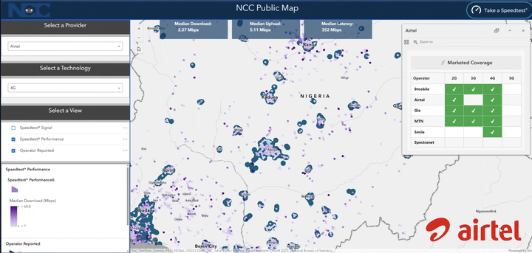
Increasing test counts and network data collection
Preliminary

Slide 17

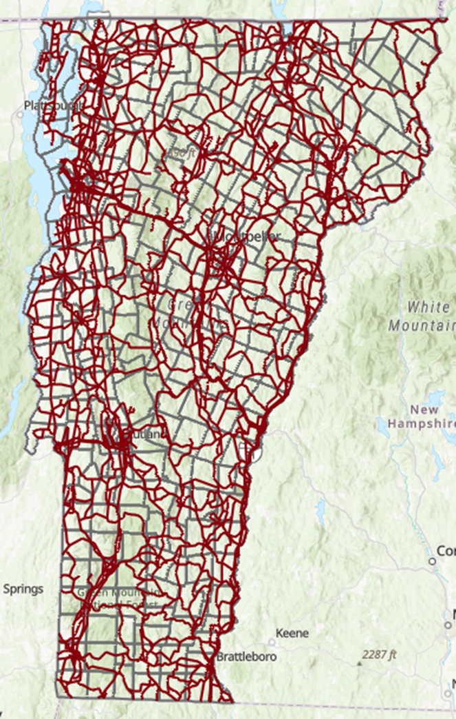
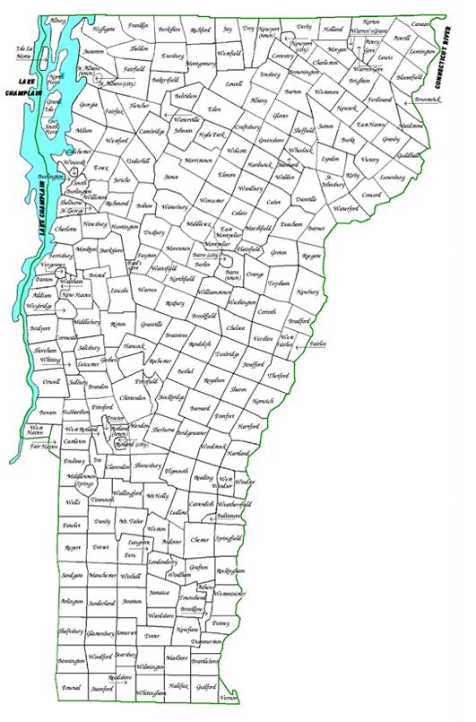

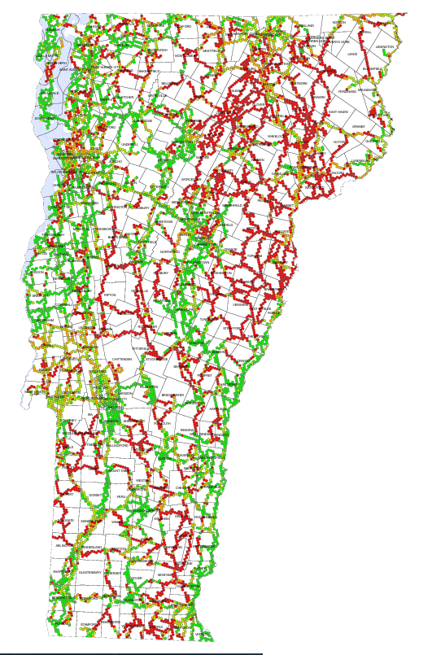
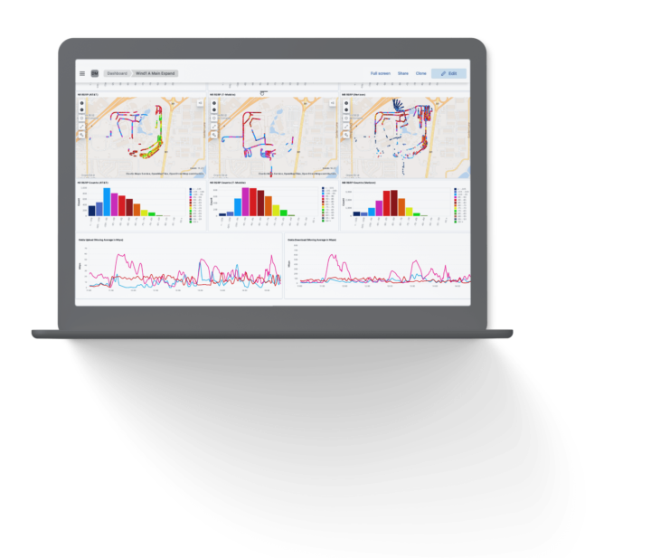
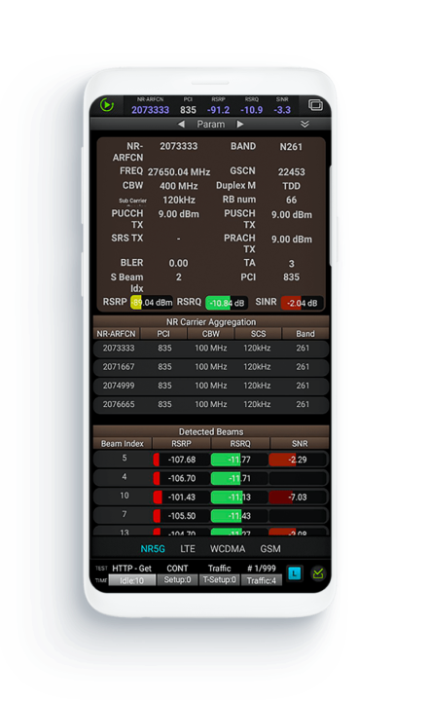
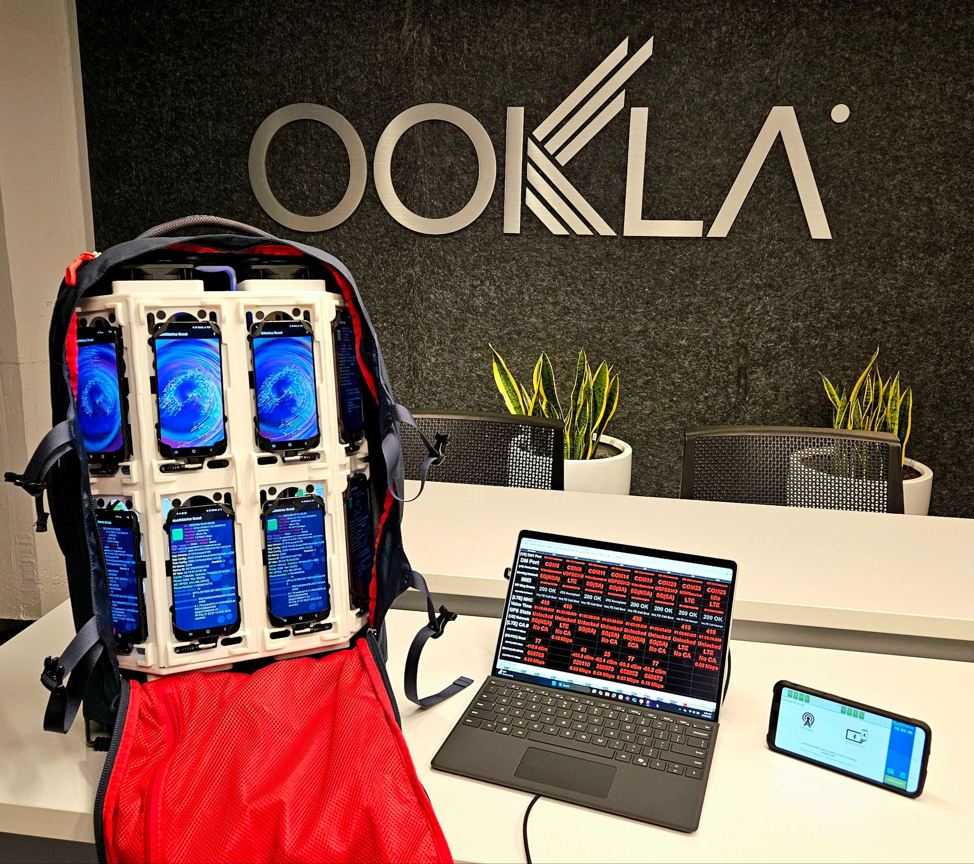
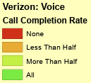
Speedtest Drive
Drive Test Routes
Mobile Voice Coverage
Client:
Operator coverage claims were not believable
Vermont government officials worked with Ookla to plan the routes and maximize data collection
Ookla’s field team drove over 6,000 miles of major highways and roads with suspicious coverage claims
Data and Voice testing performed on all networks
Verizon
reported
coverage

Slide 18
Monitoring and Compliance
Operator Accountability
Benchmarking Competitors
Demonstrating Progress

Slide 19


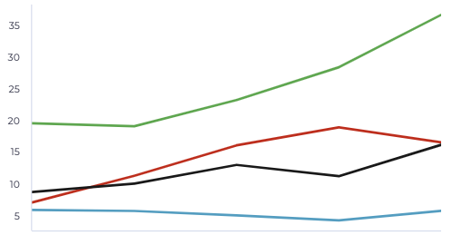
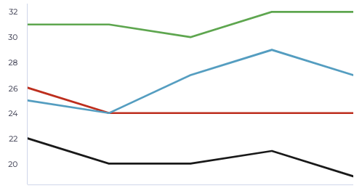



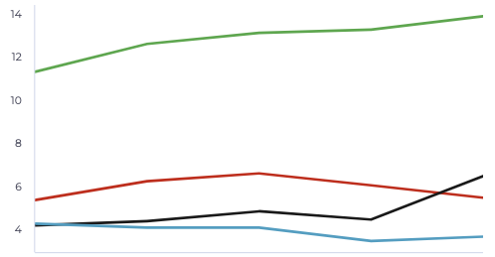
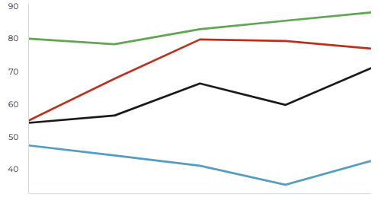

WV
Highlighting mobile
broadband progress in
Tracking progress over time
KENYA
Median Download Speed (Mbps)
Minimum Latency (ms)
Airtel
Airtel
Faiba
Faiba
Safaricom
Safaricom
Telkom
Telkom
2020
2021
2022
2023
2024
2020
2021
2022
2023
2024
Median Upload Speed (Mbps)
Consistency (% of tests at least 25 down / 3 up)
Airtel
Airtel
Faiba
Faiba
Safaricom
Safaricom
Telkom
Telkom
2020
2021
2022
2023
2024
2020
2021
2022
2023
2024

Slide 20
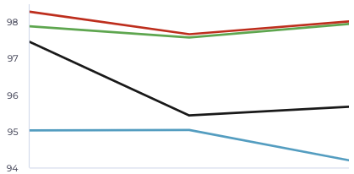
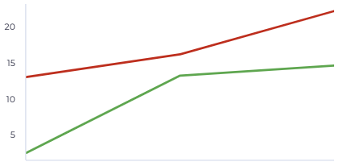
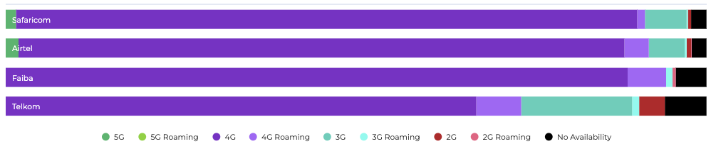
Highlighting mobile
broadband progress in
Tracking progress over time
KENYA
General Availability
5G Availability
Airtel
Airtel
Faiba
Faiba
Safaricom
Safaricom
Telkom
Telkom
2023
2024
2025 YTD
2023
2024
2025 YTD
Availability on Service-Active Devices, by Network Connection Type
0%
25%
50%
75%
100%

Slide 21
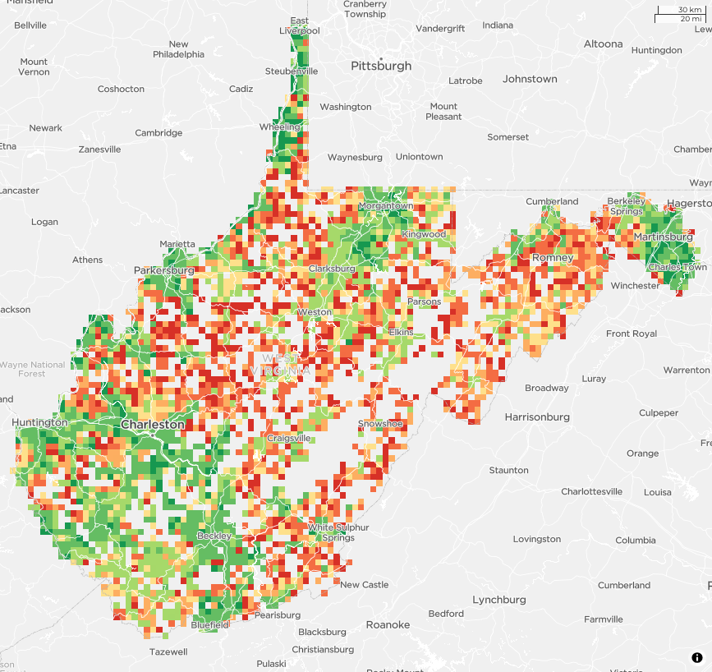
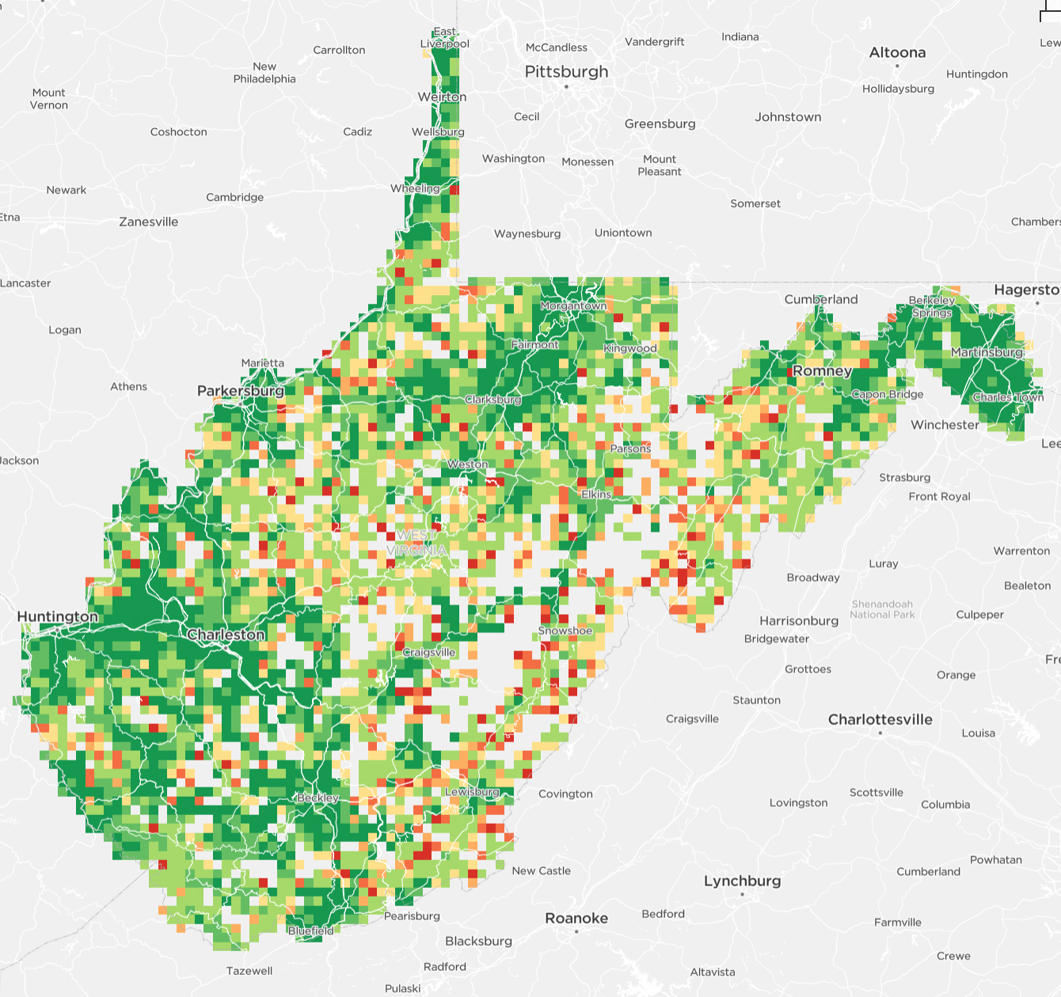
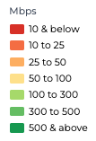
Demonstrating Progress to Leaders and the Public
Best 10%
2021
Best 10%
2024
The ”Best 10%” are results typically captured in very good conditions such as highest subscriber tier and close proximity to the gateway.

Slide 22

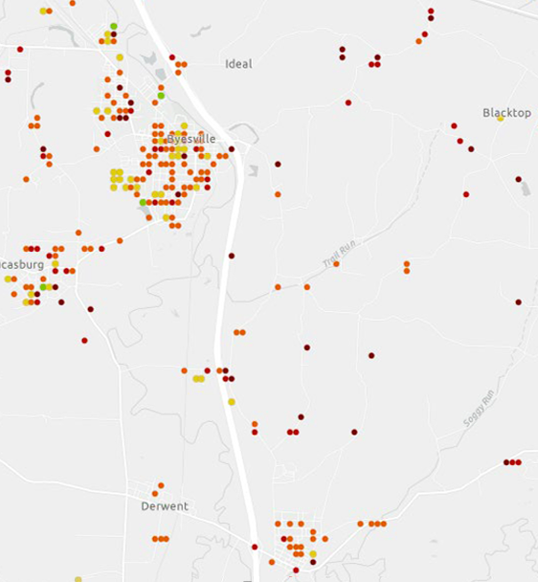
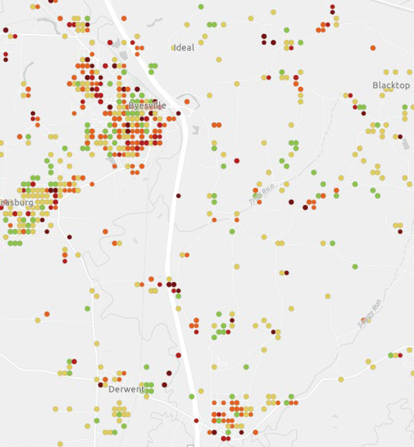

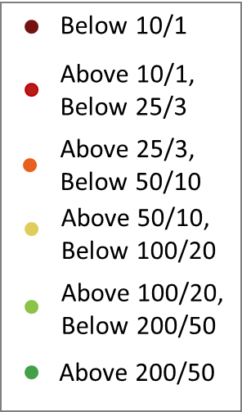
New service adoption drives data collection and demonstrates progress
Trusted by regulatory bodies, trade groups & analysts
Virtually every major ISP and carrier in the world
6,000+ host servers around the world
15 years of proven technology purpose-built for accurate performance
Service installers aren’t the only ones curious about the network performance of a new connection.
Before USF Award to ISP
1 Year After Funding
Subcribers will often run a Speedtest to validate that their new service is performing as promised.

Slide 23
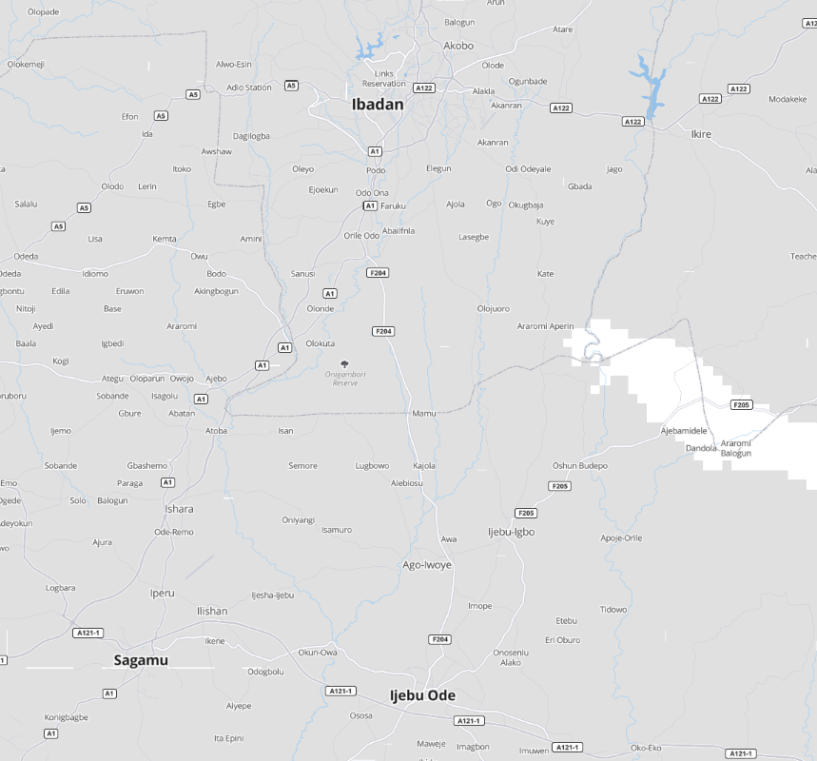
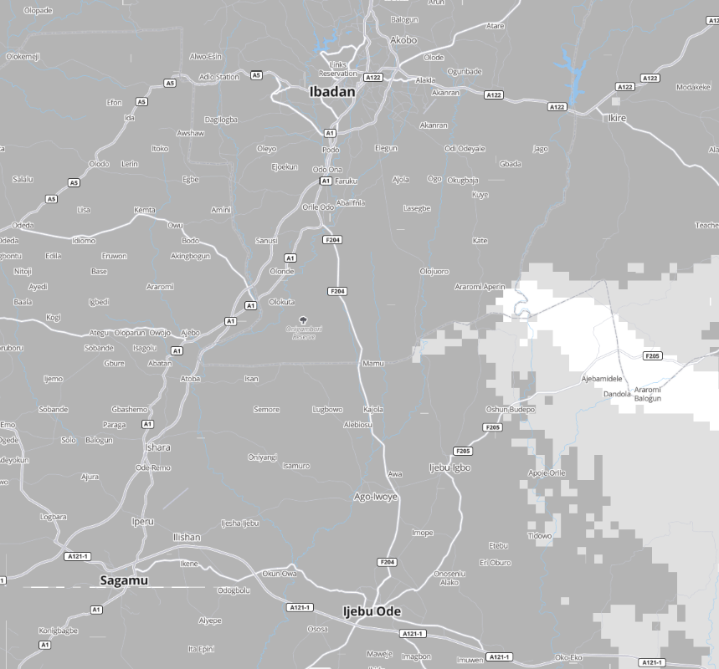
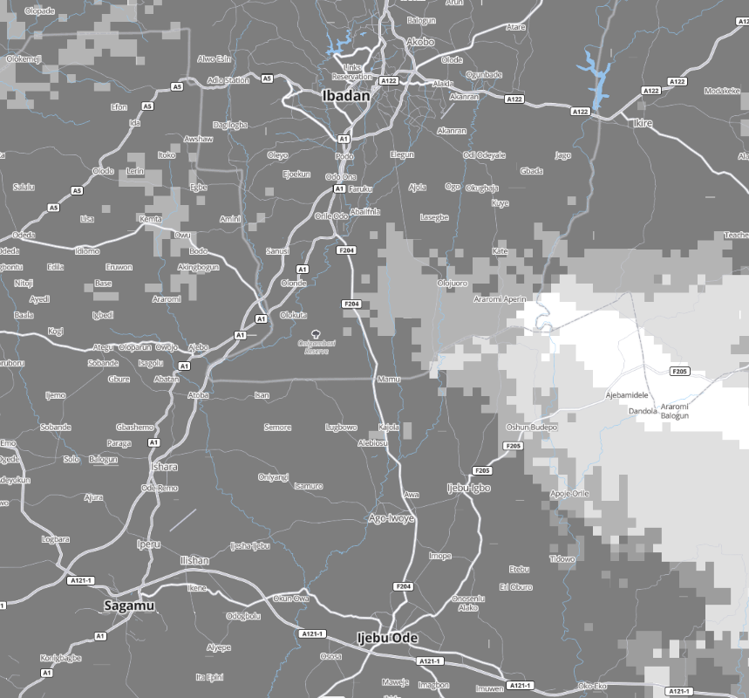
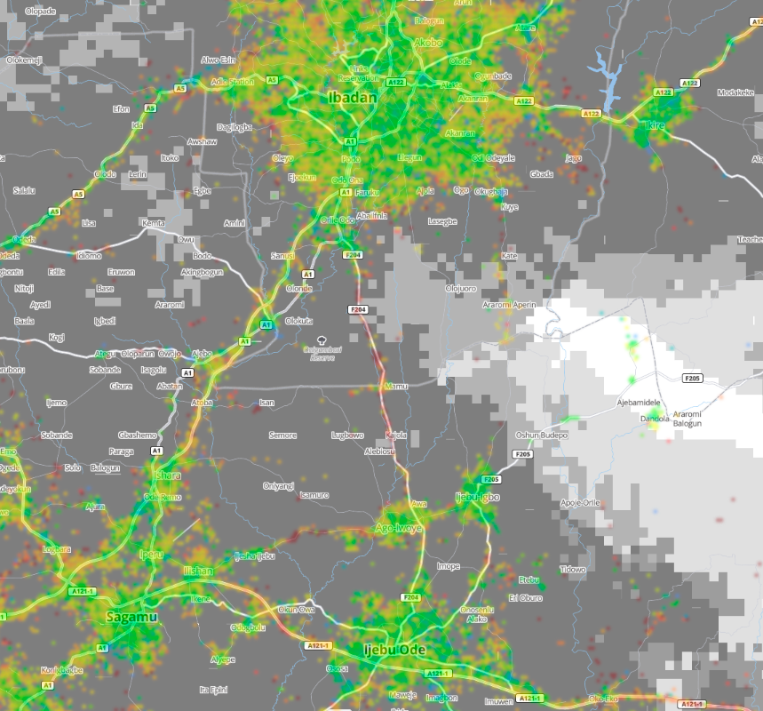
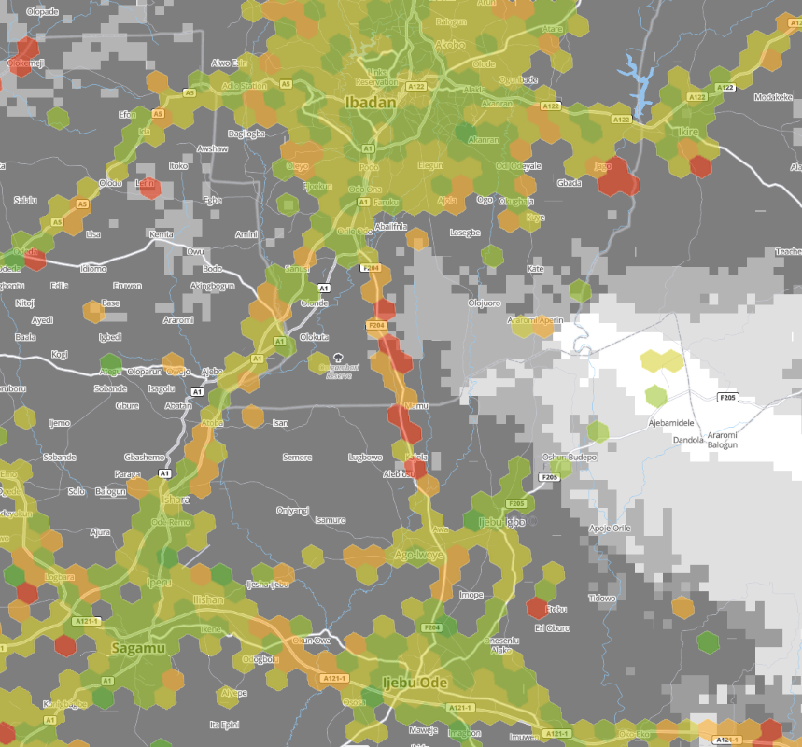

Operator reported coverage can be different from reality
Mobile operators use coverage maps to differentiate their service from competitors
Subscribers rely on this information when choosing a service provider
Crowdsourced data can inform both regulators and the public on true service availability
Operator shows covered but signal readings are poor
Measured Coverage
No coverage? Additional data may be needed
Excellent
Good
Fair
Poor
Marginal
Reported Coverage
4G coverage
3G coverage
2G coverage

Slide 24

Consumer QoE™
Real-world consumer network experience insights

Slide 25

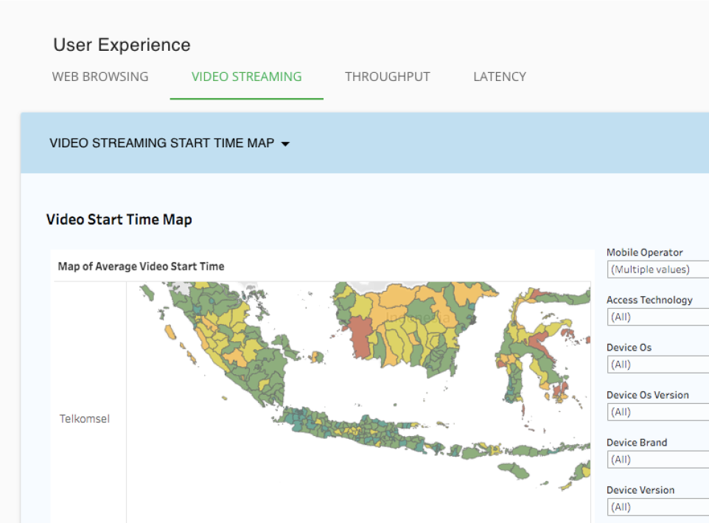
Consumer QoE™
Collecting billions of daily measurements, Ookla’s SDK provides a comprehensive picture of real-world consumer network experience — across the use cases, services, devices, applications, CDNs, and cloud providers that matter most to end users.
Analyze real-world data in volumes that are simply impossible to collect via controlled testing or probes
Get insights into the user experience metrics that matter most to consumers — benchmarked against competitors
Correlate user experience measurements to radio network conditions to uncover hidden issues
Plan network improvements to have the highest impact on consumer experience
Insights are available via both a data visualization portal and a data warehouse (add-on) for ultimate flexibility

Slide 26
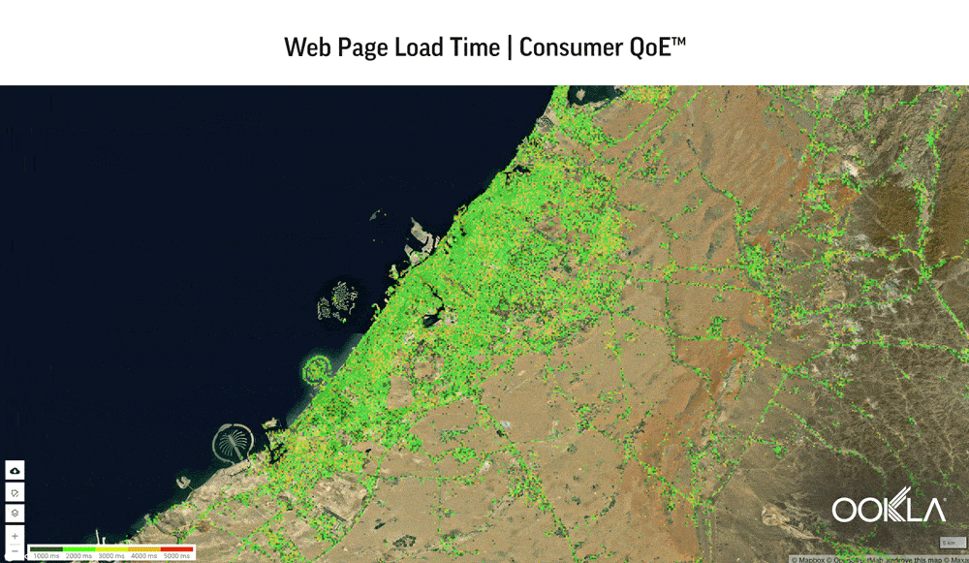
The User Experience, Visualized
Analyze in-depth consumer experience metrics for multiple services, including web browsing, streaming video, gaming, and video conferencing. Based on active tests through the SDK, this module allows you to:
Visualize real-world user experience KPIs with detailed geographic location information
Identify areas of competitive weakness or strength
Identify pain points that matter most to users, such as poor video playback or gaming latency
Correlate user experience with radio environment, throughput, or latency
Filter results by device, device capabilities, network technology, radio cells, locations, time, and more

Slide 27











Test metadata
Network and user experience data
Data includes
Timestamps
Operator & ISP info
SIM card info
Routing info
Location
Indoor/outdoor
Wi-Fi usage
Cellular data usage
Video playback metrics
Video quality & resolution
Video accessibility
Game name
Gaming connectivity metrics
Video conferencing app
Connectivity metrics
Voice call metrics
Voice MOS
DL/UL throughput
Latency
Accessibility
CDN provider performance
Web page load time
Web page accessibility
Device data
Model
Brand
Software info
Hardware info
Hardware utilization
Signal data
RF metrics for LTE & NR
Wi-Fi signal metrics

Slide 28
Thank you
Bryan Darr
Vice President, Government Affairs
bryan.darr@ookla.com
Notes:
iOS is currently available in select markets

