Slide 1


Africa BB Maps National Event
National Broadband Mapping Systems in Kenya
Context and Current State: Mapping of Spectrum Resources
Dennis Sonoiya
Data Management and Documentation
Standards and Resource Management Department
25th August 2025

Slide 2
Objectives of Spectrum Management
To ensure efficient utilisation of frequency spectrum resource, the Authority has set strategic objectives on spectrum management
Support emerging technologies and new services.
Maintaining accurate databases on frequency management
Resolution of harmful interferences
Implement international agreements and protocols on spectrum management
Promotion of optimum & efficient use of scarce frequency resource
Ensuring the compliance to assigned technical parameters
Assignment of frequencies to network operators.
Regional and Cross-Border Coordination

Slide 3
Effective Spectrum Management
Table of Frequency Allocations, EMC & Coexistence Analysis, Channelisation, Allocation, Coordination, Coverage Analysis, Channel Identification, Research.
1
Planning & Coordination
Assignment & Licensing
Application Processing, Assignment, Licensing, Billing, Reconciliation, Customer Service & Monitoring support.
2
Effective Spectrum Management
Radiofrequeny Spectrum
Monitoring & Compliance
Band Clearance, On-site Inspections, Monitoring Campaigns, Systems Maintenance, Support Enforcement.
3
Customer Service, Database Management, Systems Integration, ERP Billing Reconciliation, Data Verification, Data Analytics, Reports, Document Archival
4
Data Management
& Documentation

Slide 4
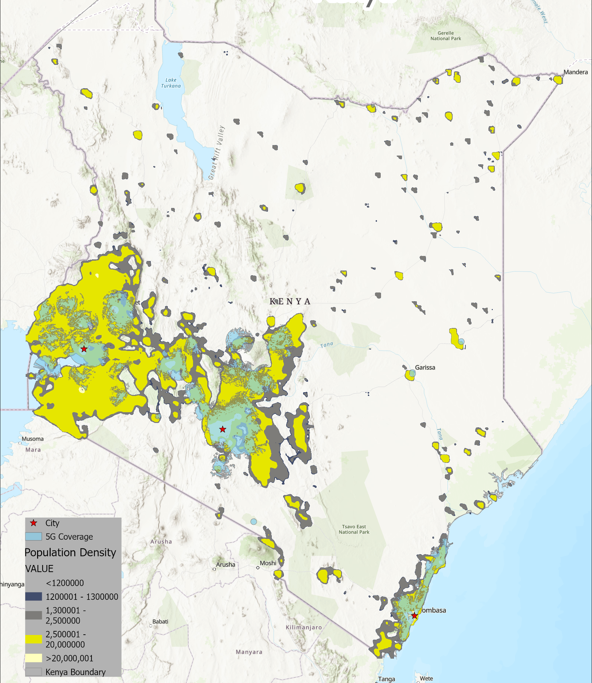
5G Deployment in Kenya
Mobile Broadband Deployment Trend 2022-25
Operator | Tech | Jun ‘22 | Jun ‘23 | Jun ‘24 | Jun ‘25
Airtel | 3G | 25,848 | 29,182 | 33,782 | 25,346
 | 4G | 16,497 | 26,855 | 33,779 | 38,405
 | 5G | - | 857 | 1,245 | 1,404
Jamii | 4G | 990 | 1,032 | 1,215 | 1,347
Safaricom | 3G | 71,132 | 75,527 | 80,023 | 86,593
 | 4G | 37,680 | 63,489 | 71,597 | 86,827
 | 5G | 102 | 1,939 | 2,311 | 5,114
Telkom | 3G | 7,804 | 7,875 | 3,577 | 3,577
 | 4G | 2,329 | 2,552 | 1,244 | 1,244
Total 5G deployments nearly doubled from 2024 to 2025 (~83%)
Date Source: Communications Authority of Kenya, 2025
Notes:
5G Spectrum Licensing
Administrative – 700 MHz
Market Based – 2.6 GHz
Spectrum Re-farming – 3.5 GHz
MNOs have deployed 5G networks
5G Population Coverage at 30%
Clearance of upper 6 GHz band - IMT
Sandbox - 26 GHz/mmWave band trial under consideration.

Slide 5
Enhanced Broadband
Use Cases & Applications
Manufacturing
Communications
Education
Healthcare
Agriculture
Smart Cities
Industrial Automation
Robotics & Remote Object Manipulation for Mining & Construction
Virtual & Mixed Reality
Low-Cost Networks
Regional ICT Centres
High-Speed Home & Office Broadband
Public Safety and Disaster Response
Fixed Wireless Access
High-Speed Home & Office Broadband
Improved E-Learning Via Videoconference.
Improved Access To Rich Media Resources
Remote surgery & examination.
Virtual meetings
Remote object manipulation.
Smart wearables.
Smart Agriculture.
Connected sensors for smart agriculture systems.
Wildlife Tracking & management
Internet of Things (IoT).
Big Data Analytics & AI.
Remote Smart Meters for Utilities
Transportation.

Slide 6
5G Uptake in Kenya
Aggressive 5G Network Rollout by Operators - Safaricom & Airtel
Rising Adoption – Mobile subscriptions for 5G
Digital Superhighway - Govt to building extensive optical fibre network to expand backbone
5G experience Centres
Locally assembled affordable smart phones (digital inclusion) – $40
1450 Digital Village Smart Hubs - Provides digital skills training and e-government services

Slide 7
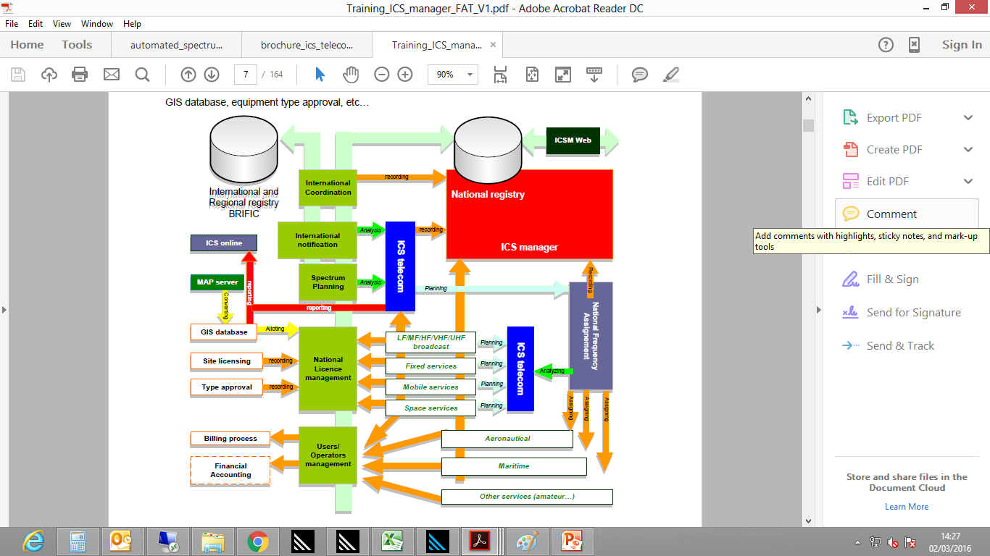
Spectrum Management System

Slide 8
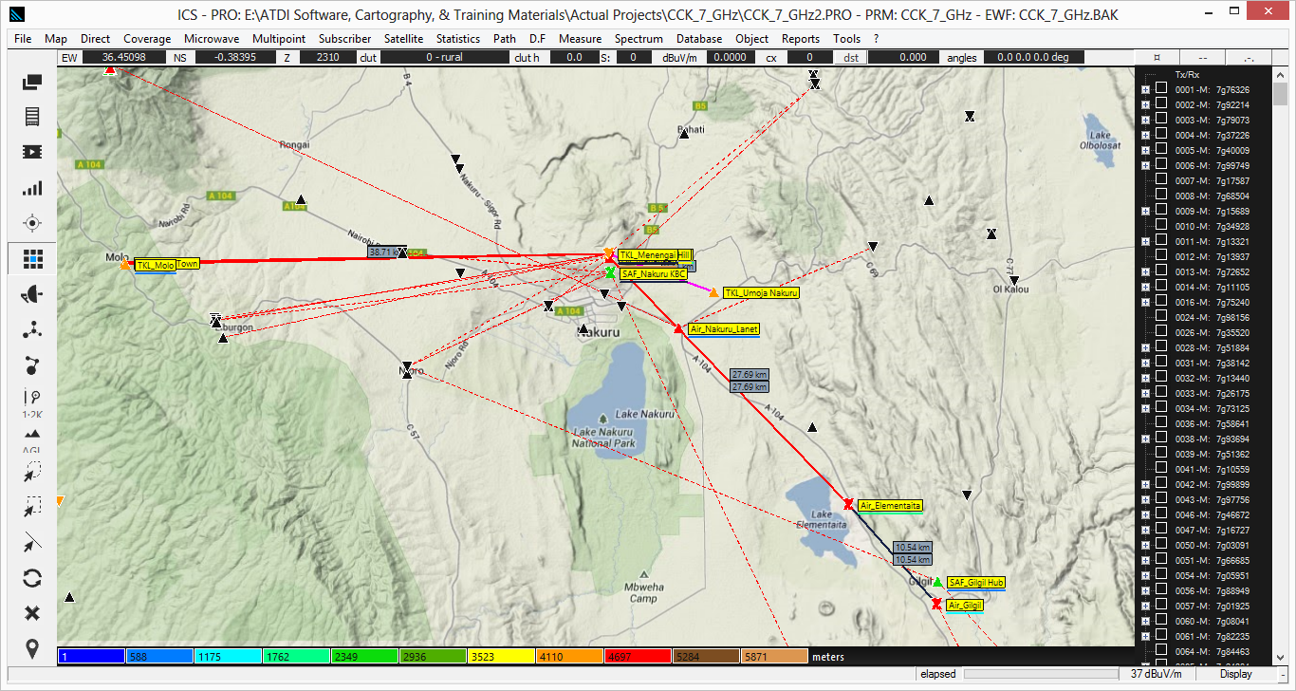
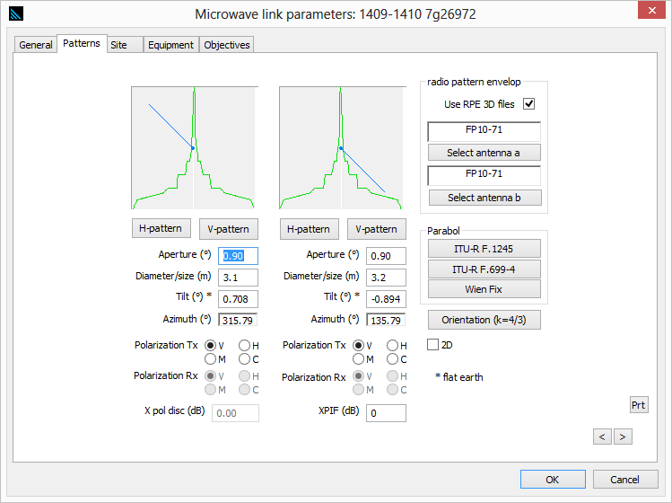
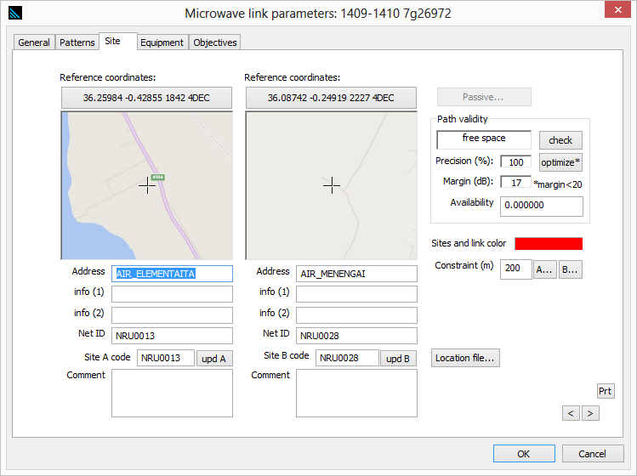
Sample use case of the Spectrum Management System for frequency assignment for fixed microwave links in the 7 GHz Band in Nakuru

Slide 9
Monitoring Facilities
Fixed Radio Monitoring Stations
HF & V/U/SHF
Mobile Radio Monitoring Stations
HF & V/U/SHF
Mobile and Backpack QoS Monitoring Stations
Fixed Broadcast Content Monitoring Locations
Notes:
The total number of broadcasters who were operational increased from 89 TV and 186 FM in the year 2018/2019 to 199 TV and 228 FM.

Slide 10
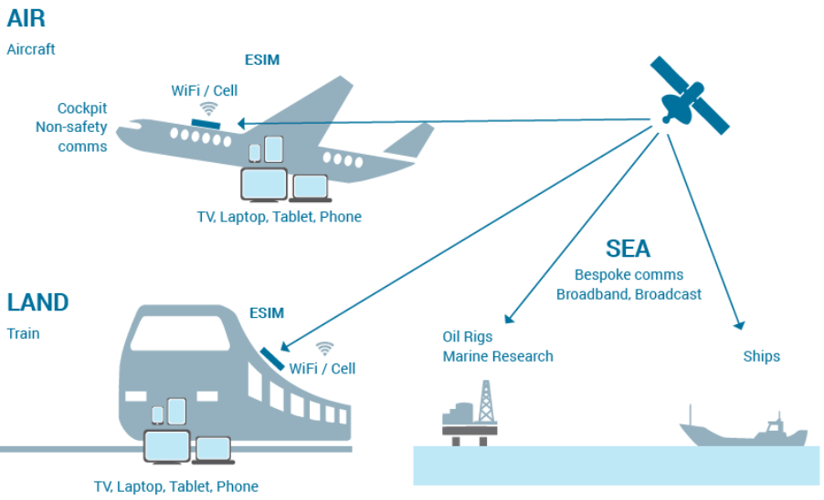
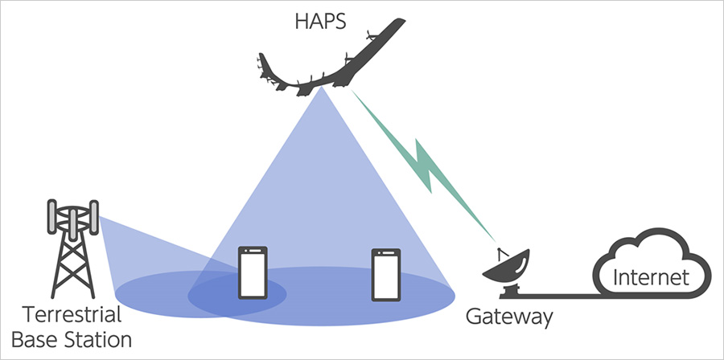
Emerging Issues – Satellite & Non-Terrestrial
Mobile Satellite Service (N-GSO LEO Deployments)
Communications of ESIMs with N-GSO to provide reliable high-capacity Internet services to aircraft, ships & vehicles.
Growth in satellite deployments is creating regulatory challenges.
Balance traditional telecom services with satellite operators.
CA Action:
Ongoing review of market structure – Validation, Public consultation.
Promote coexistence between satellite & terrestrial services.
2. High-Altitude Platform Stations (HAPS)
High-Altitude IMT Base Stations (HIBS)
Use the same frequency bands as IMT base stations on HAPS for extended mobile broadband connectivity to underserved areas, e.g., 2100 MHz. (AALTO Zephyr, Requires partnership with MNOs
CA Action:
Align licensing with global best practices to attract investment.
Support trials with other government agencies
Kenya Civil Aviation Authority
Kenya Space Agency

Slide 11


Emerging Issues – 5G & Private Networks
3. 5G Deployment & Frequency Harmonization
Release of new spectrum bands (e.g., mid-band & mmWave).
Align with ITU & regional frequency harmonization & channelisation.
Action:
Implement 5G roadmap & spectrum management guidelines.
Implement optimal spectrum allocation framework.
4. Small, Private, and Community Networks
Growing demand for spectrum by enterprises, new ISPs & small private networks.
Simplified licensing to support innovation.
Action:
Develop a framework for shared spectrum bands for Private/Industrial/Enterprise networks.
Encourage shared spectrum use models to improve efficiency.

Slide 12
Challenges Broadband Mapping – Spectrum Related
Accuracy of Broadband Coverage Maps
Inability to identify actual coverage gaps.
Enterprise Integration
Poor linkage of various systems and platforms.
Cross-Border Coordination
Signal spillover & forced roaming along borders.
Capacity of Existing Systems
Need for advanced capabilities to conduct long-term trend analysis.
Compatibility & Integration
Limited integration with other systems & platforms.

Slide 13




