Slide 1
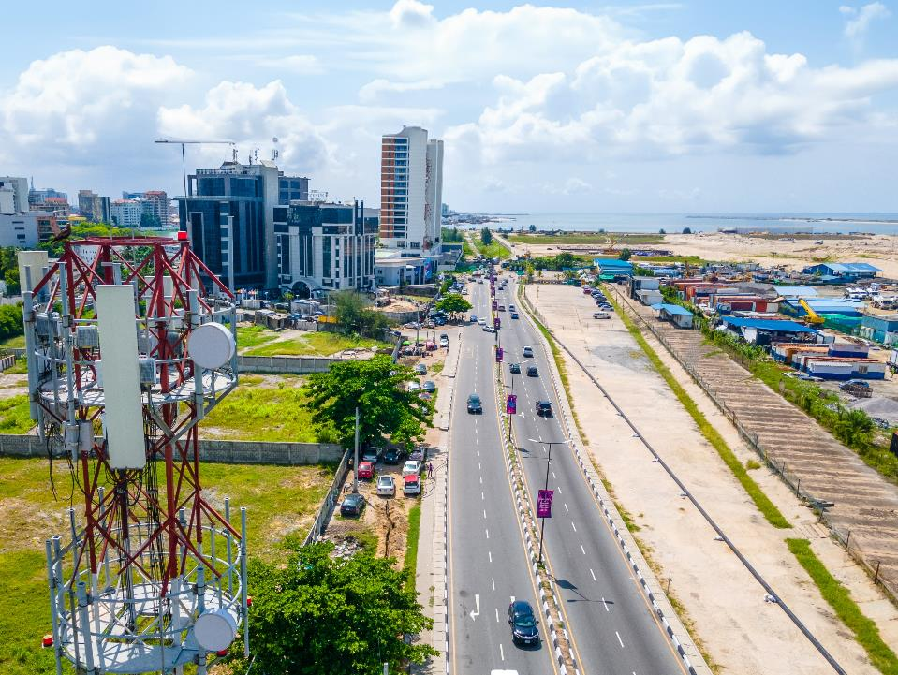


A NIGERIAN COMPANY With a Global Presence
20+year track record across the Towers value chain

Slide 2
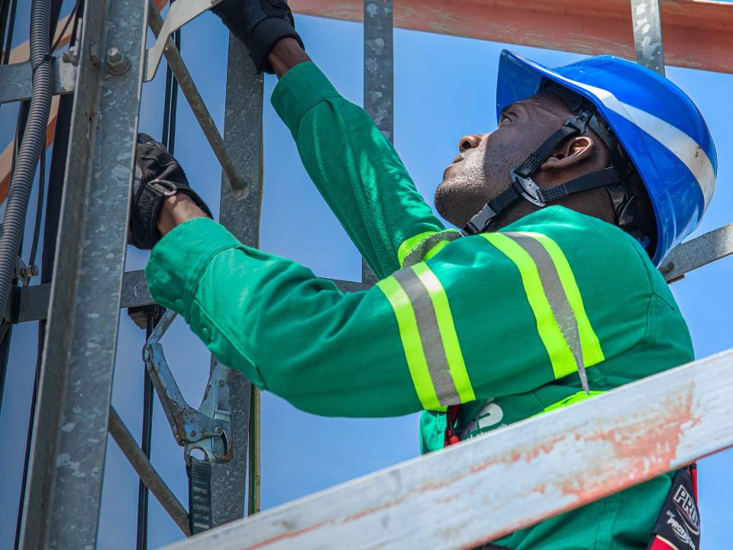

IHS NIGERIA What we do

Slide 3

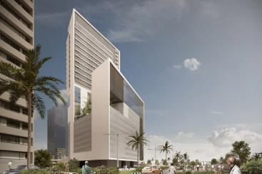
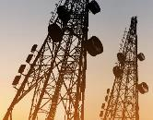
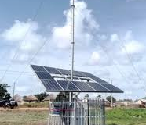

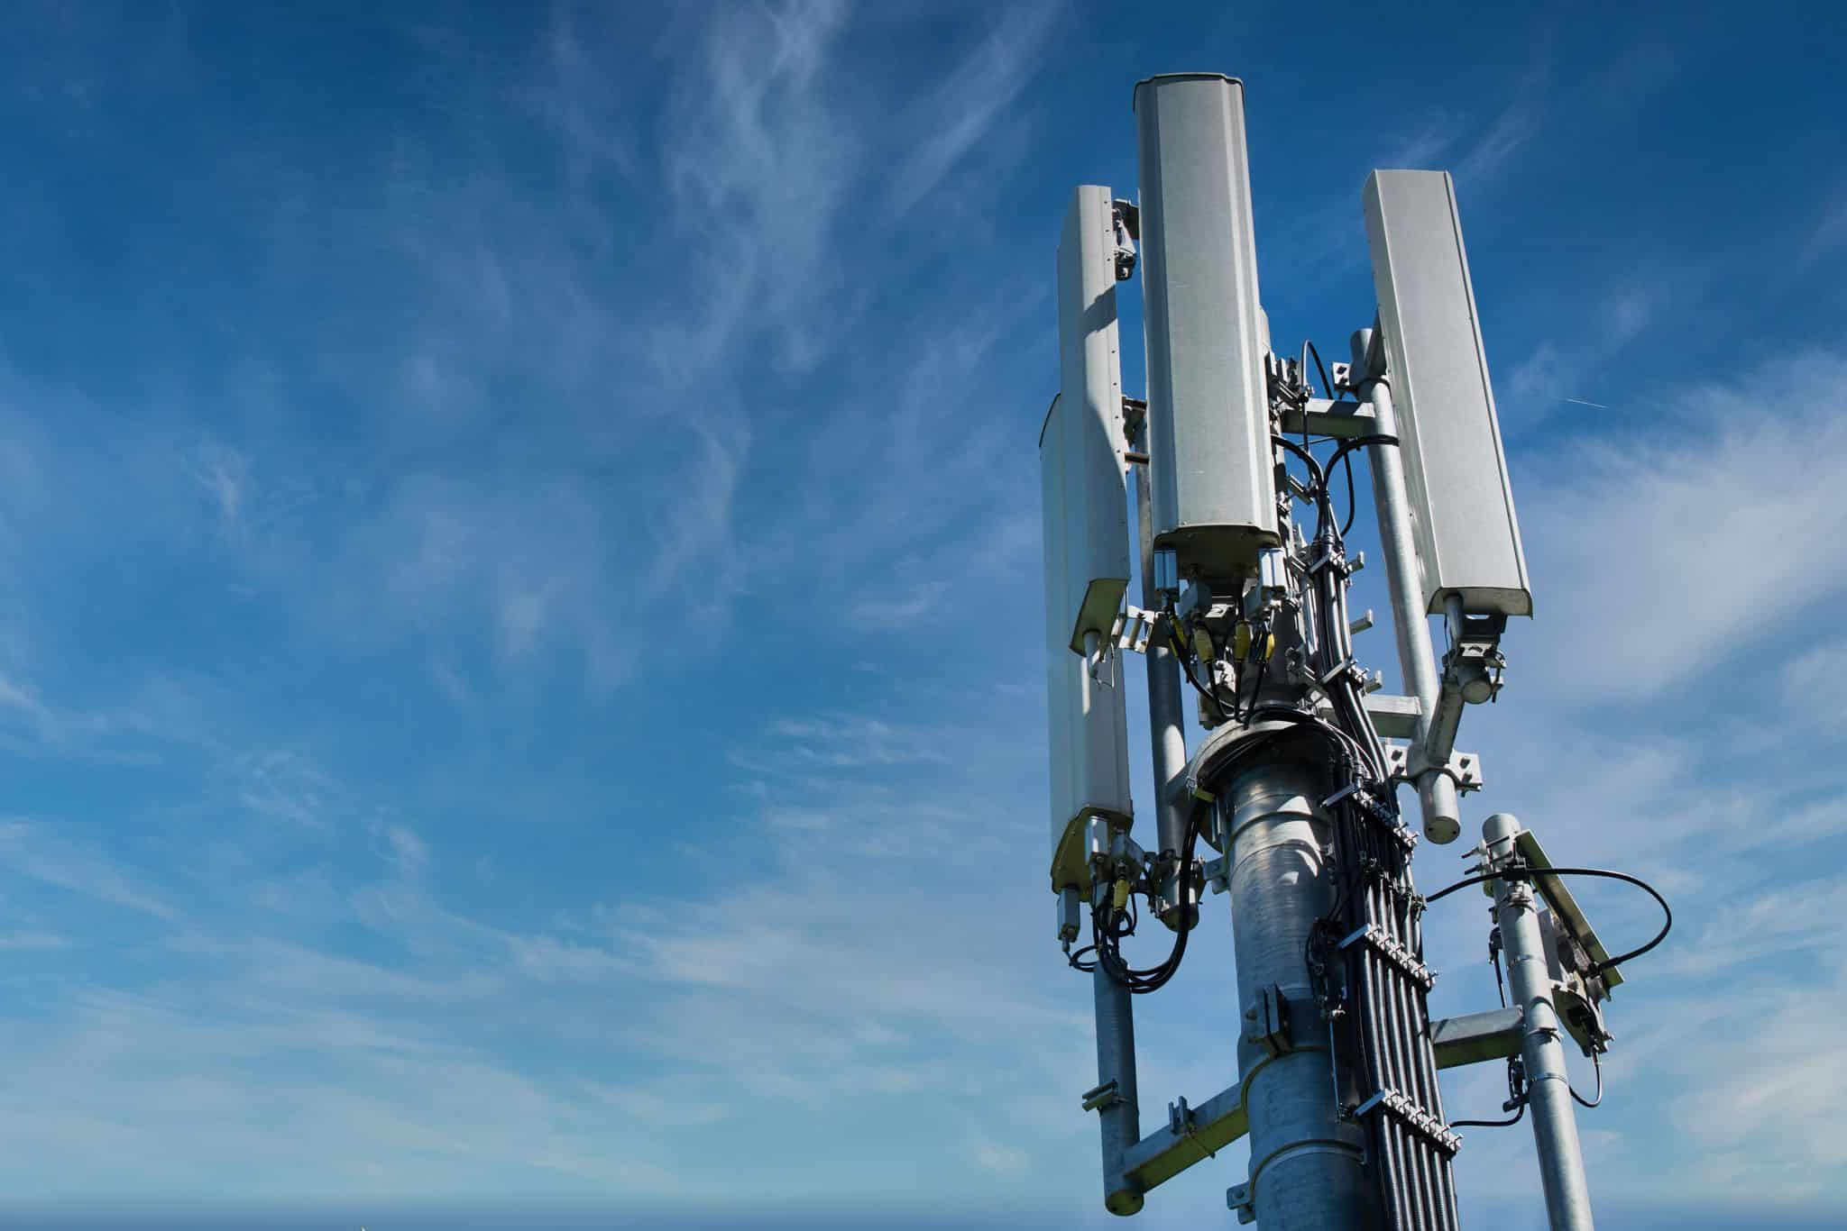
IHS NIGERIA OUR GLOBAL PRODUCT OFFERING
IHS provides a wide range of communications infrastructure solutions and managed services to help our customers achieve their connectivity goals.
Colocation
Inbuilding Solutions
Addition of customers to an existing tower
Reduces the overall cost and environmental impact of telecom operations
Connected solutions for large buildings - hotels, offices, metro stations, airports etc.
Efficient and discreet way of creating better coverage for operators.
New sites (built to suit or BTS)
Rural Telephony
Turnkey deployment of sustainable & cost-effective solution to remote communities
Brings mobile connectivity to unserved & underserved remote communities
Turnkey deployment of New Sites
Enables network operators to expand their network
Fiber Connectivity
Small Cell
Deployment of last mile fiber to towers & fiber access
Facilitates broadband expansion
Non-intrusive micro-site solutions deployed on commercial premises, lampposts, and poles etc.
Helps meet rising demand by boosting coverage & and quality in high-density urban areas
Notes:
Slide 17 – Change the rural image. Again, we can do this in-house.

Slide 4
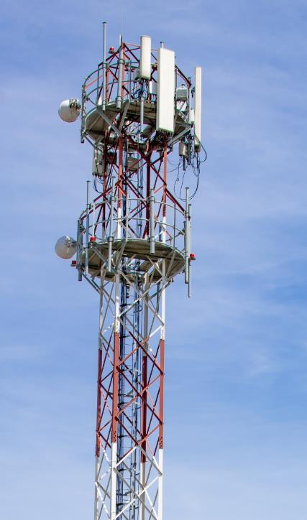
IHS NIGERIA Key Infrastructure
21+
Years of Experience
16,000+
Telecom towers
15,700+ Fibre Infrastructure
590+
Rural Sites )

Slide 5

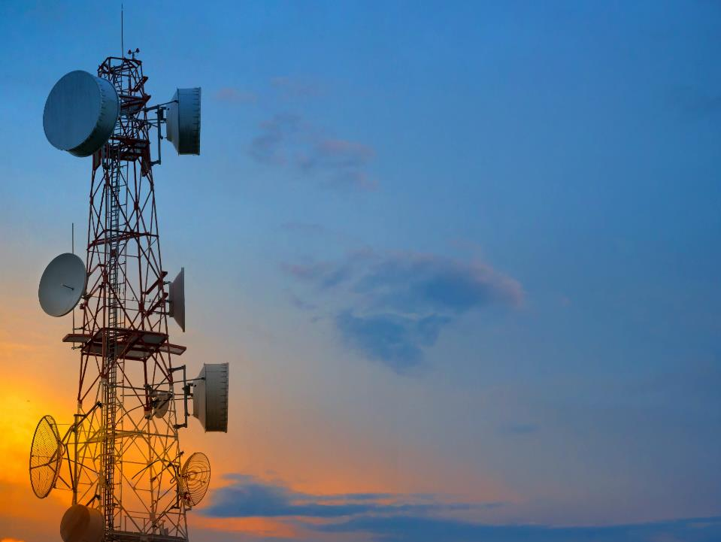
A NIGERIAN COMPANY WITH A Global Presence

Slide 6


