Slide 1



KPLC & Communications Authority of Kenya: Powering Kenya's Digital Future
Relationship between Kenya Power and Lighting Company (KPLC) and the Communications Authority of Kenya (CA), highlighting their complementary roles in developing Kenya's ICT infrastructure and broadband mapping initiatives.

Slide 2

Organizational Mandates
Communications Authority of Kenya (CA)
Kenya Power and Lighting Company (KPLC)
Regulates ICT sector (telecommunications, broadcasting, postal services)
Sole distributor of electricity in Kenya
Owns and manages the national electricity distribution network
Oversees licensing, frequency allocation, data protection compliance
Provides power to ICT infrastructure (data centers, telecom towers)
Promotes universal access to ICT and broadband services
While operating in different sectors, these organizations have significant areas of intersection that impact Kenya's digital infrastructure development.

Slide 3




Areas of Intersection
ICT Infrastructure & Power Supply
Broadband & Fiber Deployment
Infrastructure Sharing
CA encourages infrastructure sharing; KPLC poles are often used by ISPs to lay fiber cables, creating regulatory intersection.
Telecom operators rely on KPLC for reliable power to run base stations and networks. Reliable power supply directly impact ICT service quality.
KPLC has installed Optic Ground Wire fiber on power lines and leases it to telecoms and ISPs, subject to CA regulation.

Slide 4

Collaborative National Projects
Digital Inclusion Goals
Practical Organizational Links
Both entities contribute to Vision 2030 objectives:
CA and KPLC can cooperate around:
CA through Universal Service Fund (USF) for ICT access
ICT infrastructure deployment on power lines
KPLC through Last Mile Connectivity Project for electricity
National broadband mapping
Coordination to minimize service interruptions
Collaboration in rural electrification + ICT connectivity rollouts

Slide 5
KPLC's GIS Journey (1998-Present)
1998: Digital Transformation Begins
1
Conversion of paper maps to digital format (digitization)
2
GIS Database Development
Creation of comprehensive geospatial database
CORS Installation
3
Continuously Operating Reference Stations for centimeter accuracy
4
Network Mapping
Complete mapping of transmission, distribution, fiber networks and administrative boundaries
System Integration
5
Fully functional GIS system integrated with other operational systems

Slide 6
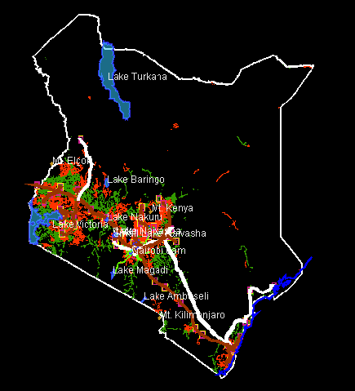
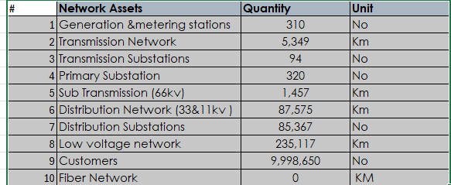
KPLC Mapping

Slide 7
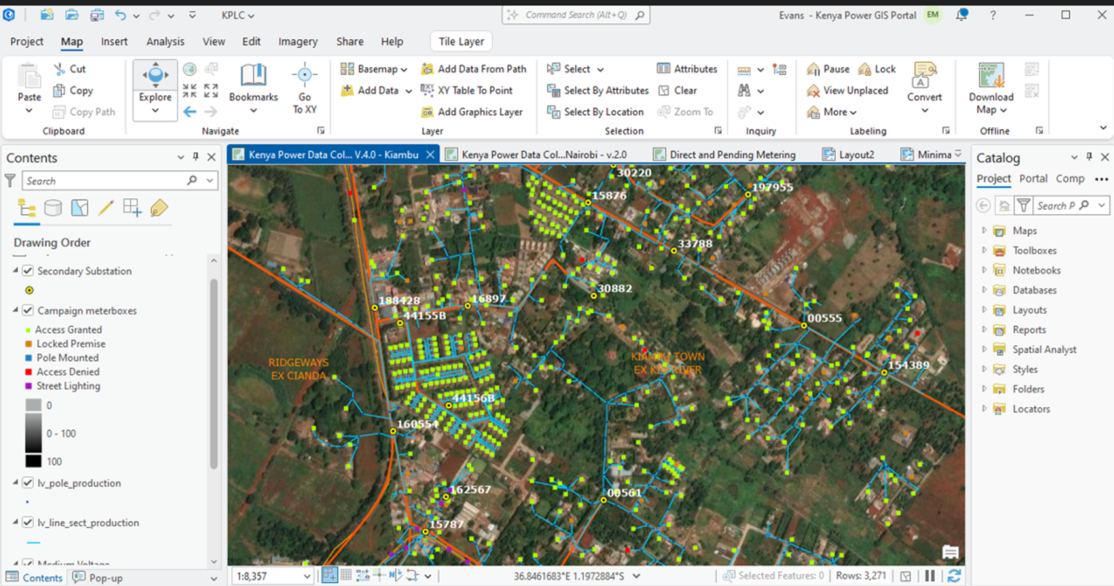
KPLC Mapping

Slide 8
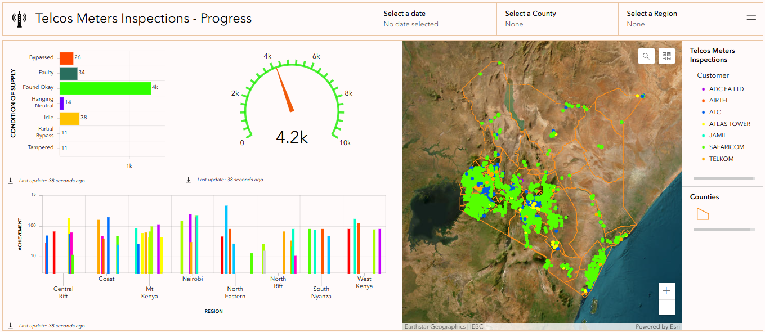
KPLC Mapping

Slide 9

Digital Superhighway Project (DSH)
KPLC has been contracted by ICT Authority (ICTA) to deploy the National Government Digital Superhighway, involving installation of fiber cables and active devices across Kenya.
KPLC GIS Roles in DSH:
Training telecommunication design teams on GIS tools
Providing network data for planning
Coordinate transformation for low-level designs (LLD)
Creating AutoCAD drawings to guide construction and form basis for invoicing

Slide 10
Strategic Benefits of Broadband Mapping to KPLC
Revenue Diversification
Grid Modernization
Commercialization of fiber assets by identifying unserved areas and leasing dark fiber to ISPs and mobile operators. Given the opportunity, KPLC IESR can offer mapping services for broadband infrastructure
Enabling smart grid capabilities, real-time monitoring, automated metering, and predictive maintenance
Strategic Partnerships
Improved Service Delivery
Attracting investment from ISPs and ICT companies while aligning with government digital initiatives
Enhanced customer experience through smart meters and reduced technical losses
Broadband mapping positions KPLC as a central player in Kenya's digital transformation while opening new revenue streams.

Slide 11

KPLC's Contribution to Broadband Mapping
Infrastructure Data Provision
GIS Database Development
Electric grid network GIS data
Centralized repository integrating power and telecom data
Fiber-optic network mapping
Electricity access data as baseline
sharing platform for government and private sector
CORS Network Leverage
Decision support tools and visualization
High-precision mapping (centimeter-level accuracy)
Strategic Alignment
National coverage support
Integration with broadband data
Positioning as a digital infrastructure utility
Collaboration with CA and Ministry of ICT
Public-private partnerships for last-mile delivery

Slide 12








Alignment Between KPLC and CA on Broadband Mapping
Shared Vision
Complementary Roles
Both support universal, affordable broadband access in line with Kenya's National Broadband Strategy
CA sets policy and regulates; KPLC provides physical infrastructure making broadband rollout faster and cheaper
Strategic Collaboration
Infrastructure Sharing
Joint development of national GIS platform for electricity and broadband coverage
KPLC agrees with CA's approach to minimize duplication by using existing utility corridors
The relationship is symbiotic — CA drives universal access, while KPLC makes rollout feasible and cost-effective.

Slide 13



