Slide 1

WIRELESS BROADBAND
BROADBAND MAPPING
Presented by
Patrick B Musiyapo
BICC LILONGWE, 7th October,2025

Slide 2
PRESENTATION OUTLINE
SADC Broadband Targets
Where we stand
Spectrum Interventions
Going forward

Slide 3
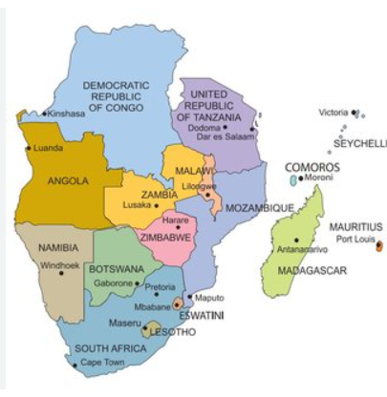
SADC Broadband Targets
Universal Access to broadband accelerates socio-economic growth, assist in disaster management, and facilitate access to public and private sector services.
In 2018 Ministers approved SADC Broadband Targets to be achieved by 2025.
The targets have assisted the region to identify short comings and opportunities and monitor its access and usage of broadband.
The SADC Broad band Targets 2025 areas follows:
By 2025, 80% of the population of each SADC Member State should be covered by broadband services; In particular, atleast 80% of rural areas should be within the reach of entry-level broadband services, be it fixed or mobile.
By 2025, 50% of the house holds in each SADC Member State should be connected to broadband.
By 2025, entry-level broadband services should be made affordable in SADC, at less than 2% of monthly Gross National Income(GNI)per capita.
By 2025, entry-level terminals and house hold installation for fixed or mobile broadband should be made affordable in SADC, at less than US$50 or 2% of ye arly Gross National Income(GNI) per capita, whichever is lower.

Slide 4
SADC Broadband Targets
By 2025, all SADC Member States should have a funded National Broadband Plan or Strategy or include broadband in their Universal Access and Service (UAS) definition.
By 2025 broadband/Internet user penetration in Each SADC Member State should reach 65%.
By 2025 ,60% of youth and adults in each SADC Member State should have achieved atleast a minimum level of proficiency insustainable digital skills.
By 2025,un-connectedness of Micro-Small-Medium Sized Enterprise (MSMEs) should be reduced by 50%, by sector.
By 2025 ,40% of the population in each SADC Member State should be using digital financial services;and
By 2025, gender equality should be achieved across all SADC Broadband Targets

Slide 5
WHERE WE STAND
Target 1:
Malawi is among the Thirteen (13) Member States (Angola, Botswana, Eswatini, Lesotho, Madagascar, ,Mauritius, Namibia, Seychelles, South Africa, United Republic of Tanzania, Zambia and Zimbabwe) that have reached the target of 80% broadband population coverage.
Target 3:
Malawi is close to the target at 3% while Five(5) Member States (Angola, Botswana, Lesotho, Mauritius and Mozambique) reported meeting the target of having entry-level broadband services atless than 2% of monthly Gross National Income(GNI) per capita.
Target 5:
Malawi is among the Nine(9) Member States (Botswana, DRC, Lesotho, Mauritius, Mozambique, Namibia, South Africa, and United Republic of Tanzania) that have reported having a funded National Broadband Plan and have incorporated broadband into their Universal Access and Service definitions.

Slide 6
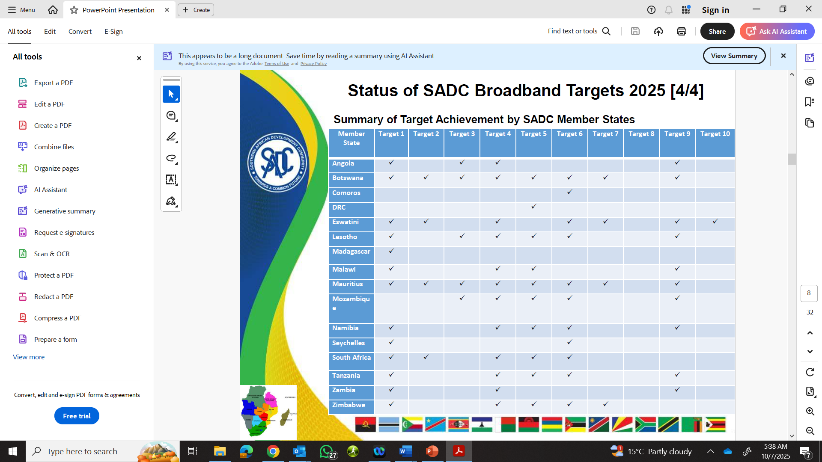
WHERE WE STAND
Summary of Target Achievement by SADC Member States

Slide 7
WIDENING DIGITAL DIVIDE: Our Context
Malawi Population has registered high Growth rate.
High Fertility rate:
Malawi's population is rapidly increasing due to a historically
Urbanization:
The country is experiencing fast urbanization, with a higher urban growth rate than the overall national rate.
Resource Pressure:
This rapid population increase is likely to put significant pressure on available resources, such as land and public services.
Climate Impact:
The region is vulnerable to climate change, with factors like droughts and flooding posing threats to the economy and nutrition, which in turn can affect population dynamics and living conditions.
Malawi population is now at 22.2million expected to grow to 23.1million by 2030.

Slide 8
Our EFFORT Enable more services
Demands for More broadband services keeps increasing
RF spectrum required to fill the gap
Space resources to compliment the terrestrial services (800MHz)
Device affordability enhancement is required

Slide 9
RF spectrum required to fill the gap
Spectrum Assignments Maximised
Band | Amount of Spectrum | Assignment Status
900MHz | 34MHz | 100%
1800MHz | 60MHz | 100%
2100MHz | 60MHz | 80%
2600Hz | 70MHz | 100%
2300MHz | 100MHz | 10%
3300MHz | 100MHz | 40%
3500MHz | 100MHz | 50%
3600MHz | 100Hz | 0%
800MHz | 30MHz | 100%
700MHz | 30MHz | 100%

Slide 10
Resources complimenting the provision of broadband services
Infrastructure Sharing Framework
SADC shared satellite programme (800MHz)
D2D technologies licensing
Fibre deployments
Nacara corridor
Songwe Kasumulu corridor
Chipata Lusaka corridor

Slide 11
Possible New Allocations for IMT
Frequency bands | WRC-27 agenda items | Responsible WPs | Available information on characteristics of terrestrial component of IMT
 |  |  | IMT-2020 and beyond | IMT-Advanced | IMT-2000
608-614 MHz | 1.17 | WP 7C | Specification related parameters: Section 3.1 of Annex 4.4 to Document 5D/716 Deployment characteristics: Section 3.2.1.1 “Below 1 GHz” of Annex 4.4 to Document 5D/716 | Report ITU-R M.2292-0 | ITU-R Report M.2039-3
694/698-960 MHz | 1.13 | WP 4C
1 427-1 518 MHz | 1.12 (1 427-1 432 MHz) 1.13 | WP 4C | Deployment characteristics: Section 3.2.1.2 “1‑3 GHz” of Annex 4.4 to Document 5D/716 | Report ITU-R M.2292-0 | ITU-R Report M.2039-3
1 710-1 785 MHz | 1.13 | WP 4C | Specification related parameters: Section 3.1 of Annex 4.4 to Document 5D/716 Deployment characteristics: Section 3.2.1.2 “1‑3 GHz” of Annex 4.4 to Document 5D/716 Antenna characteristics for IMT-2020 AAS base stations: Section 3.2.1.6 of Annex 4.4 to Document 5D/716
1 805-2 025 MHz | 1.12 (1 880-1 920 MHz, 2 010-2 025 MHz) 1.13 1.14 (2 010-2 025 MHz) | WP 4C
2 110-2 200 MHz | 1.13 1.14 (2 120-2 170 MHz) | WP 4C
2 300-2 400 MHz | 1.13 | WP 4C
2 500-2 690 MHz | 1.13 1.15 | WP 4C WP 7B

Slide 12
Possible New Allocations for IMT
Frequency bands | WRC-27 agenda items | Responsible WPs | Available information on characteristics of terrestrial component of IMT
 |  |  | IMT-2020 and beyond | IMT-Advanced | IMT-2000
3 500-3 600 MHz | 1.15 | WP 7B | Specification related parameters: Section 3.1 of Annex 4.4 to Document 5D/716 Deployment characteristics: Section 3.2.1.3 “3-6 GHz” of Annex 4.4 to Document 5D/716 Antenna characteristics for IMT-2020 AAS base stations: Section 3.2.1.6 of Annex 4.4 to Document 5D/716 | Report ITU-R M.2292-0 | ITU-R Report M.2039-3
3 600-3 800 MHz | 1.15 | WP 7B
4 400-4 800 MHz See note 1 below the table | 1.7 1.19 (4 200-4 400 MHz) | WP 5D WP 7C | Specification related parameters See Section 3.1.1 of this document Deployment characteristics: See Section 3.2.1 of this document | - | -
7 125-8 400 MHz See Note 1 below the table | 1.15 (7 190-7 235MHz) 1.19(8 400-8 500 MHz) | WP 7B WP 7C | Specification related parameters See Section 3.1.2 of this document Deployment characteristics: See Section 3.2.2 of this document | - | -
25.25-28.35 GHz. | 1.15 | WP 7B | Attachment 2 to Document 5-1/36 | - | -
37-43.5 GHz | 1.6 | WP 4A
47.2-48.2 GHz | 1.1, 1.6 | WP 4A

Slide 13
THANK YOUF SLIDE
THANK YOU

