Slide 1
Introduction à la Open Fibre Data Standard Introduction
Steve Song
song@isoc.org
National broadband mapping systems in Nigeria 5-7 August 2025

Slide 2
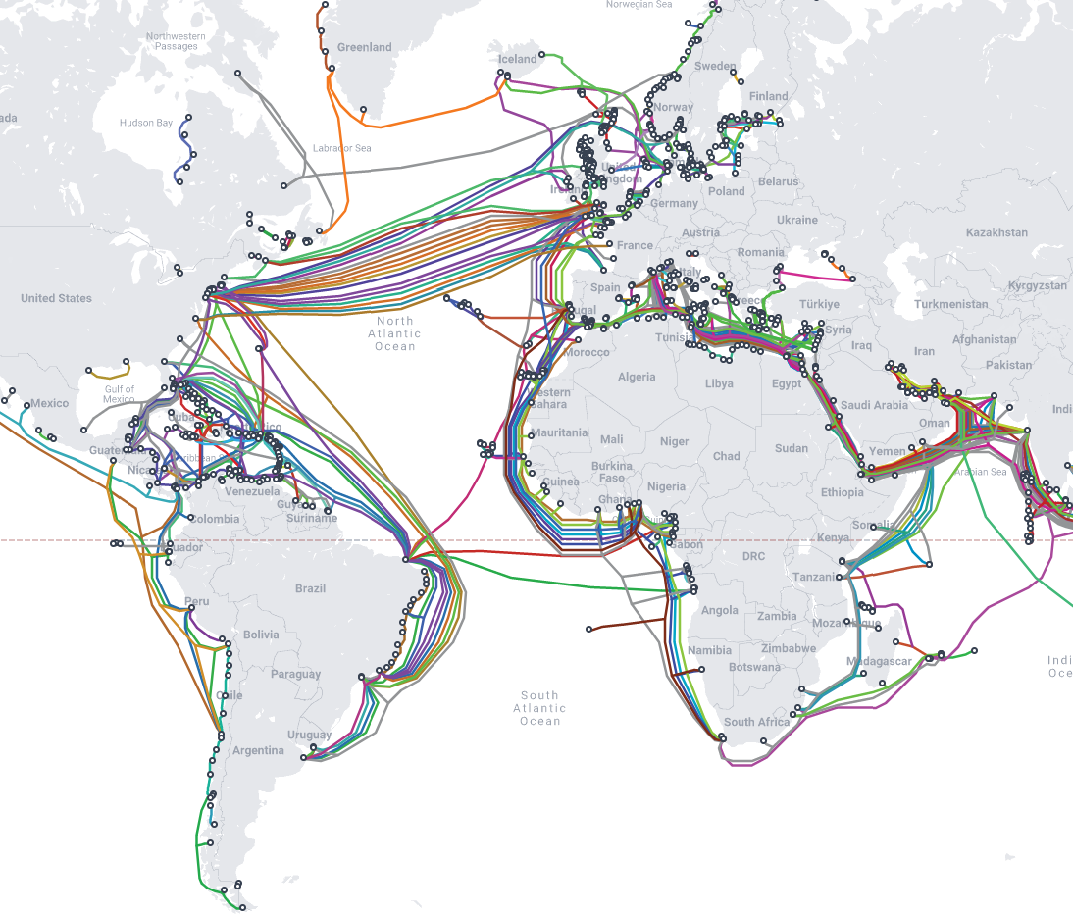
L'évolution de l'infrastructure à fibres optiques
As of 2025, there are more than 550 undersea fibre optic cables, representing nearly 1.4 million kilometres of cable.
A single cable can now carry over 300 Tbps.
Undersea cable maps are readily available.
En 2025, il existe plus de 550 câbles sous-marins à fibres optiques, représentant près de 1,4 million de kilomètres de câbles.
Un seul câble peut désormais transporter plus de 300 Tbps.
Des cartes des câbles sous-marins sont facilement disponibles.
https://www.submarinecablemap.com/ Telegeography
Notes:
https://www2.telegeography.com/submarine-cable-faqs-frequently-asked-questions

Slide 3
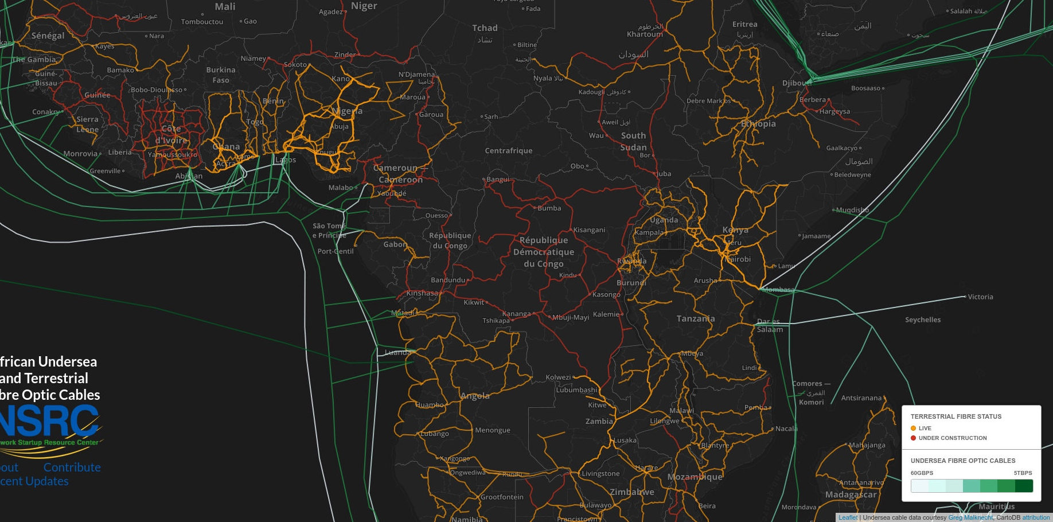
The Growth of Terrestrial Fibre Optic Infrastructure
When it comes to terrestrial fibre networks, some operators publish network maps, many do not.
En ce qui concerne les réseaux terrestres en fibre optique, certains opérateurs publient des cartes du réseau, mais beaucoup ne le font pas.
https://afterfibre.nsrc.org

Slide 4
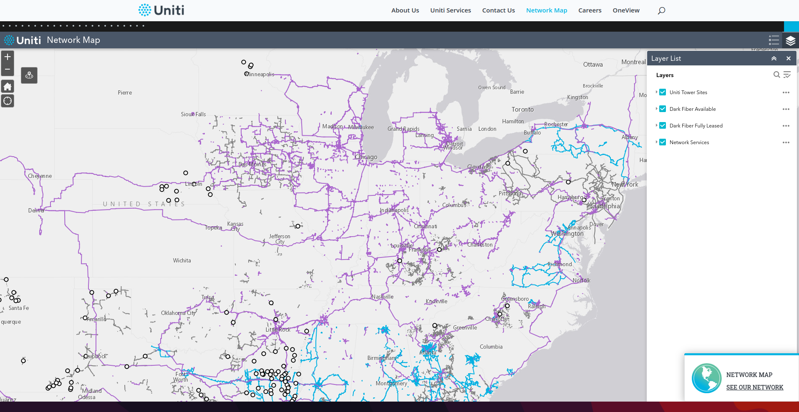
United States: Uniti
https://uniti.com/network-map/?map=fiber

Slide 5
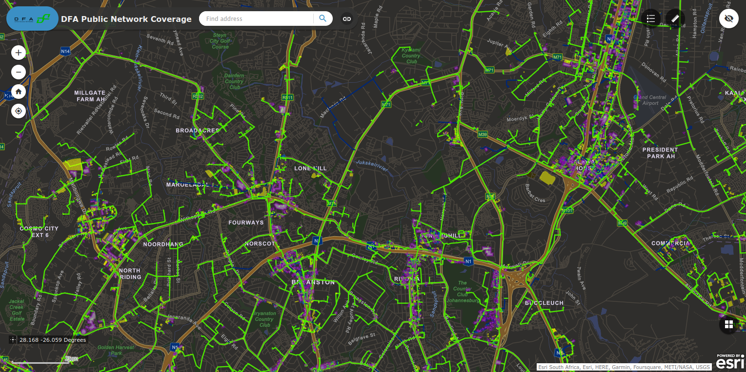
South Africa: Dark Fibre Africa
https://dfafrica.co.za/network/coverage/

Slide 6
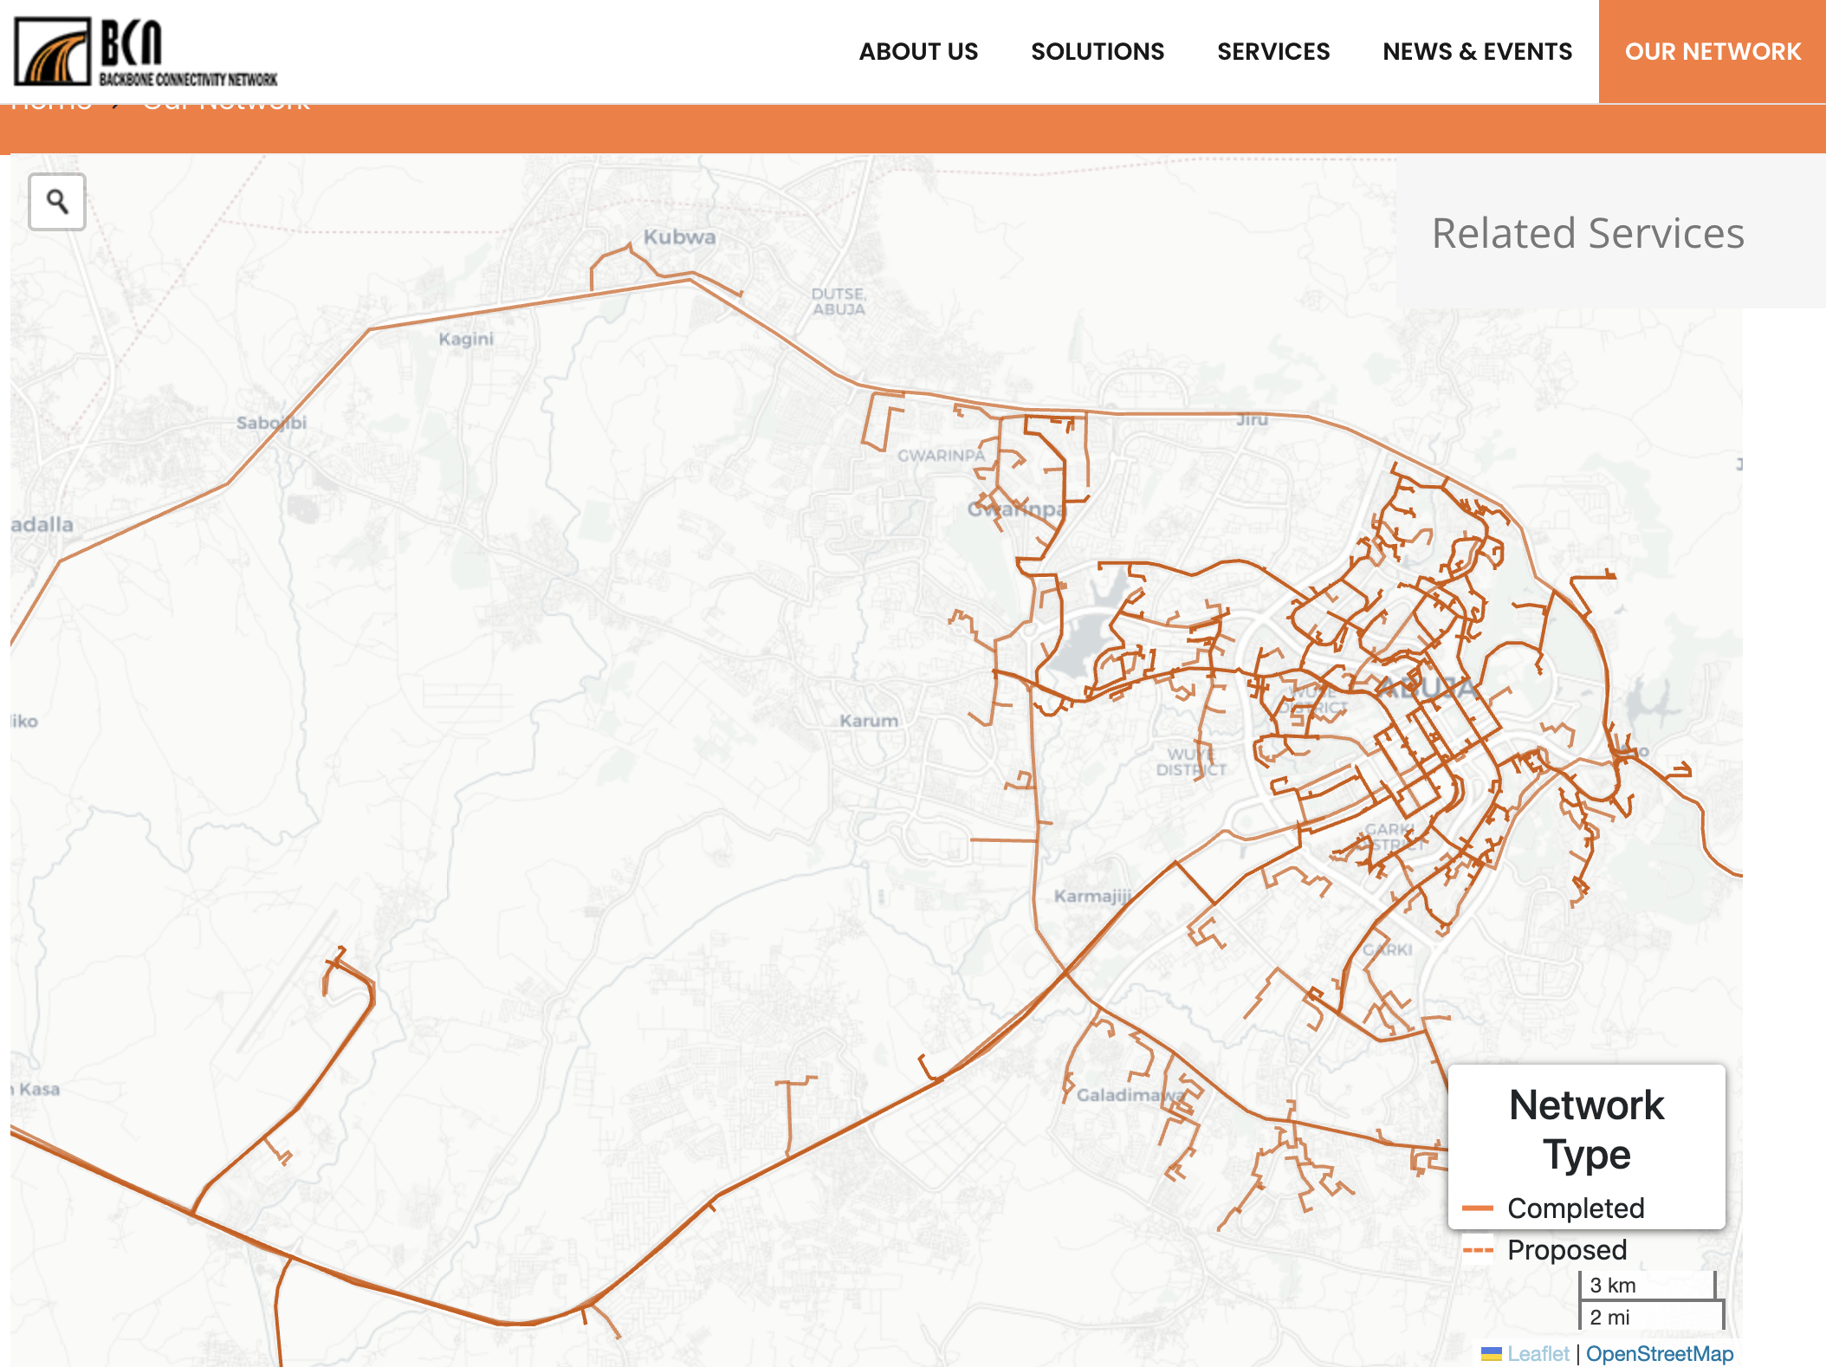
Nigeria: BCN
https://bcnnigeria.net/index.php/our-network/

Slide 7
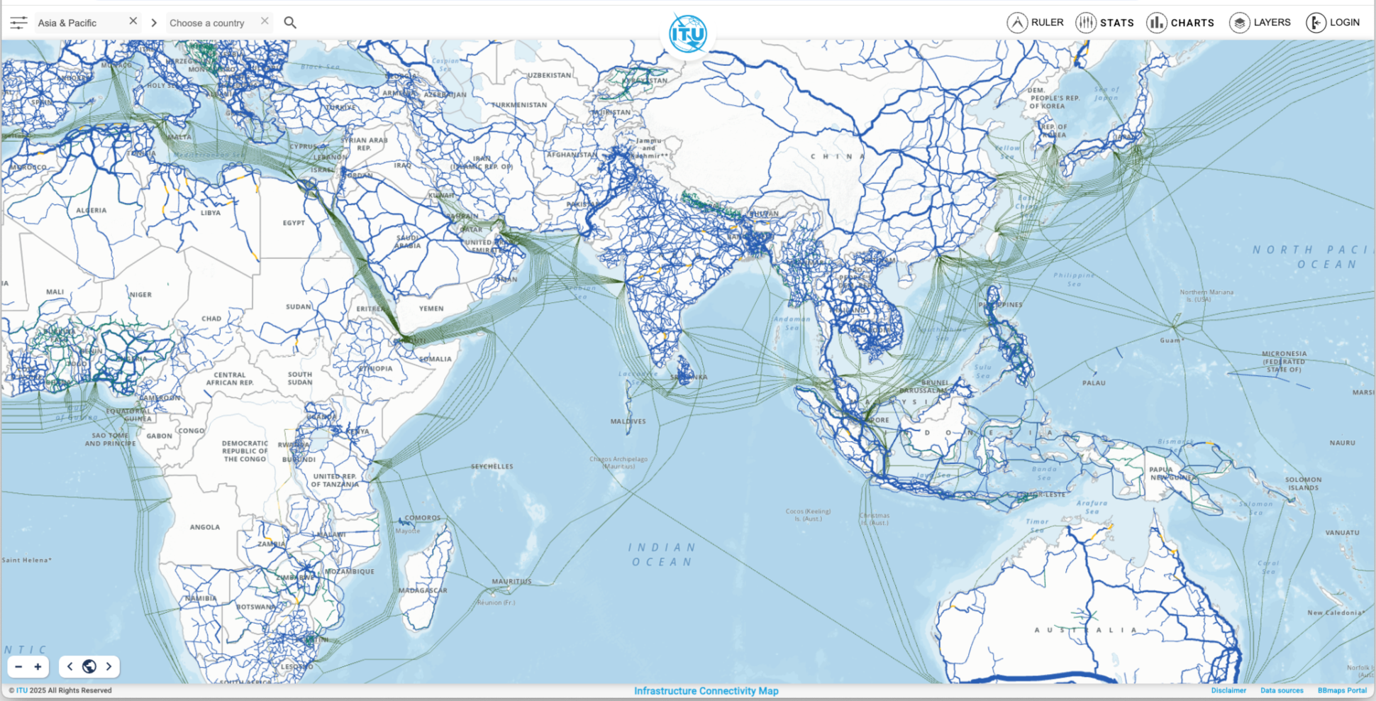
ITU Infrastructure Connectivity Map
https://bbmaps.itu.int/bbmaps/

Slide 8
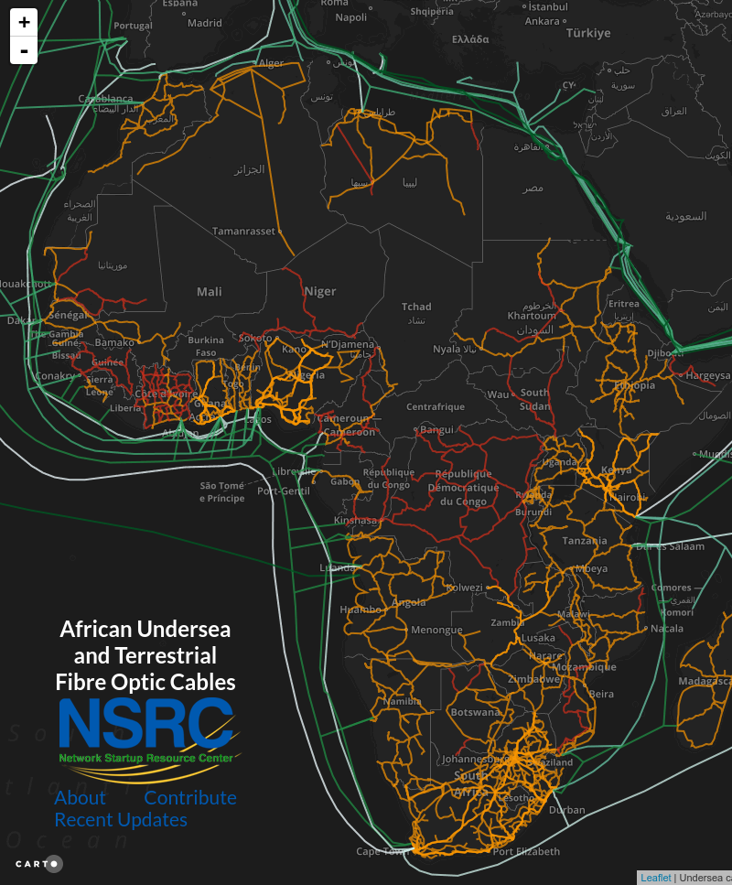
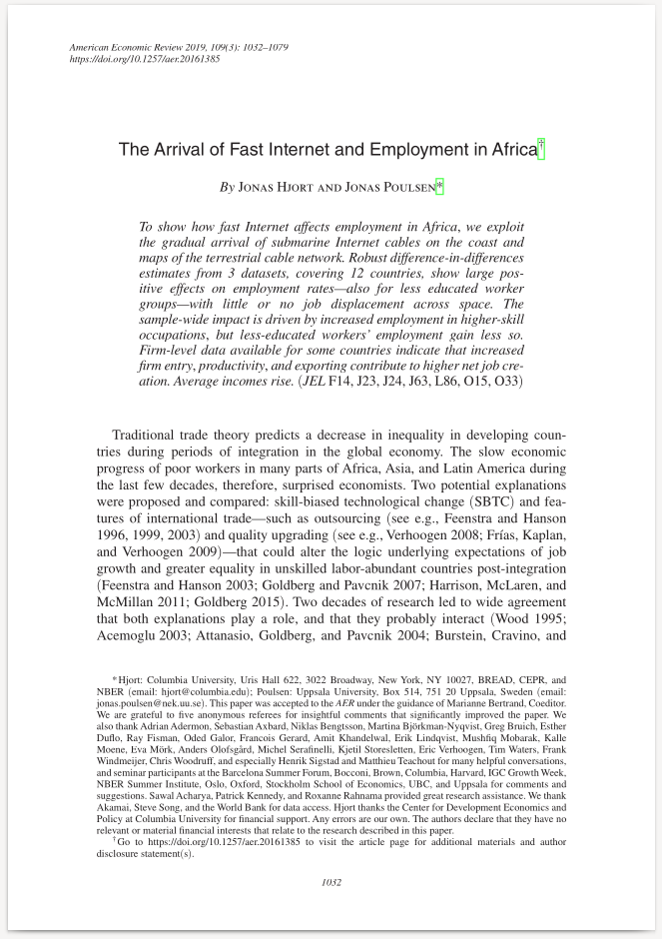
Enseignements tirés de la cartographie des réseaux de fibres optiques en Afrique
Lessons from mapping fibre optic networks in Africa
“The Arrival of Fast Internet and Employment in Africa” 2019, Hjort and Poulsen
2019
https://afterfibre.nsrc.org
https://www.aeaweb.org/articles?id=10.1257/aer.20161385
Notes:
https://afterfibre.nsrc.org

Slide 9






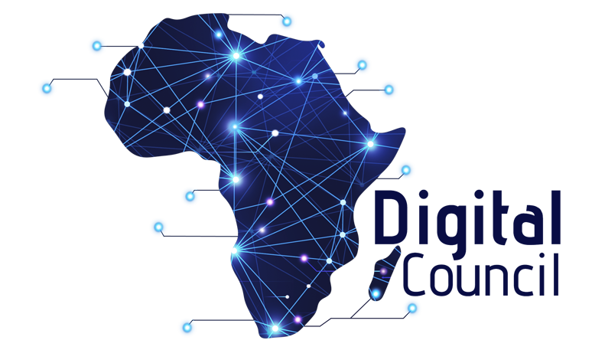
Multistakeholder Initiative
The World Bank, the International Telecommunications Union (ITU), Mozilla Corporation, the Internet Society (ISOC), Liquid Intelligent Technologies, CSquared, and Digital Council Africa are partnering to promote the collaborative development of open data standards for describing telecommunications infrastructure. La Banque mondiale, l'Union internationale des télécommunications (UIT), Mozilla Corporation, l'Internet Society (ISOC), Liquid Intelligent Technologies, CSquared et Digital Council Africa s'associent pour promouvoir le développement collaboratif de normes de données ouvertes pour décrire les infrastructures de télécommunications.

Slide 10
The Open Fibre Data Standard (OFDS) is a standard for publishing data on terrestrial fibre optic broadband infrastructure.
Le Open Fibre Data Standard (OFDS) est une norme pour la publication de données sur les infrastructures terrestres à large bande en fibre optique.
Notes:
The Open Fibre Data Standard (OFDS) is a standard for publishing data on fibre optic broadband infrastructure.
It describes:
What data to publish about fibre optic networks in order to meet a range of use cases
How to structure and format data for publication and use

Slide 11
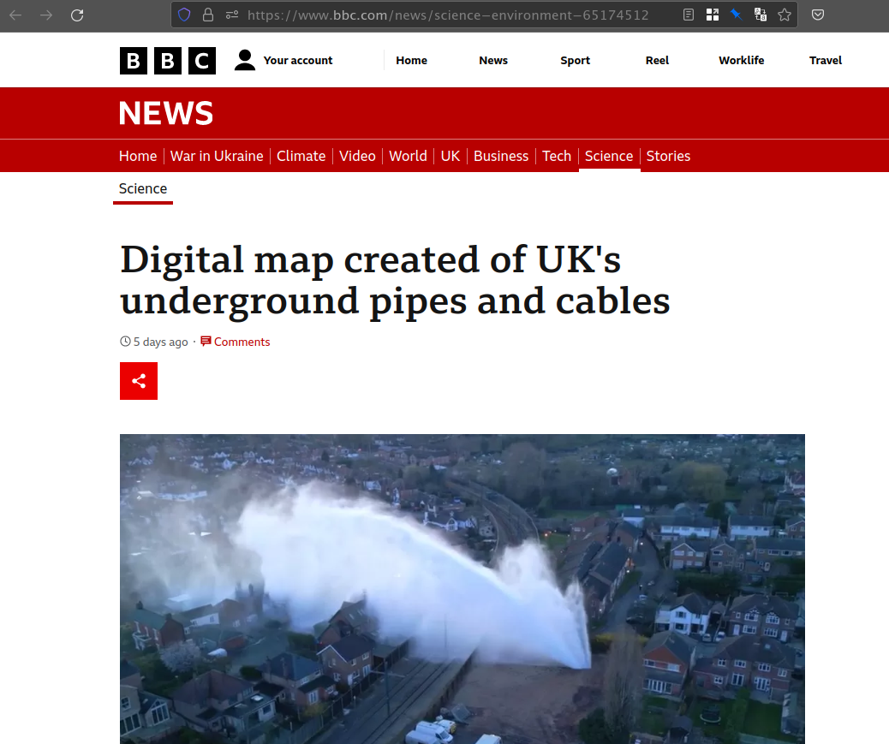
Benefits to Governments and Regulators
More effective network investments by accurately targeting the unserved.
Improved coordination across infrastructure sectors e.g. road, electricity, rail, oil & gas.
Reduction of physical network interruption and destruction.
Opportunity for national and regional benchmarking
Investissements plus efficaces dans les réseaux en ciblant avec précision les zones non desservies.
Amélioration de la coordination entre les secteurs d'infrastructure (route, électricité, rail, pétrole et gaz).
Réduction des interruptions et des destructions matérielles du réseau.
Possibilité d'étalonnage des performances au niveau national et regional
https://www.bbc.com/news/science-environment-65174512

Slide 12
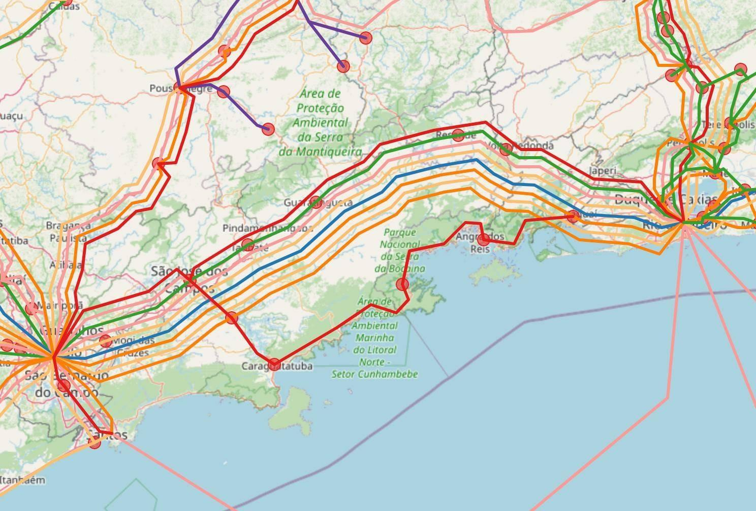
Benefits to Governments and Regulators
Understanding the true extent of national fibre infrastructure
Benefits to cyber security. Redundancy is key to network resilience.
Comprendre l'étendue réelle de l'infrastructure nationale en fibre optique
Avantages pour la cybersécurité. La redondance est la clé de la résilience des réseaux.
Map of fibre networks from Sao Paulo to Rio de Janeiro

Slide 13
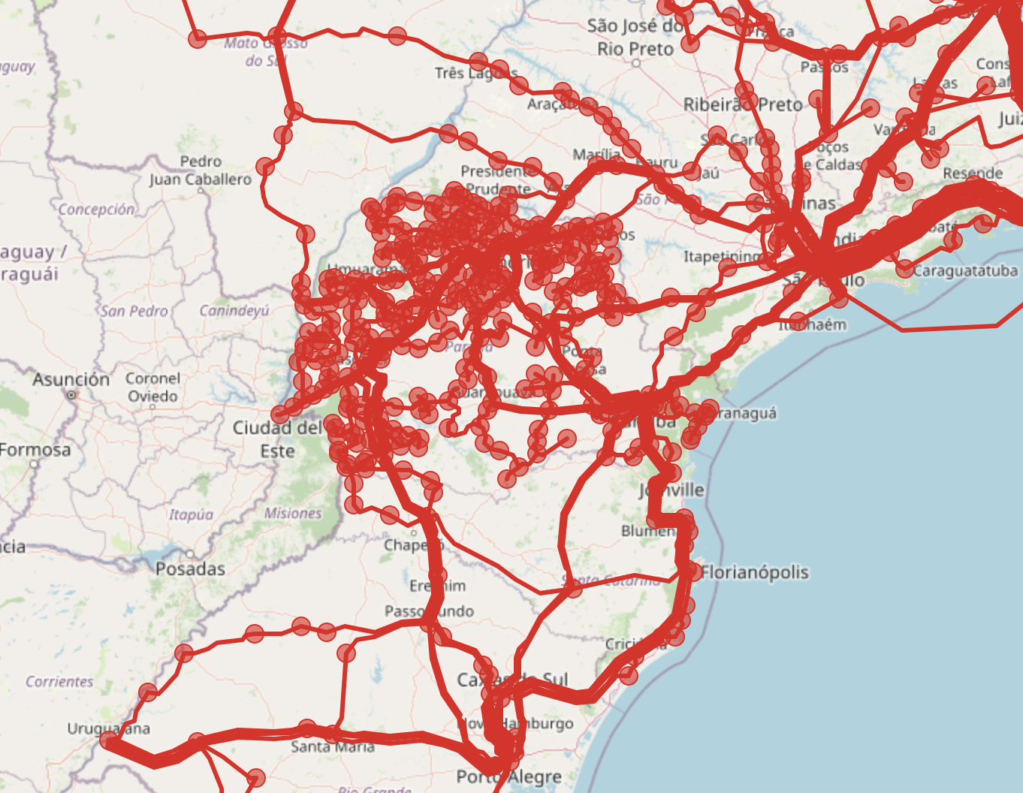
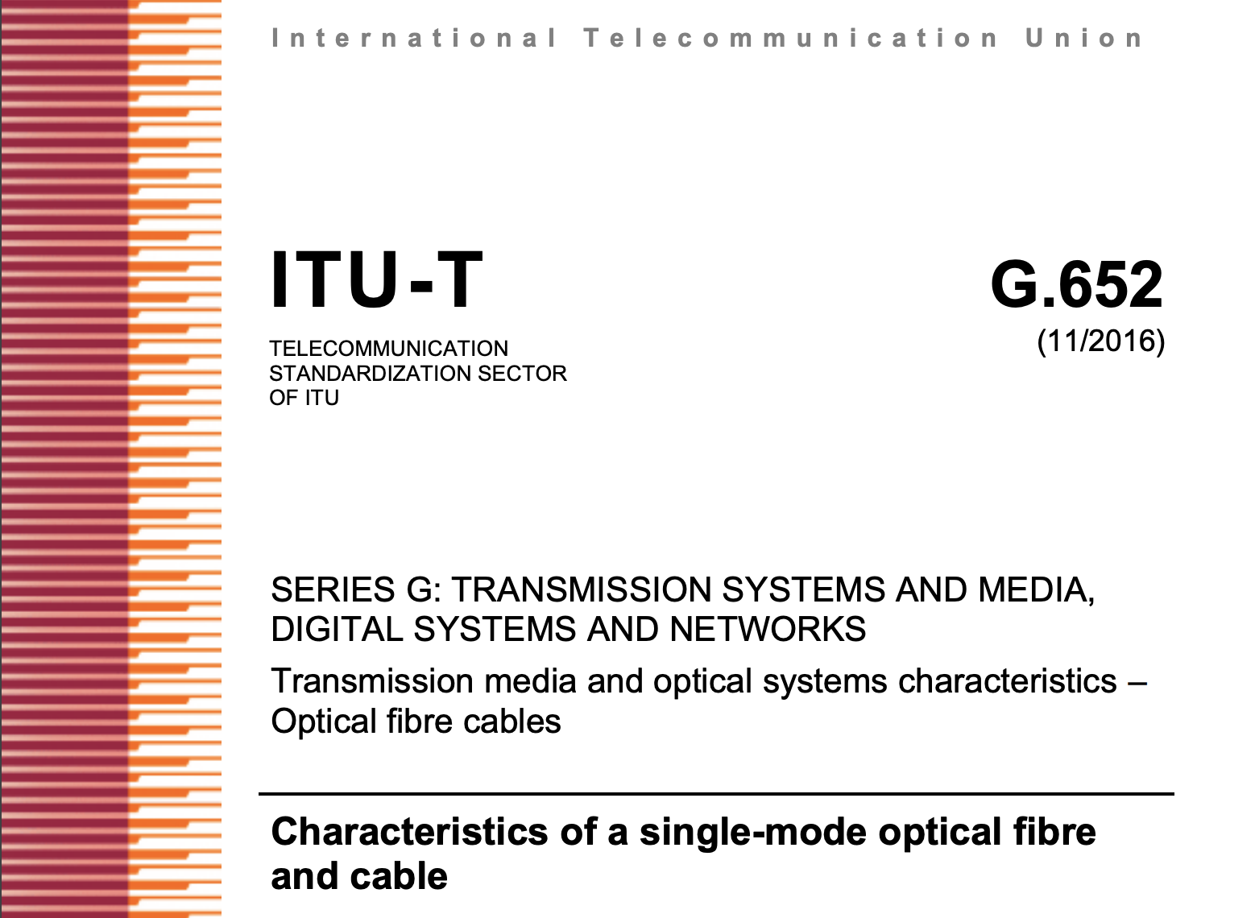












Categories of Data Catégories de données
Location / Localisation | Technical / Techniques | Administrative / Administratif
The route of fibre cables, the coordinates of PoPs, towers and IXPs. | Capacity, ITU fibre standards, power availability. | The organisations that own and operate infrastructure, the status of infrastructure, dark fibre availability.

Slide 14






Data sharing possibilities
Possibilités de partage des données
Different organisations may combine Open Fibre Data with various data sources to serve their individual missions.
Différentes organisations peuvent combiner Open Fibre Data avec diverses sources de données pour servir leurs missions individuelles.
Operator Association
Regulator
Operator
Operator
Operator

Slide 15
Risks associated with data sharing

Slide 16
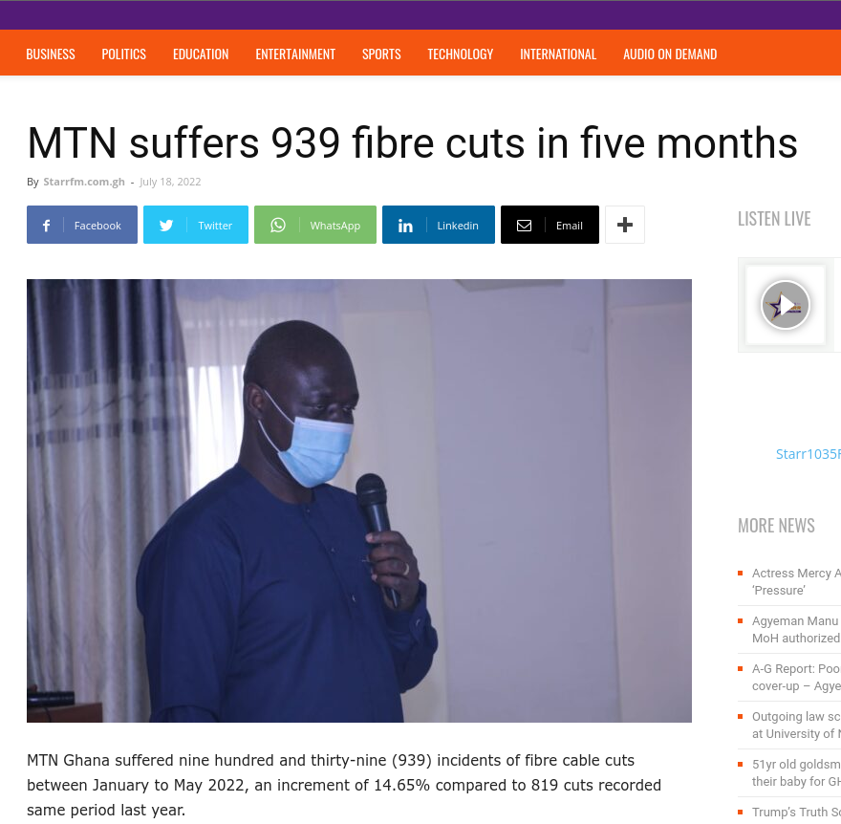
The Cost of Obscurity
Evidence suggests that the cost and risks of obscurity outweigh those of transparency:
A 2021 study with MTN Ghana estimated the cost of cuts like this would amount to a loss of USD750,000 in the 5 month period.
This does not include the economic losses from the cut to enterprises that depend on that infrastructure.

Slide 17
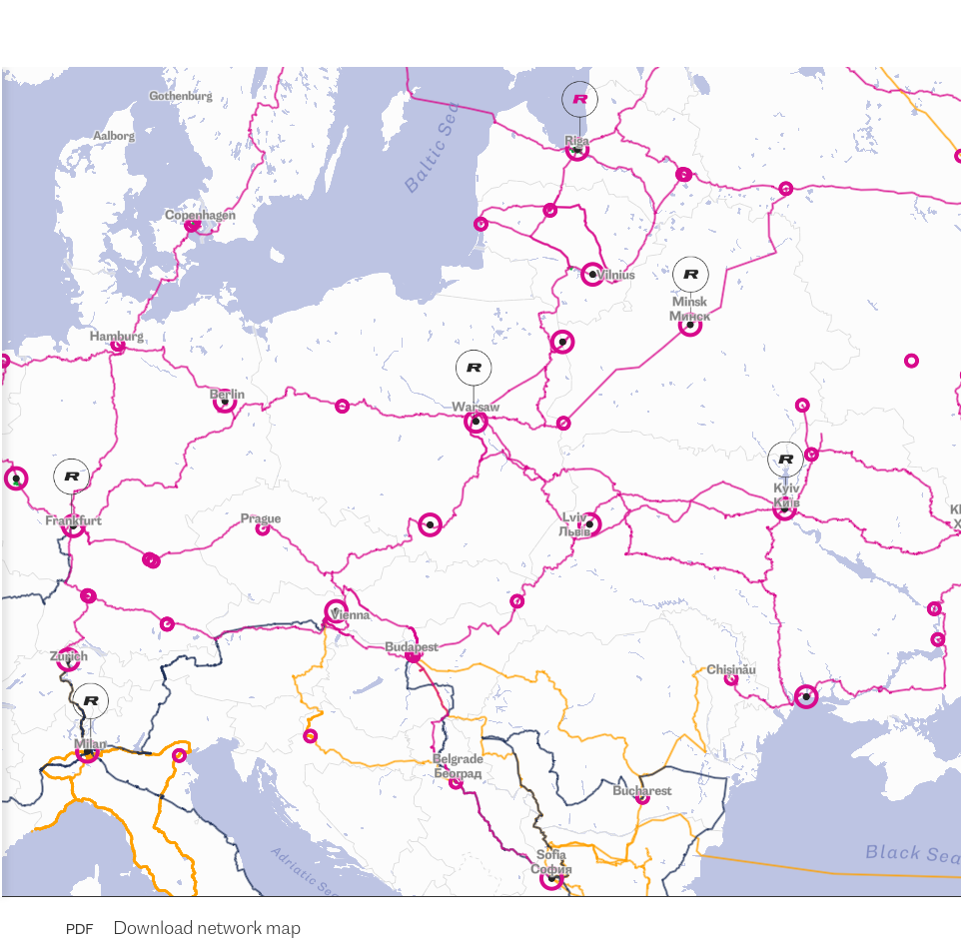
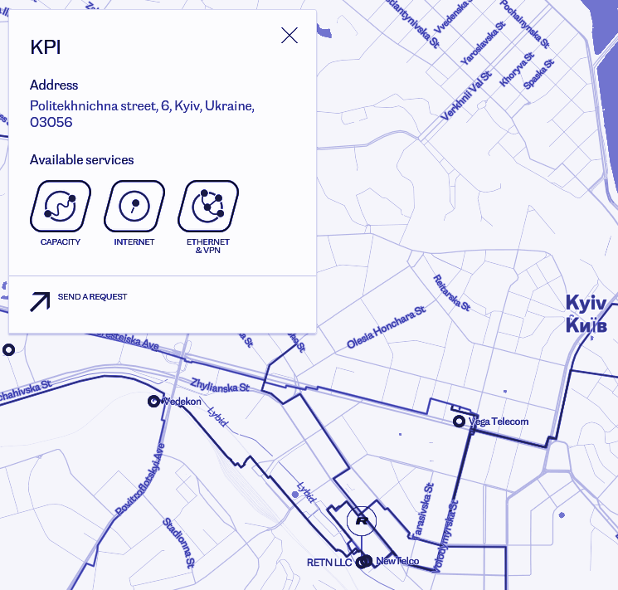
Evidence from Existing Operators
Evidence from operators who currently share detailed maps of their fibre network infrastructure suggest that publicly available maps are not a critical point of security vulnerability.
RETN in Ukraine is a dramatic case in point. They are one of the largest fibre network operators and continue to maintain, in 2025, a detailed online map. If online network maps were a security concern, it likely this would have been taken down long ago.
https://retn.net/en/network/network-map

Slide 18
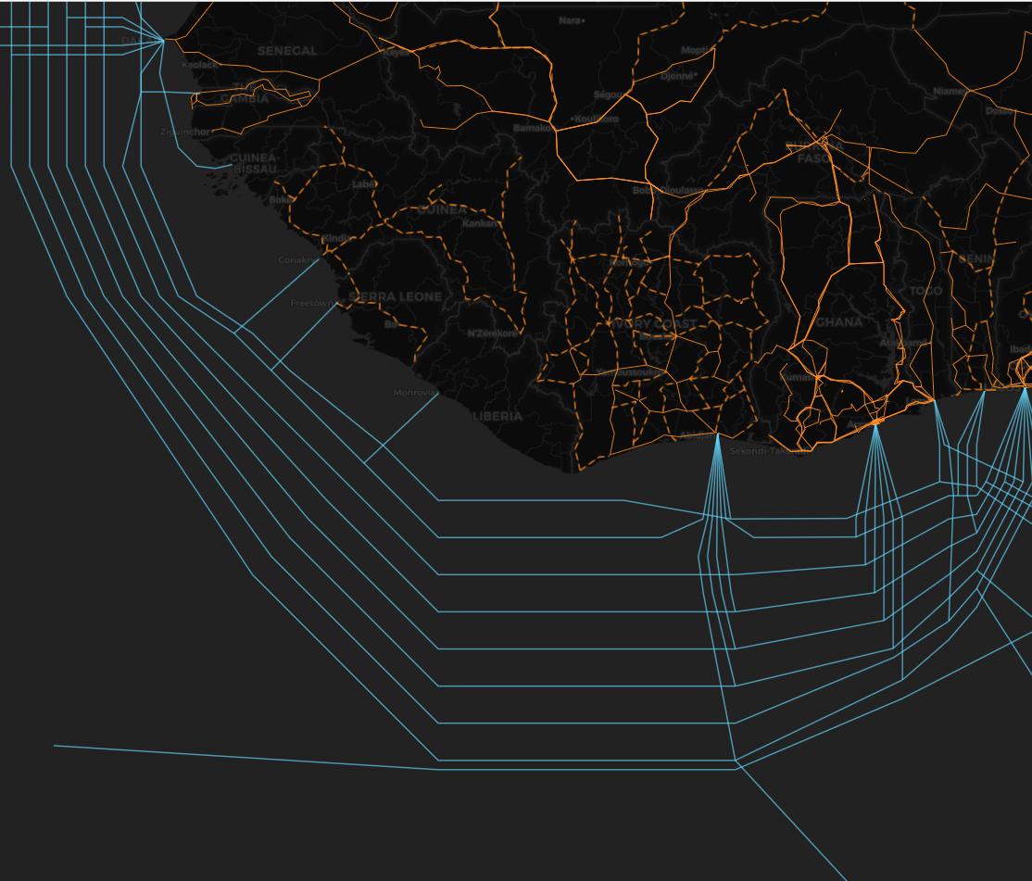
Undersea and Terrestrial Interdependence
In 2024/2025 undersea cables have come into prominence as a result of significant cable disruptions. African countries suffered particularly with cuts on both the east and west coast of the continent in 2024.
In response, the ITU has convened an international committee to discuss undersea cable resilience. However, considering undersea cables independently of terrestrial fibre optic infrastructure is only looking half of the problem.
In the case of the undersea cable cuts off the coast of Cote d’Ivoire in 2024, terrestrial fibre networks played an essential role in the restoration of services.
Terrestrial fibre data is as important as undersea cables in understanding global network resiliency.

Slide 19
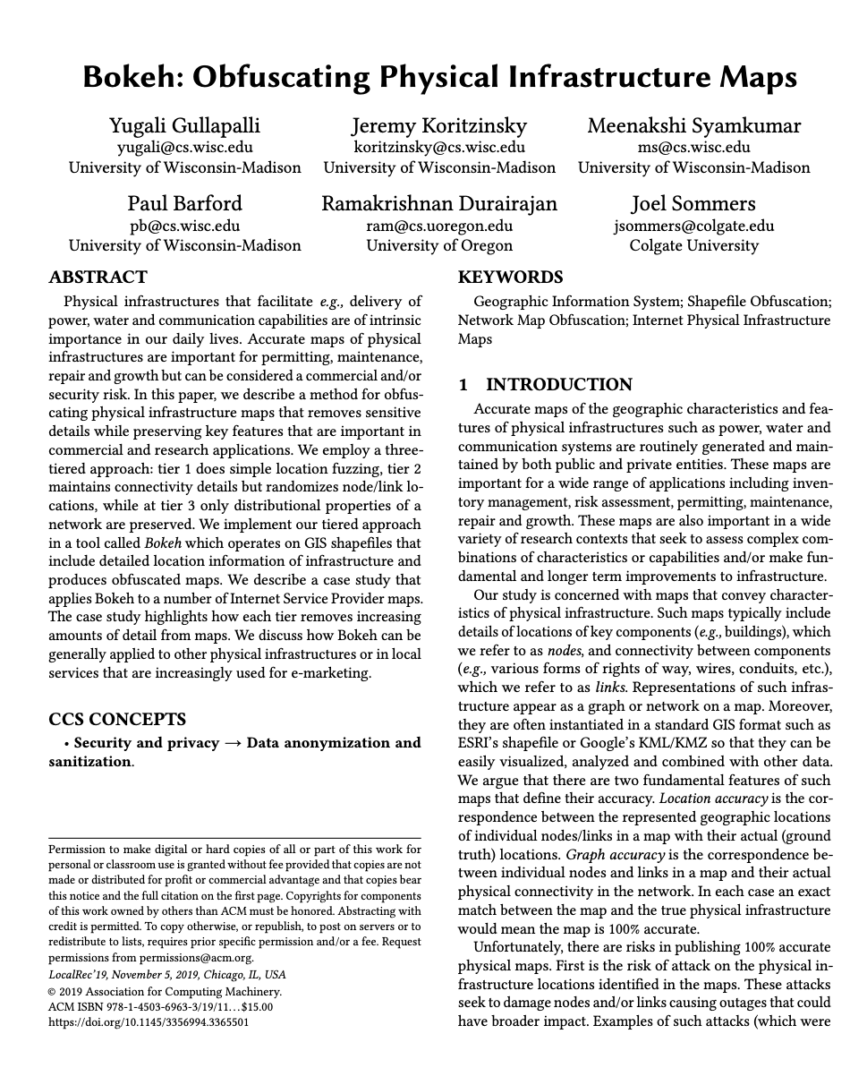
Data Obfuscation in Public Maps
Terrestrial fibre network maps can be published in a manner that is useful to researchers, but which also provides sufficient obfuscation of map data to allay operator concerns regarding security.
There are a number of technical approaches to achieving this.
https://ix.cs.uoregon.edu/~ram/papers/LocalRec-2019.pdf

Slide 20
The Importance of a Common Language
OFDS is both an Open Data initiative and an Open Standards initiative.
Whether network maps are shared publicly or not, having an Open Standard, in essence a common language, to describe them is essential to understanding network resilience and making effective investments in infrastructure.
Open Data
+
Open Standard

Slide 21





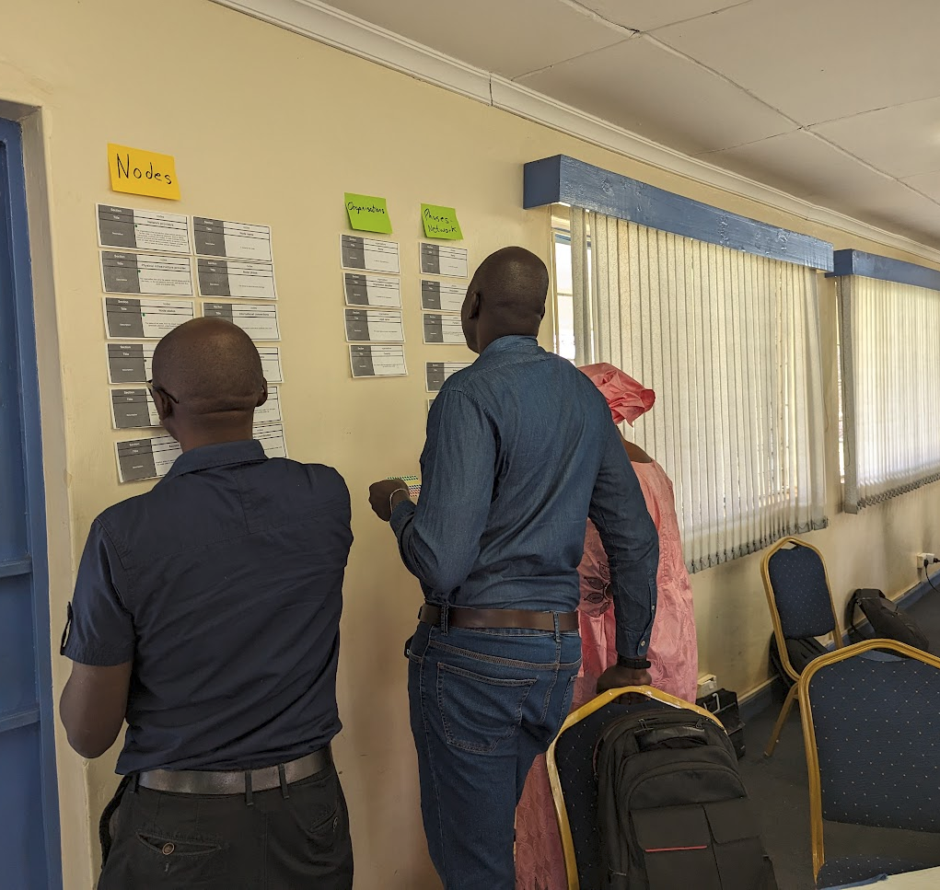
Workshops / Ateliers
 | Kenya | Ghana
Regulator
Operator Association
We have conducted OFDS workshops in Kenya and Ghana with both regulator and operator associations.
Regional workshop with AFRALTI
Integration into ITU Virtual Academy course on Advanced Broadband Mapping module
Regional Workshops

Slide 22
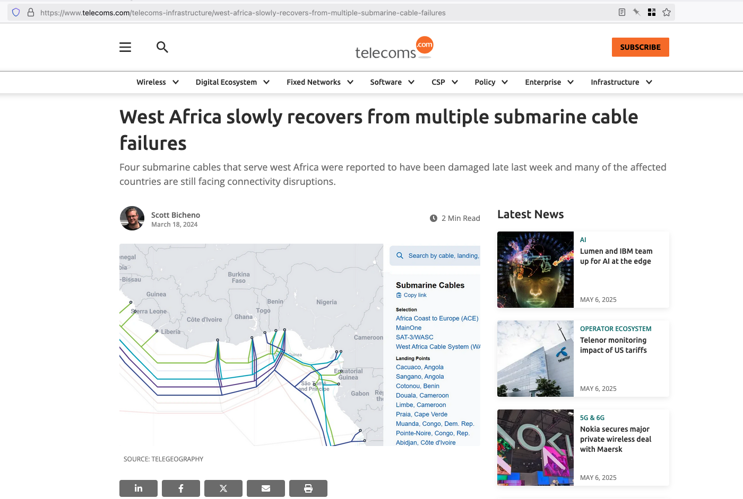
Undersea fibre optic cable maps only tell half the story.
Les cartes des câbles sous-marins à fibres optiques ne racontent que la moitié de l'histoire.

Slide 23
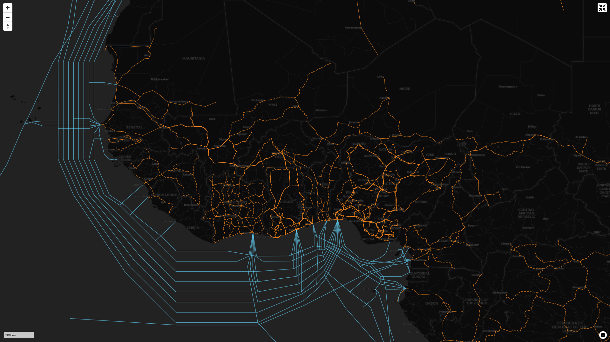
A more comprehensive picture is needed
Un tableau plus complet est nécessaire

Slide 24
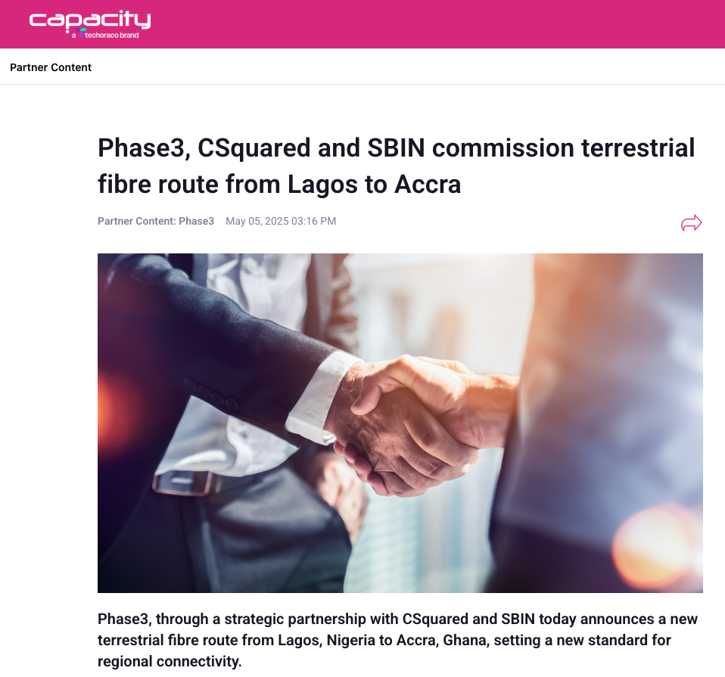
New terrestrial fibre optic network projects are being announced all the time.
De nouveaux projets de réseaux terrestres en fibre optique sont annoncés en permanence.

Slide 25
Get involved! Participez !
Thank you! Merci!
Please get in touch if you are interested in:
Learning more about OFDS
Hosting an OFDS workshop
Participating in standard development and governance
N'hésitez pas à nous contacter si vous êtes intéressé(e) :
en savoir plus sur l'OFDS
Accueillir un atelier OFDS
Participer à l'élaboration et à la gouvernance des normes
Steve Song
song@isoc.org

Slide 26
Further Reading / Pour en savoir plus
Articles World Bank - Making it Possible for the World to Log On
Internet Society - A Standard to Increase Availability, Accessibility of Terrestrial Fiber Infrastructure Data
Internet Society - Mapping Terrestrial Fibre Optic Networks is Essential for Measuring Internet Resilience
Open Data Services Cooperative - Open Fibre Data Standard: opening up fibre optic broadband infrastructure
Mozilla - Open Fibre Data Standard: Understanding the True Extent of the Internet
The State of Open Data - Telecommunications and the State of Open Data
Canonical sources Documentation https://open-fibre-data-standard.readthedocs.io/en/latest/reference/schema.html
Repository for the standard https://github.com/Open-Telecoms-Data/open-fibre-data-standard

