Slide 1
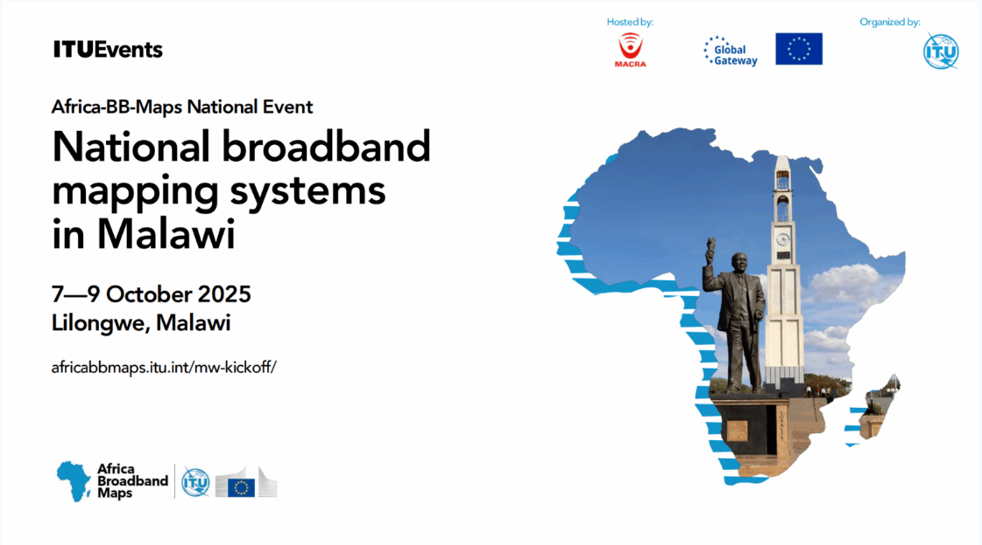

Slide 2


The Universal Service Fund (USF)
Vision
Digital inclusion for all
Mission
To facilitate the provision and access of ICT services to bridge the digital divide

Slide 3
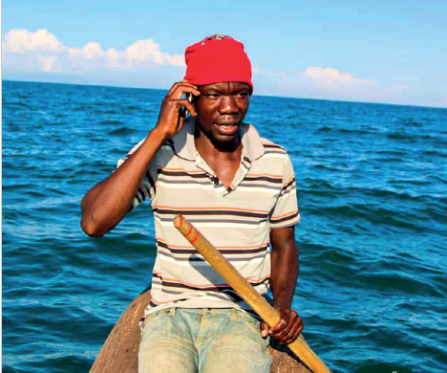




Universal and Meaningful Connectivity
The possibility for everyone to enjoy a safe, satisfying, enriching, productive, and affordable online experience.

Slide 4
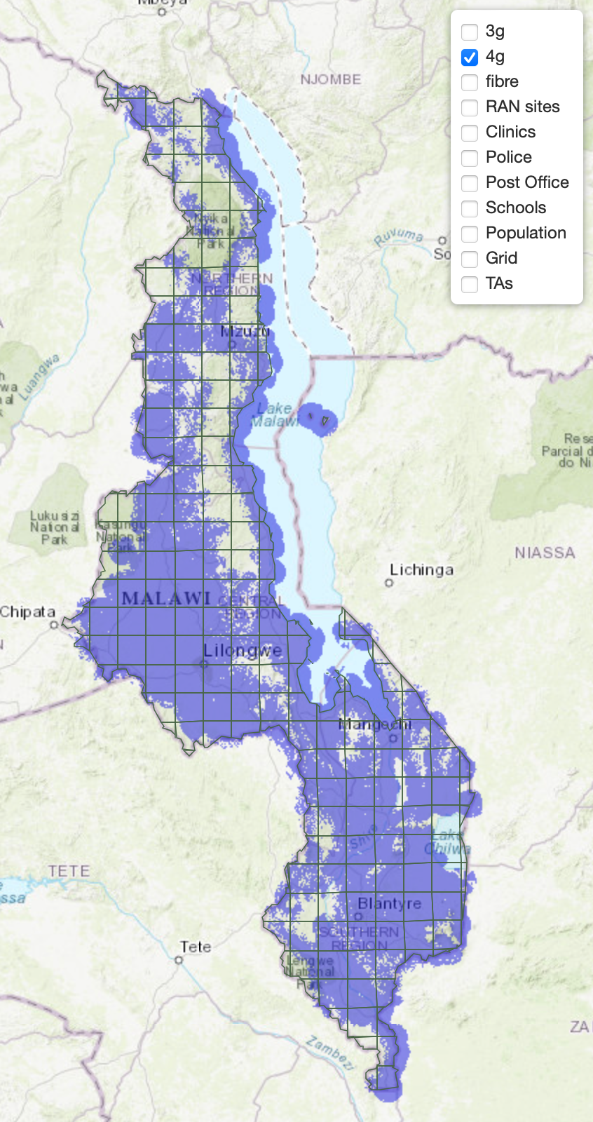
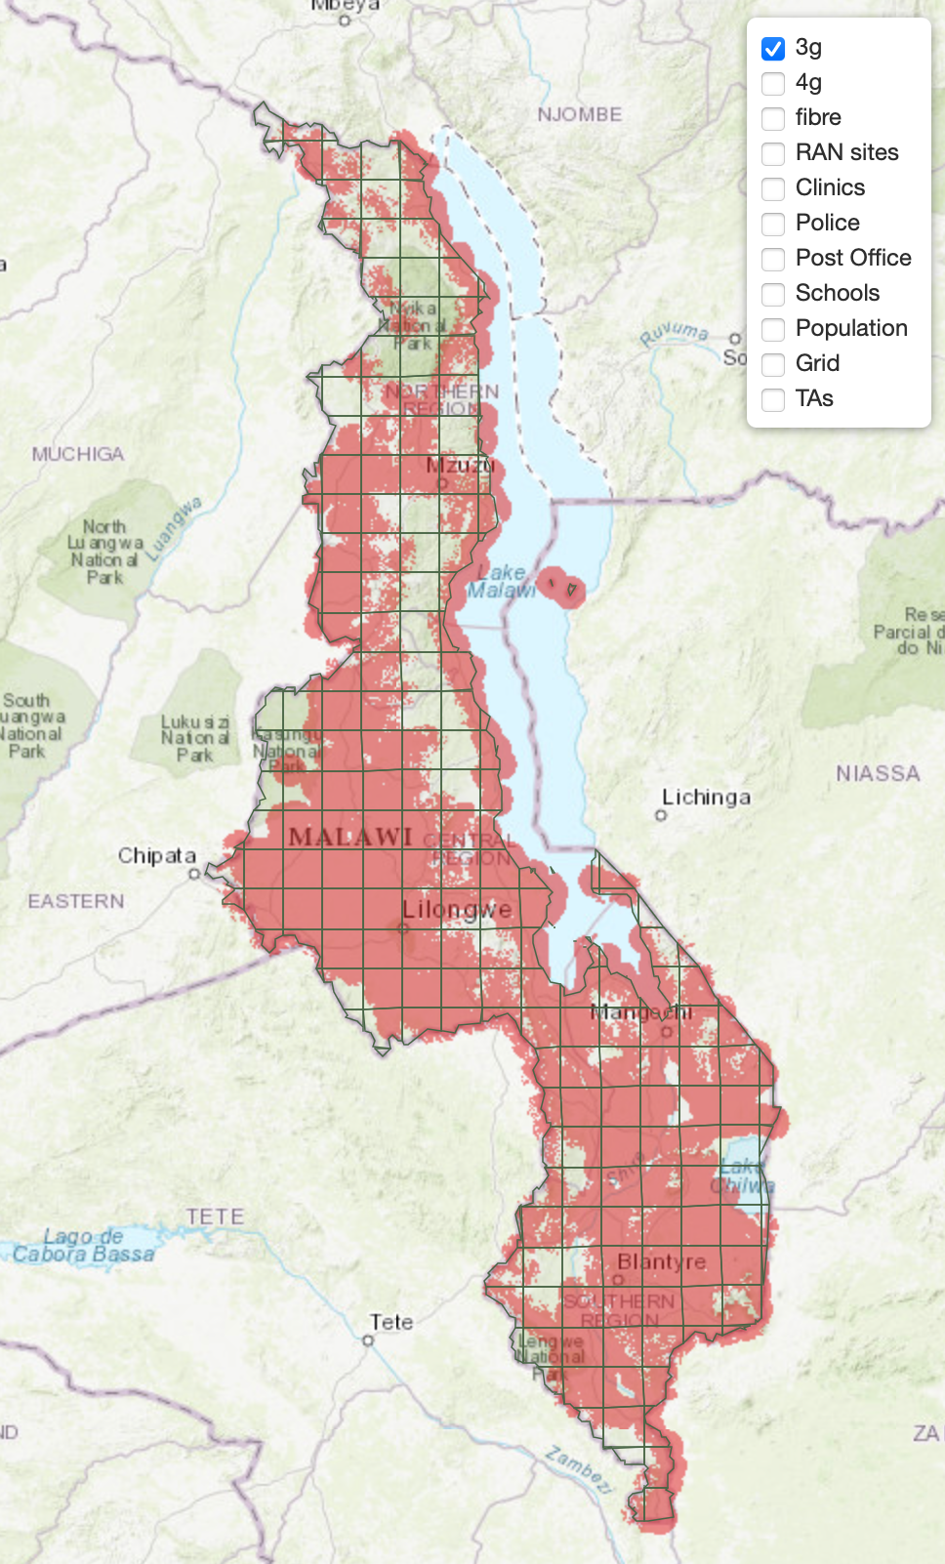
Broadband Coverage – ICT Gap Study
Malawi has a high broadband population coverage of 96%. Major urban areas have full broadband coverage. Some districts, like Chitipa, have only 66% broadband coverage. Rumphi, Nkhatabay and Mwanza are in the 80% broadband coverage category and all other districts are at 90% or higher.
STAKEHOLDERS CONSULTATION WORKSHOP – 2ND OCTOBER 2025

Slide 5
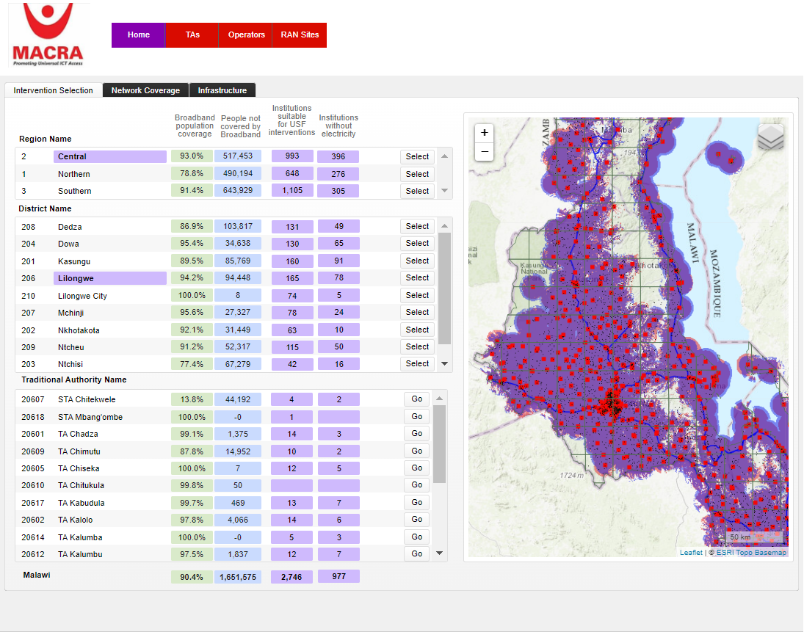
BROADBAND INITIATIVES - USF
Developed a GIS System for identification of coverage gaps in Malawi
At the inception, over 2,000,000 citizens lived out of broadband coverage areas

Slide 6
IMPACT OF LACK OF BROADBAND SERVICES
Increased vulnerability to global challenges
Deepening social and economic inequalities
Global Connectivity Report 2022.
Barriers to economic development
Increased cost of digital exclusion
Limited Access to essential services
Notes:
If there is no universal and meaningful connectivity, several consequences and situations could arise:
Deepening social and economic inequalities: The lack of connectivity can exacerbate existing inequalities, as those without access to the Internet miss out on economic opportunities, education, healthcare, and social services. ​
Increased cost of digital exclusion: The COVID-19 pandemic has shown that those without Internet access face higher costs of exclusion, such as missing out on remote work, online education, and telehealth services. ​
Limited access to essential services: Without meaningful connectivity, individuals may struggle to access essential services like government benefits, health information, and educational resources. ​
Barriers to economic development: Connectivity drives economic growth by enabling innovation, reducing transaction costs, and improving efficiency. ​ The absence of connectivity can hinder these benefits. ​
Increased vulnerability to global challenges: Connectivity is crucial for addressing global challenges such as climate change, health crises, and sustainable development. ​ Without it, countries may struggle to implement effective solutions.
These points are derived from the Foreword, Chapter 1, and Chapter 8 of the Global Connectivity Report 2022.

Slide 7
USF BROADBAND INITIATIVES
Broadband Access
Gap identification
GIS system
Drive tests
Requests from unserved communities
Radio Access Network
Facilitation of the construction of 62 mobile network towers in unserved areas
Satellite Connectivity
Connected cyclone hit communities
Public Institutions Connectivity
Connecting public institutions

Slide 8
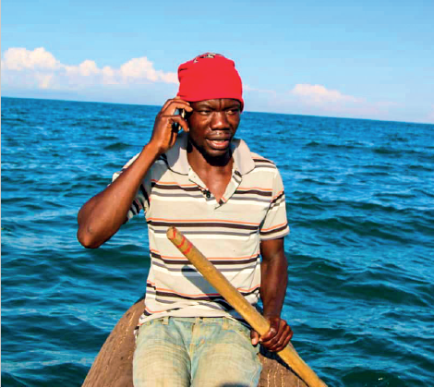
USF BROADBAND INITIATIVES
Broadband Usage Acceleration
Digital skills programme
Targeting 20,000 rural citizens / year
1,000 Trainers engaged
SMEs training
Targeting women and the youth
Smart Devices
Promoting local device assembly
Lobbying for tax cuts
Submitted proposal to Government

Slide 9
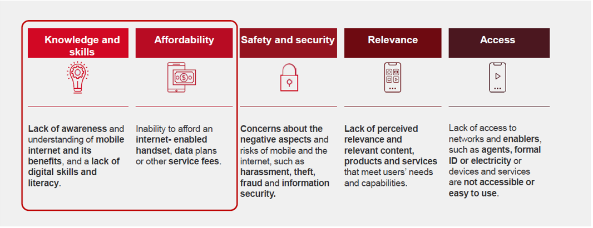
Key barriers to broadband adoption

Slide 10

Gaps in Measuring Connectivity
Consolidation of data
Data Availability and Timeliness
Technical and Human Resource Limitations
Legal and Institutional Barriers
Financial constraints

Slide 11




USF BROADBAND INITIATIVES
Broadband Access Partnerships

Slide 12
End of Presentation

