Slide 1

ITU Africa-BB-Maps Capacity Building Program
Africa-Europe Broadband Mapping Study Visit and Policy Training
(EACO Cohort)
Warsaw, 30 June – 2 July 2026

Slide 2

The Nationwide Education Network - the foundation of digital education in Poland
How Poland Connected Every School: The OSE Model

Slide 3


National Research Institute (NASK PIB) - Shaping a Digital Future
NASK is an institute that is building a modern cyberspace in Poland and conducting scientific research on cybersecurity, artificial intelligence, and cloud computing. It protects companies from cyber threats by developing security products, conducting security audits, and providing support for digital transformation, while also supporting public institutions by connecting schools to the internet, developing document management systems for government agencies, and conducting cybersecurity training.
NASK also safeguards citizens by combating online fraud, removing websites with illegal content, and conducting educational campaigns on online threats.

Slide 4
The Nationwide Education Network – high-speed, reliable, free internet for schools
Fast: OSE Internet is fast because the 100 Mb/s symmetrical bandwidth connection is dedicated exclusively to the needs of a given school - it will not be shared with other network users.
Secure: The OSE secure network detects and blocks malware and known computer viruses, and also protects against network attacks and access to illegal or potentially dangerous content.
Free: OSE's high-speed internet, along with professional security services, is funded by the state budget. This means that schools participating in the program receive it free of charge.

Slide 5






The Nationwide Education Network – high-speed, reliable, free internet for schools
The program is implemented pursuant to the Act of October 27, 2017, on the Nationwide Educational Network (OSE). Under the Act, the operation and development of the OSE network are financed from public funds.
The operator of the OSE is NASK – National Research Institute
The tasks of the OSE operator include:
preparing the OSE network in a manner that enables the provision of services using the network, as well as its operation, maintenance, troubleshooting, modernization, and oversight of its functioning;
providing the school with broadband Internet access with a symmetric bandwidth of at least 100 Mb/s;
providing the school with ICT security services, including protection against malware and monitoring of threats and network security;
promoting the principles of safe use of digital technologies;

Slide 6


The Nationwide Education Network (OSE)
23,5 k
20,4 k
Beneficiaries of the OSE Program
Schools Connected

Slide 7
The Nationwide Education Network (OSE)
367 (31 December 2018)
5,557 (31 December 2019)
2017
2018
2018
2019
Legislative Foundation
Programme Launch
WSIS Prizes 2018
Nationwide Rollout
Adoption of the Act of 27 October 2017 on the Nationwide Educational Network (OSE)
Initial deployment and pilot connections
OSE Wins the Prestigious WSIS Prizes 2018
Scaling connectivity across Poland

Slide 8
How Poland Connected Every School: The OSE Model
16,186 (31 December 2020)
20,032 (31 December 2021)
20,503 (31 December 2022)
2020
2021
2022
Accelerated Digital Transformation
National Coverage Achieved and Cybersecurity
Stabilisation and Service Enhancement
OSE becomes a critical element of Poland's digital education infrastructure
OSE reaches the vast majority of eligible schools. Expansion of cybersecurity services and digital support tools
Continued onboarding of remaining schools
Notes:
.

Slide 9
20,503 (30 May 2023)
20,430 (31 December 2024)
20,356 (31 December 2025)
2023
2024
2025
2026
Infrastructure Completion and Modernisation
Resillience and Growth of educational initiatives
Continuous Development
Completing strategic investments
Network modernisation and operational resilience,
Growth of educational initiatives such as OSEhero, Digital Hygiene
OSE continues to serve as Poland's largest educational connectivity and cybersecurity platform

Slide 10
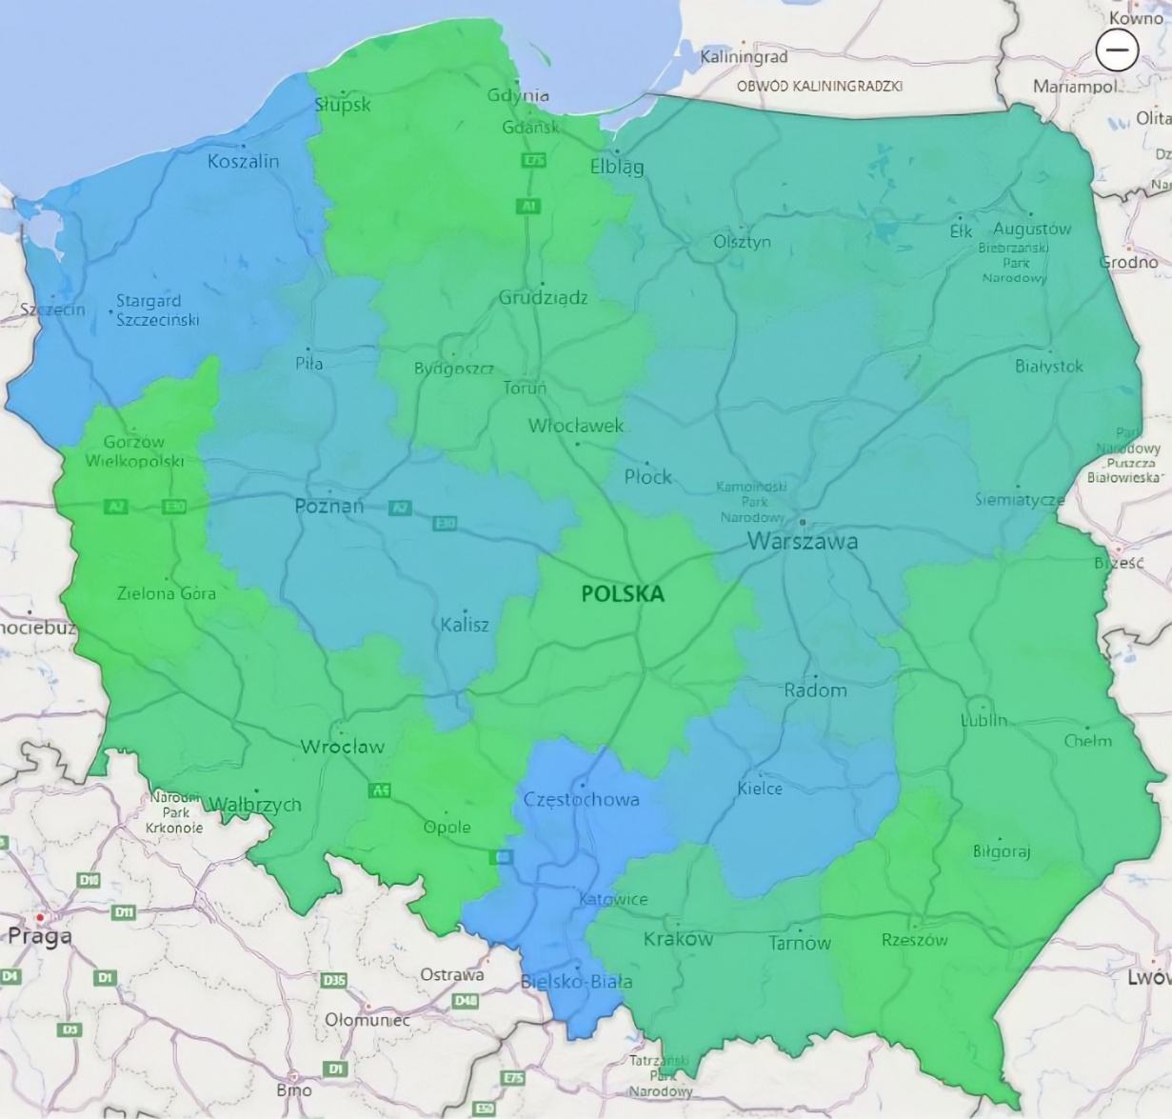
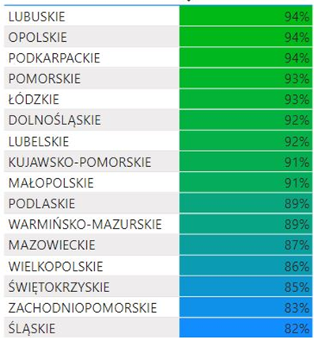
The Nationwide Education Network (OSE)

Slide 11
The Nationwide Education Network (OSE)

Slide 12
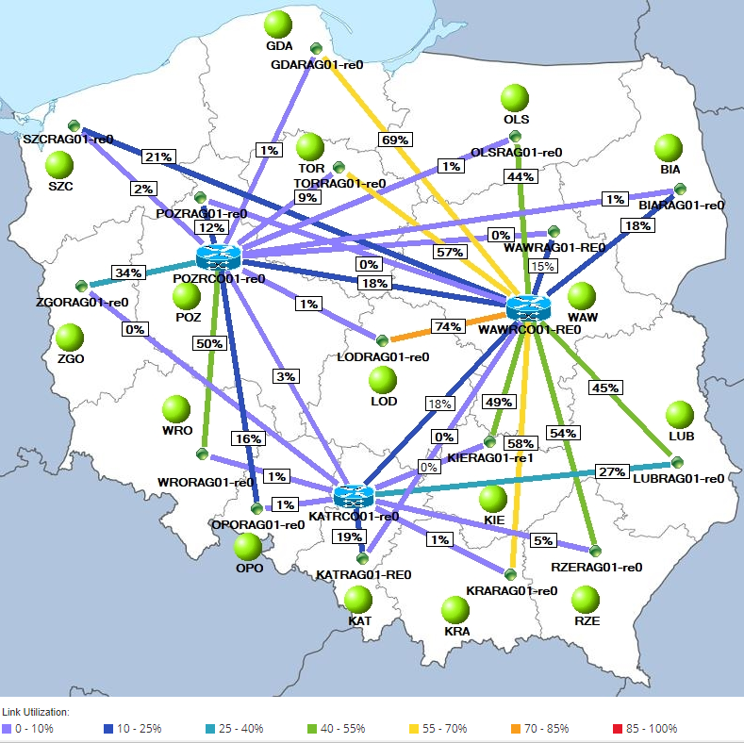
The Nationwide Education Network (OSE)

Slide 13
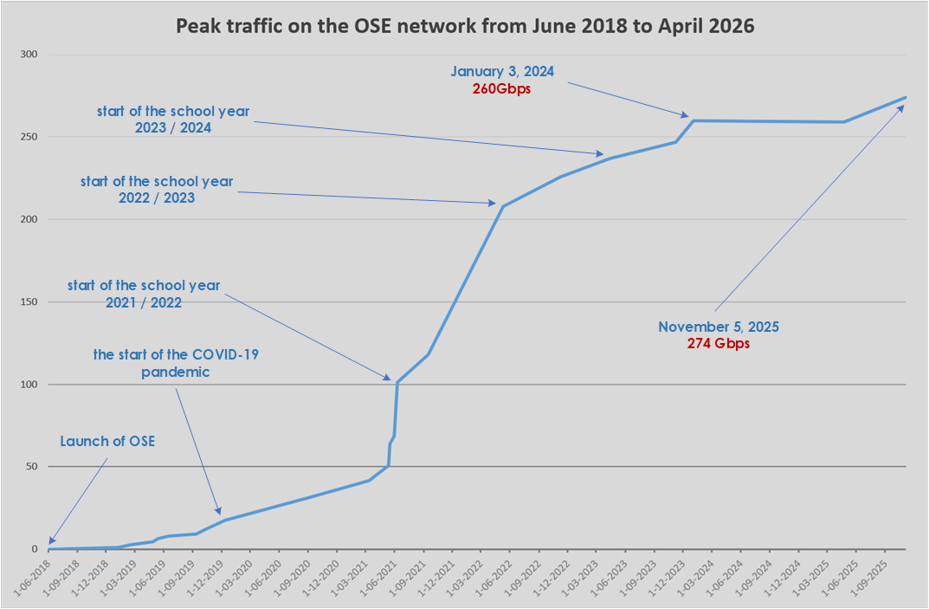
The Nationwide Education Network (OSE)
Traffic on the OSE network grew exponentially year over year.
Schools are increasingly using digital tools using OSE.
In some schools connected to our network at the launch of the OSE Program, traffic increased significantly.
During remote learning, nearly three-quarters of surveyed teachers conducted lessons using the OSE internet, including 65.7% on a daily basis.

Slide 14
The Nationwide Education Network (OSE)
We have a contract in every province for installations and maintenance support for schools. During the implementation phase, contracts with contractors allowed for the rapid connection of schools; currently, we focus on maintenance, which includes, among other things:
Troubleshooting at schools (8-hour SLA)
On-site support and diagnostics through service visits
Installation of alternative solutions (e.g., Starlink)
Migration of services to a full-scale model (e.g., ODN)
Replacement of end-of-life (EoL) equipment
Through our OSE service, we guarantee high-quality service for over 20,000 schools.

Slide 15




The Nationwide Education Network (OSE)
OSE Security Services
A solution built on three levels:
Level 1: Telecommunications security (blocking access to domains containing illegal and harmful content in the OSE, antivirus and antimalware protection, firewalling)
Level 2: Content access security (filtering access to websites containing illegal and harmful content in the OSE, antivirus protection)
Level 3: Detecting threats related to cyberbullying (harassment, harassment, aggression, humiliation), access to harmful content (pornography, violence, content inciting self-harm or suicide, discriminatory content), and sexting, based on content monitoring

Slide 16
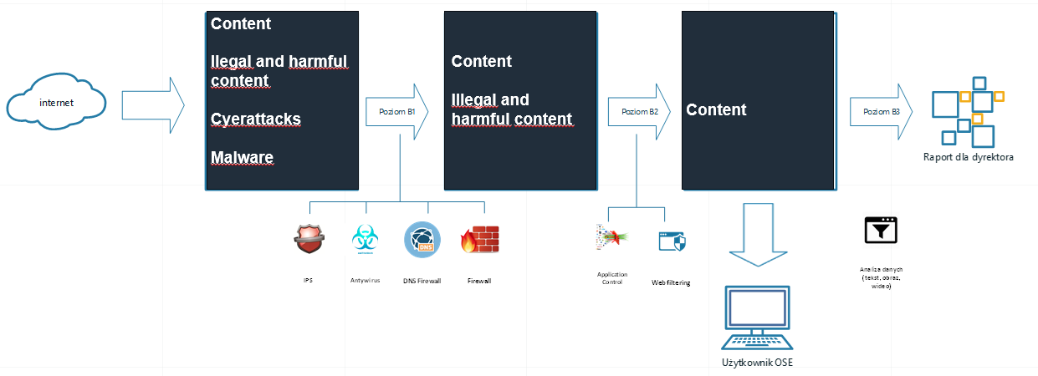
The Nationwide Education Network (OSE)
User

Slide 17



The Nationwide Education Network (OSE)

Slide 18

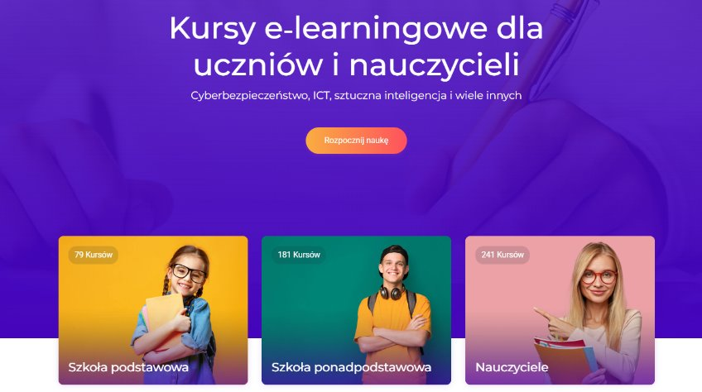
The Nationwide Education Network (OSE)
2025–2026 School Year
ose.gov.pl (September 1, 2025 – June 25, 2026):
247,500 page views
OSE IT School (September 1, 2025 – June 25, 2026):
43,800 users, 627,500 page views, total number of completed courses (since the platform’s inception): 2,343,464
Most popular courses:
“Cyberbullying – Anonymity Online” (9,500 views)
“Python Programming with the Young Programmers’ Club – Beginner Level” (7,300 views)
“Disinformation – A Course for Students” (6,800 views)
OSE IT School: ​
260 e-learning courses in 17 categories (including Cybersecurity, Digital Hygiene, Artificial Intelligence, Algorithms and Programming, Databases, Multimedia, Graphics, Web Technologies and the newest category within the Digital Opportunities Club project, over 100 other educational resources - guides for parents and teachers, lesson plans, infographics, as well as video lectures and animations​.
To the present day, over 2 million courses have been completed at OSE-IT School.
​
​

Slide 19

The Nationwide Education Network (OSE)
OSEhero: Poland's largest online safety project for teachers
A few numbers…:​
2023/2024 Edition​
Participants: 1,780 participants​
2024/2025 Edition​
Participants: 2,000 participants​
2025/2026 Edition
Participants: 2,000 participants​
From the 22/23 edition to the 24/25 edition, OSEhero teachers carried out 5,256 online safety initiatives in schools. ​The 2025/2026 edition of the OSEhero project came to an end on June 22. As part of the OSEhero project, participants carried out 2,263 initiatives in their schools, focusing on topics such as online risks and ways to protect themselves from dangerous situations online. A total of 872 people earned the title of OSEhero for the next two school years.
​

Slide 20
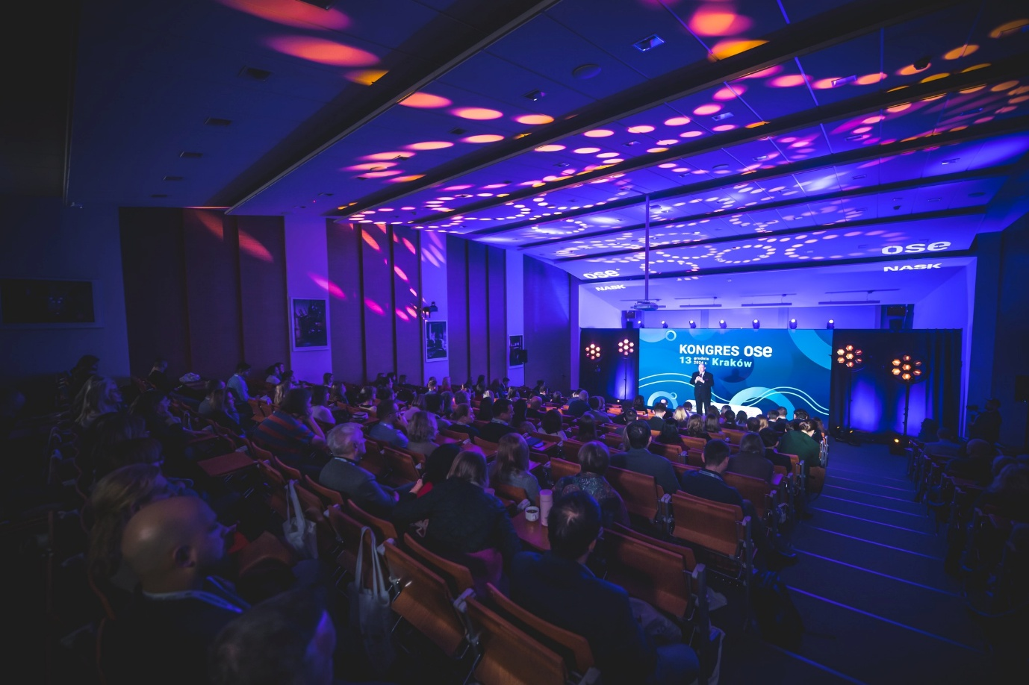
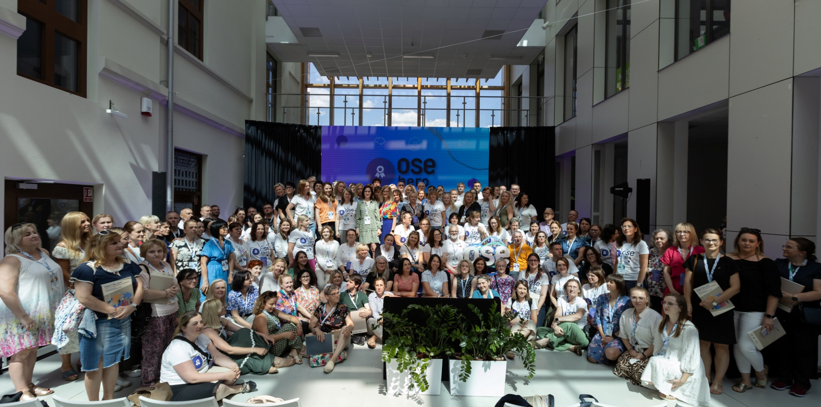
The Nationwide Education Network (OSE)
Recurring Events​
Congress OSE
Meeting OSEhero

Slide 21

The Nationwide Education Network (OSE)

Slide 22
Thank you!

