Slide 1

OUTPUT/1
REGIONAL COMMUNITY OF PRACTICE | DISCUSSED ON MONDAY 30 NOVEMBER
Investment Mapping and Prioritisation Guidance
The draft for the CoP members, the question they answer, and how each CoP sends one common position to ITU by 26 November.
West Africa CoP
East Africa CoP
Southern Africa CoP
Notes:
Send this deck to your members with the draft. It explains what OUTPUT/1 is, the question for your members and how the answers reach Brussels.

Slide 2


One standard and one Community of Practice
BRUSSELS, 30 NOVEMBER TO 3 DECEMBER 2026
EXPECTED OUTCOMES
WATRA
1. Agreement on a common data standard and data sharing approach
One Regional Community of Practice
EACO
2. One Regional Community of Practice in place of three sub-regional groups
CRASA
3. A start on investment readiness; investment planning in 2027-2028
2
Notes:
Brussels is not a training only: it is where the three groups become one Regional Community of Practice and agree three short texts. The answers your members send in November, and the common position your CoP agrees by 26 November, are what those texts are built from.

Slide 3
Investment Mapping and Prioritisation Guidance
OUTPUT/1 | DISCUSSED ON MONDAY 30 NOVEMBER
WHAT IT IS
A common way to use broadband maps to identify, rank and present investment needs.
IN BRUSSELS
Day 1, Monday 30 November
WHY IT MATTERS
Broadband data and investment readiness
A map only helps investors if it answers their questions: where coverage is missing, who is affected, what already exists nearby and what it would cost.
Corridor investment simulation in front of a donor panel, with fictitious countries and figures.
Adopted with the other two outputs on Thursday 3 December, by consensus.
3
Notes:
A common way to use broadband maps to identify, rank and present investment needs. A map only helps investors if it answers their questions: where coverage is missing, who is affected, what already exists nearby and what it would cost.

Slide 4
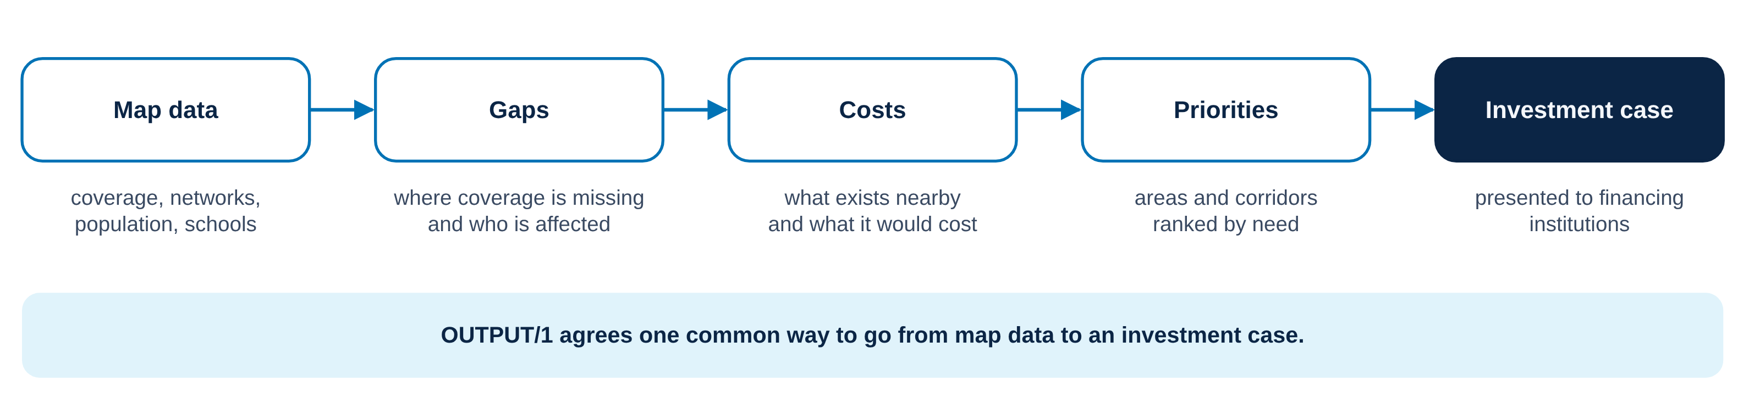
From map data to an investment case
OUTPUT/1 IN ONE PICTURE
4
Notes:
Five steps, from what the map shows to the case presented to financing institutions. The draft agrees one common way to take them.

Slide 5
One question for your members
FOR YOUR MEMBERS, TO ANSWER BY THE DATE YOUR CHAIR SETS
INVESTMENT DATA
Which of the data that financing institutions ask for are generally available in our sub-region, and where are the main gaps?
What financing institutions need is taken from reference sources (EU Broadband Investment Handbook, ITU ICT Infrastructure Business Planning Toolkit), not asked from you.
No country figures are needed. Answer from experience and for the region: no country is singled out.
5
Notes:
No country figures are needed: each member gives a general picture of what data exist in the sub-region and what is missing. Each member answers individually, in writing, to the CoP chair, with elind.sulmina@itu.int and danajon.kamason@itu.int in copy, subject “ReCoP answers, [authority], [group] CoP”.

Slide 6








How the answers reach the texts adopted in Brussels
FROM NOW TO BRUSSELS
Drafts
Briefing
Answers, ITU cc
One position
Consolidated drafts
1
2
3
4
5
6
6 Nov
From 9 Nov
By the date set
By 26 Nov
27 Nov
30 Nov to 3 Dec
ITU
Associations
NRAs
Each CoP
ITU
Brussels
sends OUTPUT/1 and OUTPUT/3 (OUTPUT/2 by 9 Nov) and this presentation
brief their NRAs, by call or in writing, and set the date for answers
each answers individually to its CoP chair, ITU in copy
meets and agrees one common position; the chair sends it to ITU
merges the three positions and publishes the consolidated drafts
three days of discussion, adoption by consensus on Thursday 3 Dec
Until 26 November
24 hours
3 days to discuss
ITU
regional associations
NRAs’ individual answers
one position per CoP
6
Notes:
Read the diagram from left to right. 1: on 6 November ITU sends the drafts of OUTPUT/1 and OUTPUT/3, with OUTPUT/2 by 9 November, and this presentation to the three CoPs and their regional associations. 2: from 9 November each association briefs its NRAs, by a short call or a written round, and sets the date for answers. 3: each NRA answers individually to its CoP chair, with elind.sulmina@itu.int and danajon.kamason@itu.int in copy, subject “ReCoP answers, [authority], [group] CoP”. 4: by 26 November each regional association holds a meeting of its CoP members, who agree one common position based on the needs of all its members, and the chair sends it to ITU, subject “ReCoP position, [group] CoP”. 5: on 27 November ITU merges the three positions within 24 hours and publishes the consolidated drafts. 6: in Brussels, from 30 November to 3 December, three days of discussion and adoption by consensus on Thursday 3 December.

Slide 7
africabbmaps.itu.int/recop
EVERYTHING ONLINE
THE DRAFT OUTPUT/1
SECRETARIAT, ITU
Investment Mapping Guidance, v0.3 (Word)
Dana Jon Kamason, Project Manager
danajon.kamason@itu.int
Elind Sulmina, Project Officer
elind.sulmina@itu.int
Patricia Schlageter, Capacity & Knowledge Coordinator
patricia.schlageter@itu.int
ON THE WEBSITE, IN ENGLISH AND FRENCH
Contribute in 6 steps
Documents: the three draft outputs and, from 27 November, the consolidated drafts
Brussels: agenda for Days 1 to 4
Your CoP’s page and contacts
Notes:
Thank your members and confirm the date by which they send their answers to you, with ITU in copy, so that your CoP’s common position reaches ITU by 26 November.

