Slide 1

OUTPUT/2
REGIONAL COMMUNITY OF PRACTICE | DISCUSSED ON TUESDAY 1 DECEMBER
Common Data Standards and Data Sharing Framework
The draft for the CoP members, the question they answer, and how each CoP sends one common position to ITU by 26 November.
West Africa CoP
East Africa CoP
Southern Africa CoP
Notes:
Send this deck to your members with the draft. It explains what OUTPUT/2 is, the question for your members and how the answers reach Brussels.

Slide 2


One standard and one Community of Practice
BRUSSELS, 30 NOVEMBER TO 3 DECEMBER 2026
EXPECTED OUTCOMES
WATRA
1. Agreement on a common data standard and data sharing approach
One Regional Community of Practice
EACO
2. One Regional Community of Practice in place of three sub-regional groups
CRASA
3. A start on investment readiness; investment planning in 2027-2028
2
Notes:
Brussels is not a training only: it is where the three groups become one Regional Community of Practice and agree three short texts. The answers your members send in November, and the common position your CoP agrees by 26 November, are what those texts are built from.

Slide 3
Common Data Standards and Data Sharing Framework
OUTPUT/2 | DISCUSSED ON TUESDAY 1 DECEMBER
WHAT IT IS
The minimum set of broadband data that all eleven countries would describe in the same way.
IN BRUSSELS
Day 2, Tuesday 1 December
WHY IT MATTERS
A common data standard
Today each country measures coverage differently, so maps cannot be compared and cross-border projects cannot be assessed.
Agree which map features are mandatory, optional or national.
Adopted with the other two outputs on Thursday 3 December, by consensus.
3
Notes:
The minimum set of broadband data that all eleven countries would describe in the same way. Today each country measures coverage differently, so maps cannot be compared and cross-border projects cannot be assessed.

Slide 4
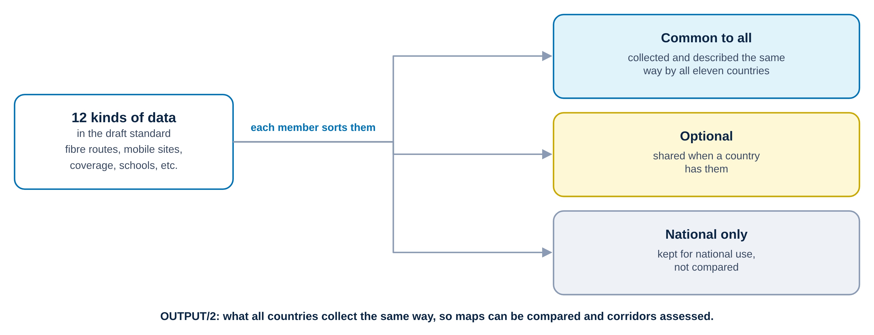
Twelve kinds of data, three boxes
OUTPUT/2 IN ONE PICTURE
4
Notes:
Each member sorts the twelve kinds of data in the draft into three boxes: common to all, optional, or national only.

Slide 5
One question for your members
FOR YOUR MEMBERS, TO ANSWER BY THE DATE YOUR CHAIR SETS
COMMON DATA
For the twelve kinds of data in the draft (fibre routes, mobile sites, coverage, schools connected, etc.), which should be common to all countries, optional, or national only?
Where members do not agree, the CoP position notes both views.
No country figures are needed. Answer from experience and for the region: no country is singled out.
5
Notes:
Common, optional, national: three boxes. Each member sorts the twelve kinds of data into them and answers individually, in writing, to the CoP chair, with elind.sulmina@itu.int and danajon.kamason@itu.int in copy, subject “ReCoP answers, [authority], [group] CoP”.

Slide 6








How the answers reach the texts adopted in Brussels
FROM NOW TO BRUSSELS
Drafts
Briefing
Answers, ITU cc
One position
Consolidated drafts
1
2
3
4
5
6
6 Nov
From 9 Nov
By the date set
By 26 Nov
27 Nov
30 Nov to 3 Dec
ITU
Associations
NRAs
Each CoP
ITU
Brussels
sends OUTPUT/1 and OUTPUT/3 (OUTPUT/2 by 9 Nov) and this presentation
brief their NRAs, by call or in writing, and set the date for answers
each answers individually to its CoP chair, ITU in copy
meets and agrees one common position; the chair sends it to ITU
merges the three positions and publishes the consolidated drafts
three days of discussion, adoption by consensus on Thursday 3 Dec
Until 26 November
24 hours
3 days to discuss
ITU
regional associations
NRAs’ individual answers
one position per CoP
6
Notes:
Read the diagram from left to right. 1: on 6 November ITU sends the drafts of OUTPUT/1 and OUTPUT/3, with OUTPUT/2 by 9 November, and this presentation to the three CoPs and their regional associations. 2: from 9 November each association briefs its NRAs, by a short call or a written round, and sets the date for answers. 3: each NRA answers individually to its CoP chair, with elind.sulmina@itu.int and danajon.kamason@itu.int in copy, subject “ReCoP answers, [authority], [group] CoP”. 4: by 26 November each regional association holds a meeting of its CoP members, who agree one common position based on the needs of all its members, and the chair sends it to ITU, subject “ReCoP position, [group] CoP”. 5: on 27 November ITU merges the three positions within 24 hours and publishes the consolidated drafts. 6: in Brussels, from 30 November to 3 December, three days of discussion and adoption by consensus on Thursday 3 December.

Slide 7
africabbmaps.itu.int/recop
EVERYTHING ONLINE
THE DRAFT OUTPUT/2
SECRETARIAT, ITU
The draft is published on the Documents page by 9 November.
Dana Jon Kamason, Project Manager
danajon.kamason@itu.int
Elind Sulmina, Project Officer
elind.sulmina@itu.int
Patricia Schlageter, Capacity & Knowledge Coordinator
patricia.schlageter@itu.int
ON THE WEBSITE, IN ENGLISH AND FRENCH
Contribute in 6 steps
Documents: the three draft outputs and, from 27 November, the consolidated drafts
Brussels: agenda for Days 1 to 4
Your CoP’s page and contacts
Notes:
Thank your members and confirm the date by which they send their answers to you, with ITU in copy, so that your CoP’s common position reaches ITU by 26 November.

